Slide 1
Good Morning, dear students
How are you?

Slide 2
IDENTITY OF TEACHER AND CLASS
MD. AFSAR ALI
CLASS-EIGHT
MAJHIRA MODEL HIGH SCHOOL, SHAJAHANPUR, BOGURA

Slide 3
Let’s enjoy a video then guess what about the video

Slide 4
Our today’s topic is
THE ART OF SILENCE
UNIT: 7 Lesson: 2

Slide 5
Learning Outcome
If you follow the class attentively. I can say that after finishing the lesson, we will be able to---
read and understand texts through silent reading
infer meaning from the context
tell a statement true or false
fill in the blanks

Slide 6
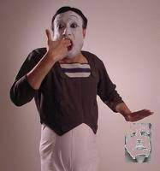
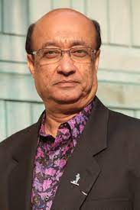
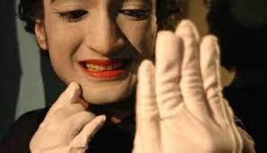
Short discussion of the topic
Bangladeshi Partha Pratim Majumder, who was born in a very cultural minded family on 18 January 1954, is a maestro performer of miming art and regarded as the pioneer of miming in Bangladesh. His name and fame have honoured him with different national and international awards. From time immemorial, arts like music, dance, paintings have been evolving and human’s attempt to express themselves have taken the form to the art of silence. This are depicts character, mood, idea or narration with gesture and bodily movements without any utterance.

Slide 7
TEXT READING
At first I am reading the passage loudly. Listen to it attentively. Then read it.
Culturally rich Bangadesh is the homeland of an artist whose fame took him across the border and honoured him with different national and international awards. Have you heard about Partha Pratim Majumder? He is a maestro performer of miming art. If food is the nutrition for a body, art is the nutrition of soul. To keep the souls alive and fresh different arts like music, dance, paintings have enolved during the ancient time. Humankind has tried to express himself from the very beginning of civilization. These expressions have taken the forms of art with the touch of his creativity in expressing the untold in silence. It is an art of depicting a character, mood, idea, or movements without any utterance. This ancient dramatic entertainment represents the primitive time when people would use signs as a medium of communication. In Bangadesh, the boy named Partha Pratim Majumder from Pabna overwhelmed people with this Art. He left people mesmerized by his graceful presentations of art of silence. It was like a new era in theatre art in Bangladesh when Partha came with effort to make people look at their everyday experience, but in a new form. He made people reveal meanings for all trivial things of life which they usually would overlook.

Slide 8
TEXT READING
He used to depict stories of sadness, laughter, different characters, birds, insects or even animals through his miming. Some of his topics are the portrayal of a thief stealing, one-sided love, picking up flower and hurting it, delicate changes in nature etc. His actions often led audience to their conscience on different issues. He is regarded as the pioneer of miming in Bangladesh. Partha cherished a passion for art from his very childhood. He was born in a very cultural minded family on 18 January in 1954. His photographer father nurtured him as a passionate lover of art. The family resided in a village called Kalachandpara. There used to be a lot of cultural programmes in Kalachandpara in those days which had an impeccable influence on Partha’s affection for art. Destiny introduced Partha to a mime artist Mr. Jogesh Dutta in 1966 when he went to live at his aunt’s home in Chandernagar, 30 kilometres away from Kolkata. Partha could foresee his future and got admission in Mr. Dutta’s mime academy in kolkata. The major lift up of his life was when he presented a solo performnance at Bangalsesh Shilpakala Academy in 1979. The then Frence Ambabssador in Bangladesh Mr. Loic Moreau, having observed his talent as an audience in that programme, offered him a scholarship at France.

Slide 9
TEXT READING
Partha took all the opportunities to learn from Mr. Etiene Decroux and Mr. Marcel Moreau, both of whom were legendary genius of miming at that time in Paris. He was trained in the mime school called ‘Ecole Internationalle de Mimodrame de Paris Marcel Marceau’. Gradually he became a very busy artist performing in Europe and America and he was highlighted in media too. Later on this Bangladeshi legendary mime artist received ‘the Moliere Award’ in the year 2009 which is the highest honourable accolade in the France Theatre. Next year, he was honoured with ‘Ekushy Padak’ for the contribution to Bangladesh. He was alson awarded with Chevalier de I’odre des Art et Letters’ (Knight in the order of Arts and Humanities) in 2012 for his contribution all over the world.
This great artist is now looking forward to opening an international miming institute in Bangladesh. We hope more Partha Pratim Majumder comes out from the dream institution

Slide 10
Let’s introduce with some key words
Depict
Portray
Represent
Illustrate
Picture
Sentence: Her paintings depict the lives of ordinary people in the last century.
Meaning: to show or represent something

Slide 11
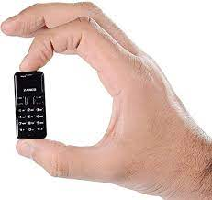
Trivial
Slight
Small
Minor
Petty
Sentence: He could remember every trivial incident in great detail.
Meaning: a little value or importance

Slide 12
Gesture
signal
sign
motion
wave
Sentence: In human`s life first language were signs and gestures.
Meaning: a movement or body parts to show a particular meaning

Slide 13
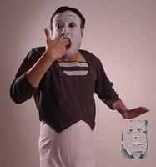
Mime
pantomime
earliest
first
prehistoric
Sentence: Partha won the highest award in mime named `Moliere Award’.
Meaning: a performance using the body movements and facial expressions.

Slide 14
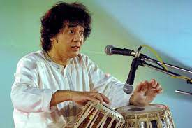
Maestro
genious
master
expert
wizard
Sentence: One of the greatest tabla players, Zakir Hussain is a musical maestro from India.
Meaning: a great performer

Slide 15
Solo
single
solitary
alone
lone
Sentence: He just issued his first solo album.
Meaning: without anyone helping you

Slide 16
Individual work
Read the text B again. See if the following statements are True or False. If false, give the correct information.
a. Partha Pratim belonged to a culturally enlightened family.
Ans. True
b. Kalachandpara was 30 kilometres away from Kolkata.
Ans. False Correct Information: Chandernagar was 30 kilometres away from Kolkata.
c. Ecole Internationale de Mimodrame de Paris Marcel Marceau is an international award.
Ans. False Correct Information: Ecole Internationale de Mimodrame de Paris Marcel Marceau is a mime school.
d. Partha Pratim took his topics from very trivial issues of everyday life.
Ans. True
e. Performance at Shilpakala Academy created the major opportunity for him.
Ans. True
Notes:
The teacher may give instructions how to write the answer.

Slide 17
Pair work
Read the following text and fill in the gaps with appropriate words to make a meaningful passage.
Partha Pratim Majumder is the (a)...................of miming in our country. He introduced a new era in theatre art through the art of (b)............... . Through (c) .............presentations, Partha enchanted people. He depicted happy or sad stories and made his audience think about their everyday experience (d)................... . This often pricked the (e).....................of the audience.
.
pioneer
silence
graceful
differently
conscience
Notes:
The class will be divided into several pairs and then, asked to describe the people & their activities.They will have to find out whether any difference get.

Slide 18
Group work
E. Read the statements below and form appropriate questions for each of them.
a. The brithplace of Partha Pratim Majumder is in Pabna.
Ques: Where is the birthplace of Partha Pratim Majumder?
b. Partha Pratim developed a passion for art from his childhood.
Ques: When did Partha Pratim developed a passion for art?
c. Jogesh Dutta was a renowned mime artist in Kolkata.
Ques: Who was a renowned mime artist in Kolkata?
d. Partha Pratim performed in Europe and America.
Ques: Where did Partha Pratim performed?
e. Partha Pratim’s dream is now to open an international miming school in Bangaldesh.
Ques: What is Partha Pratim’s dream now?
Notes:
The class will be divided into several groups and then, asked to write the question.

Slide 19
Evaluation
C. Choose the best answer.
1. Miming is a ..................
solo dance (b) drama without sound
(c) music (d) recitation
2. What is not synonym for the word mesmerize?.....
make spell bound (b) overwhelm
(c) hypnotize (d) shock
3. Who was not Partha Pratim’s trainer?
Marcel Moreau (b) Jogesh Dutta
(c) Loic Moreau (d) Etiene Decroux
4. Which year did Partha Pratim Majumder receive ‘Ekushe Padak’?
in 2009 (b) in 2010 (c) in 2011 (d) in 2012

Slide 20
Home work
Write a summary of the above passage in not more than 90-100 words

Slide 21
Thanks to all
G
O
O
D
B
Y
E

