Slide 1
welcome

Slide 2
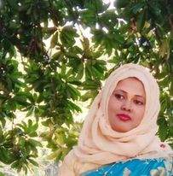
Teacher’s Introduction
Mst.Sharmin Akter
Assistant teacher
Matain Govt. Primary School
Hajiganj, Chandpur
E-mail:
mstsharminakter1985@gmail.com

Slide 3
Lesson Identity
Class : Five
Subject : English
Lesson :1-2
Unit:2
Activity: A
Time : 40 min
A
e
r
G

Slide 4
Learning Outcomes
Student’s will be able to-
Listening:1.3.1-recognize which words in a sentence are stressed.
Speaking:1.1.1-say words and phrases and sentences with proper sounds and stress.
Reading:1.5.1-read words , phrases and sentences with proper pronunciation , stress and intonation.
Writing:5.1.3-read silently with understanding dialogue.

Slide 5
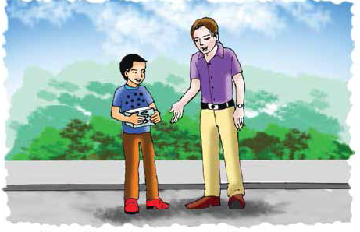
We can see here 2 persons are talking.
What can you see in the picture ?

Slide 6
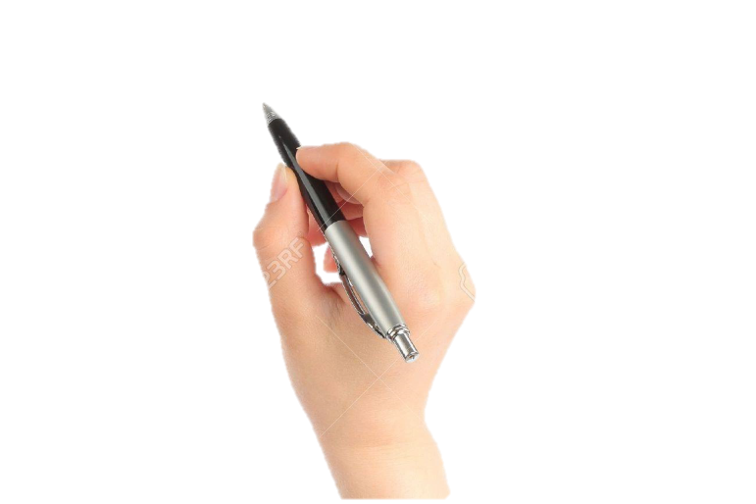
Lesson declaration
Our todays lesson is See you !

Slide 7
New word
fair
medicine
hour
later
great

Slide 8
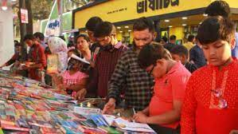
fair
exhibition
I’m going to the book fair.

Slide 9
great
extreme
You did a great job.

Slide 10
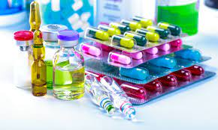
medicine
drug
I want some medicine.

Slide 11
hour
60 minutes
I can meet you in an hour.

Slide 12
later
after
I can meet you later.

Slide 13
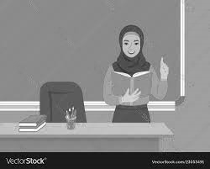
Teacher’s Reading

Slide 14
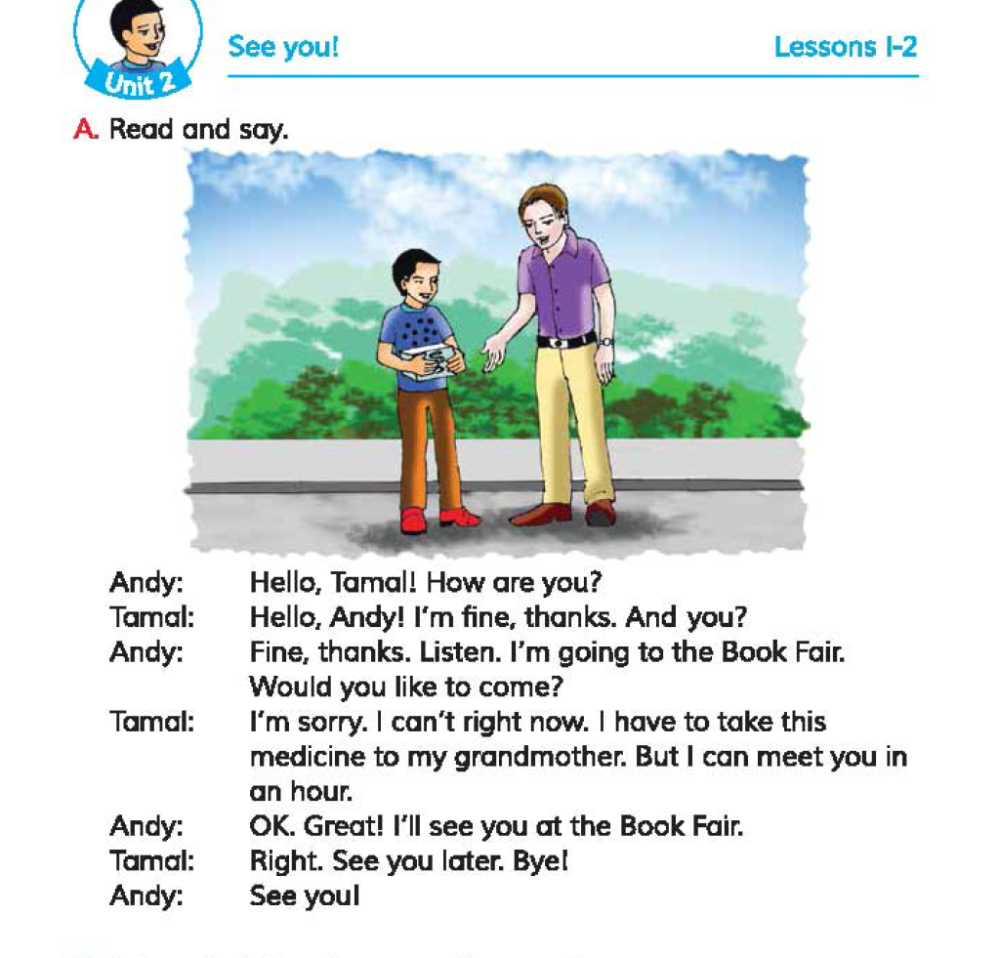
Open your book at page 6.

Slide 15
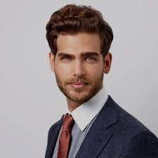
Andy: Hello , Tamal ! How are you ?
Tamal: Hello, Andy ! I’m fine, thanks. And you ?

Slide 16
Andy:Fine, thanks. Listen, I’m going to the
Book fair . Would you like to come?
Tamal:I’m sorry. I can’t right now. I have to take this
medicine to my grandmoher. But I can meet you in an hour.

Slide 17
Andy: Ok, Great! I’ll see you at the book fair.
Tamal: Right. See you in later. Bye !
Andy: See you !

Slide 18
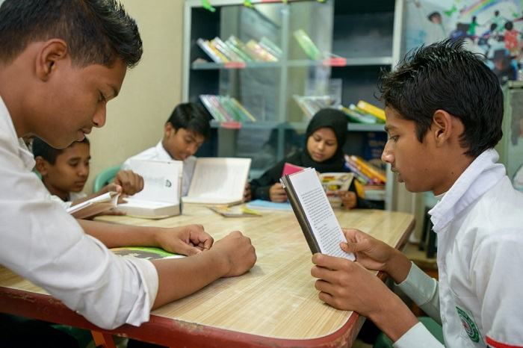
Group reading

Slide 19
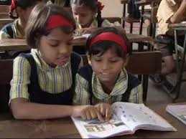
Read in pair

Slide 20
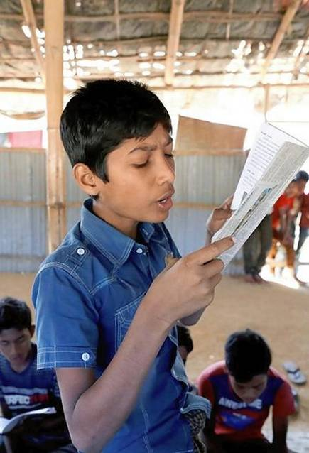
IW
Student’s reading

Slide 21
Practise the conversation with your partner.

Slide 22
Questions:
1.Where is Andy going?
2.Where is Tamal going?
3.Why do he go there ?
4. When can Tamal meet Andy ?
gw

Slide 23
Answers:
1.Andy is going to the book fair.
2.Tamal is going to Bazar.
3. Tamal is going to buy some medicine .
4.After an hour Tamal can meet Andy.
gw

Slide 24
Bingo game
fair
great
book
later
meet
see
hour
right
take
listen

Slide 25
One day one word
Medicine-ঔষধ

Slide 26
That’s all for today.

