Slide 1
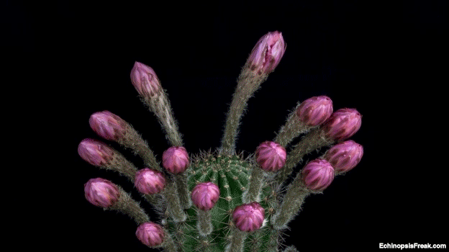
Welcome

Slide 2
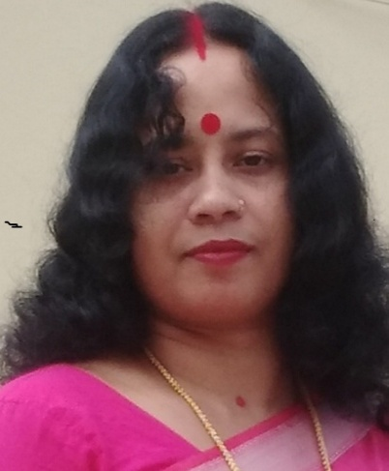
Teacher’s Identity
Monika Rani Das
Head Teacer
Dr.Bosontokumar Acharjee GPS
Baniachong,Habigonj

Slide 3
Lesson Title
Unit 20 :Life Is Beautiful
Part of leasson: But Maria is .... learner.
Subject:English
Class:5

Slide 4
Learning outcomes
Student will be able to-
4.2.1. Understand and enjoy simple stories.
1.1.1. Recognize sound differences in the context of words.
5.1.2. Read silently with understanding stories.
8.1.1. make sentences using words and
phrases given in the text book.

Slide 5
Let`s see a video

Slide 6
Our today’s lesson is “ Life is Beautiful”

Slide 7
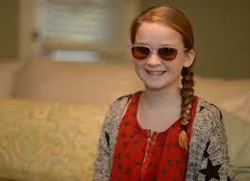
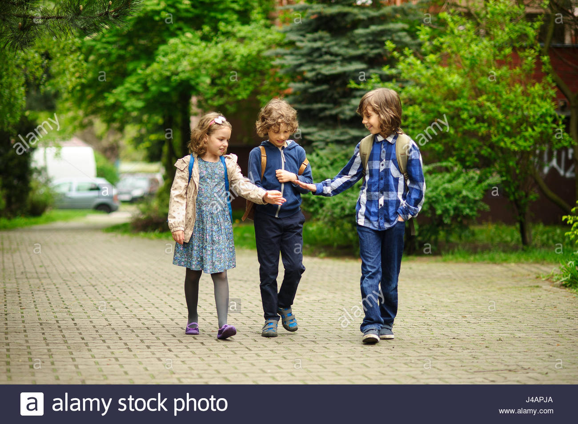
But Maria is happy. She goes to school everyday.

Slide 8
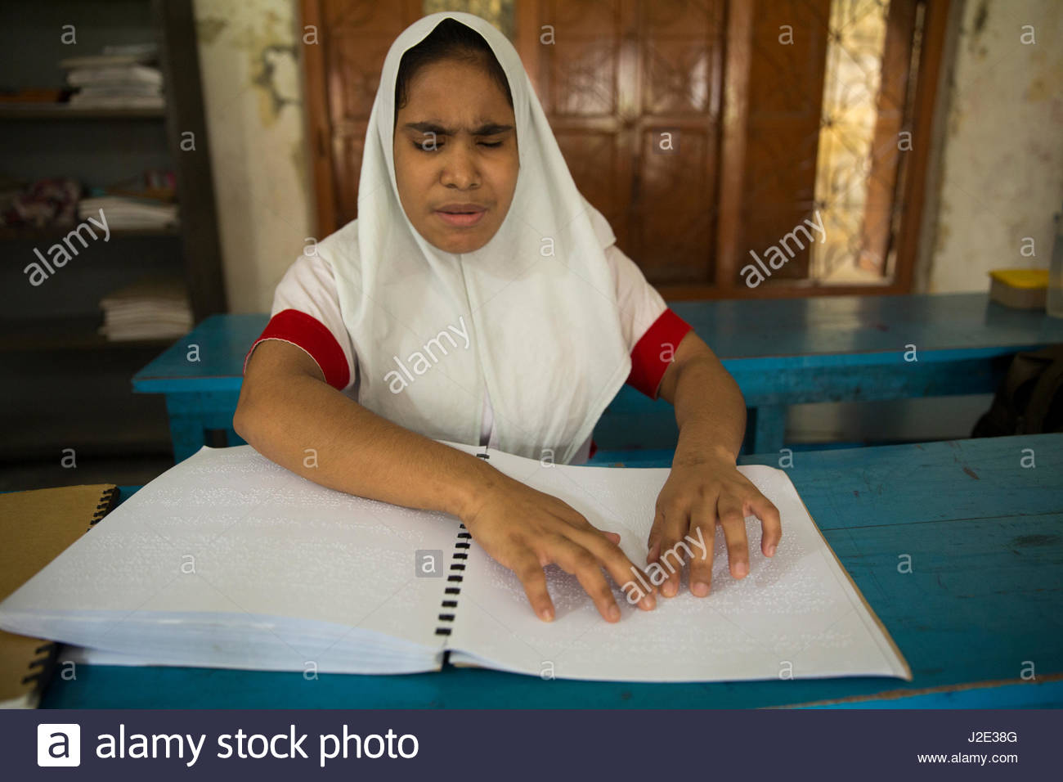
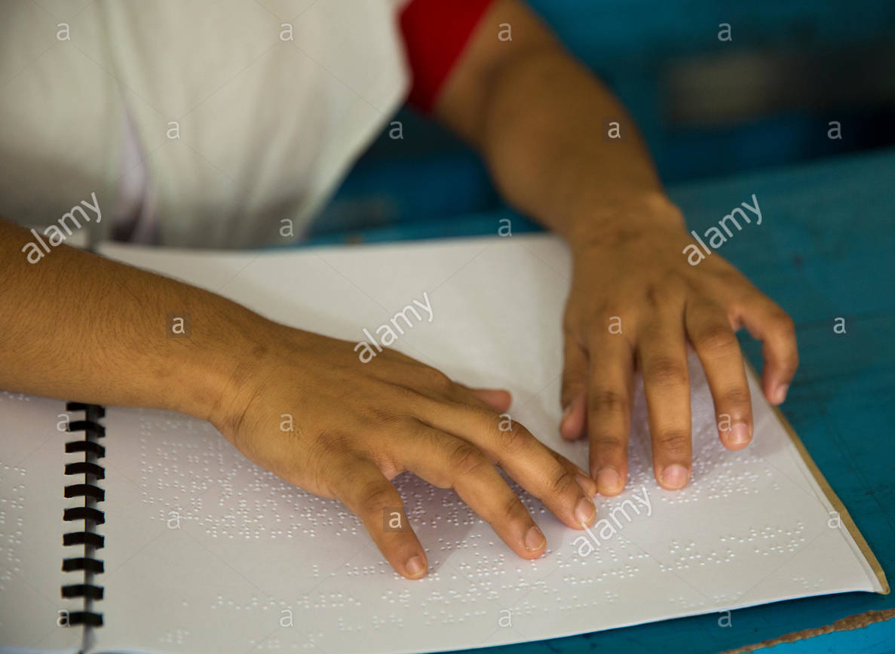
She can learn information because she reads Braille.

Slide 9
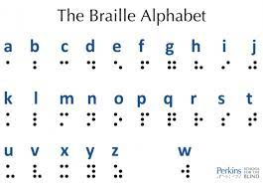
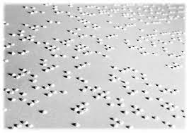
Braille is a script that uses raised dots.

Slide 10
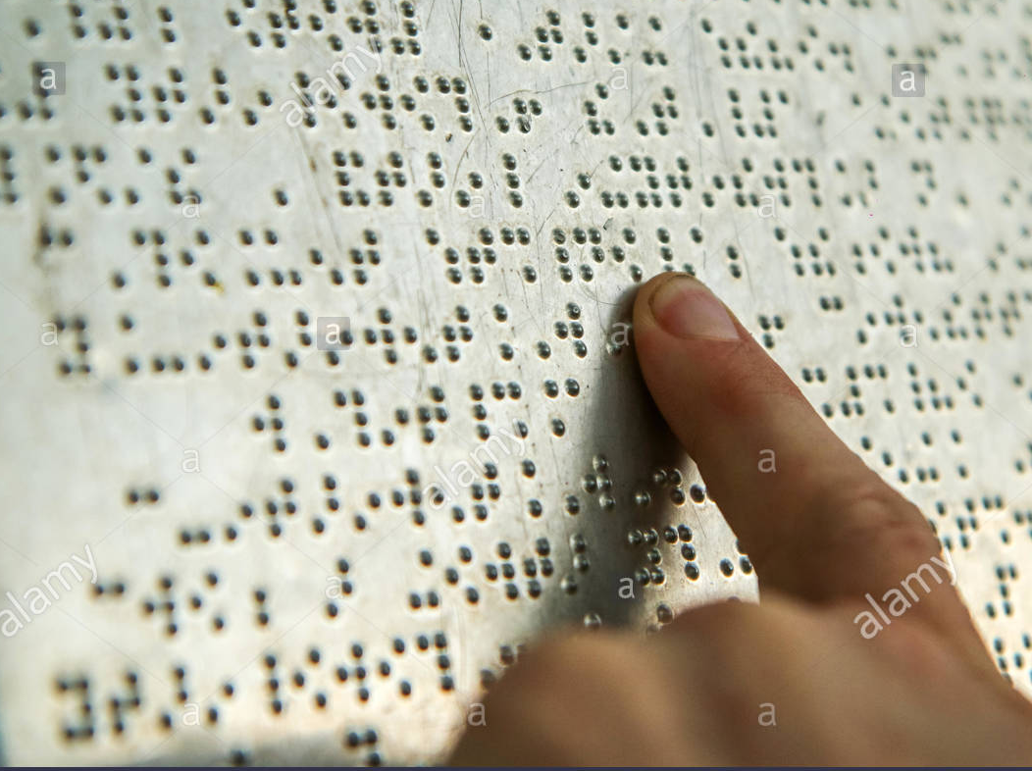
Each letter is made from dots. People move their fingers across the raised dots to read .

Slide 11
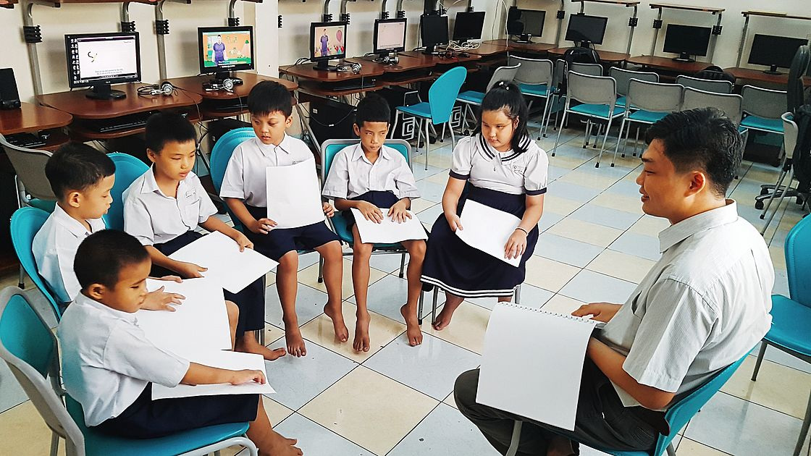
Maria learn to read Braille as a young child.

Slide 12
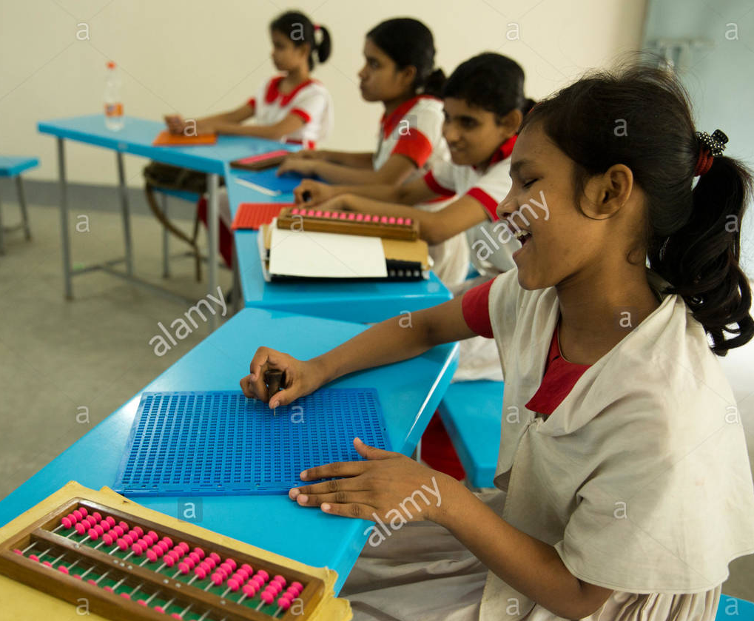
Her books at school are in braille.

Slide 13
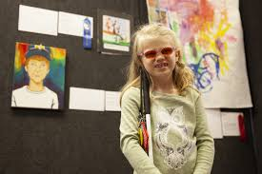
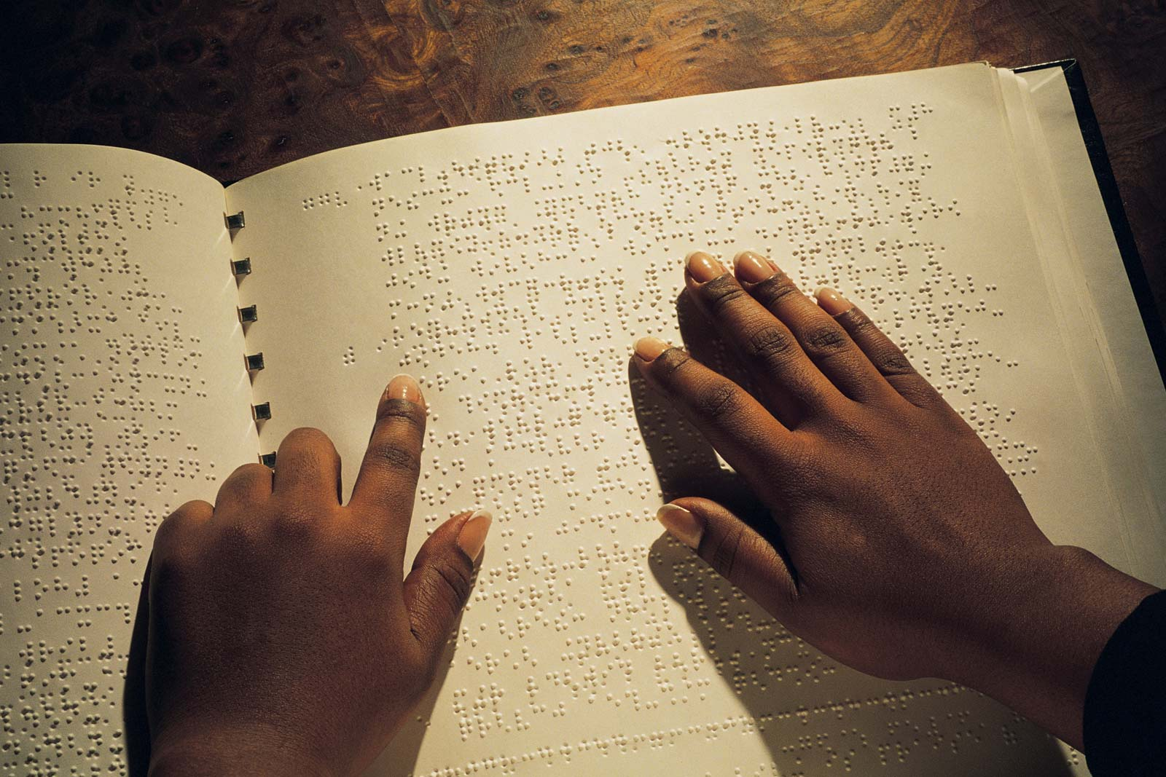
She enjoyed reading poems and histroy .

Slide 14
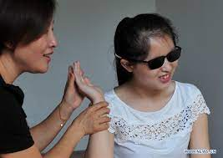
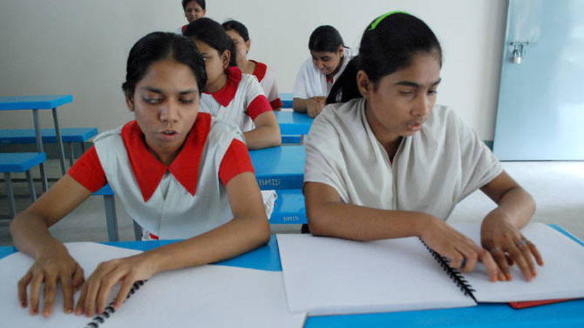
Maria’s teacher says that she is good learner.

Slide 15
Now open your book at page 79 read after me.

Slide 16
Individual work
Fill in the blanks with the right word.
Maria goes to school everyday.
Braille is a script that uses raised dots.
Maria is a good learner . .
Maria’s books at school are in Braille .

Slide 17
Evaluation
1. Who goes to school everyday?
Ans. Maria goes to school everyday.
2. How did Maria learn ?
Ans. Maria learnt by reading books in Braille script.

Slide 18
Write 5 sentence about Maria.

Slide 19
Good bye.

