Slide 1
welcome

Slide 2
Introduction
Teacher
Lesson
Md. Ismail Hossain
Assistant Teacher English
Ganguria High School
Porsha, Naogaon
Mail: ismail.psn@gmail.com
Contact No: 01712313942
Class- 10
Subject- English 1st paper
Unit – 07
Lesson- 01

Slide 3
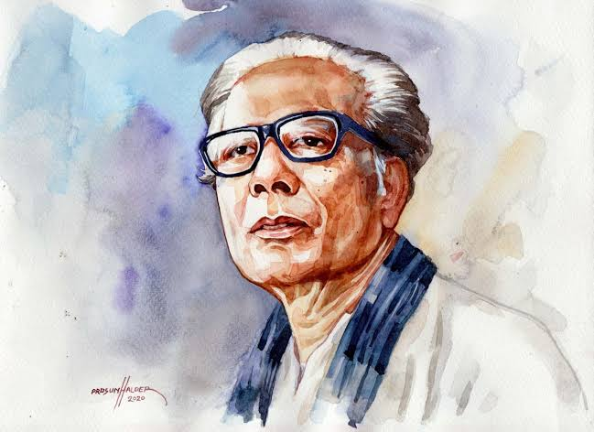
Who can say the name of that man?
What do you know about him?

Slide 4
After the lesson the learners will be able to # narrate the man. # Ask and answer questions. # Tell the story about the picture. # listen to a text for specific information. # write a dialogue.

Slide 5
Individual work
Acclaim
Admire
Figure
Body
Starvation
Hunger
Shocking
Sad
Compassion
Kindness
Reputation
Fame
Devastating
Destructive

Slide 6
Write answer the following questions. 20 min 1. Write in details how Zainul Abedin portrayed the sufferings of the people. 2. What influence did the river Brahmaputra have on Zainul Abedin? How did he show this influence in his works? 3. What did thes works earn him later in his life? 4. How did his art help to intensify the non-cooperation movement?
Group Work

Slide 7
Now match with yours
1. Ans. Zainul Abedin portrayed the sufferings of people with profound human compassion. His ‘Famine Sketches’ of 1940 give testimony to his overwhelming affection for suffering humanity and hunger-induced deaths. The skeletal figures are the expression of month-long starvation of the people and shocking poverty of the whole nation. All his drawing materials were very cheap but each of the drawings is a masterpiece. Those are the iconic images of human sufferings.

Slide 8
2.Ans. Zainal Abedin spent a major portion of his childhood near scenic beauty of the river Brahmaputra. As a result, the river had a great influence on his mind. Zainul Abedin paid his tribute to the river by using a series of water colours in his paintings. He presented his paintings of water colours in an all India exhibitions in 1938 that brought him Governor’s Gold Medal. Besides, this award took him to light and gave him confidence to create his own style of paintings.

Slide 9
3. Ans. Later in his life these art works brought him an honour of Shilpacharya meaning “great teacher”.
4. Ans. His water colour paintings portraying the rural East Pakistan in phases from abundance to poverty intensified the already heightened non-cooperation movement against the Pakistani regime. The sketches were the picture s of how West Pakistanis exploited the people of East Pakistan. People became more conscious of their helpless situations at the hands of the West Pakistani authorities.

Slide 10
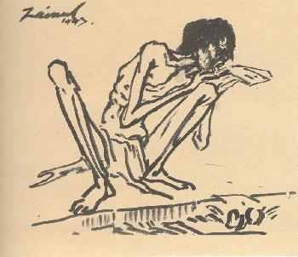
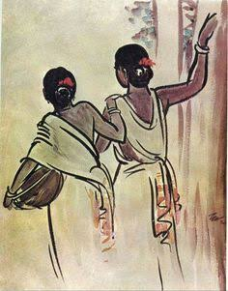
Look at the pictures
Work in groups and talk about them.

Slide 11
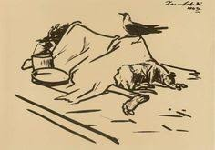
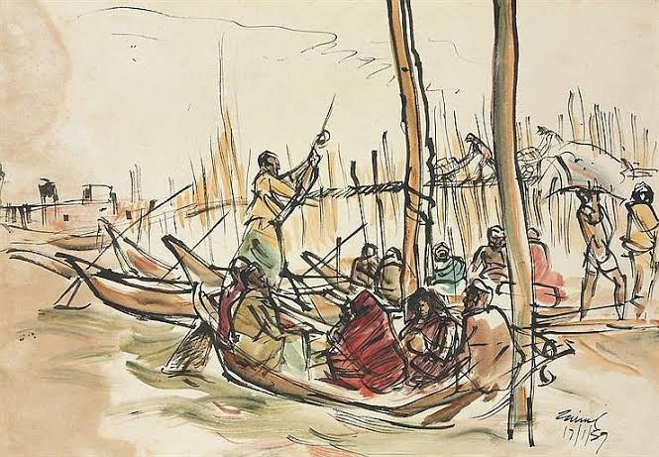

Slide 12
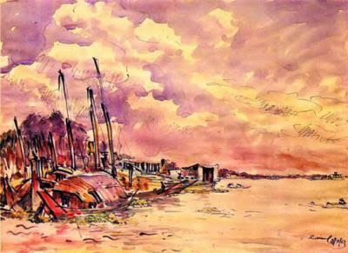
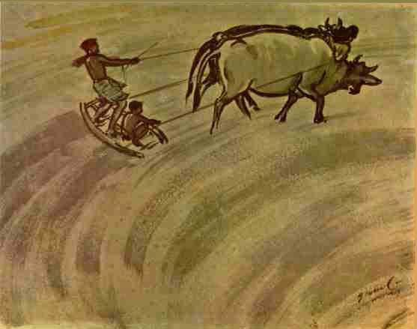
After Cheking their group work Give feetback

Slide 13
Listen to the audio and answer the questions

Slide 14
The us Abasador to Bangladesh considered Zainul Abedin a --------.
a.great painter. b. populer painter. c. master painter. d. unique painter.
Zainul’s art gallery was set up in -------. a. 1972. b. 1973. c.1974. d. 1975.
The US Ambassador commented that the museum in a global ------.
wealth. b. asset. c. gift. d. treasure.
4. The number of Zainul’s artwork preserved in the gallery is ------- .
a. 53. b. 62. c. 65. d. 75.
5. Mozena visited the gallery for ----------,
a. 3 hours. b. 2 hours c. 1 hour . d. ½ hour.
1.c. master painter. 2.d. 1975. 3.a. wealth. 4. b. 62, 5.c. 1 hour

Slide 15
Home Work
Write a short paragraph

Slide 16
Thank you all

