Slide 1
Welcome To Multimedia Class
Nelufa Afrose Bithi

Slide 2
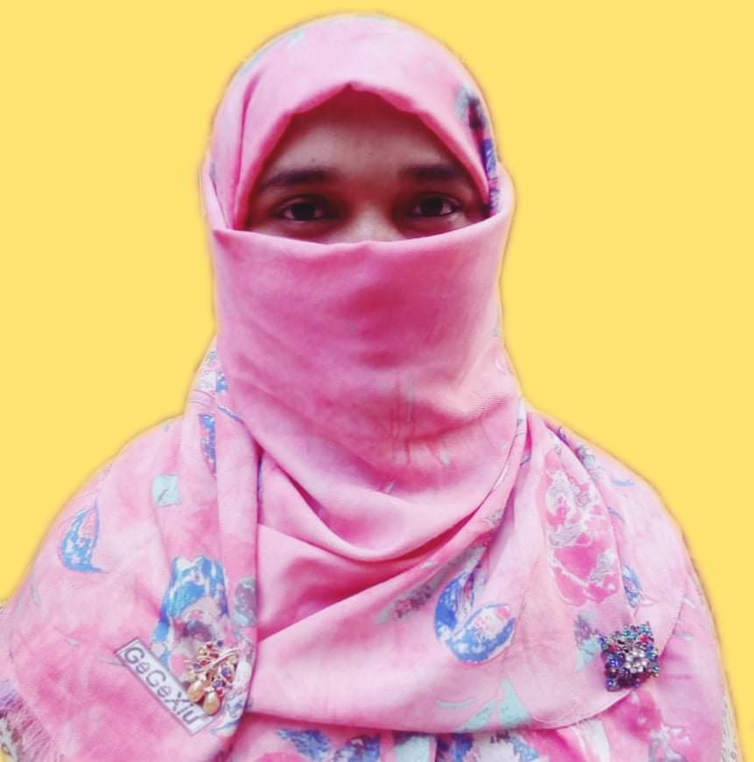
Presented by-
Mosammat Nelufa Afrose (Bithi)
Lecturer in English
Khilbaisa Rahmania Fazil(Degree) Madrasah
Sadar, Lakshmipur
E-mail:nelufa.afrose@gmail.com
Nelufa Afrose Bithi

Slide 3
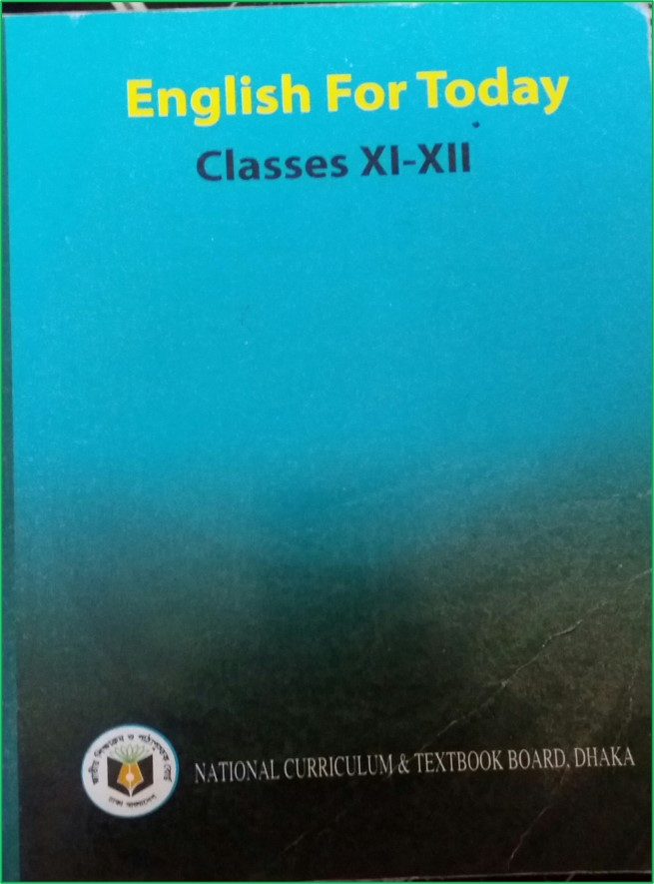
Introduction of lesson
Class: xi/xii/Alim
Subject: English 1st paper
(English For Today)

Slide 4
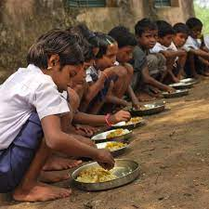
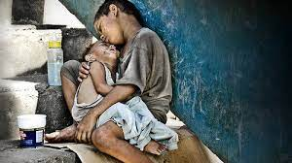
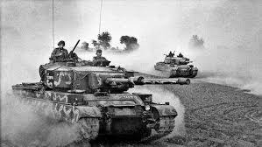
Look at the pictures below-
What is happening in each picture?
These pictures are about human rights violations.
Nelufa Afrose Bithi

Slide 5
Our today’s lesson is-
Paragraph on-
“Human rights”
According to U-5,L-4
Nelufa Afrose Bithi

Slide 6
By the end of the lesson students will able to know-
Definition of Human Rights.
What kinds of right does a human being enjoy?
About the Universal Declaration of Human Rights.
Present situation of Human Rights in the world.
Nelufa Afrose Bithi

Slide 7
Paragraph on Human Rights-
Human beings are the best creation of Allah. They live under the same sun and bear the blood of same colours. So every human being rich or poor, man or woman, young or old, black or white, American or African, Asian or Europe , must have the equal rights as he is a human being.
Nelufa Afrose Bithi

Slide 8
Human rights mean the basic needs of men and women that everyone can anticipate as a human beings. He should be protected from all sort of discrimination.
Nelufa Afrose Bithi

Slide 9
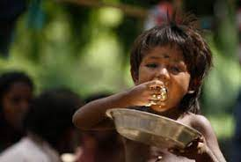
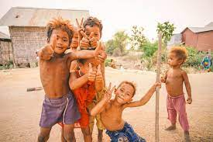
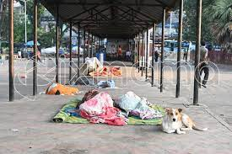
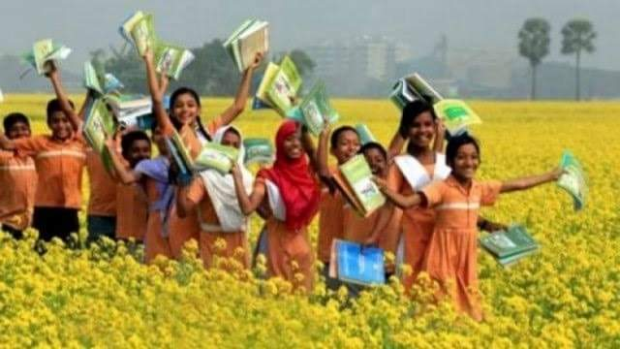
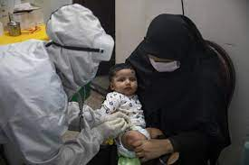
Human rights include both basic needs and lawful rights.
Basic needs are
food,
clothing,
Shelter,
Education,
and medical care.
These are inborn rights to a man.
Without these rights the development of a person will be hindered. Even his life may come to an end.
Nelufa Afrose Bithi

Slide 10
On the other hand, there are some rights that a person is entitled to either as a citizen of a country or as a person belonging to this world.
Nelufa Afrose Bithi

Slide 11
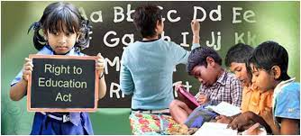
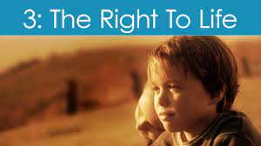
These rights include the freedom of opinion, security of life, right of citizenship, right to vote, right to education, right to justice and so on. Freedom of press is very important for a nation. Human rights also include religious right.
Nelufa Afrose Bithi

Slide 12
A person can move and settle wherever he likes within the state he belongs. Its his human rights.
No one shall be forced to be slave or to do any work.
Cruel and degrading punishment cannot be gives.
Nelufa Afrose Bithi

Slide 13
All these rights are written in the Universal Declaration of Human Rights of 1948. Rights help a person for his correct physical, mental and spiritual growth and development.
Nelufa Afrose Bithi

Slide 14
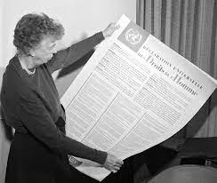
But the question is that whether the rights are observed or confined to paper only. If we notice the present situation of the world, we see that these very rights are violated everywhere from family to state. So, the people are suffering inhumanly.
Nelufa Afrose Bithi

Slide 15
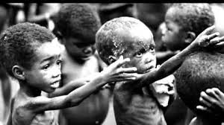
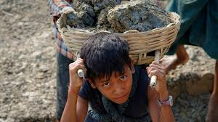
In the third world’s country human rights are neglected. The children do not get proper right. They are deprived of education and Medicare. Many of them engage in risky children labour.
Nelufa Afrose Bithi

Slide 16
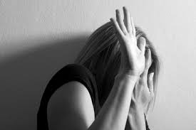
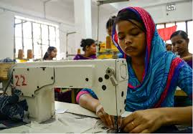
Women in our country face discrimination throughout her life. They are deprived of her rights in parents house as well as in laws house. Women work longer than men but they get less money.
Nelufa Afrose Bithi

Slide 17
Human rights do not support inhuman behaviour. Yet, “Might is right” is done everywhere in the world. The powerful countries oppress the weaker countries.
Nelufa Afrose Bithi

Slide 18
Voting right is not ensured properly.
People do not get justice.
Nelufa Afrose Bithi

Slide 19
But as a human being we need to ensure human rights fully for peaceful living in the world.Everybody should be aware of it.
Nelufa Afrose Bithi

Slide 20
Read the Paragraph silently.
Nelufa Afrose Bithi

Slide 21
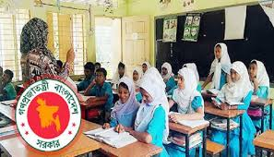
Evaluation
Answer the following Questions-
Who are the best creations in the world?,
Are all men equal? Why?
Where are the declaration of human rights written?
Nelufa Afrose Bithi

Slide 22
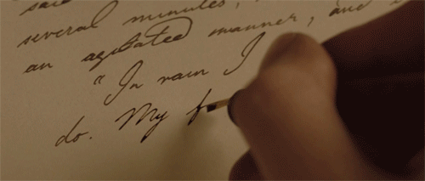
Individual Work
Write a letter to your friend telling him/her that you have learnt about human rights.
Nelufa Afrose Bithi

Slide 23
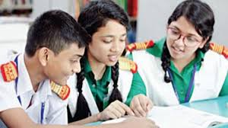
Group Work
Pick up the day’s news and find out stories about violation of human right/rights of children, women, disadvantaged, ethnic minorities etc. and summarize them in a paragraph .
Nelufa Afrose Bithi

Slide 24
Home Work
Write a paragraph on ‘Human Rights’ in about 200 words based.
(According to board Question no-7)
Nelufa Afrose Bithi

Slide 25
Thank You
Nelufa Afrose Bithi

