Slide 2
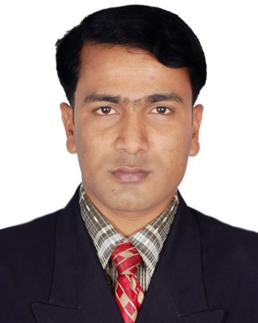
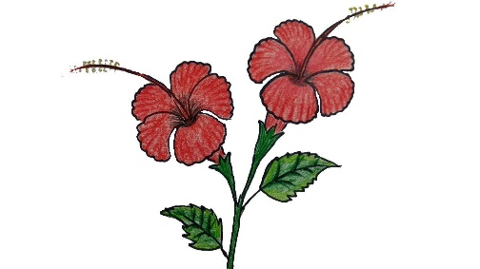
Identity
Muhammad Rehan Uddin
Assistant Teacher
Pakshail Ideal High School
Barlekha, Moulvibazar.
Mobile: 01742823363
Subject: English 1st paper
Class: Eight
Unite: Three, Lesson: 3
Time: 50 Minute

Slide 3
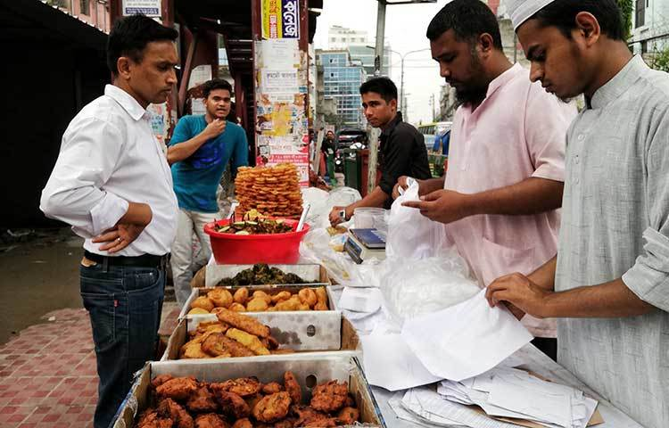
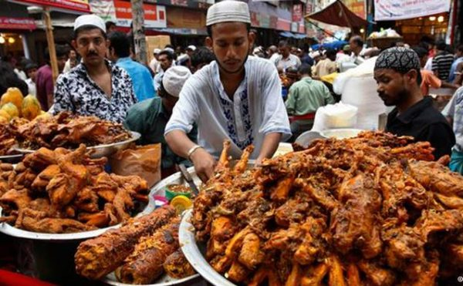
Let’s see some pictures

Slide 4
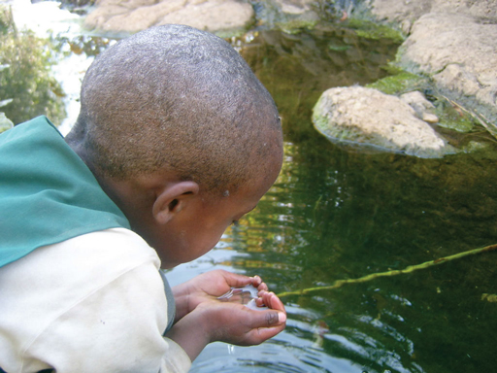
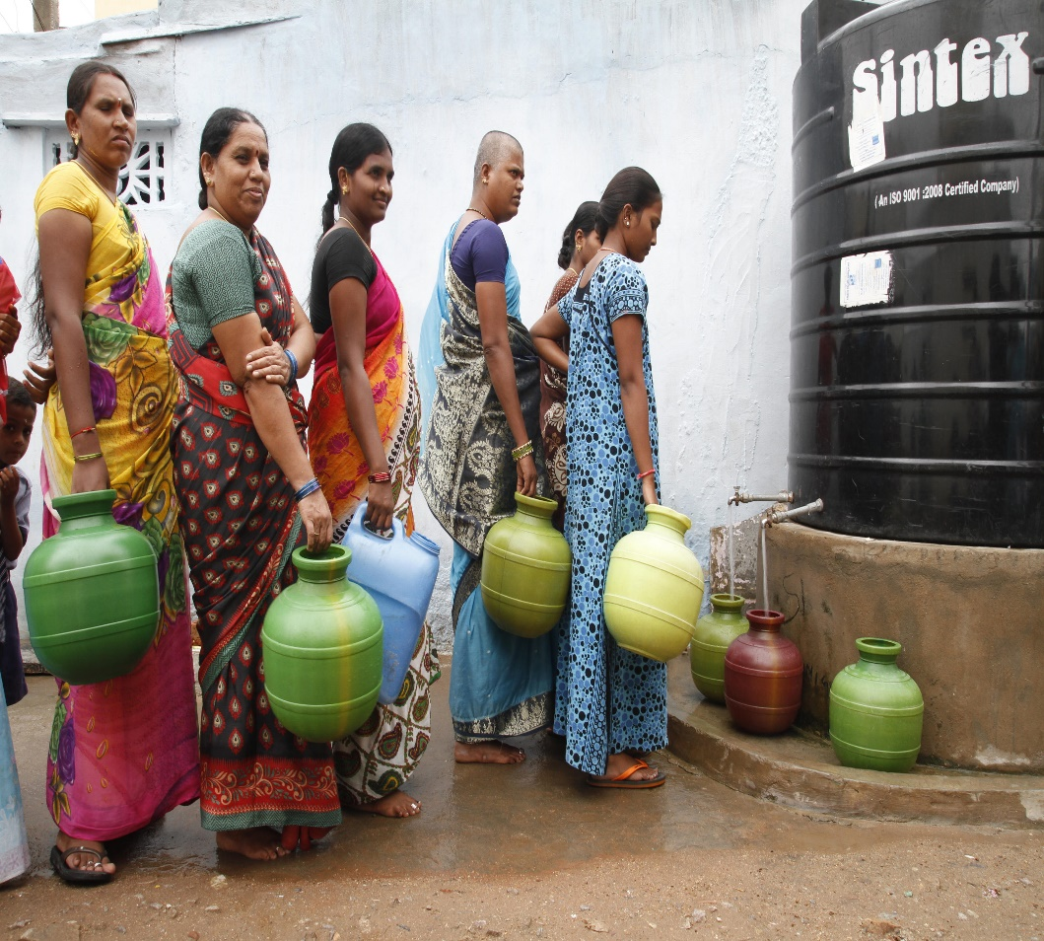
What do you Guess see the pictures?

Slide 5
So, today’s our lesson is……..?
Health & Hygiene

Slide 6
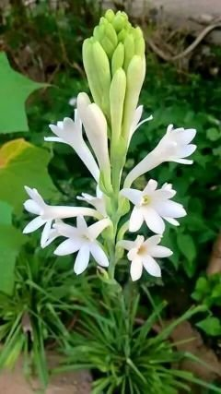
Learning Outcomes:
After studying this lesson, you will be able to…
read and understand texts through silent reading
listen for information
ask and answer questions
write answers to questions
write a paragraph.

Slide 7
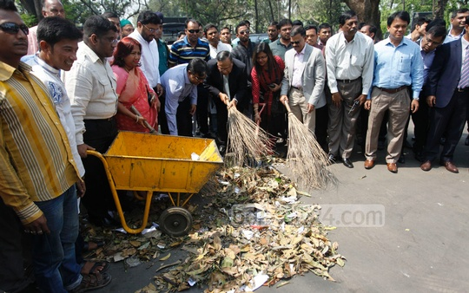
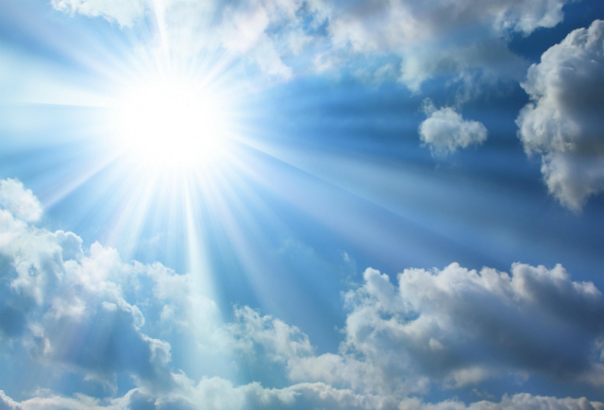
Hygiene
Cleanliness
Godliness
Holiness

Slide 8
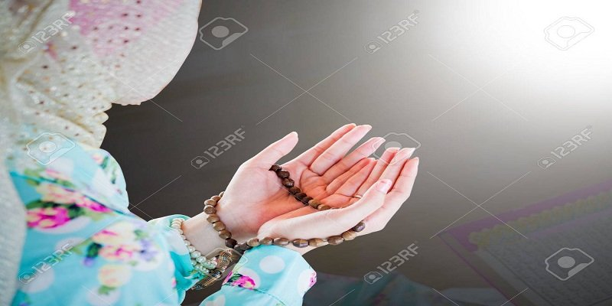
Achieve
Attain/gain
Spiritually
Morally/piously

Slide 9
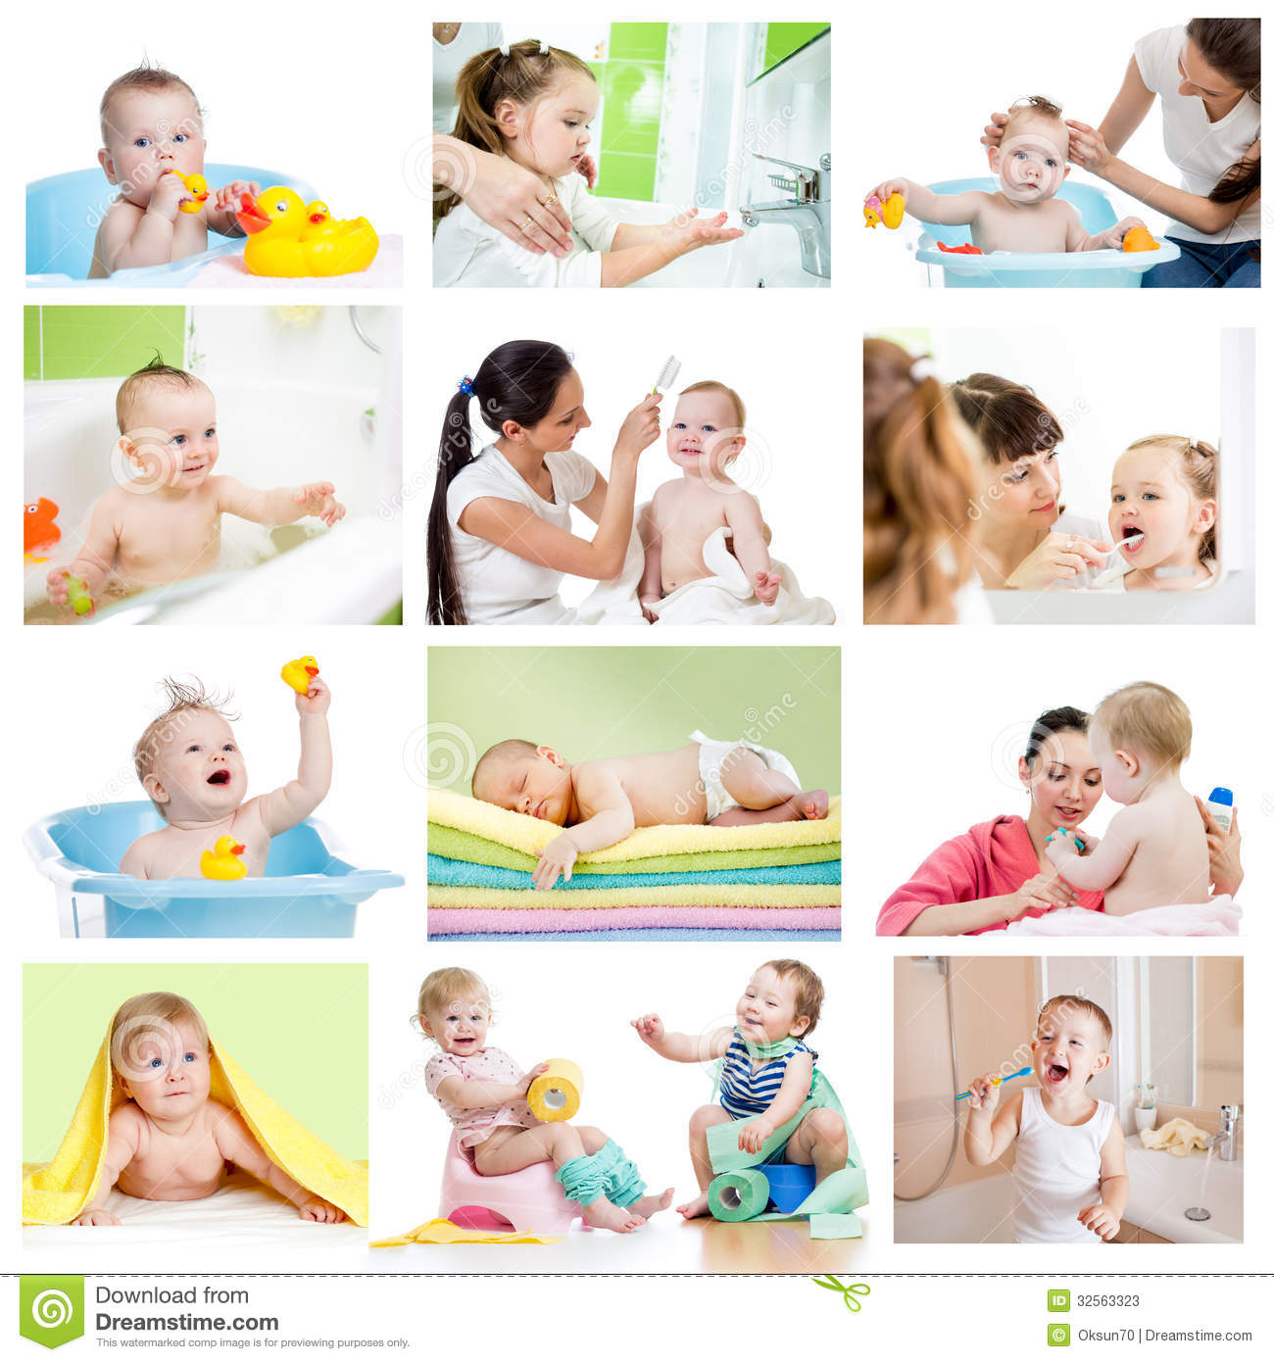
Hygiene
Hygiene means the practice of keeping oneself clean.

Slide 10
Kinds of Hygiene
Hygiene
Physical
Mental

Slide 11
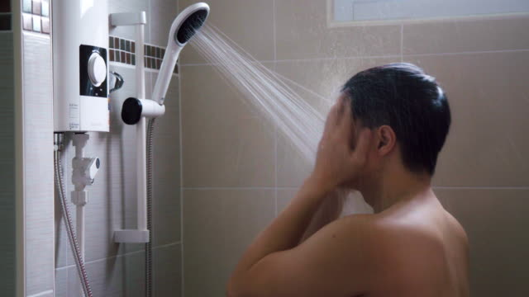
So, to maintain cleanliness, we need to…….
Bathe Every Day

Slide 12
Wash our hair regularly

Slide 13
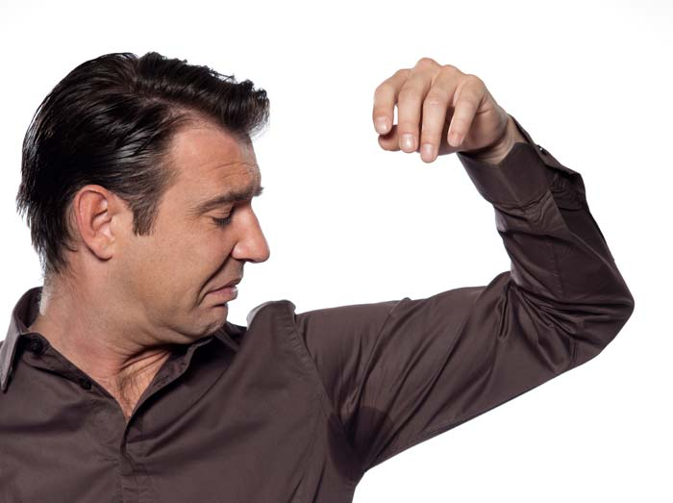
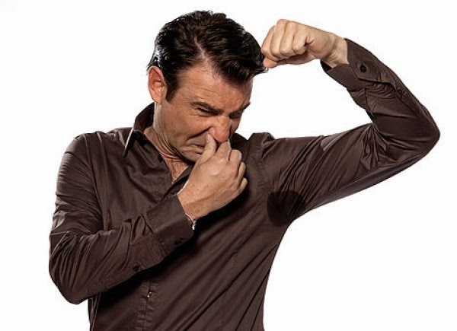
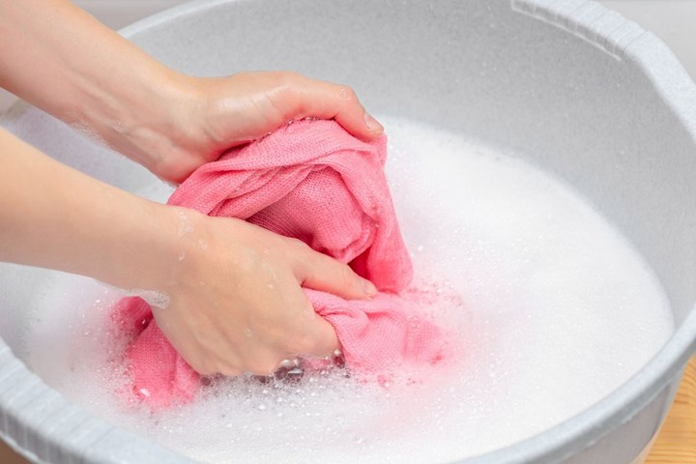
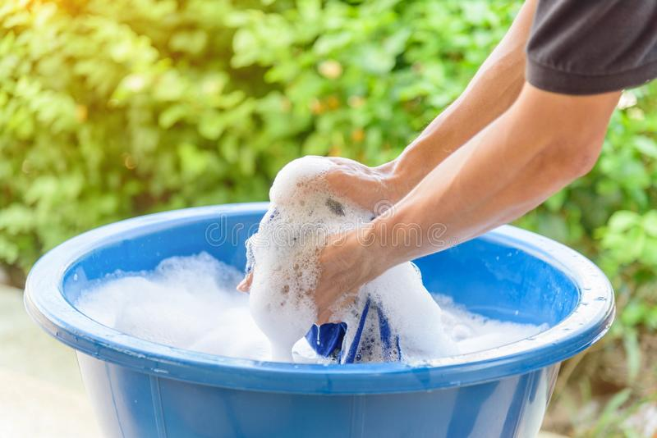
Bad Smell
Wash our cloths regularly

Slide 14
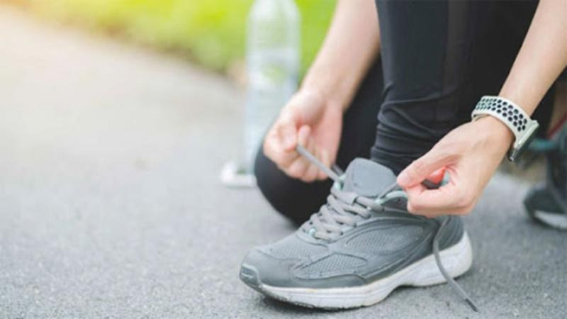
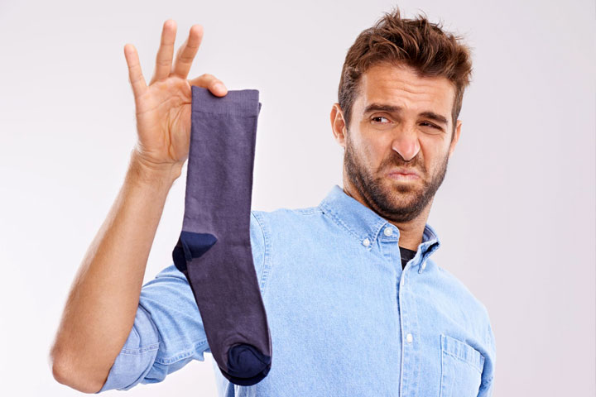
We should wear socks and shoes to protect our feet from dust and germs.

Slide 15
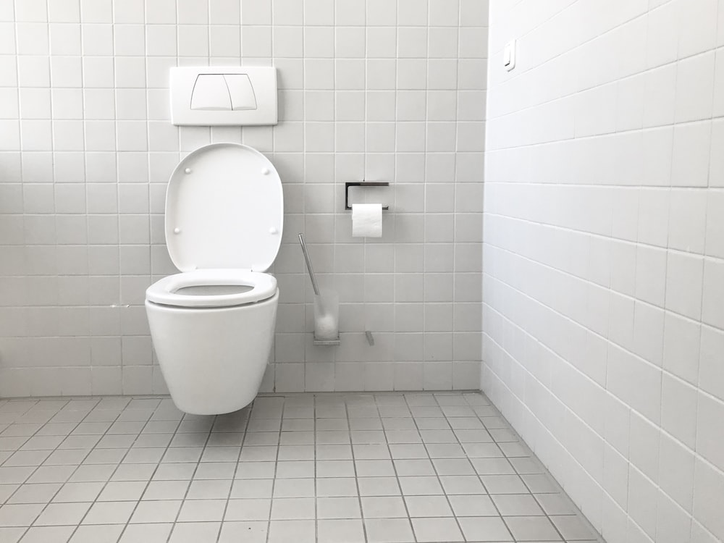
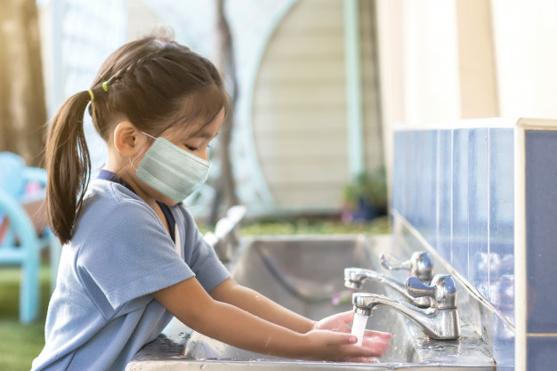
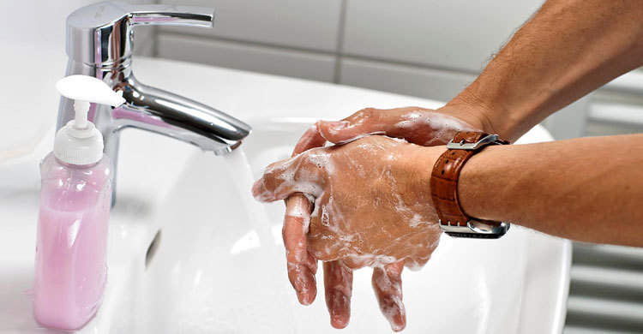
Wash our hands before meals & after using toilet

Slide 16
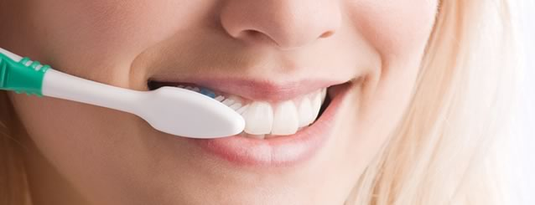
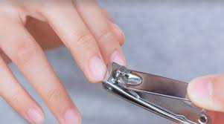
Brush our teeth twice a day.
cut our nails regularly.

Slide 17
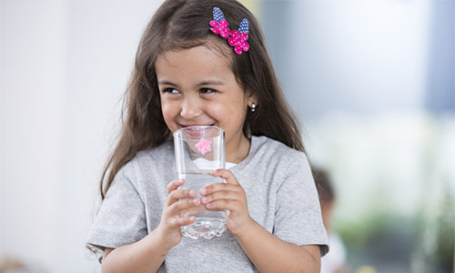
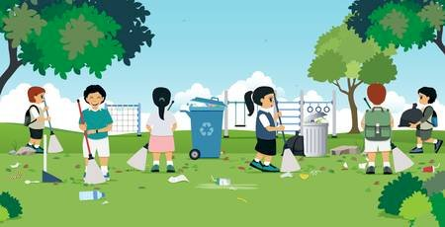
Drink pure water.
Keep our environment clean.

Slide 18
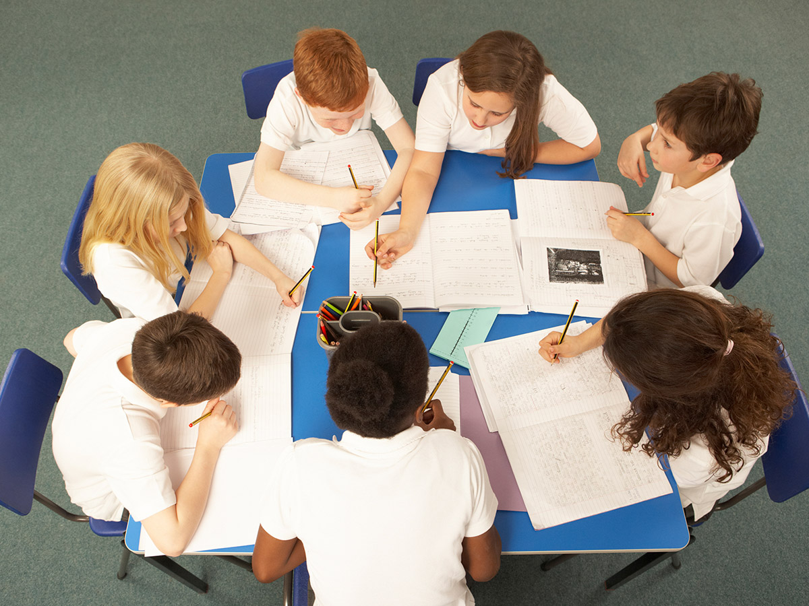
Group Work:
Make a list of five things that you do daily to maintain personal hygiene. Share with other groups, make a poster and display it in the class.

Slide 19
Evaluation
Task-1: Write true or false? If false, give the correct information.
1. Cleanliness is part of good health.
2. Cleanliness is very important for mental health.
3. We need to wear socks and shoes to look smart.
4. We need to brush our teeth before meals.
5. We must keep ourselves clean.
6. We can have pure drinking water from tube wells.
Task-2: Complete the following sentences.
1 If we are healthy, we ----------------------------- .
2 We must be clean so that-------------------------- .
3 You must exercise to ------------------------------- .
4 Nobody likes an ------------------------------------ .
5 If we obey the laws of hygiene, we ---------------- .

Slide 20
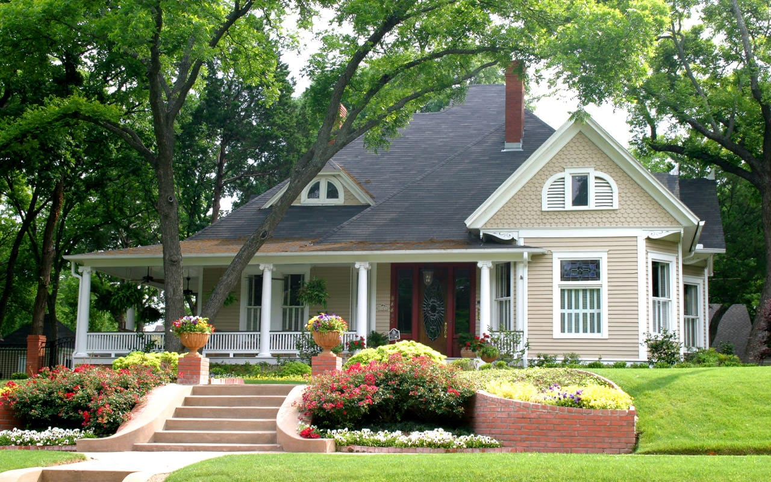
Home Work
Write the answer the following questions:
1. What can be a hotbed of germs?
2. How many times should we brush our teeth a day?
3. What kind of water should we drink?
4. What does ‘hygiene’ mean?
5. What is godliness?

