Slide 1
Welcome to my class

Slide 2
Introduction
Shaheen Ahmed
Assistant Teacher
Singraoli GPS
Biswanath, Sylhet
Mob: 01712332117
E-mail: shaheen332117@gmail.com

Slide 3
Class : Two
Subject : English
Time : 40 minute

Slide 4
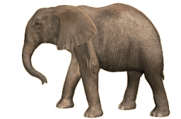
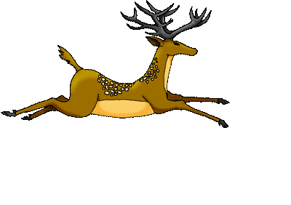
What can you see the picture?
Do you find out any difference between them ?
Their difference between sizes.

Slide 5
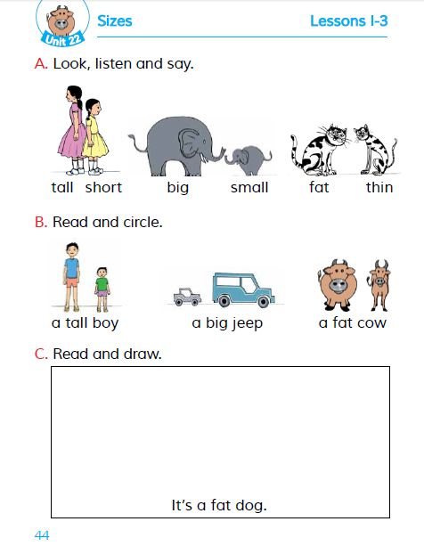
Today’s lesson
Size
Unit : 22
Lessons : 1-3
Page : 44

Slide 6
Learning outcomes
1.1.1 become familiar with English sounds by listening to common English words.
1.1.1. repeat after the teacher simple words and phrases with proper sounds and stress.
1.1.2 say simple words and phrases with proper sounds and stress.
1.3.1 recognize and read the names of objects having the same initial and final sounds.
1.4.1 read word and phrases with the help of visual clues (about 30 new words) and simple sentences.

Slide 7
Look, listen and say
Tall
Short
Short
Tall

Slide 8
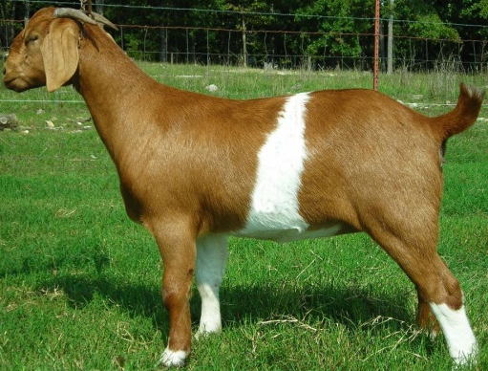
Evaluation
It’s a ……………tree.
tall
small
It is a ………….. house .
It’s a ………… goat .
fat

Slide 9
Home work
Read and draw
It is a fat dog.

Slide 10
Thank you everybody.
See you again.

