Slide 1
Welcome to all

Slide 2
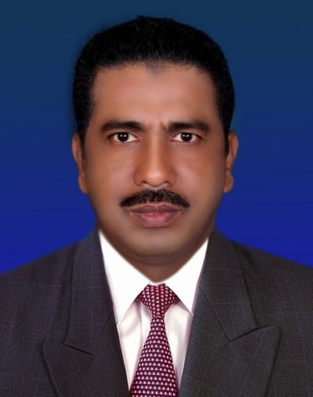
English 1st Paper
Class-Nine
Unit –Three,Lesson-2
Time- 50 minutes
SUBJECT
Mohammed Faizur rahman Bhuiyan.(M.a,b.p.ed)
Assistant Teacher.
Bara Gobindapur A.M.B high
School
Chandina,Comilla.

Slide 3
Learning Outcomes
Students will be able to
talk about International Mother Language Day.
speak out why & how the language movement took place.
ask and answer questions.
match the words with their meanings.

Slide 4
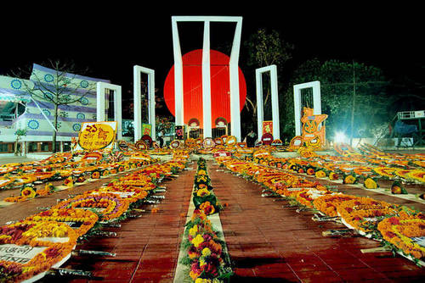
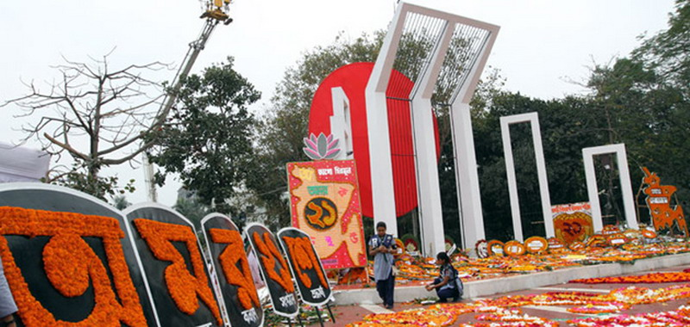
Look at the pictures and talk about it :
1. What’s the picture about?
2. Where do you think it is?
3. Why was it built?

Slide 5
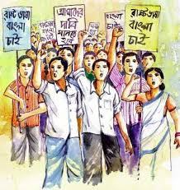
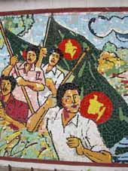
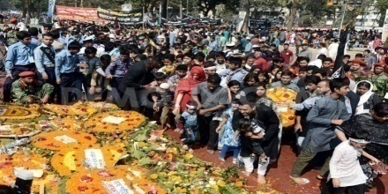
Lesson Declaration
International Mother
Language Day

Slide 6
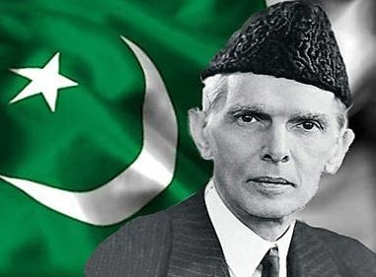
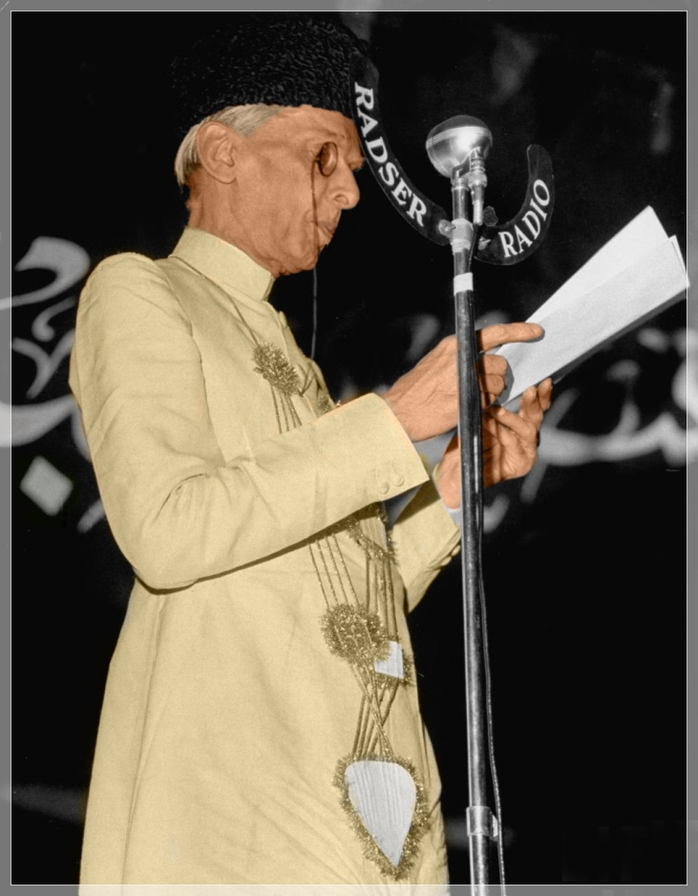
Do you know who is he?
Mohammad Ali Zinnah

Slide 7
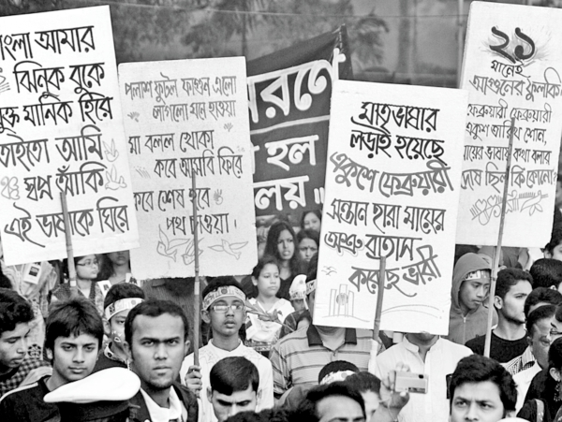
Peaceful protest of the students of Dhaka University

Slide 8
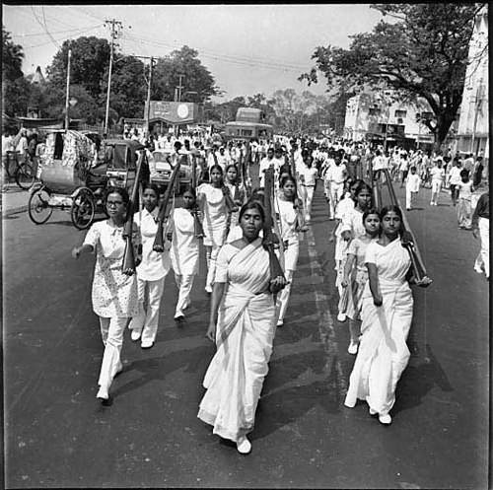
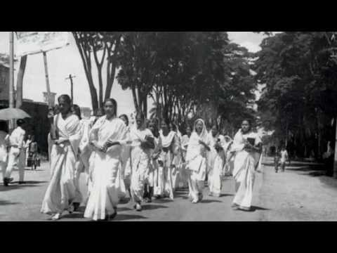
The protest of women

Slide 9
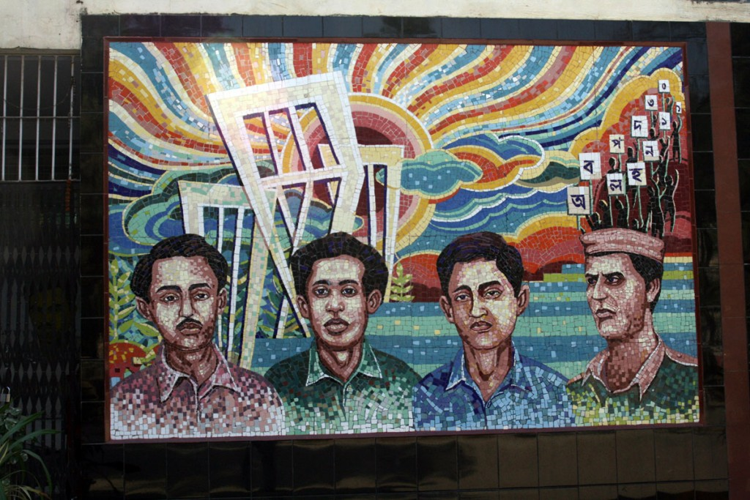
Language martyrs: Salam, Rafiq, Barkat and Jabbar

Slide 10
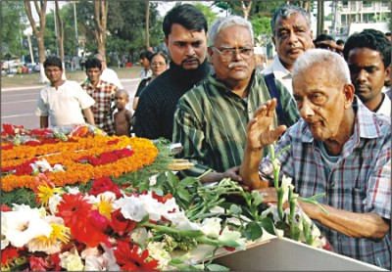
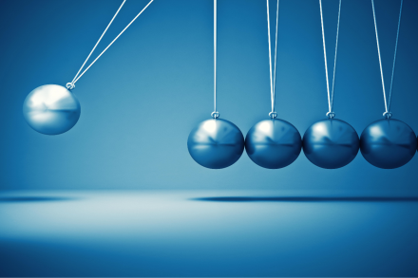
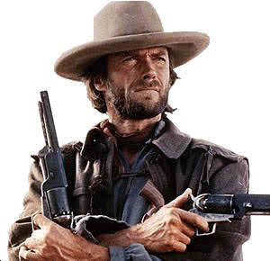
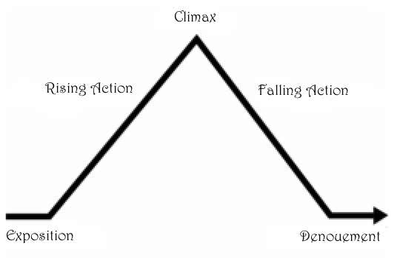
New vocabularies
Tribute
An act or gift intended to show respect
Momentum
Impetus gained by movement
Outlaw
A person who has broken the law and remains at large.
Climax
The most exciting point

Slide 11
Individual Work
Read the lesson silently and complete the following chart.
Time | What happened
1947
1948
1952

Slide 12
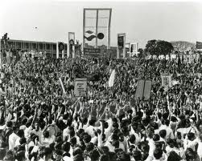
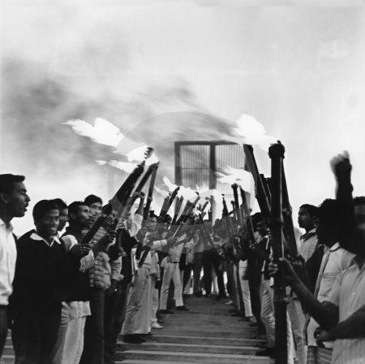
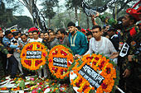
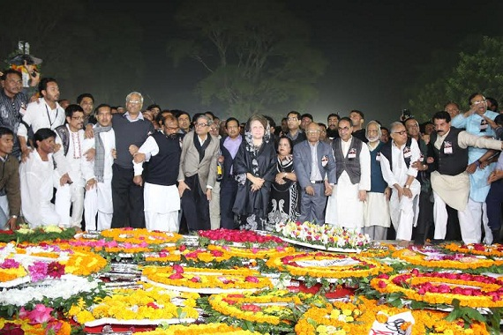
What is happening in these pictures?
Protest for Bangla as our state language
People are paying homage to the language martyrs

Slide 13
Why 21 February is a memorable day in our national history?
(Here Teacher will use blackboard)
.
.
.

Slide 14
Pair work
Match the words with their meanings.
Words | Meanings
climax outlaw defy provoke relent Momentum tribute | to refuse to obey to give in the ability to keep increasing or developing an act to show respect or admiration the most exciting point in time to ban To cause or to stimulate

Slide 15
Evaluation
Answer the following questions
1. Why do we observe 21 February as the International Mother Language Day?
2.What happened when Urdu was declared as the only state language of Pakistan?
3. “ The seed of independence was sown on 21 February 1952” . Do you agree with the comment ? Why?

Slide 16
Home Work
Write an article within 150 words on what did you do on the last 21 February.

Slide 17
Thanks to all

