Slide 2
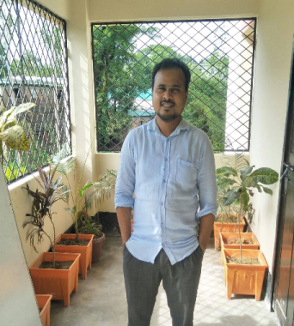
Teacher’s introduction
Md. Rafiqul Hasan
Assistant Teacher
Khonkarkhil Government Primary School, Sadar, Cox's Bazar.
email:
rafiquecox1@gmail.com
mobile: 01815 605 444

Slide 3
Lesson’s introduction
Class: Five
Subject: English
Unit: 22 (Completing forms)
Lesson: 1-2
Activity: A and B
Page: 86

Slide 4
Learning outcomes
Listening:
1.3.1 recognize which words in a sentence are stressed.
3.4.1 understand statements made by the teacher and students.
Speaking:
6.2.1 talk about people, objects, events etc.
Reading:
1.7.1 read paragraph, dialogues, stories, letter and other texts.
Writing:
6.1.2 use capital letters for proper nouns.

Slide 5
Let’s enjoy a video

Slide 6
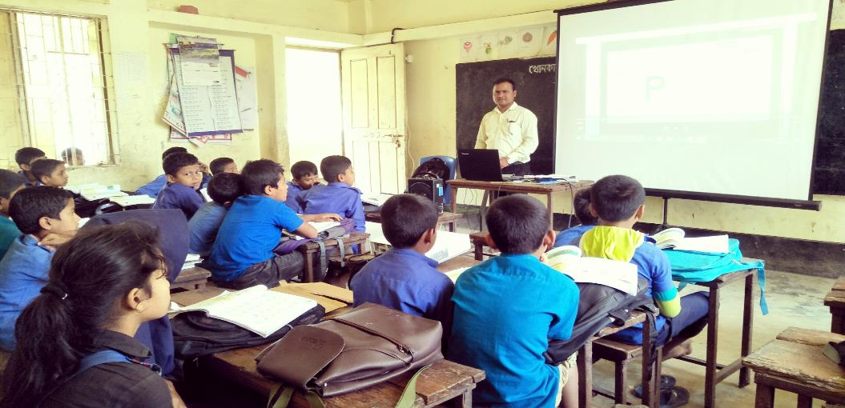
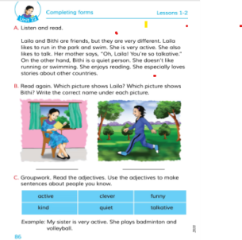
Teacher’s Reading

Slide 7
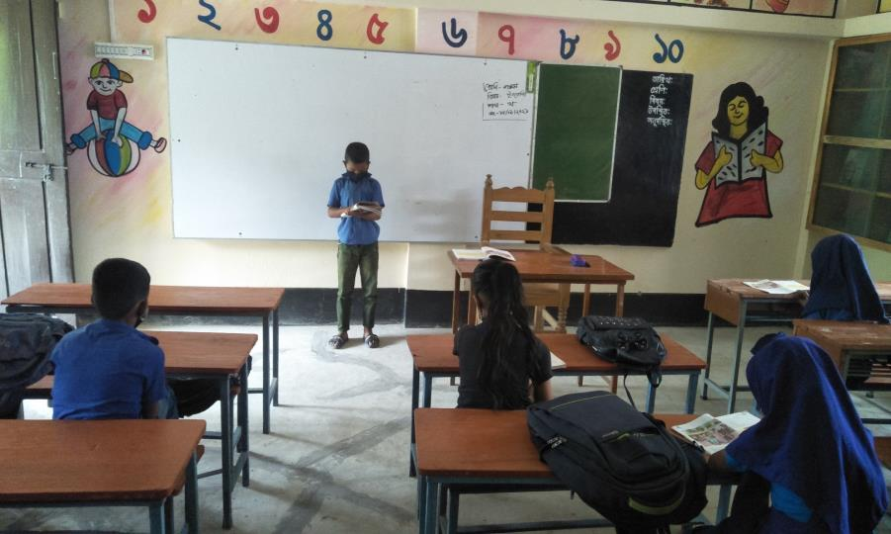
Silent Reading

Slide 8
Laila
Bithi
Laila and Bithi are friends. But they are very different.

Slide 9
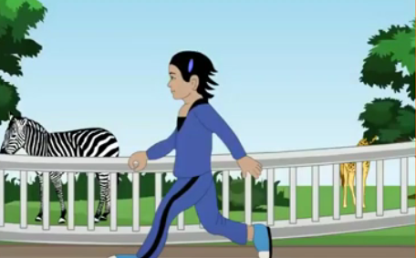
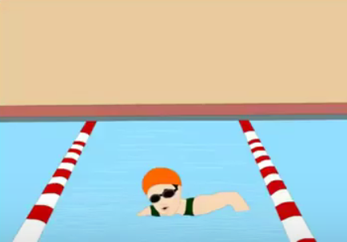
Laila likes to run in the park and swim . She is very active. She also likes to talk. Her mother says ,” oh, Laila! You’re so talkative.”

Slide 10
On the other hand , Bithi is a quiet person. She doesn’t like running or swimming. She enjoys reading. She especially loves stories about other countries.

Slide 11
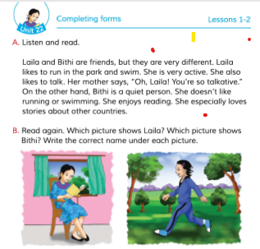
Open your EFT book at page 86.

Slide 12
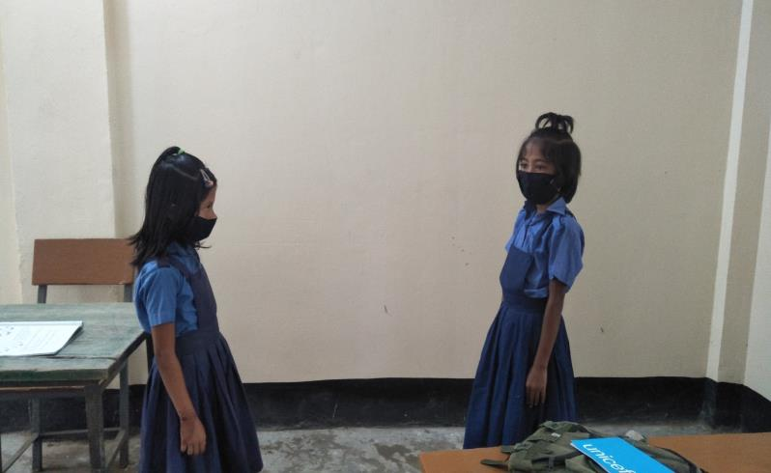
Pair work
Read the text in pair. One will read and other will listen.

Slide 13
Read again. Write the correct name under each picture.
Laila
Bithi

Slide 14
Vocabulary
Friend
বন্ধু
Pal
Different
ভিন্ন
Unlike
Talkative
বাচাল
Chatty
Quiet
শান্ত
Silent

Slide 15
Vocabulary
Run
দৌড়
Track
Swim
সাঁতার
Bath
Active
কর্মঠ
Energetic

Slide 16
Fill in the blanks.
Laila and Bithi are ………………….
Bithi is a ……………. person.
She doesn’t ……….. running or swimming.
She ……………… reading.
She ……………… stories about other countries.

Slide 17
Fill in the blanks.
friends
Laila and Bithi are ………………….
Bithi is a ……………. person.
She doesn’t ……….. running or swimming.
She ……………… reading.
She ……………… stories about other countries.
quiet
like
enjoys
loves

Slide 18
Use capital letters in the following sentences:
1. laila and bithi are friends.
2. laila likes to run in the park.
3. bithi is a quiet person.
4. bithi enjoys reading.
5. laila is very active.

Slide 19
Use capital letters in the following sentences: (match your answers)
1. Laila and Bithi are friends.
2. Laila likes to run in the park.
3. Bithi is a quiet person.
4. Bithi enjoys reading.
5. Laila is very active.

Slide 20
Home work
Write 5 sentences about your friend.

Slide 21
See you tomorrow
That's all for today

