Slide 1
WELCOME TO MY CLASS

Slide 2
INTRODUCTION OF TEACHER
NAME : AKIDUL ISLAM
ID NO: 8
DESIGNATION: LECTURER
NILPHAMARI GOVERNMENT COLLEGE,NILPHAMARI.

Slide 3
Class : Honors’s 3rd yead
Subject :Quantum Mechanics
TOPICS IN QUESTION
1. QUANTUM MECHANICS , CLASSICAL MECHANICS AND PARTICLE IN A BOX.
2.Comparation between quantum mechanics and classical mechanis

Slide 4
Lerning outcome:
To Learn about quantum mechanics
To Learn about classcal mechanics
To compara between classical mechanics and compare mechanics

Slide 5
Classical mechanics:
Descrive about massive particle F=MA
S=ut+1/2at^{2.}

Slide 6
QUANTUM MECHANICS:
DESCRIVE ABOUT VERY SMALL PARTICLE
SUCH AS, ELECTRON

Slide 7
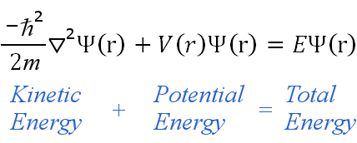
Schroedinger Equation
m = mass of particle
Is wave functin
V= potentian energy

Slide 8
COMPARA BETWEEN QUANTUM MECHANICS
AND CLASSICAL MECHANICS

Slide 9
A particle in a box

Slide 10
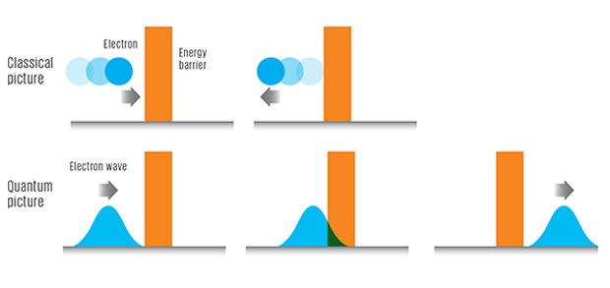
THE COMPARATIVE CONCEPT BETWEEN CLASSICAL MECHANICS AND QUANTUM MECHANICS

Slide 11
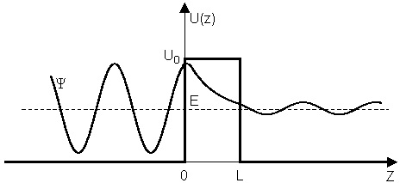

Slide 12
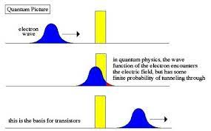

Slide 13
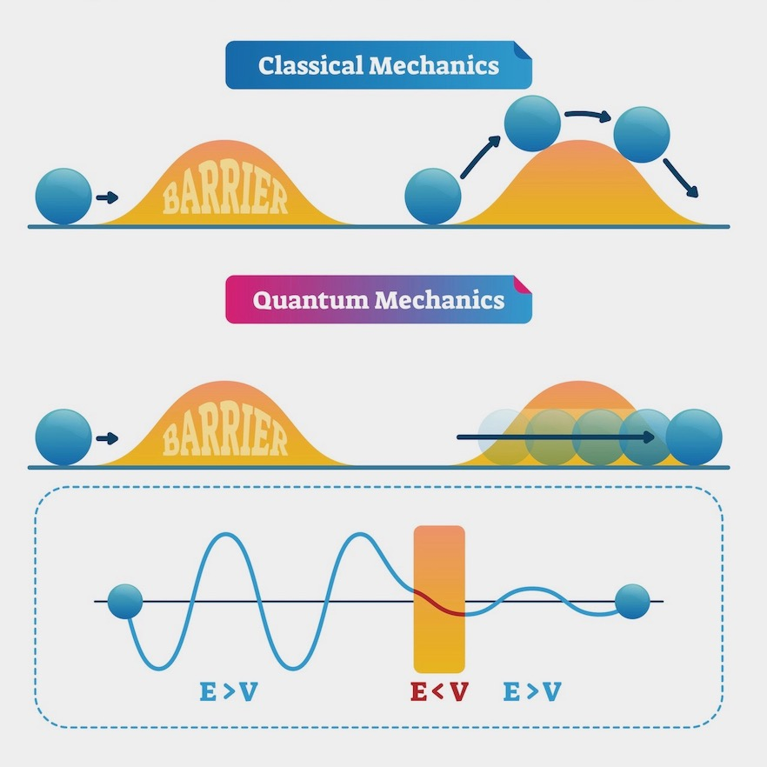

Slide 15
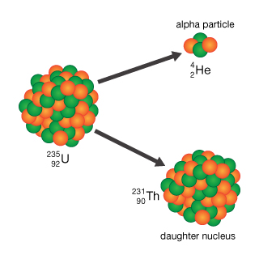
ALPHA PARTICLE DECAY

Slide 16
1.What is primary idea of classical and quantum mechanivs
2.What is the main assumption about Quantum mechanics and Classical mechanics
3.Descrive the comparation between quantum mechanics
and classical mechanics

