Slide 2
Welcome Everybody

Slide 3
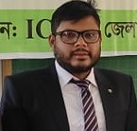
ID – QUAMRUL16
DISTRICT AMBASSADOR
ICT4E
কামরুল হাসান আহমেদ
সহকারি শিক্ষক
শালগ্রাম সরকারি প্রাথমিক বিদ্যালয়
আদমদীঘি ,বগুড়া
quamrulkumu@gmail.com

Slide 4
Today’s Lesson
Class : Three Time: 40 minutes
Sub : English
Unit: 37
Lesson: 1-3
Title : What food should we eat?

Slide 5
Learning outcomes
Speaking-
Students will be able to:
1. Ask and answer Wh questions.
2. Ask and answer Yes/No questions.
Reading-
Students will be able to:
1. Read words, phrases and sentences in the text with proper pronunciation, stress and intonation.

Slide 6
Greetings song.
Hello! Hello!
How are you?
I’m very well,thank you.Thank you.
And how are you?
I’m very well,too.
Thank you,thank you.

Slide 7
Let’s see some pictures

Slide 8
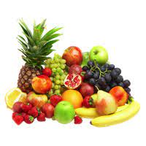
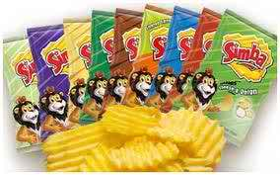
Fruits
Chips

Slide 9
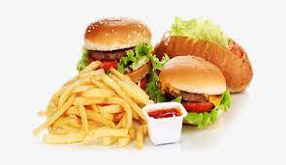
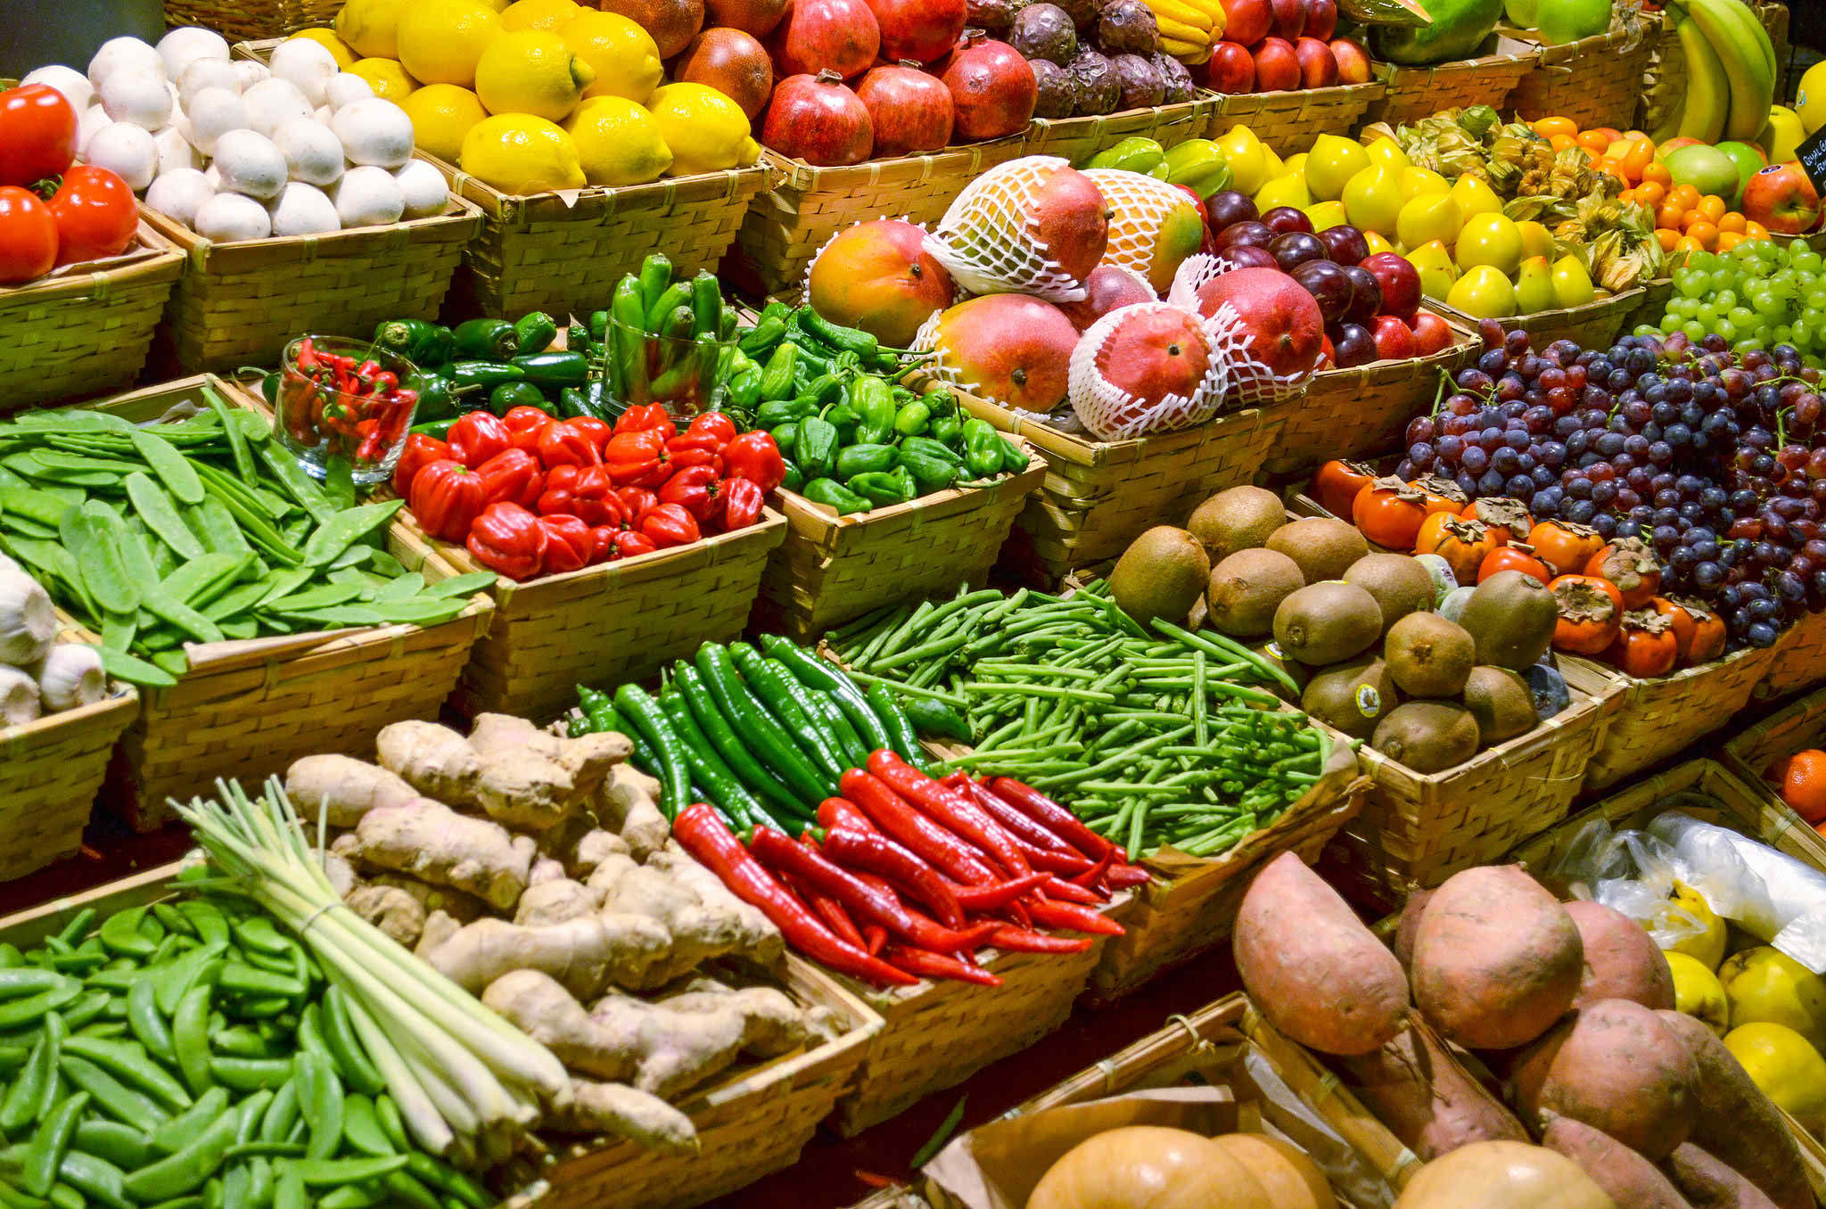
Junk food
Vegetables

Slide 10
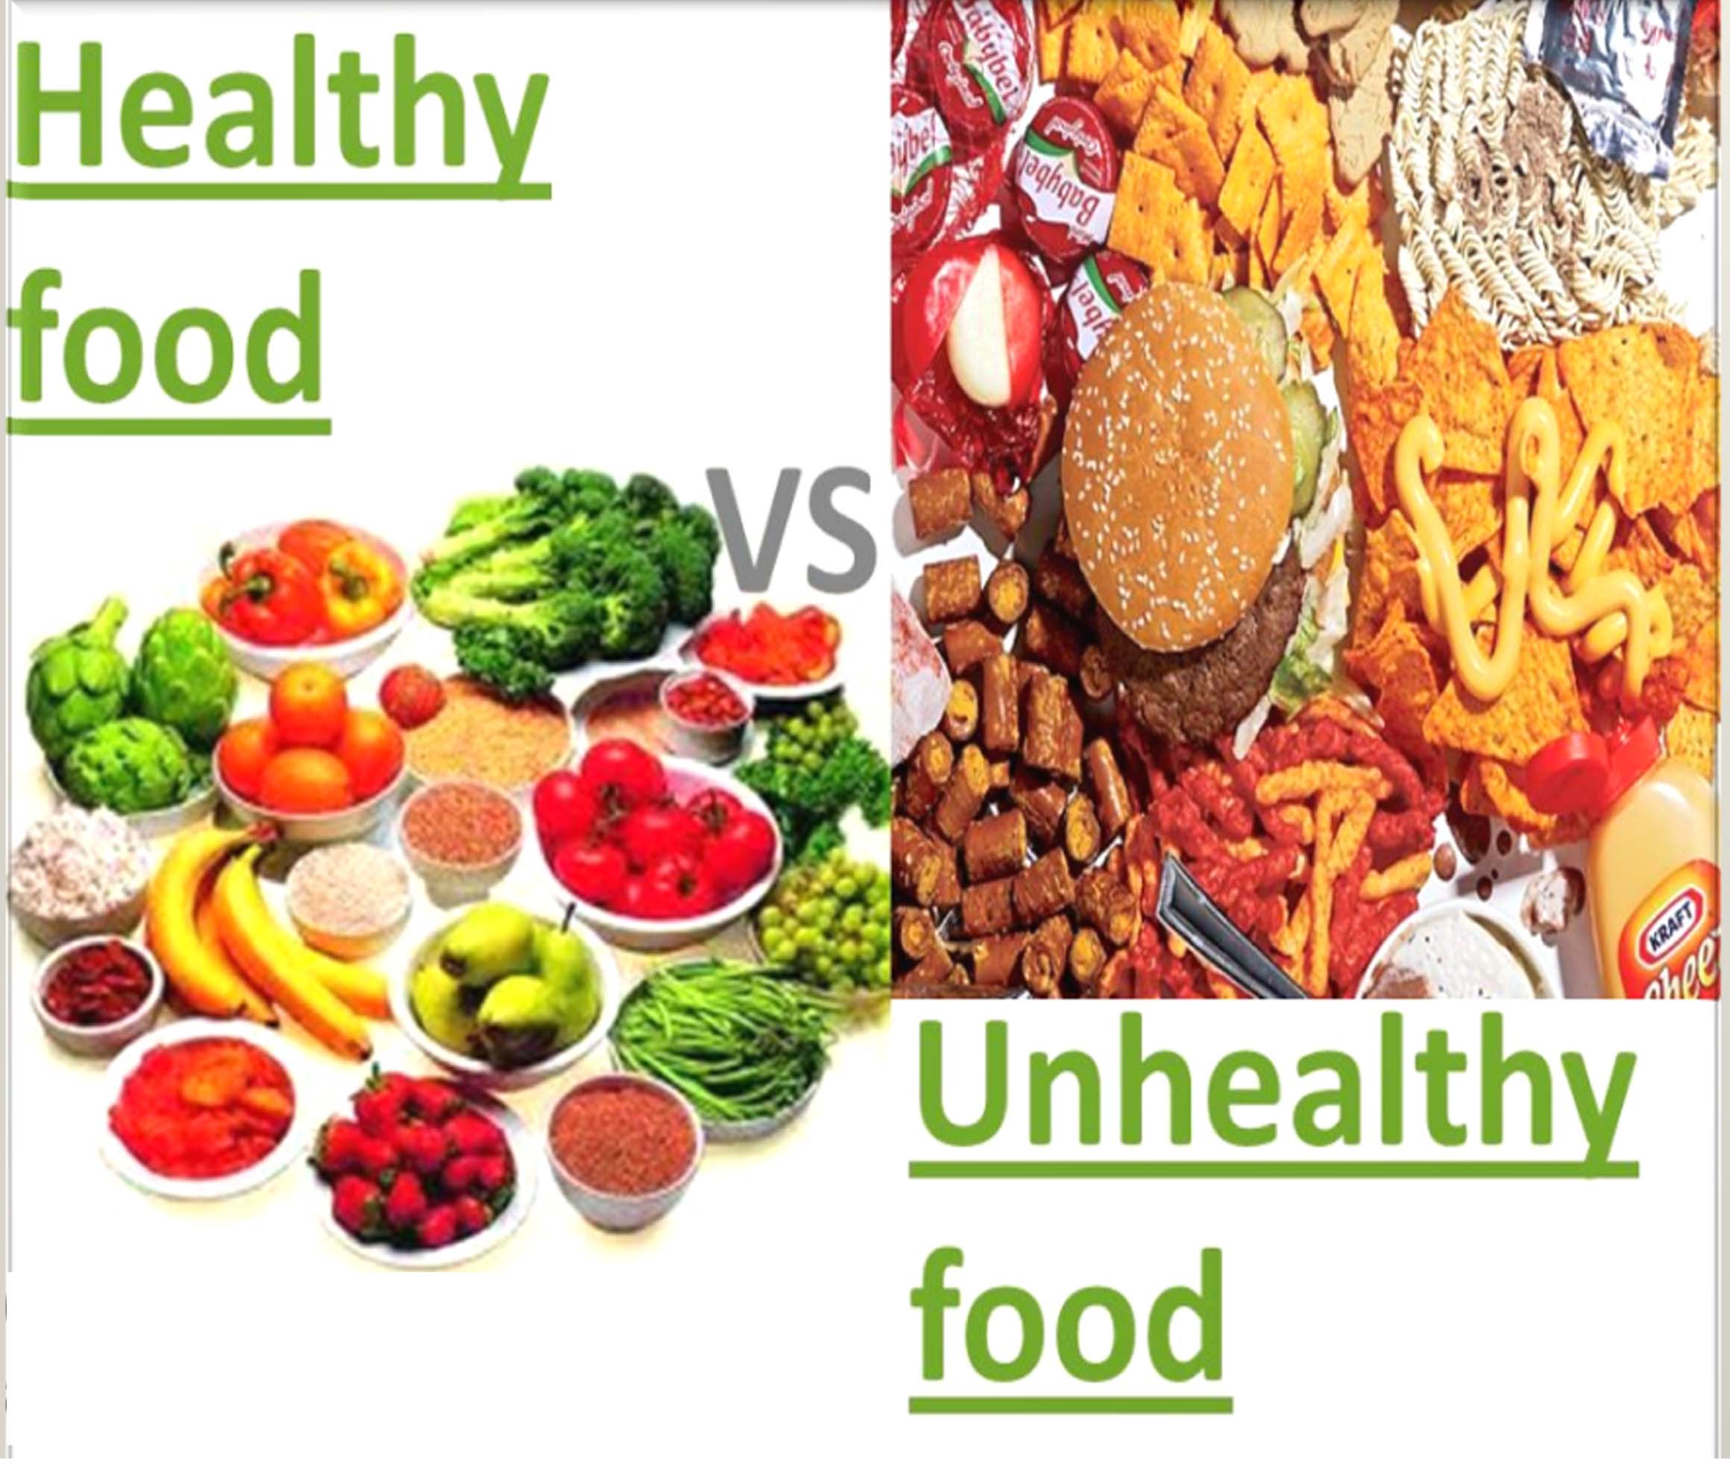

Slide 11
Should we eat chips or chocolate?
No, we shouldn’t
Why not?
Because these are junk food or unhealthy food \
Should we eat fruits or vegetables?
Yes, we should.

Slide 12
What’s the Reason?
Because these are fresh food or healthy food.
The name of our today’s lesson is
“What food should we eat?”

Slide 13
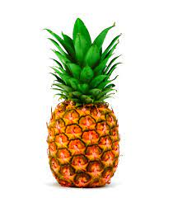
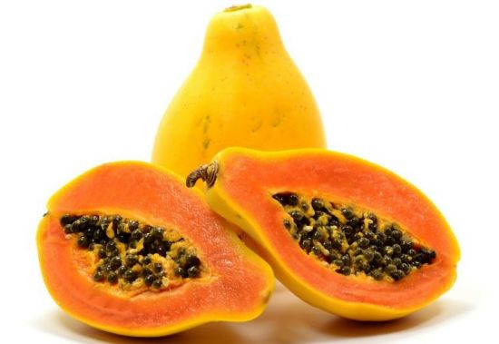
Let’s see some more pictures
Pineapples
Papayas

Slide 14
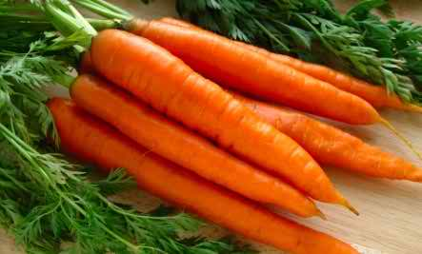
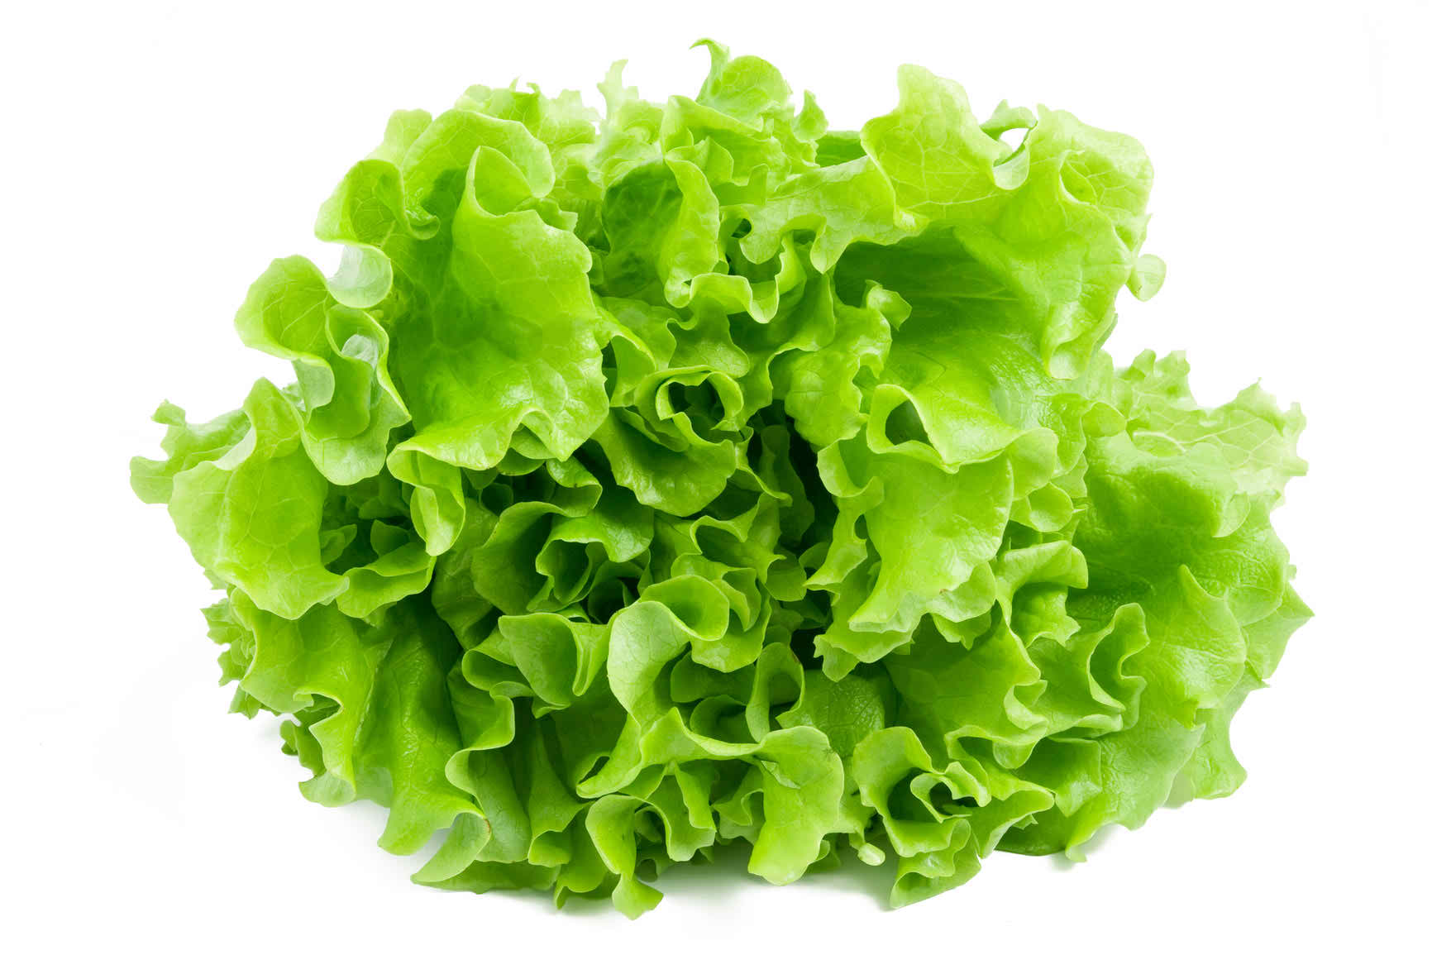
Carrots
Lettuce

Slide 15
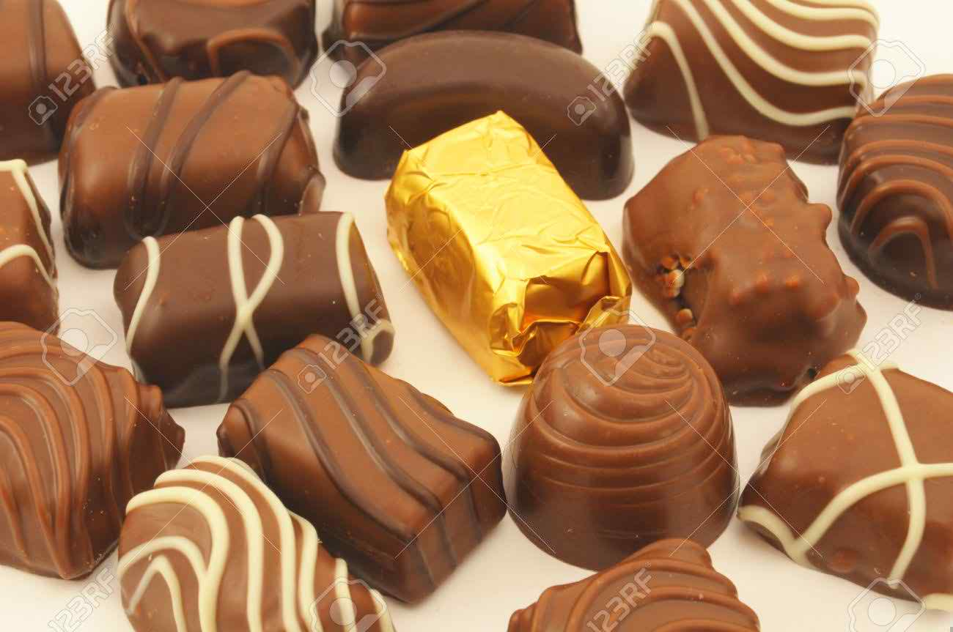
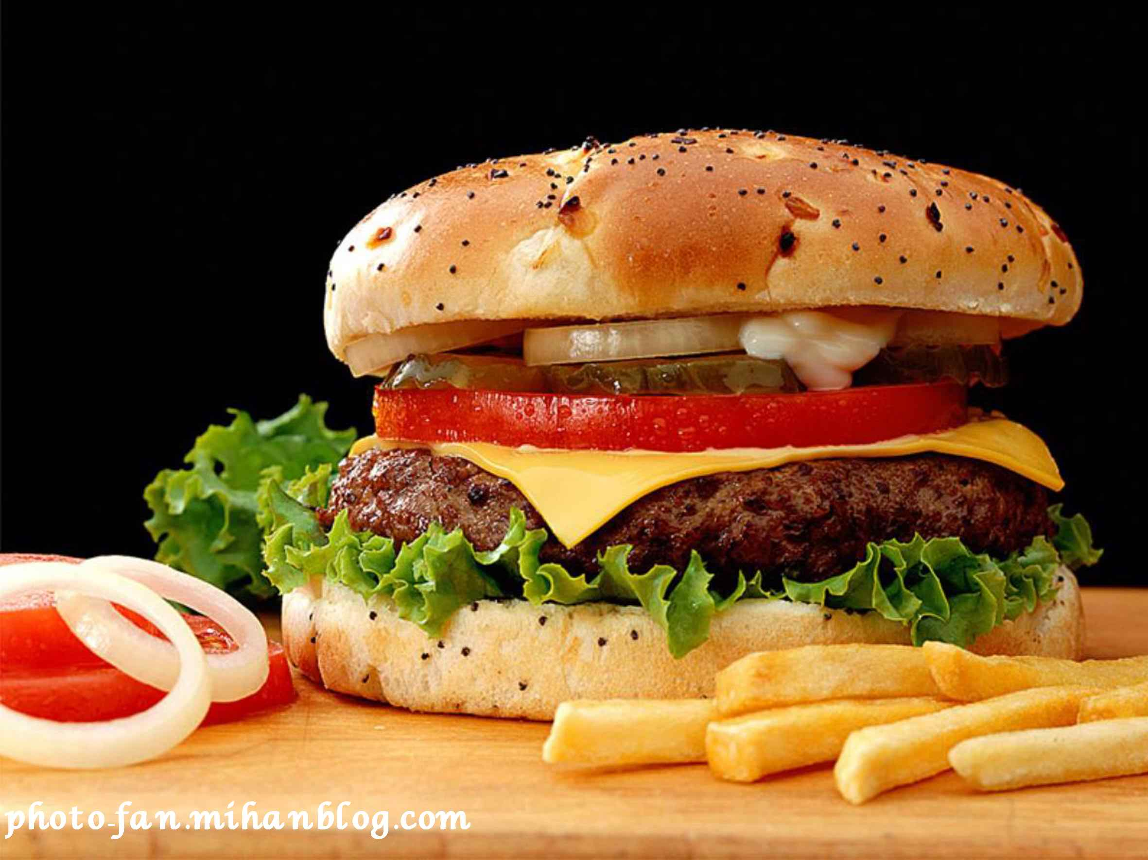
Chocolate
Burger

Slide 16
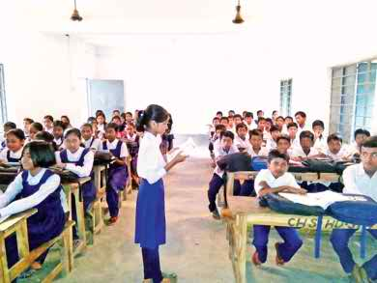
Student’s reading

Slide 17
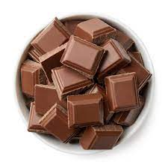
:Let`s See some new words
Carrots
Chocolate

Slide 18
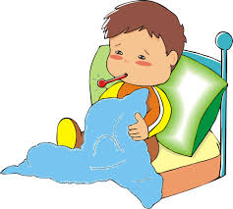
Practice
Make sentences with following words:
Unhealthy

Slide 19
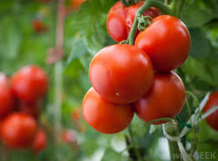
Carrots
Tomatoes

Slide 20
Fill in the gaps:
food
(a) We should eat healthy----------.
(b) Lettuce and tomatoes are also-------- food.
(c) We shouldn’t eat to much ------------food.
healthy
unhealthy

Slide 21
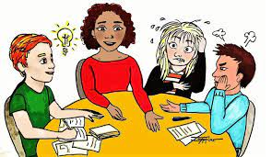
Group work
Write the name in correct lists in your exercise book.
No | Healthy food | Unhealthy food
1
2
3

Slide 22
Questions and answer:
1. Which food should you eat?
Ans: Fruits, carrots, lettuce, tomatoes etc..
2. Are vegetables and fruits healthy food?
Ans : Yes.
3. Which are unhealthy food?
Ans: Ice-cream, chocolate, chips, burgers etc.

Slide 23
(4) Should you eat too many junk food?
Ans: No, we shouldn’t.
(5) Which foods are harmful for our health?
Ans: Unhealthy food / junk.

Slide 24
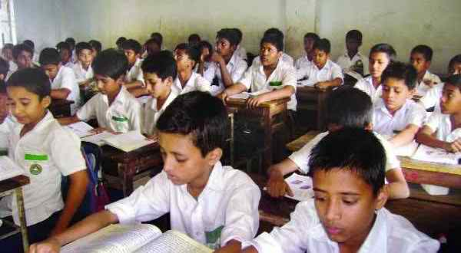
Silent reading

Slide 25
Task
1. Is pineapple healthy food?
Ans: Yes.
2. Ice-cream is unhealthy food. It’s true/false.
Ans: True.

Slide 26
Home
Work
Which food you should not eat – write down these name in your exercise book from home.

Slide 27
Thanks Everyone

