Slide 1
welcome

Slide 2
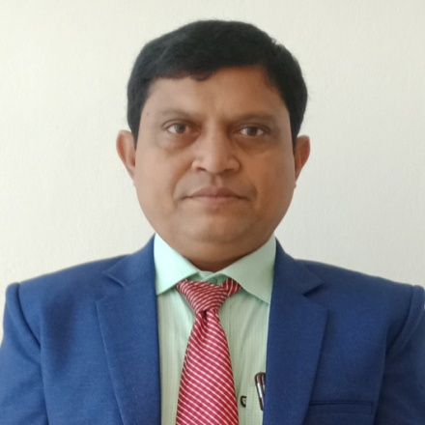
ফনিভুষন চন্দ্র সরকার
প্রধান শিক্ষক
ইমেইল- pbict3@gmail.com
ভাটিপাড়া সরকারি প্রাথমিক বিদ্যালয়

Slide 3
Lesson identity
Class: four
Subject: English for today
Unit: 21 Food around the world
Lesson: 1(A,B&C)
Time:45 minutes

Slide 4
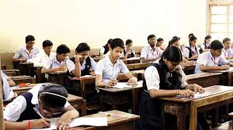
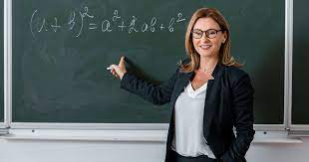
Greeting
Good morning students.
Good morning teacher..
How are you ?
Fine,and you ?
I am also fine,thanks.
Welcomes.

Slide 5
By the end of the lesson student will be able to
Listening
3.3.1 understand question about objects around them.
3.4.1 understand statements made by the teacher and students.
Speaking
1.1.1 say words,phrases and sentences with proper sounds and stress.
6.2.1 talk about people ,objects,events,etc.
8.1.1. take part in conversation on appropriate topics.
Reading
1.5.1 read words, phrases and sentences in the text with proper pronounciation,stress and intonation.

Slide 6
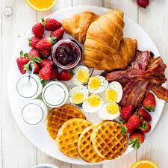
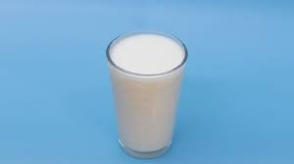
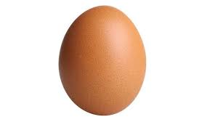
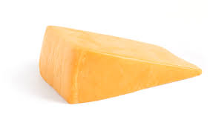
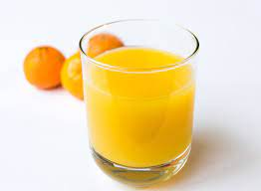
Word Meaning
Breakfast
Light food for morning
Milk
Dairy
Egg
A round object laid by a female bird
Cheese
A food produce from curd of milk
Juice
Broth of fruits

Slide 7
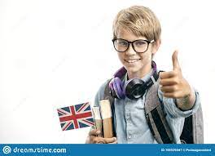
Hi ! I’m Alex.
I live in London.
I’m British.

Slide 8
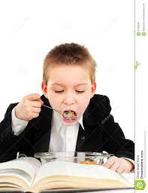
I start my day at 7 a.m. & I have breakfast at 8 o’ clock.

Slide 9
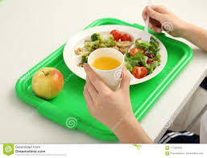
On weekdays, I usually have milk, cereal and an apple.

Slide 10
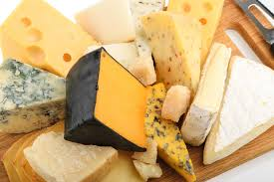
Sometime I have fried eggs with cheese and some juice.

Slide 11
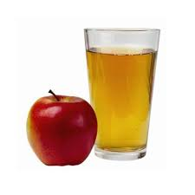
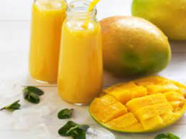
Apple juice is my favourite, but I like mango juice, too.

Slide 12
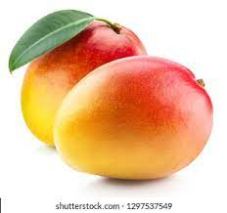
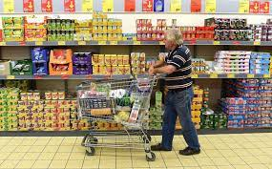
We don’t grow any mangoes in my country, but we can get mango juice at the supermarket.

Slide 13
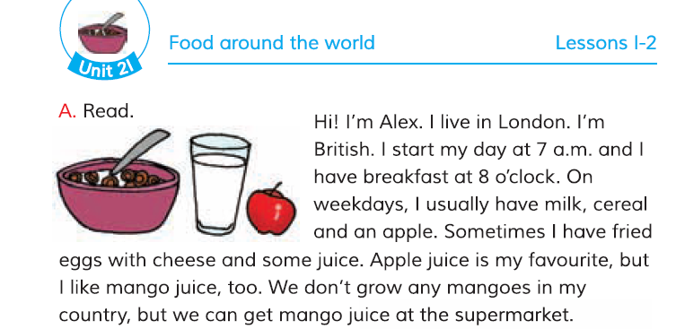

Slide 15
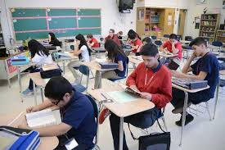
Silent reading

Slide 16
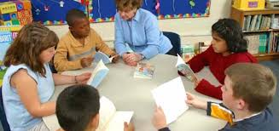
Group reading

Slide 17
Evaluation
Make sentences
London
I have not gone toLondon.
breakfast
I take my breakfast at 8 o’ clock.
supermarket
Let us go to supermarket.

Slide 18
Evaluation
Answer the questions
1. Where does Alex live?
2.What foods does he usually has?.
3. When does Alex have his breakfast?
4. Why does get mango juice at the supermarket?
5.Write about yourself ?

