Slide 1
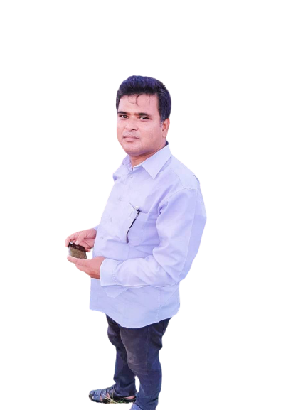
Badaghat govt. Primary School
Class: Four
Tahirpur
Sunamgonj

Slide 2
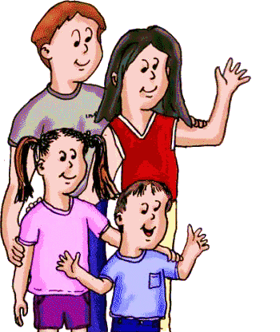
Dear students
WELCOME EVERYBODY

Slide 3
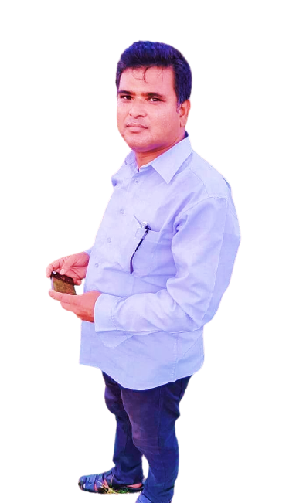
Identity
Abu Hossain Md. Asadul Islam Assistant Teacher
Badaghat govt. Primary School. Tahirpur, Sunamgonj.
Subject: English.
Class: Four.
Unit:15
Lesson: 1-2
Time: 45 Minutes.

Slide 4
What can you see in the picture?
Some family picture.
So you can guess what is out today’s topic.

Slide 5
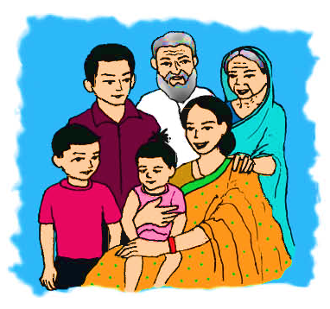
Our todays topic is
Sagar and his family

Slide 6
Learning outcomes
Bye the end of the lesson students will be able to
Listening
1.1.1Recognize sound difference in the context of word.
1.2.1Recognice which syllable in a words is student.
Speaking
1.1.1Repeat after the teacher and say words phrases and sentences with proper sounds.
6.2.1Take about people object event.
Reading
1.4.1 Read word phrases and sentences in the text.
1.7.1Read short paragraph dialogue and simple letters

Slide 7
Teacher model reading
Listen attentively

Slide 8
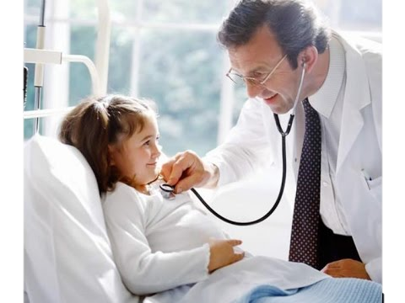
Key word
Doctor
One who treats patients.

Slide 9
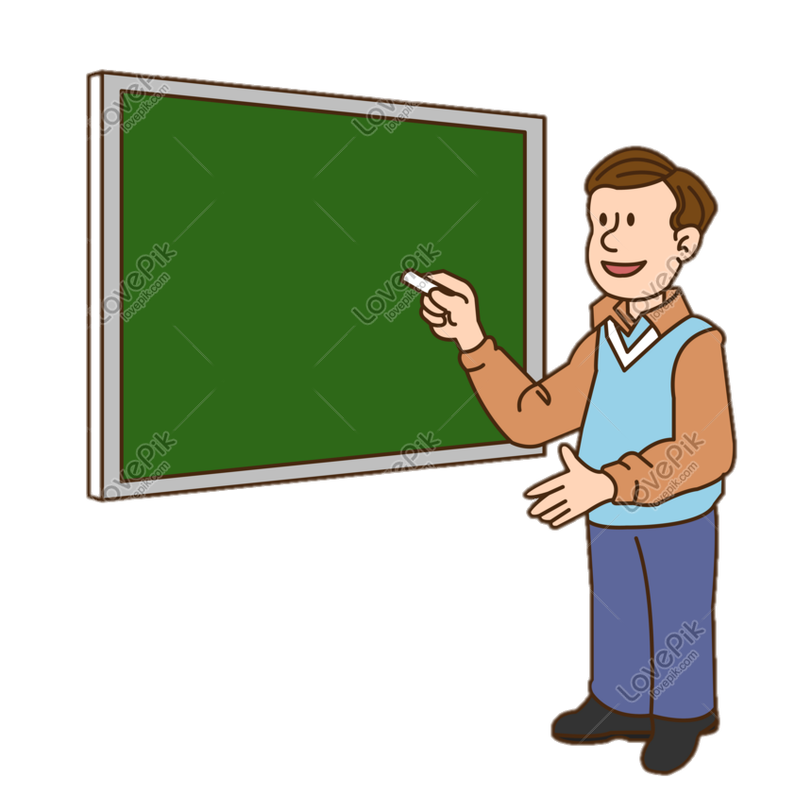
Key word
Teacher
Sagar and his family
A person whose job is teaching.

Slide 10
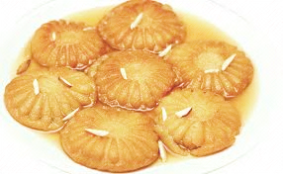
Key word
Home made cake
Pitha

Slide 11
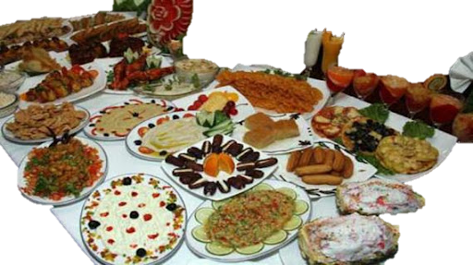
Key word
Very pleasant to eat.
Delicious

Slide 12
Invidual work
Read aloud

Slide 13
Look at the picture and read the statements
She is a Sagar little sister. Her name is Keya.
She’s only three years old.

Slide 14
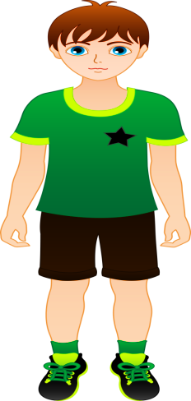
Look at the picture and read the statements
Sagar is in class 4.
He is nine years old.

Slide 15
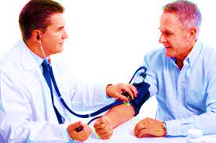
Look at the picture and read the statements
Sagar father is a doctor.

Slide 16
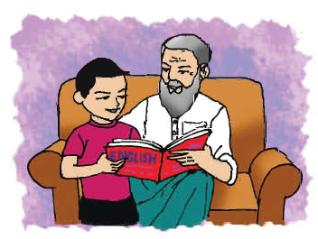
Look at the picture and read the statements
Sagar grandfather was a teacher. But he doesn’t work now. His grandfather helps him with his homework.

Slide 17
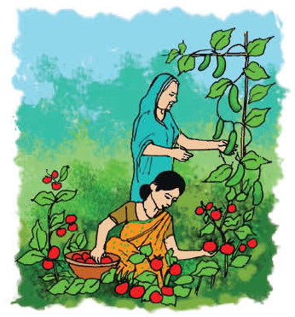
Look at the picture and read the statements
She grows the best tomatoes and cucumbers.
She has a wonderful garden.
They are delicious.
Sagar mother is a housewife.

Slide 18
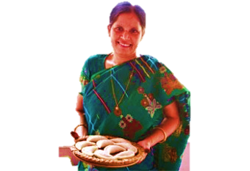
Look,listen and say
Sagar grandmother works at home. she makes the best pithas in the world. She helps his mother in the garden.

Slide 19
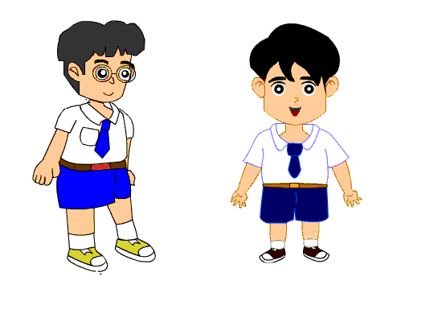
Pair work
Make conversation to each other about your mother.

Slide 20
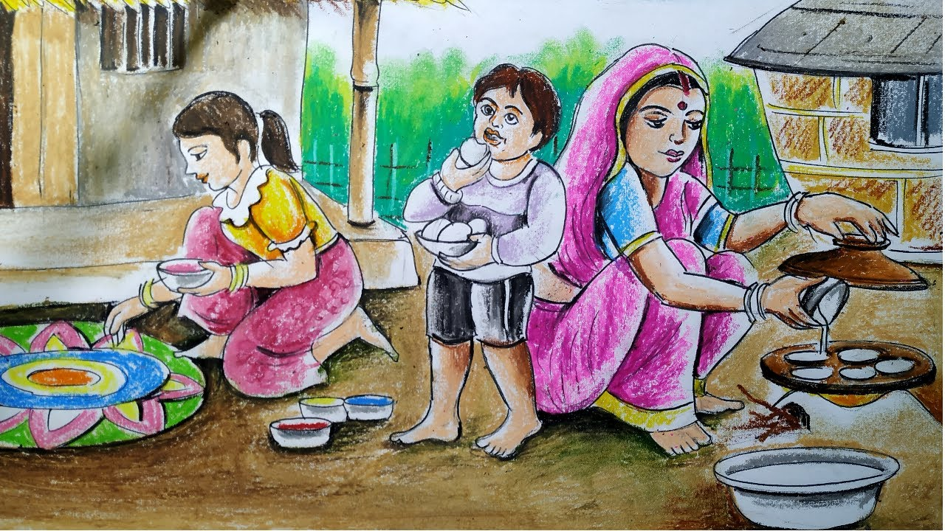
Look at the picture and tell abot it
Saikat grandmother makes the best pitha’s in the world.

Slide 21
Look at the picture and tell abot it
Saikat mother works in the garden and his grandmother help her

Slide 22
Group work
1.Who works in the garden?
2.Who makes best pitha’s in the world?
3.Who help saikat mother in the garden?

Slide 23
Evaluation
Write five sentences about Saikat family.

Slide 24
Write five sentences abot your family.

Slide 25
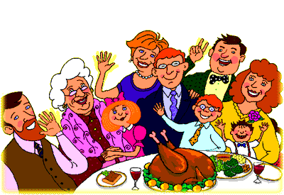
Thanks to all

