Slide 1
W
L
E
M
E
O
C

Slide 2
Teacher`s Identity
Lutfor Rahman (M,A, M-Ed)
Assistant Teacher,
SB Trainer English, Arts and Crafts and BGS.
Selected Master Trainer in English TMTE Project British Council and DPE.
ICT4E District Ambassador, Dinajpur
Kundarampur, Government Primary school School,
Ghoraghat, Dinajpur.
E-mail: mlutfor81@gmail.com

Slide 3
Dear students, think and try to say about the story.
Yes, you are correct. The story is about happy birthday. Thank you all. Today`s lesson is…
Click the play icon

Slide 4
Dear students, think and try to say about the story.
Yes, you are correct. The story is about happy birthday. Thank you all. Today`s lesson is…

Slide 5
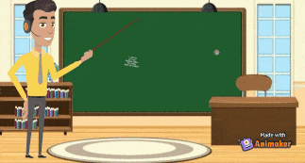
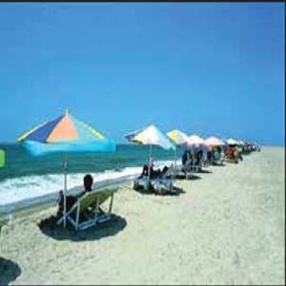
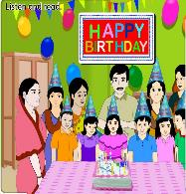

Slide 6
Learning Outcomes
Listening
3.1.1 understand question asked by the teacher about them.
Speaking
1.1.1 say words, phrases and sentences with proper sounds and stress and stress. 6.1.2 say what others and doing. 6.2.1 talk about people, objects, events etc.
Reading
1.5.1 read words, phrases and sentences in the text with proper pronunciation, stress and intonation. 1.7.1 read paragraphs, dialogues stories, letters and other texts. 5.1.1 read silently with understanding paragraph.
Writing
10.1.1 write a short piece of composition by answering a set of question answering a set of questions
3.4.1 understand statement made by the teacher and student.

Slide 7
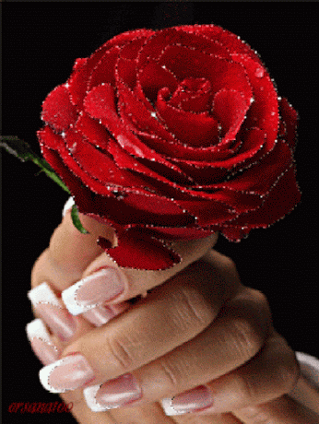
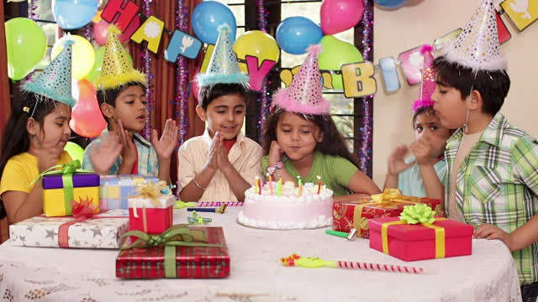
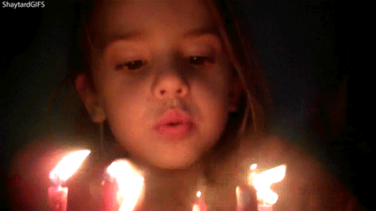
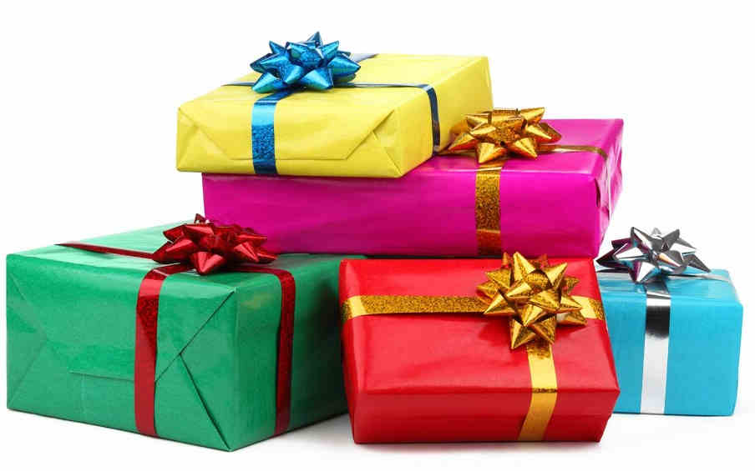
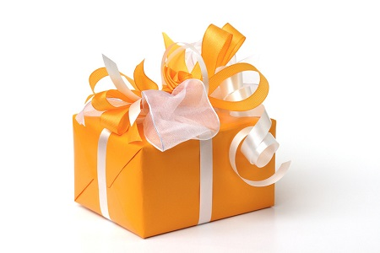
Special
A person’s birthday is a special day.
Exceptional
People around the world celebrate birthdays in different ways.
Celebrate
Observe
At the end of the song, the person blows out the candles.
Blows out
Put out
Wrap
Conceal
The gifts are wrapped in colurful paper.
Gift
Present
The gifts are wrapped in colurful paper.

Slide 8
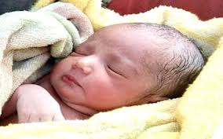
Think about the picture
Suppose, the baby`s date of birth is 10-06-2020. So, in every year the baby will celebrate his/her birthday on 10th June.
A person`s birthday is a special day.
A baby

Slide 9
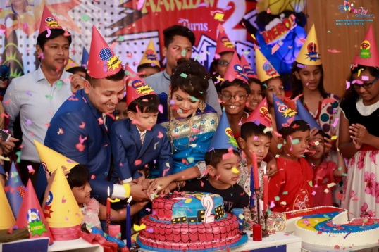
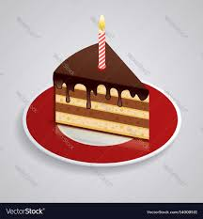
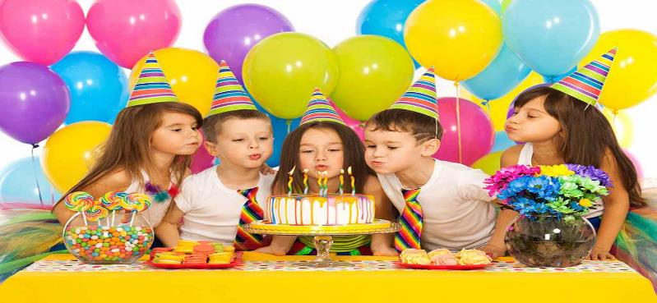
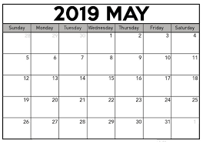
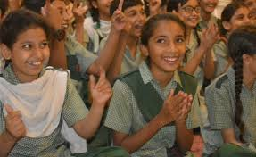
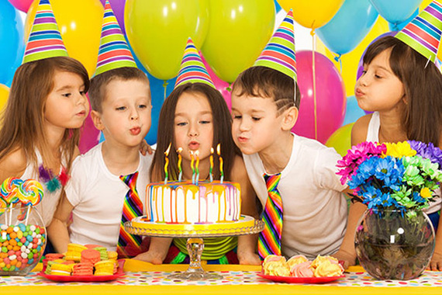
Think about the picture
In many countries, people celebrate with a cake. There are candles on a cake. There is one candle for each year of the person’s life.
People sing a song for the person. At the end of the song, the person blows out the candles .
This is the date when the person was born.
People around the world celebrate birthdays in different ways.

Slide 10
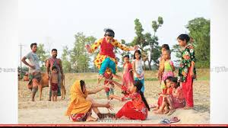
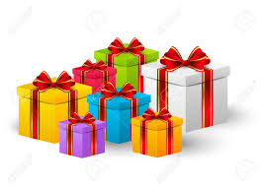
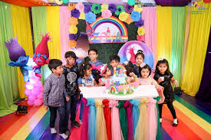
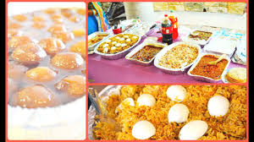
Teacher`s Reading
Think about the picture
Dear students,
open your book at page 58. Say after me.
The children play games and sing . The friends often bring a birthday gift for the child . The gifts are wrapped in colourful paper . The gift may be a toy , a book , or some clothes .
In some countries, there is often a party for a child’s birthday . The child’s friends come to the home . There is special food , like sweets .
In some countries, the friends don’t bring gifts. The most important thing is to enjoy the day and spend time with friends and family.

Slide 11
Teacher`s Reading
Dear students,
open your book at page 58. Say after me.

Slide 12
A person`s birthday is a special day. This is the date when the person was born. People around the world celebrate birthdays in different ways. In many countries, people celebrate with a cake. There are candles on a cake. There is one candle for each year of the person’s life. People sing a song for the person. At the end of the song, the person blows out the candles. In some countries, there is often a party for a child’s birthday . The child’s friends come to the home . There is special food , like sweets. The children play games and sing. The friends often bring a birthday gift for the child . The gifts are wrapped in colourful paper. The gift may be a toy , a book , or some clothes. In some countries, the friends don’t bring gifts. The most important thing is to enjoy the day and spend time with friends and family.
Click the play icon

Slide 13
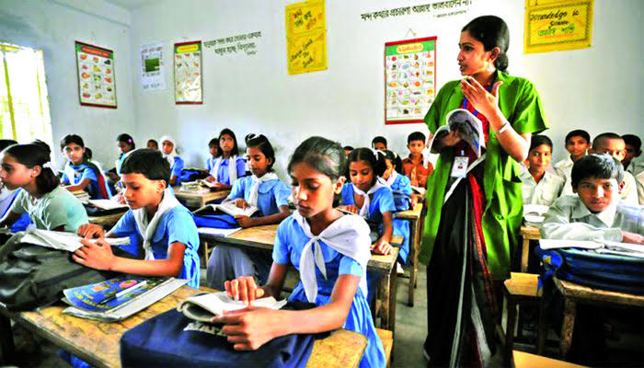
Student's Loud Reading
Student`s Silent Reading
Dear students read the text loudly.
Dear students, read the text silently.
Open your English book at page number 58 read and point out with your finger.

Slide 14
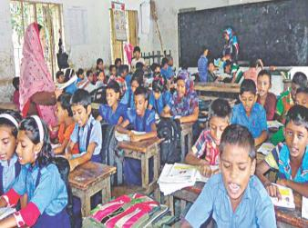
Student's Loud Reading
Dear students read the text loudly.

Slide 15
Pair Work
Write ‘True’ for correct statement or ‘False’ for incorrect statement.
People around the world celebrate birthdays in the same way.
A birthday is a special day.
People sing a birthday song for the birthday person.
The friends do not bring any gift for the birthday person.
The most important thing is to enjoy the day.
False
True
True
False
True

Slide 16
1)People --------------the world celebrate birthdays.
2)There are ------------on the cake.
3)There is one candle for---------- year of the persons birthday.
4)The children ------------games and sing song.
5)The gifts are------------- in colourful paper.
Answer the following questions by discussing in your group:
Fill in the blanks with the following words:
candles, each, around, wrapped, play, often, spend.
1. Do people around the world celebrate birthday in the same way?
2. How do people celebrate birthday in most of the country?
3. How many candles are put on the cake?
4. What do people bring to a birthday party?
candles
each
around
wrapped
play
Ans: No, people around the world celebrate birthday in the different way
Ans: Most of the country people celebrate with a cake.
Ans: There is one candle for each year of the person`s life.
Ans: People bring gift to a birthday party.

Slide 17
Fill in the blanks with the following words:
candles, each, around, wrapped, play, often, spend.
candles
each
around
wrapped
play
1)People --------------the world celebrate birthdays.
2)There are ------------on the cake.
3)There is one candle for---------- year of the persons birthday.
4)The children ------------games and sing song.
5)The gifts are------------- in colourful paper.

Slide 18
Column A | Column B
a) Enjoy | 1. The feeling of great happiness.
b) Joy | 2. Personal affairs.
c) End | 3. The land occupied a nations.
d) Celebrate | 4. To get pleasure from something.
e) Country | 5. A short piece of music.
 | 6. The last part of something.
 | 7. To do something special on an event or occasion.
Write a short composition in 5 sentences about “Your birthday” by answering the following questions.
Match the words in column A with their meanings in column B
1.What is a birthday?
2.Who arranged the party?
3.How do you celebrate this day?
4.Who attend the party?
5.What is your feeling about your birthday?

Slide 19
Match the words in column A with their meanings in column B
Column A | Column B
a) Enjoy | 1. The feeling of great happiness.
b) Joy | 2. Personal affairs.
c) End | 3. The land occupied a nations.
d) Celebrate | 4. To get pleasure from something.
e) Country | 5. A short piece of music.
 | 6. The last part of something.
 | 7. To do something special on an event or occasion.

