Slide 1
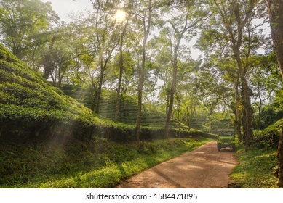
Welcome

Slide 2
Nahidal Arjin
Class:Five
Subject:English
Title: It was a Great day.
Unit: 21
Lesson: The next….
Time:45 minutes
Date:01/11/2021
Assistant Teacher
Boddipur Govt. Primary School
Satkhira Sadar, Satkhira

Slide 3
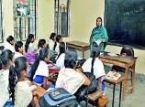
Good morning, students.
Good morning, Teacher.
How are you students?
Fine, thank you teacher.

Slide 4
Let’s watch a video
Click the video below:
What do you see in the video?

Slide 5
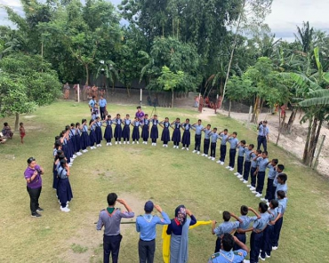
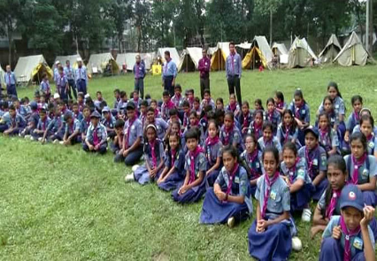
Look at the picture and say about it.
What is cub scouts?
The cub scouts, is a voluntary non-political educational movement for young people.

Slide 6
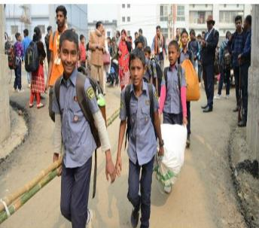
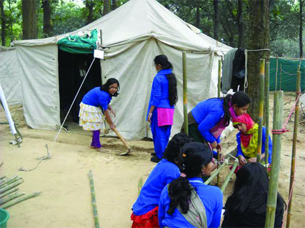
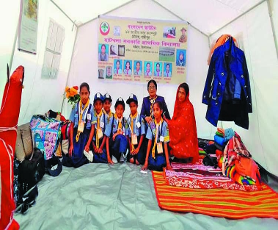
Look at the picture and say about it.
What are your feelings about Cub Camporee?
Campuri is the largest gathering of Cub Scouts. Cub scouts learn by playing in these gathering

Slide 7
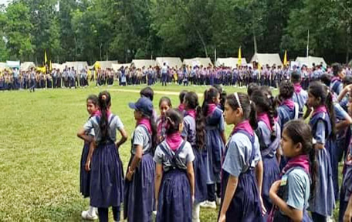
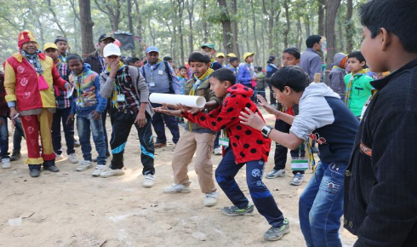
Look at the picture and say about it.
How was your experience regarding camporee?
By participating in these competitive activities, a Cub Scout will be able to gain an idea of the skills and abilities that are hidden inside him and at the same time he will be able to gain knowledge by playing tricks. Will move forward in the larger range of life

Slide 8
Lesson Declaration
It was a great day !

Slide 9
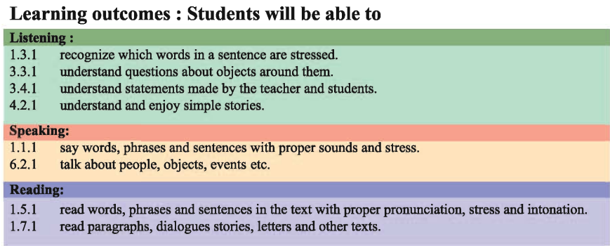
Learning Outcomes

Slide 10
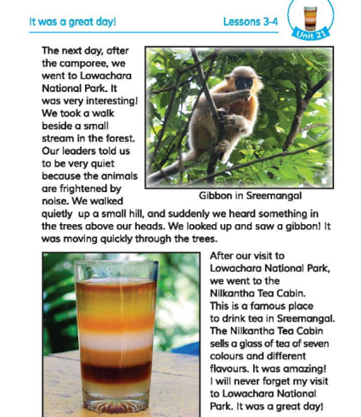
Open page at 83

Slide 11
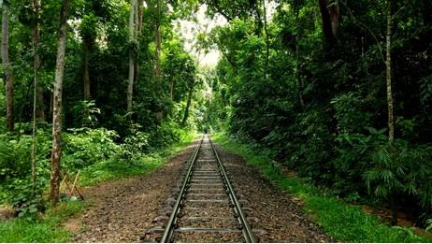
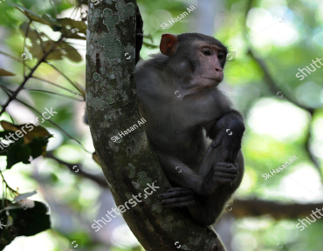
Look at the picture and say about it.
We went to the Nawachara national park. It was very interesting.

Slide 12
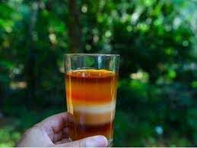
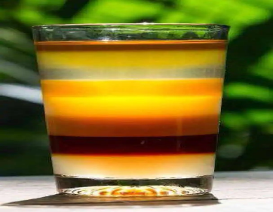
Look at the picture and say about it.
What is it?
Tea in seven colours
The nilkhanta Tea cabin sells a glass of tea of different colours and flavours.

Slide 13
Teacher’s reading

Slide 14
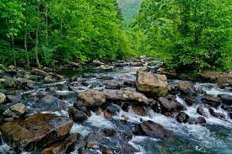
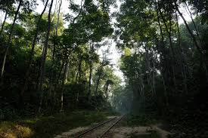
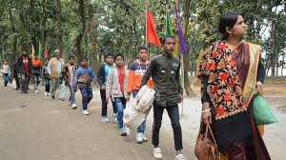
NEW WORD
Stream
River
Woodland
Forest
Leader
Head

Slide 15
Pair Work
Read the Text
Open your book page at 83

Slide 16
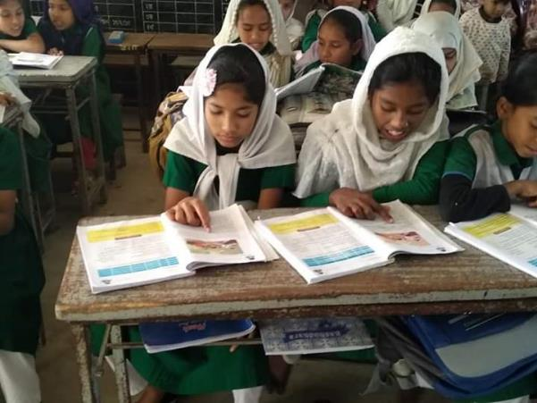
Silent reading

Slide 17
Individual work
Fill in the blank with correct word
quitely
national park
interesting
1. We went to Lawachara ………….
We walked ………..
It was very…………… .

Slide 18
Group Work
1. What did the team members do afterbreakfast?
2. How did the team go to Sreemangal?
3. What did they do in the evening?

Slide 19
Evaluation
Answer the following question.
1) Why was the next day interesting?
2) What is the Nilkontho Tea Cabin ?
3) What is the passage about ?
4) How does the tea garden look ?
5) What was the next day ?

Slide 20
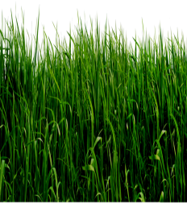
Home Work
Write a short composition on “Lawachara national park” in at least five sentences.

Slide 21
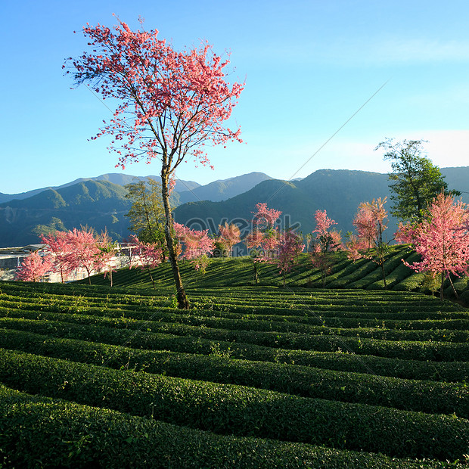
Thank you to all

