Slide 1
w
e
l
l
c
o
m
e
t
o
l
e
v
e
r
y
b
o
d
y

Slide 2
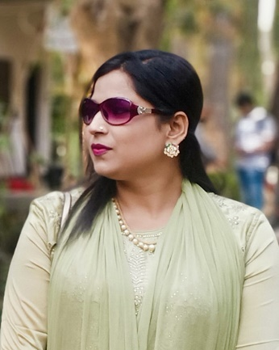
Introduction
Class: Four
Sub: English
Lesson: Sagar’s week
Activity: A
Page: 32
Time: 45 minute
Nasima Akter
Assistant Teacher
Chatiachala Gov:
Primary school.
Sakhipur, Tangail.

Slide 3
Students will be able to:
Listening
1.1.1- recognize sound differences in the context of word.
3.2.1- understand questions about family and friends of students.
Speaking
Learning outcomes:
1.1.1- repeat after the teacher and say words, phrases and sentences with proper sounds, stress and intonation.
Reading:
1.5.1- read words, phrases and sentences in the text with proper pronunciation, stress and intonation.

Slide 4
One day one word
often
English meaning is
Every now and then
Bengali meaning is
প্রায়ই
Antonym word is
Rarly
Similar word is
Mostly
Sentence
He oftens come to me

Slide 5
What can we see in this video
Let’s see a video

Slide 6
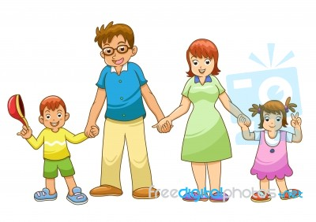
Let’s see some picture
What can you see
in these picture?
These picture are
Family’s picture.

Slide 7
Today’s lesson:
Sagar and his family
Part of the lesson:
Activity- A

Slide 8
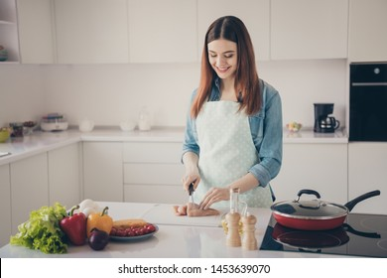
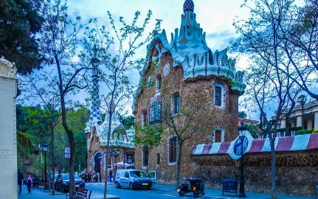
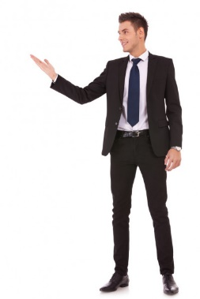
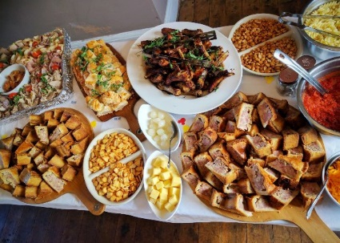
Let’s know the meaning of some new words
House wife
গৃহিণী
চমৎকার
wonderful
Smart
সুদর্শন
Delicious
সুস্বাদু
World
পৃথিবী

Slide 9
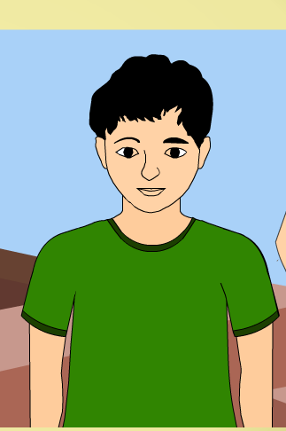
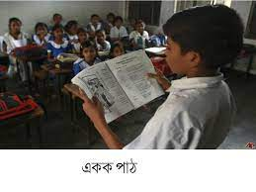
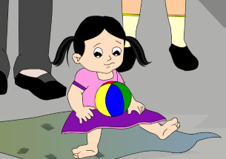
Let’s see some picture and know about this
I’m Sagar. I’m in class 4.I’m nine years old. I have a little
Sister.Her name is keya.She’s only three years old.

Slide 10
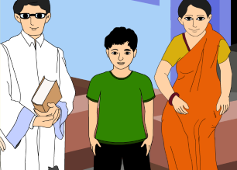
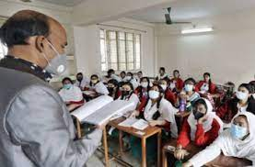
Let’s see some picture and know about this
My father is adoctor and my mother is ahousewife.My
grandfather was a school teacher, but he doesn’t work now.
My grandfather helps me with my homework.He is very smart.

Slide 11
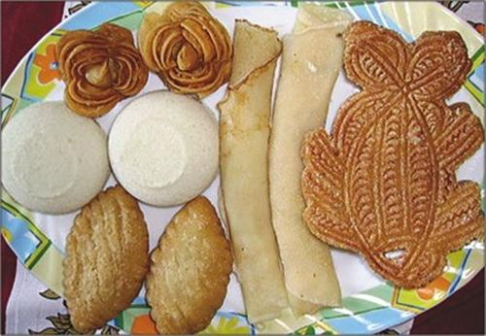
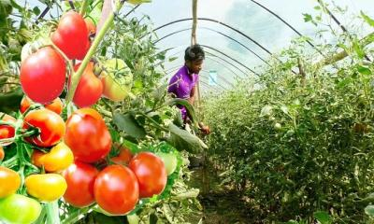
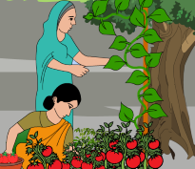
Let’s see some picture and know about this
My grandmother works at home.She makes the best ‘pithas’
In the world.She helps my mother in the garden.My mother
Has a wonderful garden.

Slide 12
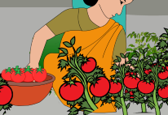
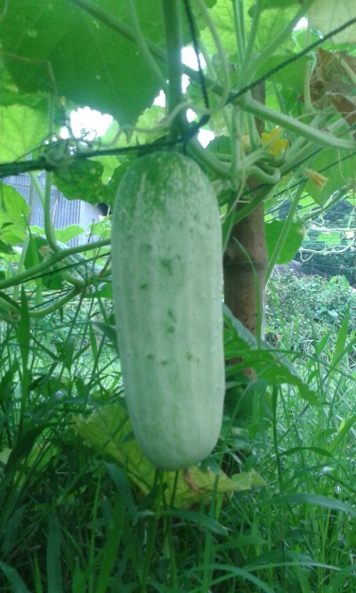
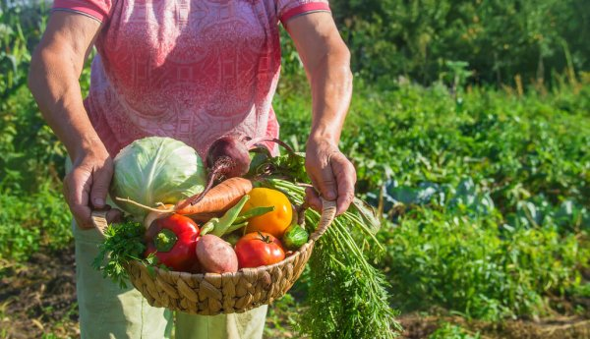
Let’s see some picture and know about this
I am very proud of it.She grows the best tomatoes and
Cucumbers in the neighbourhood.They are delicious.

Slide 13
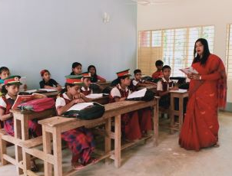
Teacher’s reading
I will read the text, the
students will listen very
attentively and will follow
each line with their finger.

Slide 14
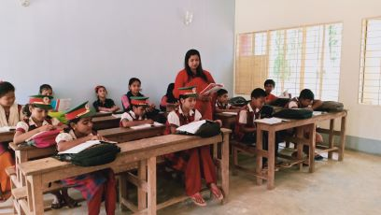
Students readings
I will read the text loudly
and the students will
read with after me

Slide 15
Pair work
I will ask them to
make pair and to
read the text with each other

Slide 16
Individual work
I will ask to come some students one by one
Infront of class. And I will ask to read the text them.They will read and other students will
follow with Their finger.

Slide 17
Discussion question and answer from the text
a) How old is Sagar?
Ans: nine years old.
b) What does his father do?
Ans: His father is a doctor.
c) Who is Keya?
Ans: Keya is his sister.
d) Who helps his mother in the garden?
Ans: His grandmother.
e) What does his mother do?
Ans: His mother is a housewife .

Slide 18
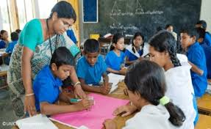
Group work
Sentence making game
I will make a group of each five.And I will give one word card
to each group.Every one will make a sentence of group with
help each other. I will monitoring every group and those who
Weak I will help them. That group will can finish first,
They will win.

Slide 19
Assessment
a) How old is Sagar?
b) What does his father do?
c) Who is Keya?
d) Who helps his mother in the garden?
e) What does his mother do?

Slide 20
Home work
Students will write a short
paragraph about their family.
Thank you

