Slide 1


Slide 2
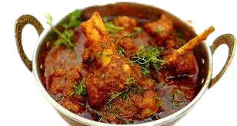
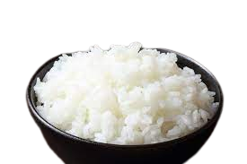
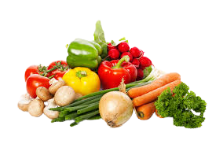


Slide 3



Md.Abdur Razzak
Assistant Teacher (English)
Shatgram Akota High School
Baniachang,Habigang
District Ambassader,Habigang
Class:Eight
Subject: English For Today
Unit:Three
Lesson:Eight
Email:marazzak55555@gmail.com
Mobile Number:01731181479

Slide 4

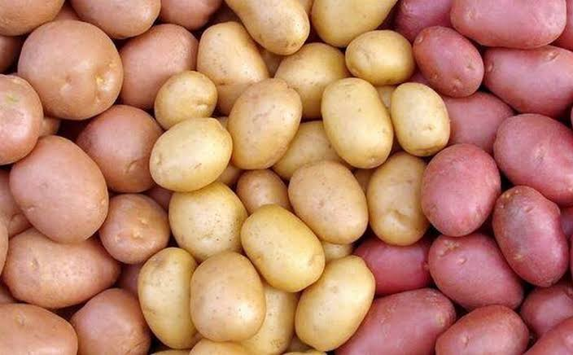
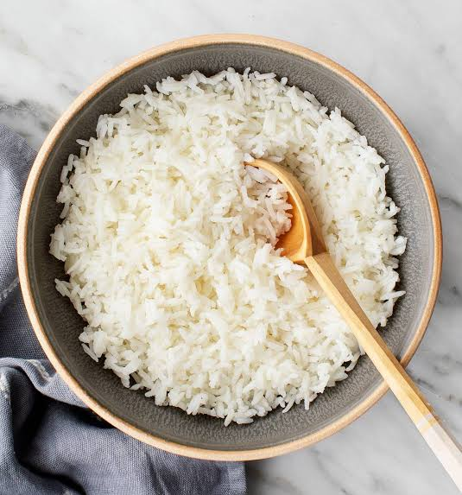
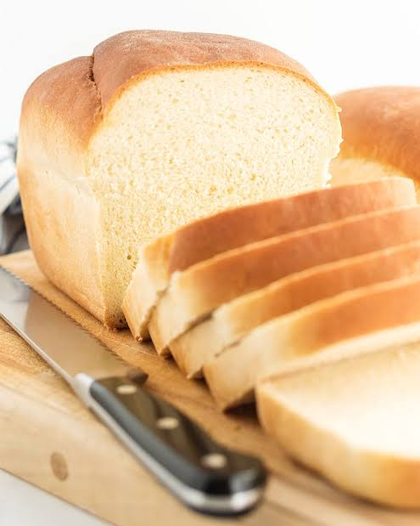
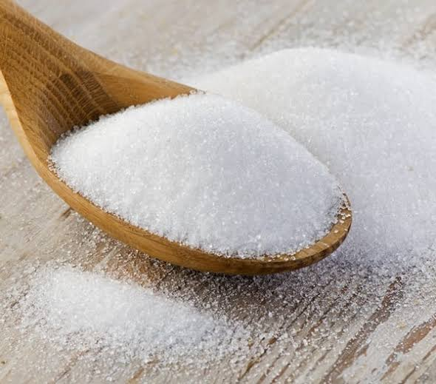
?
Carbohydrate
potato
rice
sugar
bread

Slide 5

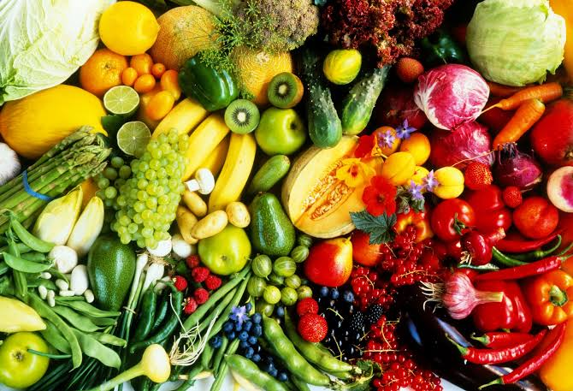
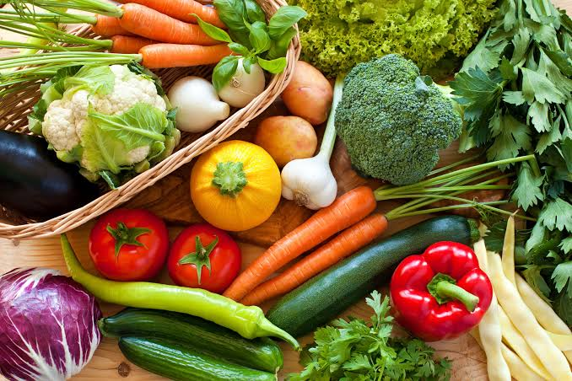
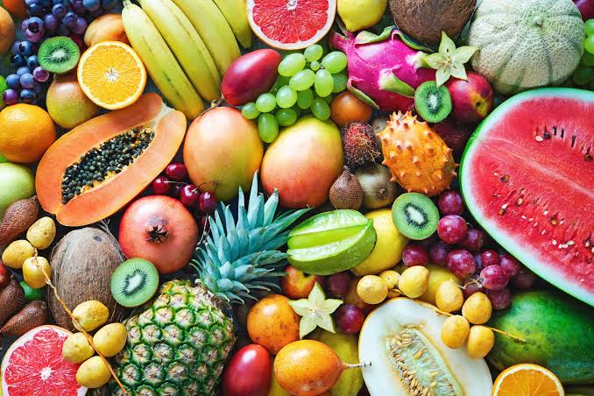
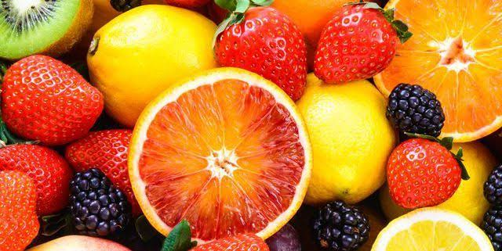
?
Vitamins and minerals
Vegetables
Vegetables
fruits
fruits

Slide 6

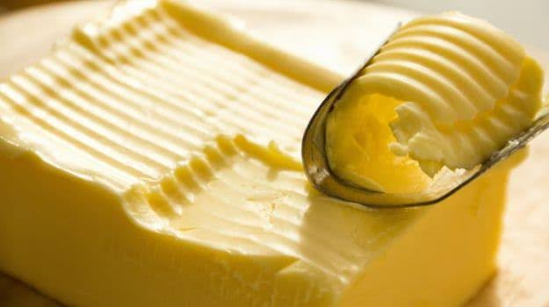
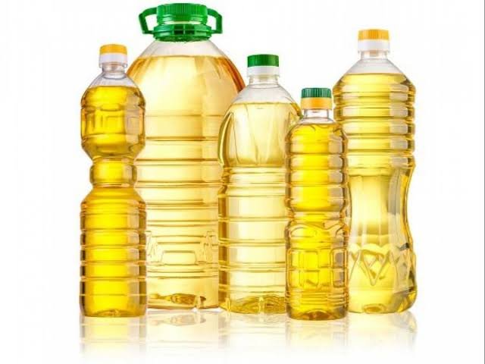

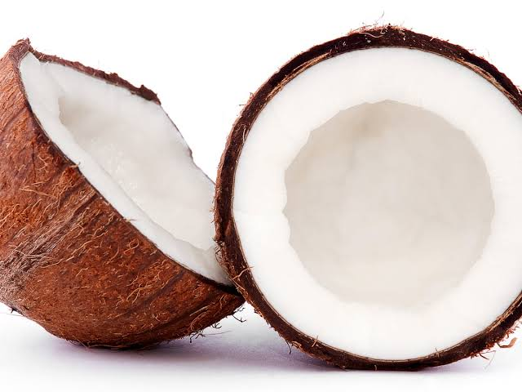
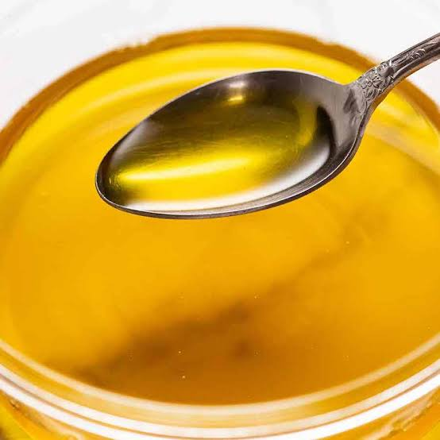
Fat
butter
oil
Cocunut
butter

Slide 7
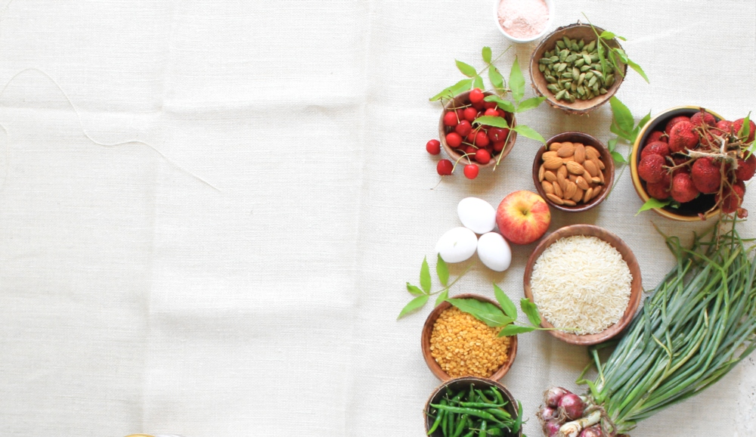
What can be today’s topic-

Slide 8
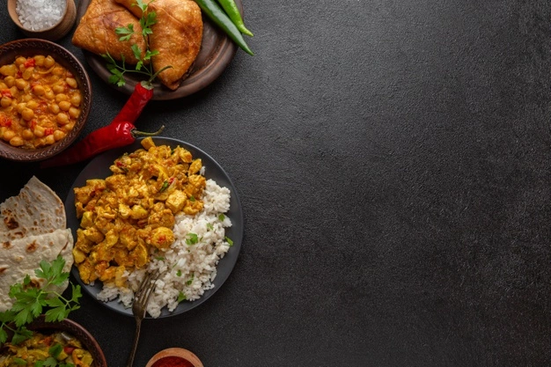
So, our today’s topic is-
Kinds of Food

Slide 9
Learning outcome
By the end of the lesson the students will be able to-
listen to the audio
choose the best answer.
write the answer of the questions.
write a paragraph

Slide 10
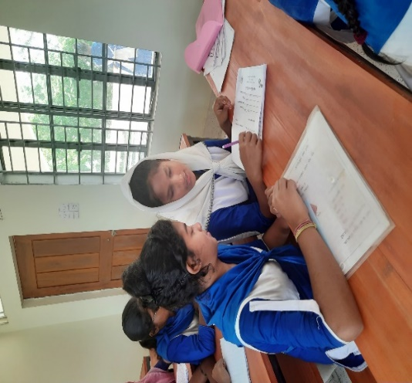
A.Listen to the audio and choose the best answer from the following objectives.
1. Foods are divided into classes according to their-
Pair Work
a) colours and tastes.
b) shapes and sizes
c) substances they contain
d) water they contain.
2. Potatoes contain a lot of-
b) protein
a) carbohydrate
c) vitamins
d) minerals
3. Butter and ghee are a good source of-
a) protein
b) fat
c) vitamins
d) carbohydrate
4. Minerals are present in-
5
00
2
3
6
4
a) nuts
8
1
b)peas
7
c)milk
d)water
5. Which food has the most carbohydrate?
a) sugar
b) rice
c) fruits
Time:Seven minutes
d) vegetables

Slide 11

A.Listen to the audio and answer the following questions in group.
1. How many kinds of food do we need?
2. What are they?
3. Which food contains carbohydrate?
4. What is the benefit of minerals?
5
9
00
10
2
3
6
4
8
1
7
5. What is the function of protein?

Slide 12

We need six kinds of food.
2. They are carbohydrate, protein, vitamins, minerals, fat and water.
3. We get carbohydrate from rice, bread, potato and sugar.
4. Minerals help our body grow, develop, and stay healthy. It is good for our bones.
5. Hair and nails are mostly made of protein.Our body uses protein to build and repair tissues.

Slide 13
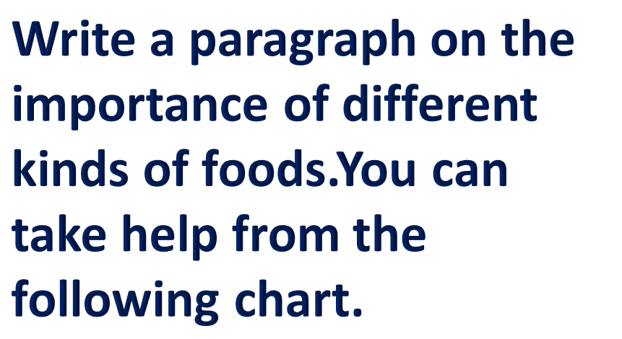
Importance
Of
Foods
Carbohydrate
Protein
minerales
Vitamines
fat
water
5
9
00
2
3
12
11
13
6
4
8
1
10
7

Slide 14


Write a paragraph on the importance of different kinds of food.

Slide 15


