Slide 2
Welcome to my dear student
How are you?

Slide 3
I
D
E
N
T
I
T
Y
Subject: English
Class: Three
Unit: 23
Lesson: What do they do?
Lesson Title: A
Time: 40 Minutes
Date: 01-11-2021
China Khatoon
Assistant teacher
Hatmurshon G.P.S
Singra, Natore.

Slide 4
Learning outcomes:
At the end of the class Students will be able to…
1.1.1 repeat words, phrases and sentences after the teacher with proper sounds and stress.
1.1.2 say words, phrases and sentences with proper sounds and stress.

Slide 5
Warm up Activity
Dear students, do you want to listen to “Hello…hello” song? Let’s Sing the song.
https://youtu.be/tVlcKp3bWH8

Slide 6
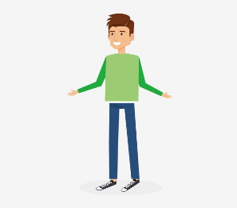
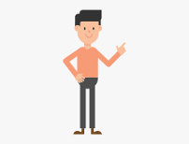
Checking Previous Knowledge
short
tall
Who is tall?
Who is short?
Tall opposite word short .

Slide 7
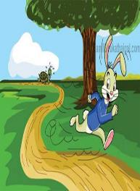
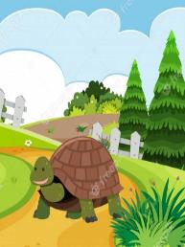
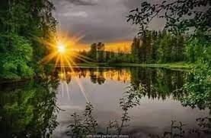
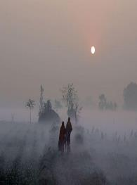
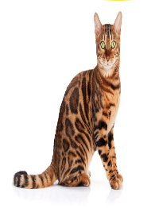
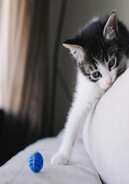
Let’s See the pictures
What can you see in the picture?
Can you say what is our today’s lesson?

Slide 8
Today’s lesson
What do they do?
Lesson: A

Slide 9
New Word
New word
quick
lazy
early
slow
active
Dirty

Slide 10
New Word
quick
slow
early

Slide 11
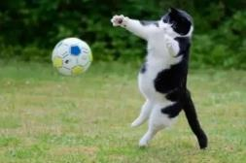
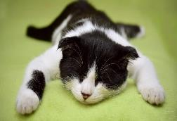
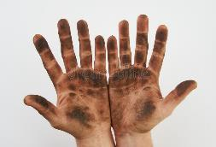
New Word
active
lazy
dirty

Slide 12
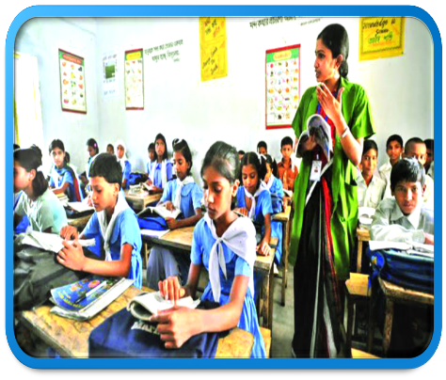
Teacher’s loud reading
Students open your EFT book at page 46 and follow the sentences by your finger.

Slide 13
Read aloud

Slide 14
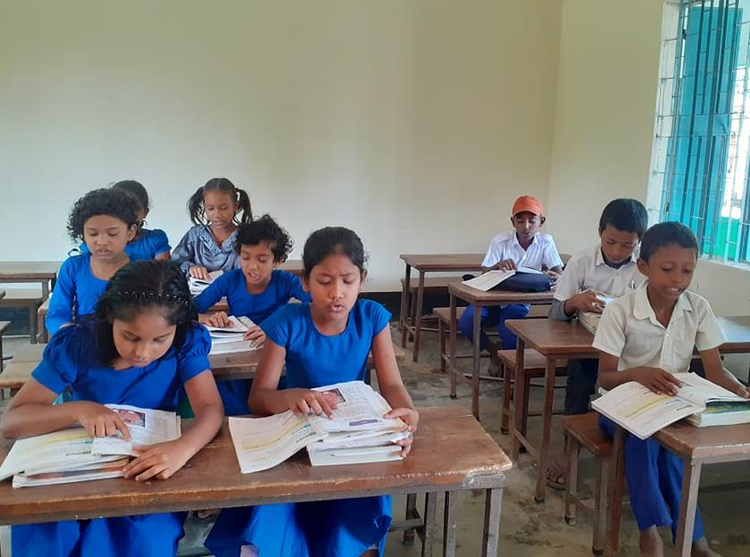
Student’s loud reading

Slide 15
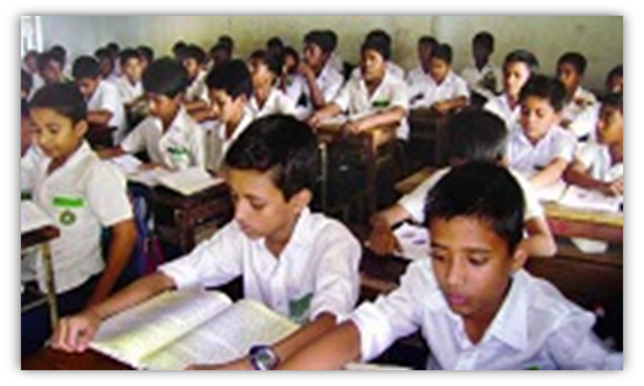
Students read Silently

Slide 16
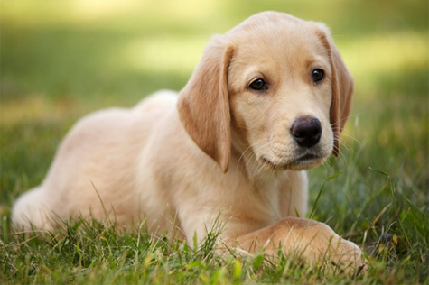
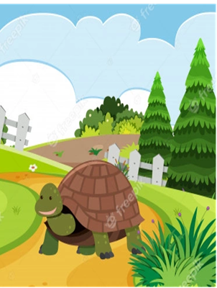
Individual Work
Say the name of the picture?
Dog
Tortoise

Slide 17
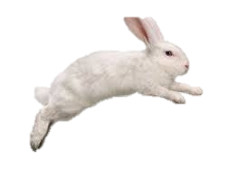
Let’s see some picture and read
quick
slow

Slide 18
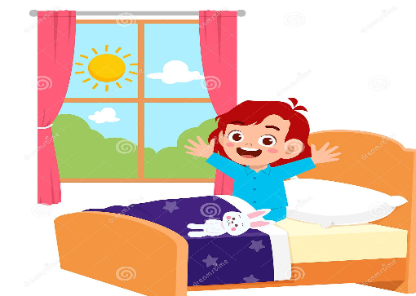
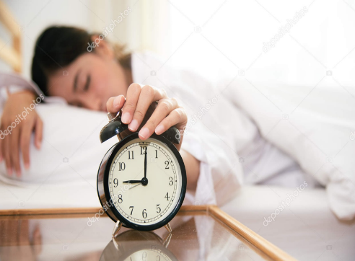
Let’s see some picture and read
early
late

Slide 19
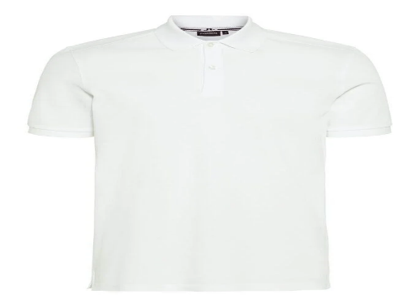
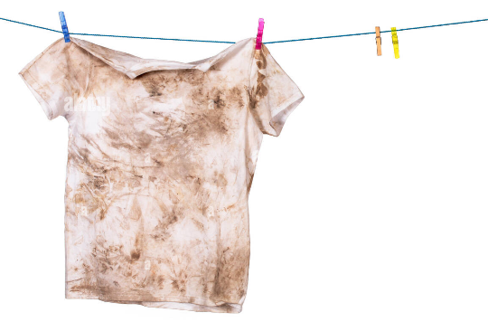
Let’s see some picture and read
clean
dirty

Slide 20
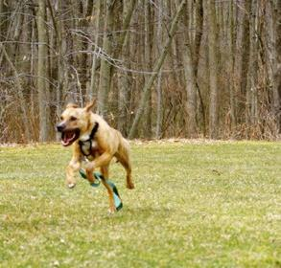
Let’s see some picture and read
active
lazy

Slide 21
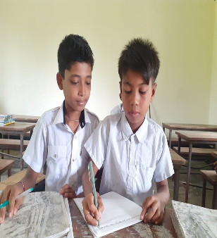
Pair Work
quick
slow
late
early
dirty
clean
active
lazy
Students will practice the opposite words in pairs and will try to make sentences.

Slide 22
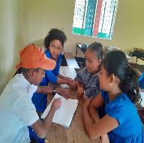
Group Work
Group-A
Match the word column A with column B
Column A | Column B
quick | lazy
early | slow
clean | late
active | dirty

Slide 23
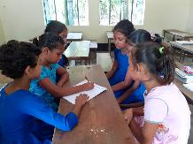
Say True or False
Group-B
The tortoise run in slow.
True
2. The dog active all day.
False
3. The hare run in quick.
True

Slide 24
Evaluation
Fill in the gaps with the word.
quick
lazy
early
clean
The sun …………… in the morning.
The shirt is ………….
The hare run in………….
The dog is ………….

Slide 25
Today we have learnt about some opposite word’s

Slide 26
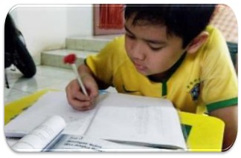
Home Work
Make sentence with below the word.
Late, active, slow, dirty.

Slide 27
Good bye
Good bye
It’s time to go away
Good bye
Good bye
I wish you a good day.

Slide 28
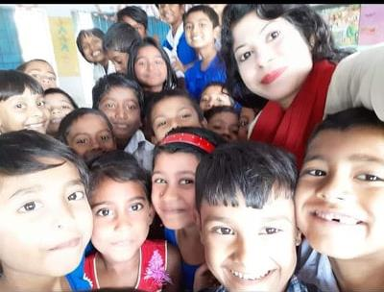
Thanks

