Slide 1
Welcome to English class

Slide 2
Presented by-
Mottalib Hossain
Assistant Teacher (English)
Shambhudia M.LHigh School.
Mobile: 01723-457771
Email: m.mottalib95@gmail.com

Slide 3
Class : Eight/Nine/Ten
Subject: English 2nd paper (Grammar part)
(Transformation of Sentence)
( Assertive to Interrogative)

Slide 4
Notice these sentences…
He reads book.
Doesn’t he read book?
She is writing.
Isn’t she writing?
Do you find any change between first two and last two sentences............?
Yes
NO

Slide 5
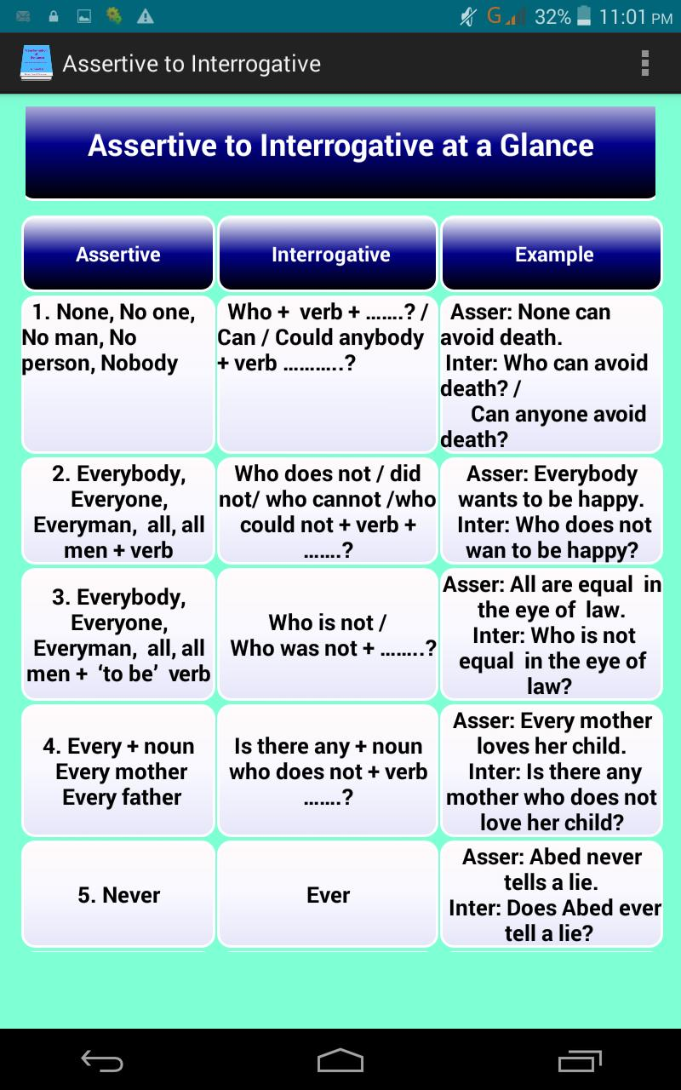
Today’s Topic

Slide 6
Learning Outcomes:
After the lesson, learners will be able to ---
Use the rules of transformation of sentences (assertive to Interrogative)
use interrogative sentence in different situation.
transform sentences (assertive to Negative)

Slide 7
Definition
Transformation is a process of changing a sentence without changing its real meaning.
Example:
Assertive : Arman is a good student.
Interrogative: Isn’t Arman a good student?
Both sentences are the same with semantic side.

Slide 8
The rules of transformation of sentence
Assertive to Interrogative :
Rule-1: If the sentence is affirmative, the interrogative will be negative-interrogative
Be verb+not + Sub + rest of sentence+?
Example:
Assertive: He was born in Hoogly.
Interrogative: Wasn’t he born in Hoogly?

Slide 9
Rule-2:
If the sentence is negative, the interrogative will be affirmative-interrogative-
Be verb + sub + rest of sentence +?
Example :
Assertive: He is not a good person.
Interrogative: Is he a good person?

Slide 10
Rule-3-1:
If there is no auxiliary verb, and the verb is present form, the interrogative will be---
Do/don’t + sub + verb + rest of---- + ?
Example :
Assertive: They go to school. Interrogative: Don’t they go to school?
Assertive: They do not go to school.
Interrogative: Do they go to school?

Slide 11
Rule-: 3-2
If there is no auxiliary verb, and the verb is past form, the interrogative will be-
Did/didn’t+ sub + verb-1 + rest of---- +?
Example:
Assertive: He lived with his family.
Interrogative: Didn’t he live with his family?

Slide 12
Rule-: 3-3
If the verb has s, es, the interrogative will begin with Does / Doesn’t. Then ‍s, es rises end of the verb.
Example :
Assertive: Ali goes to school.
Interrogative : Doesn’t Ali go to school?
Assertive: He does not write a letter.
Interrogative : Does he write a letter?

Slide 13
Individual work
Transform the following sentences into Interrogative
1. He is in the school
2. He can save the money.
3. He likes ice-cream.
4. He went to school.
5. He did not play Piano.
6. He was not in the market.
7. They do not complete the task.
8. Shuli can not operate a mobile.

Slide 14
Rule-4:
If the sentence is formed with never/ nothing. The interrogative will be--
Aux.verb + Sub+ ever/anything + verb +-----+?
Example:
Assertive: I never drink tea. Interrogative: Do I ever drink tea?
Assertive : I had nothing to do. Interrogative : Had I anything to do?

Slide 15
Rule-5:
Everybody/everyone/All--replaced with Who
Who + Don’t/ Doesn’t/ Didn’t(according to subject and tense) +verb-1+rest of ---- + ?
Example:
Assertive: Everybody wishes to be happy. Interrogative: Who doesn’t wish to be happy?

Slide 16
Individual work
Transform the following sentences into Interrogative
1. Everybody wants to be win.
2. All hates a liar.
3. I never do that work.
4. Everyone knows his birth place.
5. I shall never forget you.
6. Everybody respect a truthful person.

Slide 17
Rule-6:
Every + noun → Replaced by→ Is there any
+ noun
Is there any + noun+ Who don’t/doesn’t/ didn’t(according to subject and tense) +verb-1+---- ---- + ?
Example:
Assertive: Every man wishes to be happy. Int: Is there any man who doesn’t wish to be happy?

Slide 18
Rule-7:
Nobody/ No one / None/Noman → Replaced by → Who.
Who + can/could+verb-1+------ + ?
Example:
Assertive: No one can beat him.
Interrogative: : Who can beat him?

Slide 19
Rule-8:
There is no/ nothing but → Replaced by→
What (thing) /Who (person).
What/Who + verb+------ + ?
Example:
Assertive: There is no use of this law.
Int: What is the use of this law?
Assertive : There is no man happier than Jamil.
Int: Who is happier than jamil?

Slide 20
Rule-9:
Nowhere→ Replaced by→ Anywhere
Aux.verb+sub+verb-1+ -------+ ‍anywhere+ ------------?
Example:
Assertive: You will find this book nowhere in the shop.
Interrogative: Will you find this book anywhere in the shop?

Slide 21
Individual work
Transform the following sentences into Interrogative
1. Every citizen loves his country.
2. Nobody trust a liar.
3. None likes to forget his homeland.
4. None can prosper in life without industry.
5. Every child respects his superior.

Slide 22
Home work
Transform the following sentences into Interrogative
1. Bangladeshi cuisine is full of variety.
2. He does not put any work for tomorrow
3. He eats rice.
4. Suddenly I noticed a very nice deer.
5. I never been to Cox’s Bazar.
6. There is no bench in the room.
7. Everybody likes flower.
8. Nobody trusts a liar.
9. Nowhere You will find such an honest man.

