Slide 1
WELCOME
Notes:
Teacher can greet by any other processes.

Slide 2
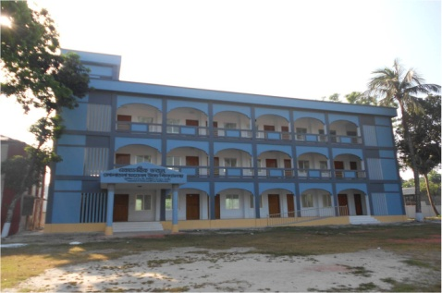
Introduction
Uday Krishna Das
Senior Teacher (English)
Patkelghata High School
Satkhira
ENGLISH FOR TODAY
CLASS : Nine & Ten
UNIT - 4
Lesson : 1
Notes:
Teacher can hide this slide.

Slide 3
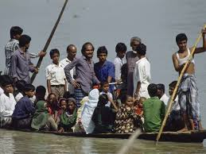
What about the picture?
Discuss with your partner then answer the following questions.
Where can you fine this kind of boat ?
Why does the boatman carry passengers across a river ?
Why do people use country boats ?
Notes:
This slide only for mind set up. Teacher can ask another questions for grow class arrange.

Slide 4
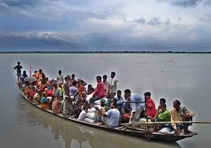
So today we’ll discuss about
The ferry boat

Slide 5
Learning outcomes
After completing this lesson, students will be able to-
ask and tell about problems.
seek and give suggestions.
listen for specific information.
narrate something in writing.

Slide 6
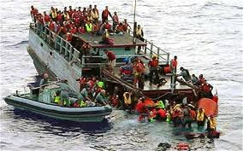
Let’ watch a video clip
What were the causes of this accident? And say how we can avoid it?
Notes:
Showing the video teacher can ask question to the whole class. SS will raise their hands. Teacher can ask 5/6 students to narrate the video.

Slide 7
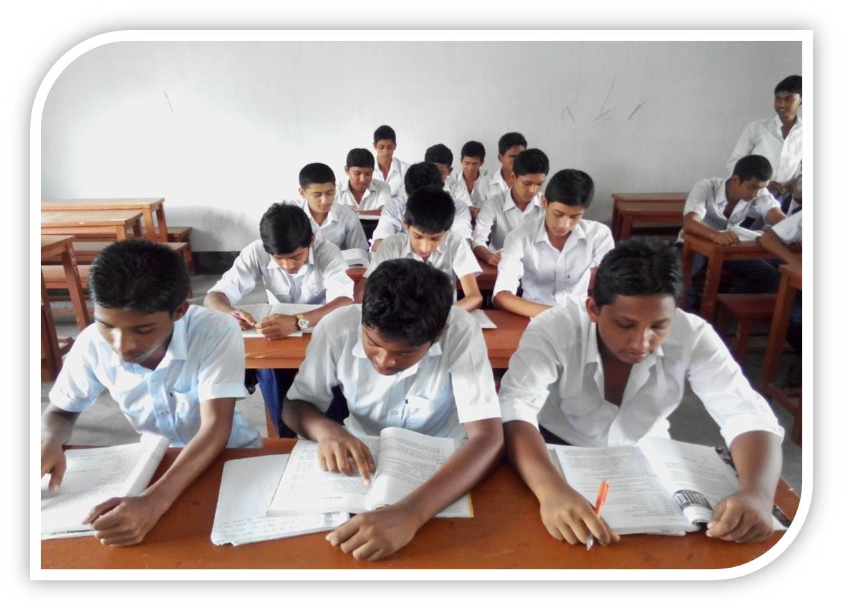
Individual Work
Read the text silently to answer the multiple choices
Notes:
Teacher will monitor the class and can help them.

Slide 8
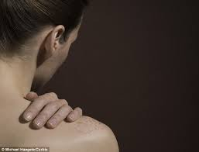
Shoulder
Key word
Can you make a sentence with the word “shoulder”.
Often country people carry their bags on shoulder.
Meaning
(Click here)
A organ of human body
Notes:
At first teacher will show the words then ask his/her students to tell the meaning and making sentences. If they fail teacher will show the picture again. For feedback click on meaning button.

Slide 9
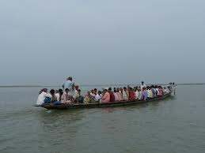
Cross the river
Key word
They are crossing the river by boat.
Can you make a sentence with the word “cross the river”.
Meaning
(Click here)
To go another side of a river.
Notes:
At first teacher will show the words then ask his/her students to tell the meaning and making sentences. If they fail teacher will show the picture again. For feedback click on meaning button.

Slide 10
Ferry boat
Key word
Can you make a sentence with the word “ferry boat”.
After shopping they are returning home by a ferry boat.
A kind of boat by that`s people cross the river to paying fare.
Meaning
(Click here)
Notes:
At first teacher will show the words then ask his/her students to tell the meaning and making sentences. If they fail teacher will show the picture again. For feedback click on meaning button.

Slide 11
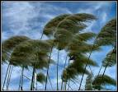
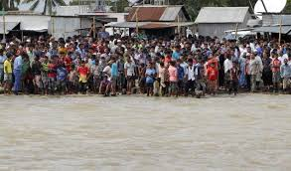
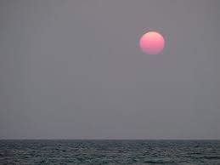
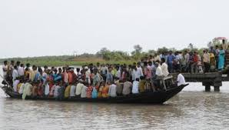
Individual/Pair works.
Look at the pictures and guess why do many people have little or no patience in situations as in the ferry boat?
Notes:
Students will see the pictures, they can discusses it with their partner and will write minimum five sentences, teacher also can help them if necessary.

Slide 12
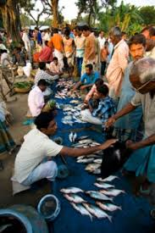
Individual Work
Guess if we have too many buyers of fish in the market, what is likely to happen?
Notes:
Teacher cam make easy specially for the girl students.

Slide 13
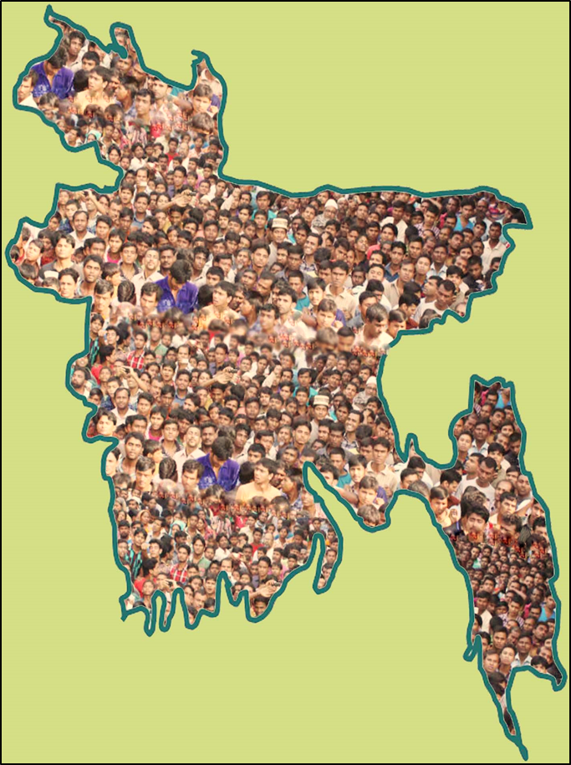
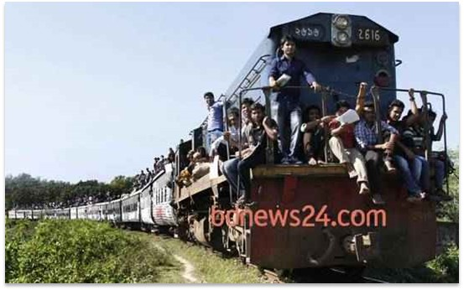
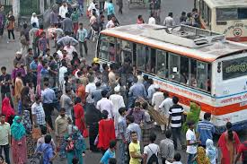
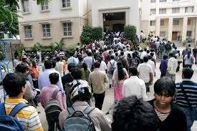
Population problems?
Look at the above pictures and guess if we have too many people in a town, bus and train then what will happen?
Notes:
Teacher can discusses about our population problems.

Slide 14
HOME WORK
Write a paragraph with in ten sentences about The ferry accident.
Notes:
Teacher can give some instructions to do the home work.

Slide 15
The end
Notes:
Teacher can use any other language.

