Slide 1
Welcome to our
Todays class

Slide 2
Introduction
Md. Azizur Rahman
Assistant Teacher
Kandigoan Govt. Primary School
Kamalgonj , Moulvibazar
English For Today
Class : Five
Subject : English
Unit : 13
Lesson : 01

Slide 3
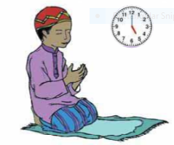
What do you see in the pictures ?
This is a picture of a clock and someone is praying

Slide 4
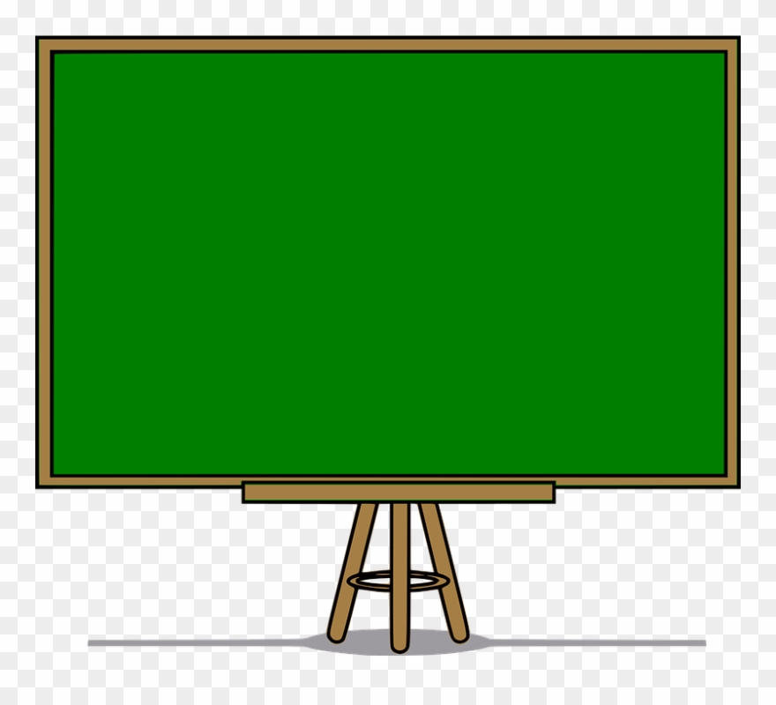
Lesson declaration
‘ Teling the time ’
Unit: 13 , Lesson: 01
Page: 50

Slide 5
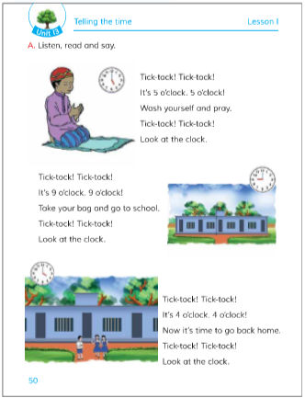
Page no 50

Slide 6
Learning Outcome
Students will be able to -
Listening:
3.4.1 understand statement made by the teacher and students .
Speaking:
1.1.1 say words, phrases and sentences with proper sounds and stress.
Reading:
1.5.1 read words, phrases and sentences in the text with proper pronunciation, stress and intonation .

Slide 7
Let`s know some new words
Wash
Pray
ধৌত করা
প্রার্থনা/ নামাজ

Slide 8
Let`s know some more new words
Look
Clock
তাকানো
ঘড়ি

Slide 9
Let`s know some more new words
Take
Bag
নেওয়া
থলে

Slide 10
Let`s know some more new words
Go back
Home
ফিরে যাওয়া
বাড়ি

Slide 11
Open at Page no 46
T R

Slide 12
Match the time
Go back home
Say fajar prayer
Go to school

Slide 13
Student’s reading

Slide 14
GW
Try to ans the below questions
1. When do we usually get up ?
Ans: We usually get up at 6 o’clock .
2. At what time students come to school?
Ans: Students usually come to school at 9 am .
3. At what time students leave school?
Ans: Students usually leave school at 4 pm .

Slide 15
Evaluation
Write the first 10 lines of todays lesson

Slide 16
One day one word
Telling
বলা

Slide 17
Home work
You will write down the text in
your notebook / khata.

Slide 18
Thanks to all.
See you in the next class

