Slide 1
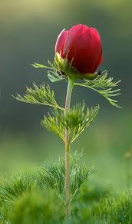
WELCOME TO EVERY BODY

Slide 2
TEACHER INTRODUCTION
Md.Abdul Matin. senior
Assistant English teacher
Raghunathpur high school,
Nawabganj,Dinajpur.
E-abmatin1977@gmail.com
Phone:01823385723
UNIT :Seven
Lesson :01
E,F,T : Nine
Topics :Zainul Abdin ,
The great Artist.
Date :29/09/201

Slide 3
LEARNING OUTCOMES
By the end of the lesson the learners will be able to
1. Students say something about Zainul Abedin
2.answer questions
3.describe the paints and drawings of Zainul Abedin
4.write descriptions on Zainul’s paintings.

Slide 4
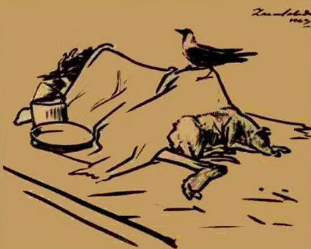
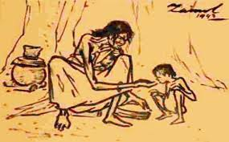
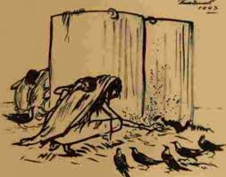
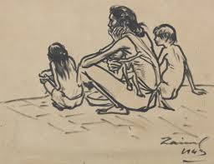
Feminine Sketches

Slide 5
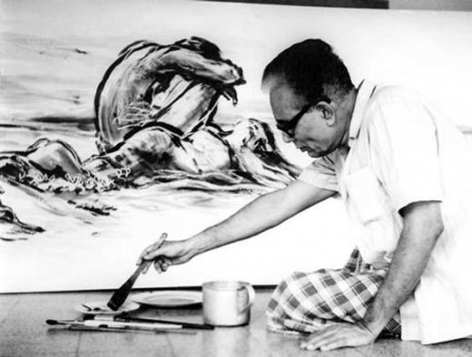
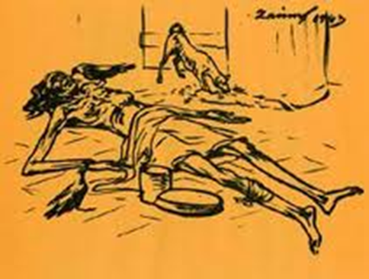
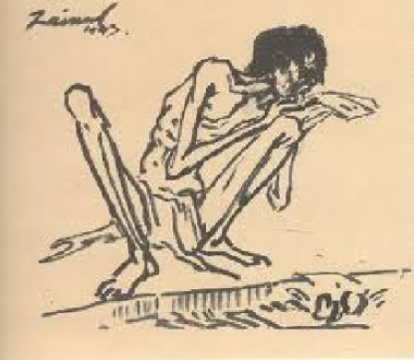
Skeletal Figures

Slide 6
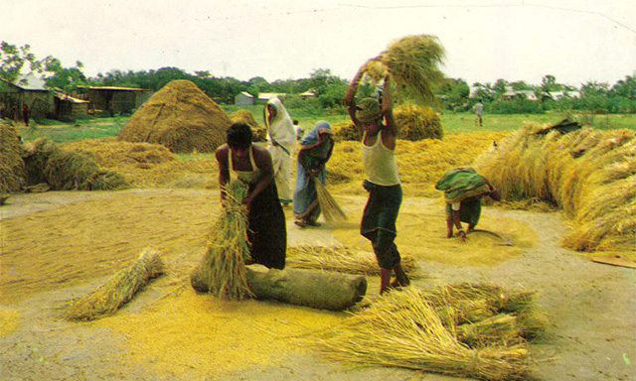
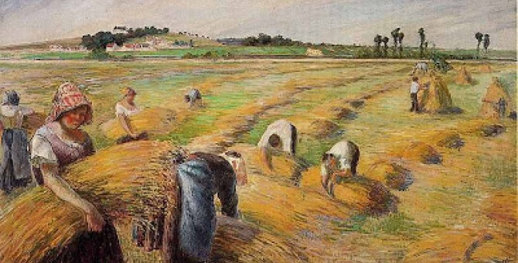
Nabanna (Harvest)
Exhibition
Nabanna

Slide 7
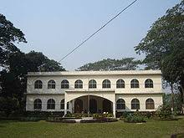
Art Gallary

Slide 8
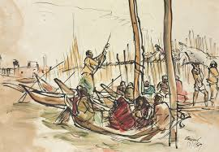
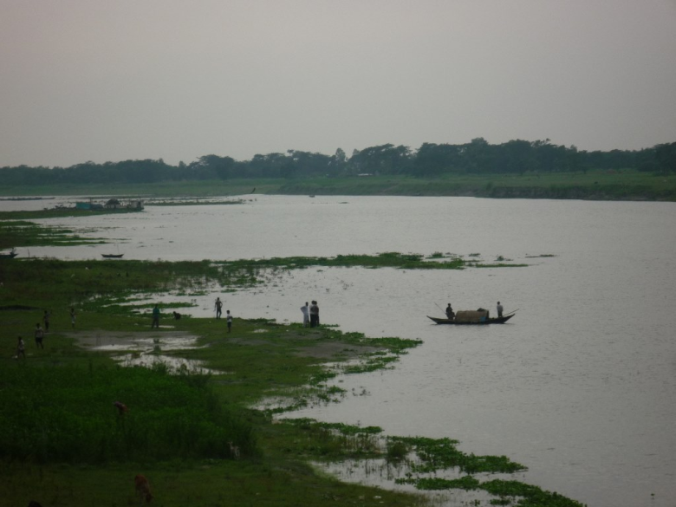
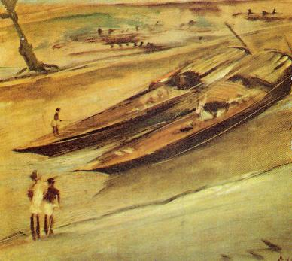
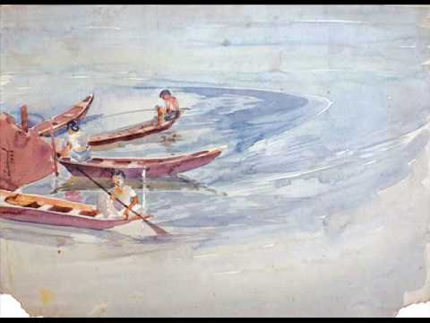
Source of his Inspiration in paintings
- The River Brahmaputra

Slide 9
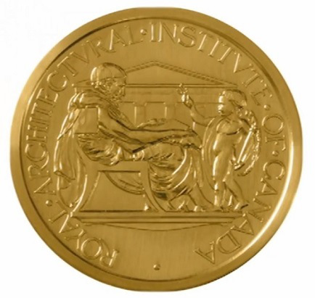
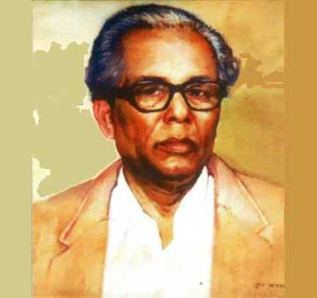
Achievement of Gold Medal from the Then Governor in
an all –India exhibition in 1938

Slide 10
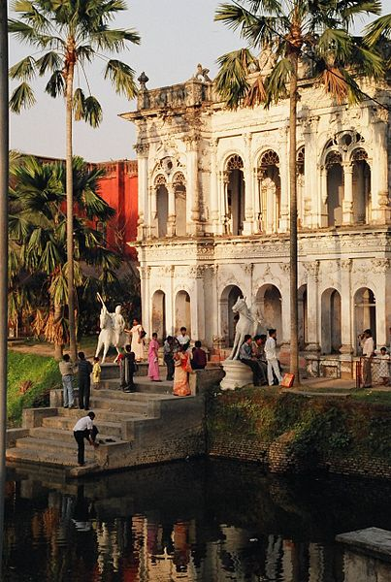
Folk Art Museum, Sonargaon

Slide 11
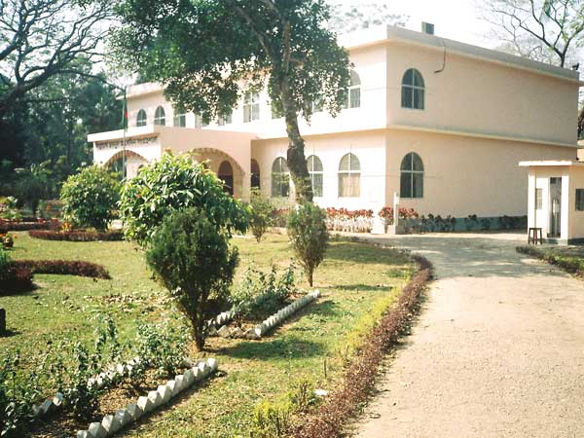
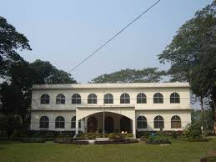
Zainul Abedin Sanggrohoshala
Mymensingh, founded 1975

Slide 12
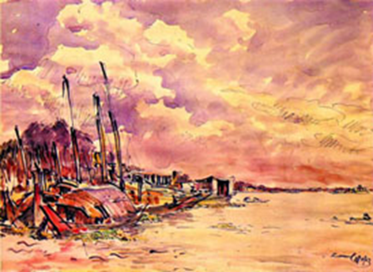
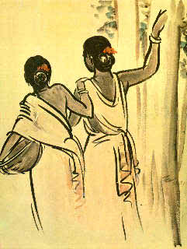
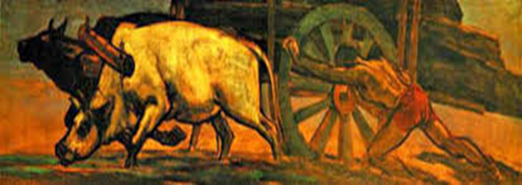
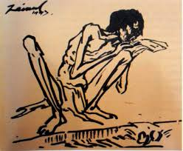
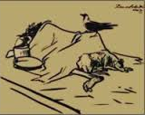
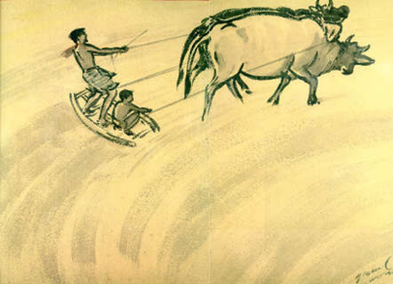
Pair works
Look at the series of pictures. Work in groups and talk about them . Now briefly write about what each picture portrays.

Slide 13
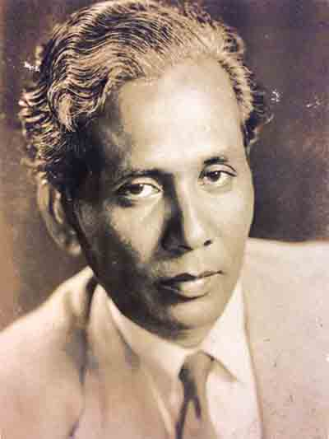
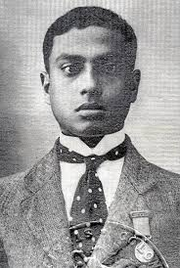
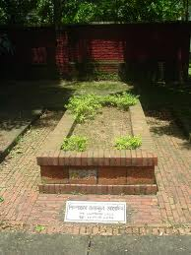
Life Span of Shilpacharyia Zainul Abedin :
29 December 1914- 28 may 1976

Slide 14
Choose the short question and answer
a) Zainul developed a knack for drawing and painting when he was a high school student.
The word knack refers to
a special skill, ii) attraction iii) fascination
b) Zainul Abedin is as the pioneer of modern Bangladeshi art.
considered ii) regarded iii) assigned iv) known
c) The phrase ‘visionary qualities’ is a
i) Noun ii) verb ) iii) adjective iv) adverb

Slide 15
HOME WORK
Answer the following questions
When will the Birth anniversary program be held?
What will the program include?
What is the area of the Sangrohoshala?
Why should we preserve the things?
What does the Sangrohoshala contain?

