Slide 2
Good Morning

Slide 3
INTRIDUCING
Class : Four
Subject : English
Lesson : 1 – 2
Unit : 25
Activity : A
Kanan Roy
Assistant Teacher
Dakshin Chand Pur -1 Govt Primary School
kananroy6@gmail.com

Slide 4
Learning outcomes
Listening
3.4.1
Understand statements made by the teacher and students .
Speaking
Repeat after the teacher and say words , phrases and sentences with proper sounds and stress .
1.1.1
Reading
Read short paragraphs , dialogues and simple letters .
1.7.1

Slide 5
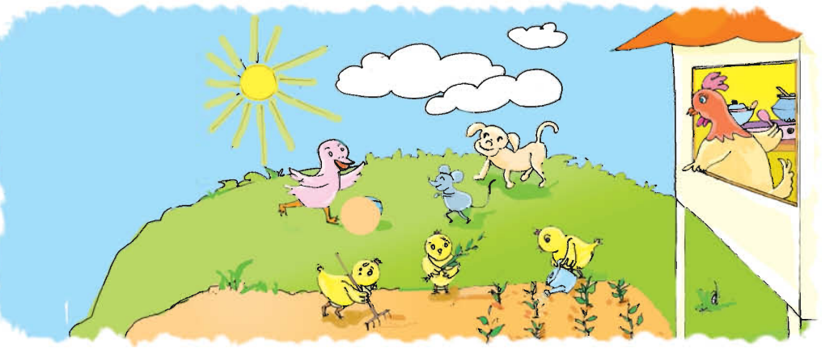
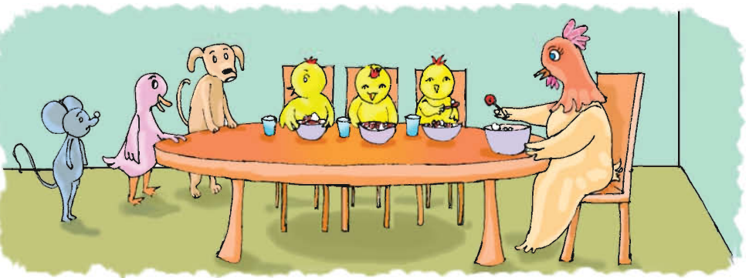
Let’s see pictures
What can you see in the picture ?

Slide 6
Let’s know about new words
Word
Similar word
Bangla meaning
Hard
Difficult
শক্ত
Smell
Flavor
গন্ধ
Part
Portion
অংশ

Slide 7
Let’s know about new words
Word
Similar word
Bangla meaning
Dine
Eat
আহার করা
Plant
Sapling
চারা

Slide 8
Teacher’s Reading
Chick 1 : This work is hard ! It’s hot in the sun !
Chick 2 : Mouse , Duck and Dog are having fun !
Chick 3 : Why can’t we laugh and play and run ?
Hen : You will know when the work is done .
Dog : Is that bread ? It smells so fine !
Mouse : I want some bread ! What part is mine ?
Duck : I want some , too ! When do you dine ?
Hen : You didn’t plant or work or cook .
Chicks : So you can’t eat ! You can stand and look !

Slide 9
Student’s Reading
Chick 1 : This work is hard ! It’s hot in the sun !
Chick 2 : Mouse , Duck and Dog are having fun !
Chick 3 : Why can’t we laugh and play and run ?
Hen : You will know when the work is done .
Dog : Is that bread ? It smells so fine !
Mouse : I want some bread ! What part is mine ?
Duck : I want some , too ! When do you dine ?
Hen : You didn’t plant or work or cook .
Chicks : So you can’t eat ! You can stand and look !

Slide 10
Rearrange the word to make sentence
WCW
1 . hard / this / is / work !
Ans: This work is hard !
2 . fine / smeels / it / so !
Ans: It smell so fine !
3 . Some / I / bread / want !
Ans: I want some bread !

Slide 11
Rearrange the word to make sentence
WCW
4 . Cook / work / you / or / didn’t / plant /or
Ans: You didn’t plant or work or cook .
5 . Can / and / look / you / stand !
Ans: You can stand and look !
6 . Know / when / done / work / you / will / the / is .
Ans: You will know when the work is done .

Slide 12
Make sentence with the following word
Pair work
Smell
Flowers smell is very sweet .
Hard
This work is hard .
Plant
You didn’t plant or work or cook .
Part
What part is mine ?
Dine
I dine bread .

Slide 13
Match word of column A with their meanings in column B
A | B
Hard | Flavor
Smell | Eat
Part | Difficult
Dine | Partion

Slide 14
IW
Write true or false
1 . You will know when the work is done .
True
False
2 . This work is easily .
3 . Is that ruti ?
False
4 . Mouse , Duck and Dog are having fun !
True
5 . You did plant or work or cook .
False

Slide 15
One day one word
Know
Job
I know that how to swim .
জানা

Slide 16
Good Bye Students

