Slide 1
Welcome

Slide 2
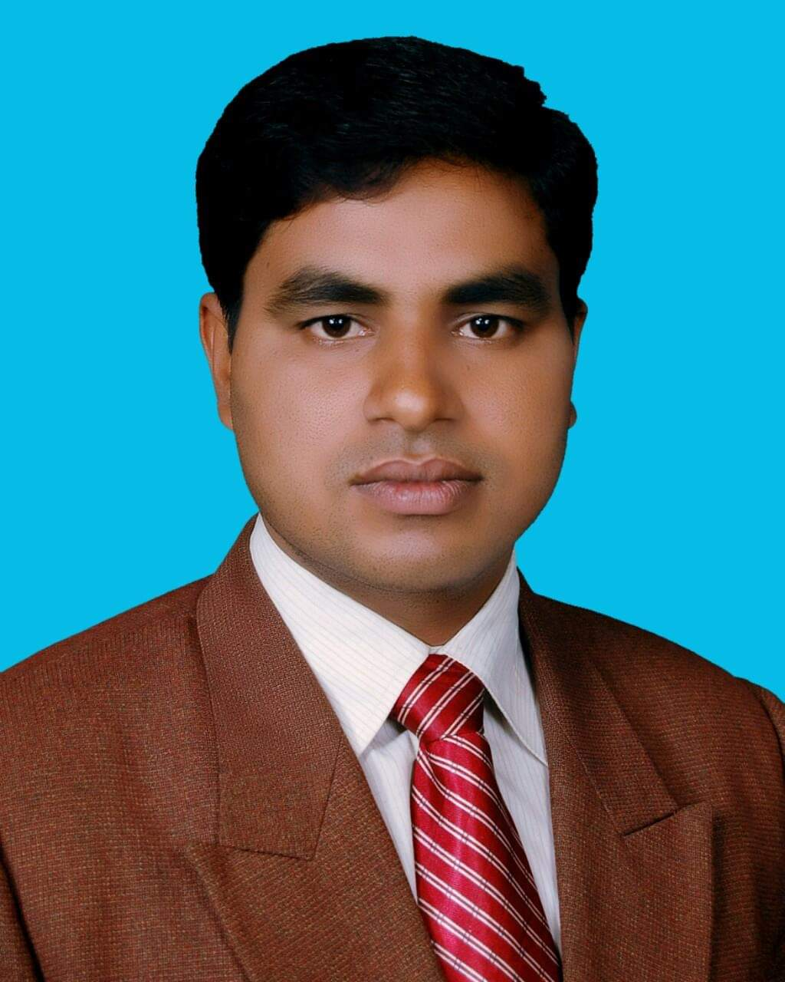
Identity
Md. Noor –E- Alam Siddiki
Asstt. Teacher
Nageswari Keramatia M.L High School.
Mobile- 01716962418
Email- nooralam.na35@gmail.com
Unit -2, Lesson 2

Slide 3
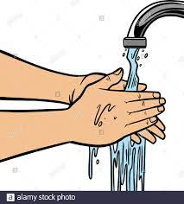
Look at the picture and guess what it says.
I wash my hands frequently. It is essential for everybody to wash their hand before meal and after using toilet.
I wash my hand frequently to keep me healthy.
a) How often do you wash your hands?
b) Why do you wash our hands?

Slide 4
Today’s class title is
Health
Unit 2, Lesson 1

Slide 5
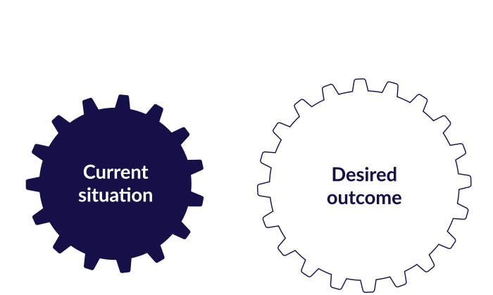
After studied the lesson , students will be able to …
answer questions.
develop reading skill .
choose the best answer .
develop writing skill .

Slide 6
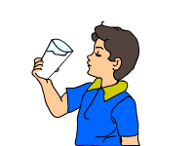
Let’s know some new words
Essential
absolutely necessary; extremely important.
a thing that is absolutely necessary.
Water is essential for our body.

Slide 7
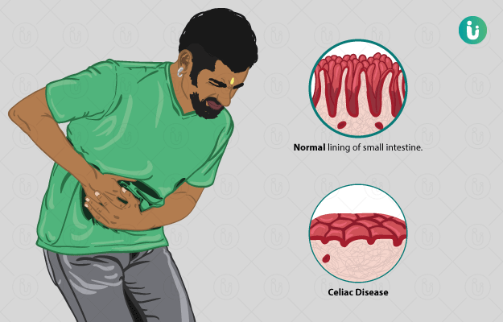
Disease
a disorder of structure or function in a human, animal, or plant, especially one that produces specific symptoms or that affects a specific location and is not simply a direct result of physical injury.
Vitamins and Minerals keep our body free from disease.

Slide 8
Concentrate
focus all one's attention on a particular object or activity.
He couldn't concentrate in reading.

Slide 9
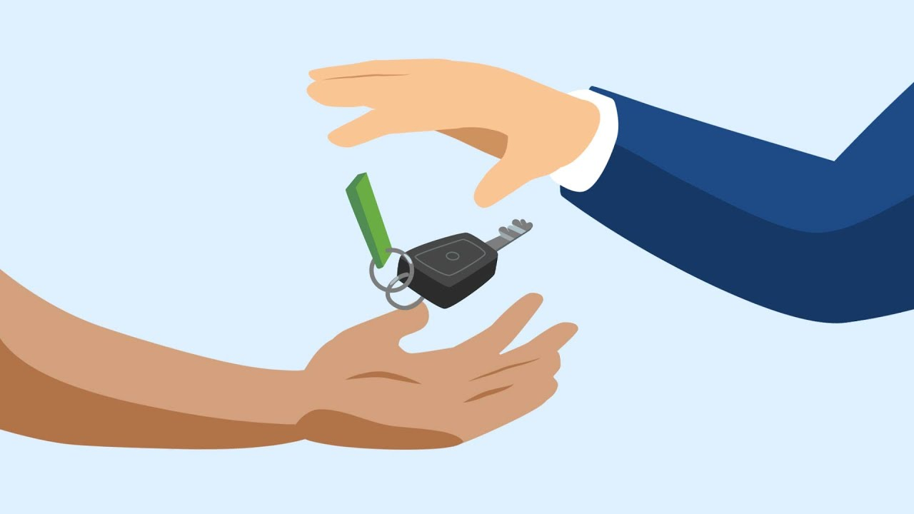
possession
the state of having, owning, or controlling something.
something that is owned or possessed.
He possessed a vast property.

Slide 10
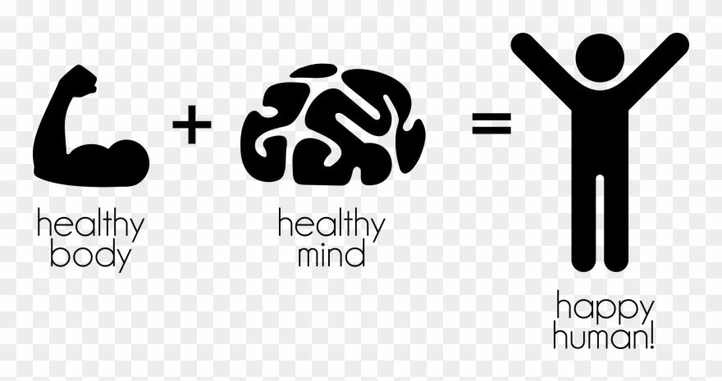
Health is the condition of our body and mind. Good health means healthy body free from disease.

Slide 11
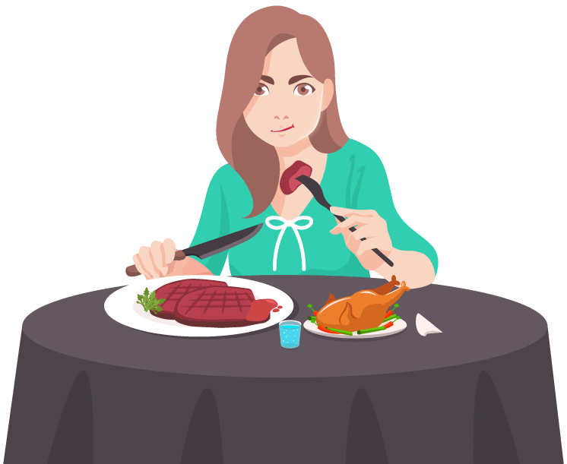
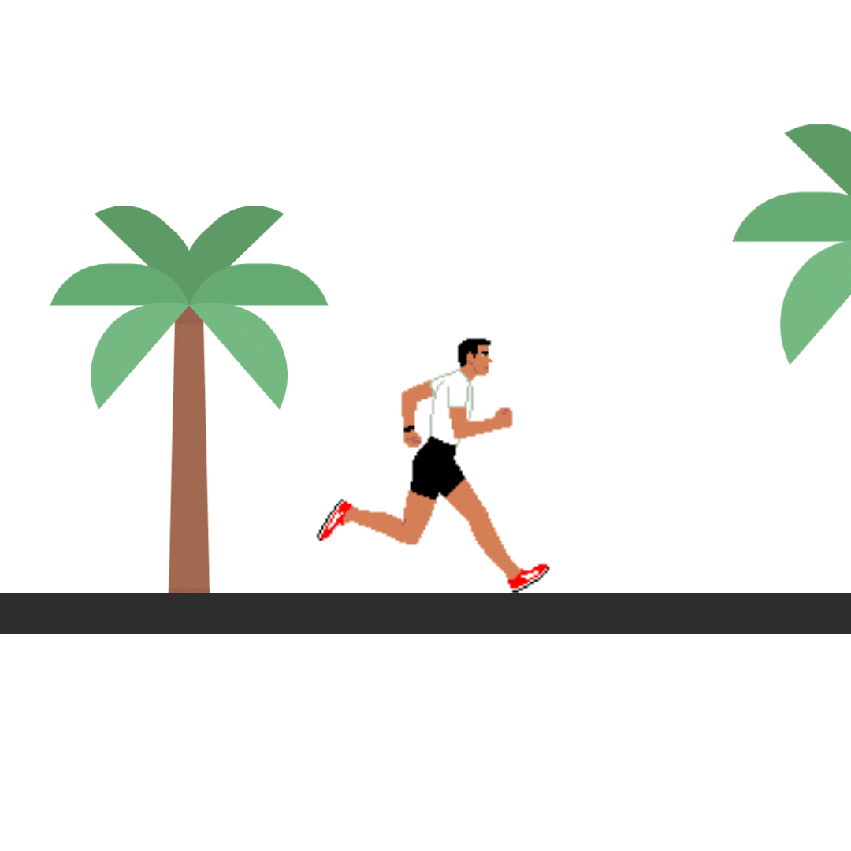
To keep ourselves healthy
We have to take a balanced diet.
We must exercise regularly.

Slide 12
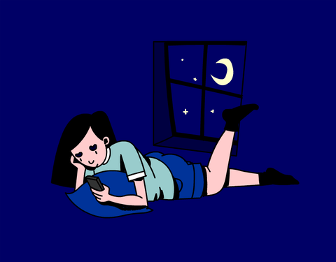
We should not keep late hours.
We must not worry over small things of life.

Slide 13
Read the questions first.
1. Why is good health essential for us ?
2. Why is physical exercise necessary ?
Now read the text silently and answer the above questions.

Slide 14
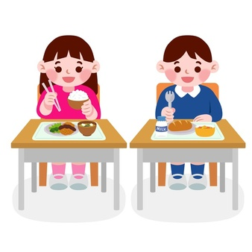
Individual work
What is good health?

Slide 15
Pair work
Read the text B silently and choose the best answer.

Slide 16
Match your answer
1. Health means the condition of
a) Our body
b) Our mind
c) Our body and mind
d) Our environment
2. A healthy person is one who
a) Is physically and mentally sound
b) Eats good food.
c) Has a lot of wealth.
d) Is overweight.

Slide 17
3. We need to eat
a) Rich food
b) Balanced diet.
c) Little food
d) Lot of food.
4. The phrase ‘ to keep late hours’ means
a) To go to bed late
b) To wake up late in the morning.
c) To do things late always.
d) To be late for the class.

Slide 18
Group work
Write a short paragraph about how you can maintain good health within 180-200 words.

Slide 19
Evaluation
what should we do to keep ourselves healthy?

Slide 20
Thank you.

