Slide 1
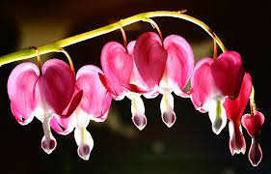
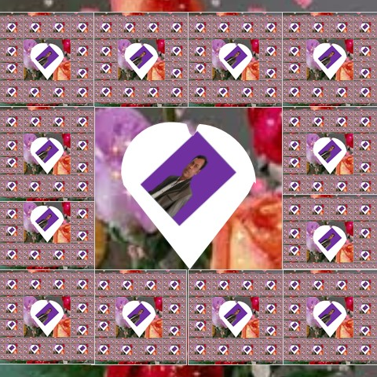
Welcome to todays lesson.

Slide 2
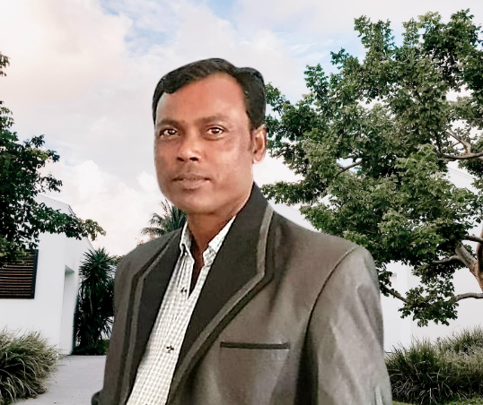
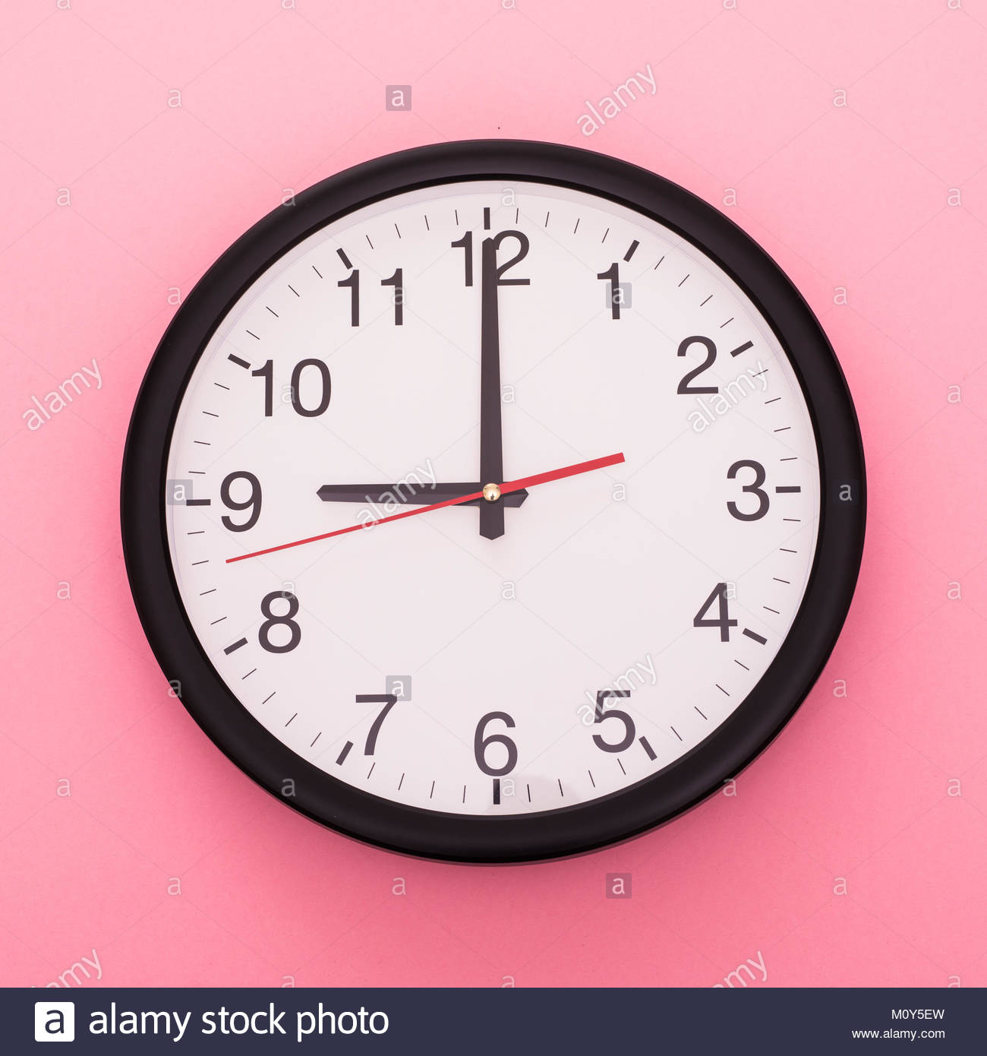
Identity
Class:five
Sub:English
Unite:13
Telling the time
Lesson:4-7
Time :45minite
Date :2/10/21
Name :Ramjan ali
Assistant teacher
Majer gaon gov primary school
Companigonj, Sylhet
Mobail no :01724354399.

Slide 3
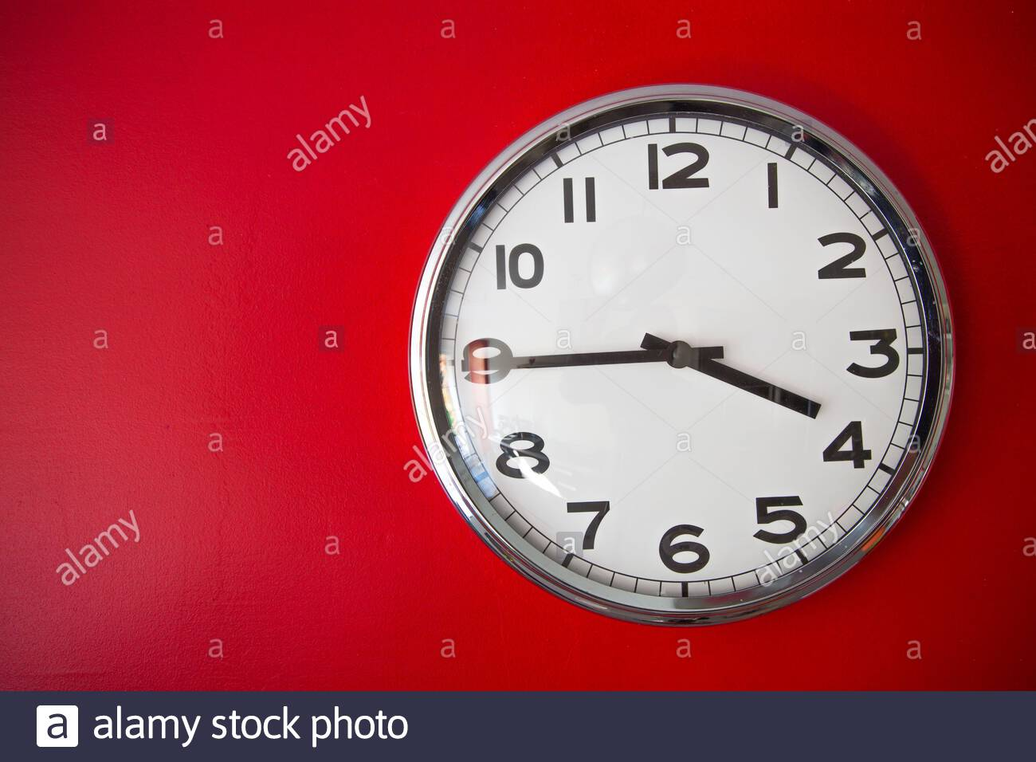
Lets go now a video
I am sure that you are enjoy the video

Slide 4
Today we are going to read
Telling the time.

Slide 5
Learning Outcomes
At the end of the lesson the students will be able to,
1.Use a.m and p.m in their daily activities.
2.Say the times by seeing different angels
of a watch
3.Write their daily activities by using time.
4. To tell the time (hours and minutes and mention a.m/p.m half past, quarter past, quarter to etc

Slide 6
One Day One Word
Our todays one word is
Word
Bangla Meaning
Sentences
Midnight
We are sleeping at midnight.
মধ্যরাত

Slide 7
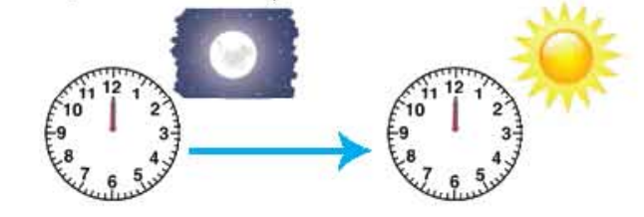
Look at the clocks and think about the time.
12o'clock midnight to 12 o'clock
midday are a.m. times.
12 o'clock midday to 12 o'clock
midnight are p.m. times.

Slide 8
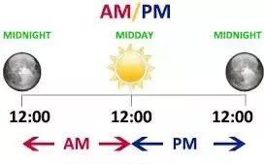
Explanation of a.m. and p.m.

Slide 9
Full form of A.M. is
Anti Meridiem.
and
Full form of P.M. is
Post Meridiem.

Slide 10
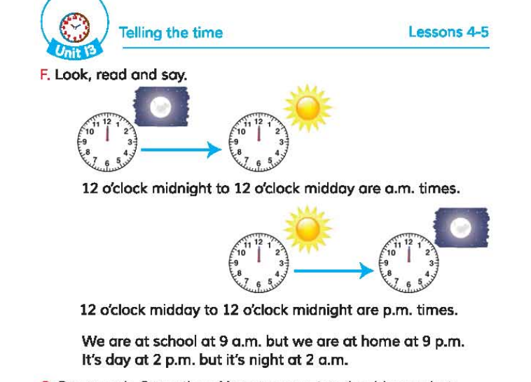
Now open your book at page no: 52, unit:13, lesson:4-5
Let's read the text silently

Slide 11
Pair Work
Match column A with column B.
1.We are at school at 1. 2 p.m.
2. We are at home at 2. 9 a.m.
3.It’s day at 3. 2 a.m.
4.It’s night at 4. 9 p.m.
A
B

Slide 12
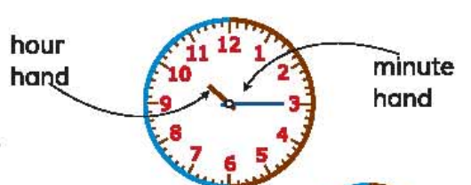
A clock has two hands. The big one indicates minute and the small one indicates hour.

Slide 13
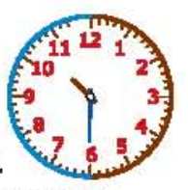
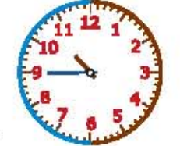
Look at the clocks and tell the time.
It’s 10:30.
It’s half past ten.
It’s 10:45.
It’s quarter to 11.

Slide 14
Group Work
Look at the clocks and discuses with your friend about the time.
It’s 7:20.
It’s 11:30.
It’s 3:50.
It’s 6:10.

Slide 15
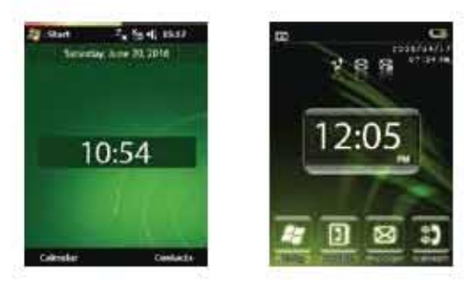
Group Work.
Look at the digital clocks and say the time.
It’s 10:54.
It’s 12:05.

Slide 16
Evaluation
1.When do you get up from bed?
Ans: I get up at 5 a.m. from bed.
2.When do you go to school?
Ans: I go to school at 9 am.
3. When do you go to sleep?
Ans: I go to sleep at 10 p.m.

Slide 17
Home work
Write a short composition about your daily activities by using time.

Slide 18
THANK YOU AND GOODBYE.

