Slide 1
To my class

Slide 2
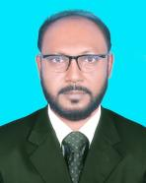
IDENTITY
S.M.Mozammel Kabir
Asst. Head Teacher
Bhowal Baria Union High School
Gazipur Sadar,Gazipur.
Mobile: 01770633593
E-mail: mozammelkabir777@gmail.com
Subject: English Grammar
Unit: 9 Lesson: 2
Class: Seven. Date: 16/05/2021

Slide 4
Today’s Topic
Article

Slide 5
Objectives
By the end of the lesson students will have…….
To know what is Article and kinds of Article
To understand the use of Article “ The”
To understand the omission of the Articles

Slide 6
What is article?
Articles are words that define a noun as unspecific or specific.
Article
How many kinds of it?
Indefinite
Definite
A , An
The

Slide 7
What is definite article?
The definite article is the word "the“. It is used before a noun to define it as something specific (e.g., something previously mentioned or known, something unique, or something being identified by the speaker).

Slide 8
I'm the pirate.
(This means a specific pirate)
Can we go to the park?
(The park is specific. It is known to the speaker and the listener.)

Slide 9
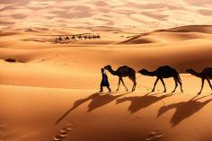
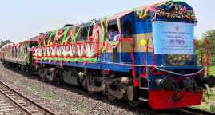
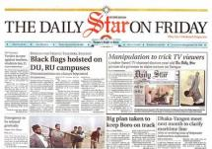
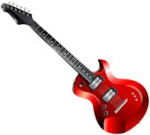
Sahara desert
Bonolota express
Here ‘The’ is definite article.
Daily Star
Guitar

Slide 10
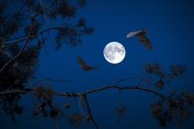
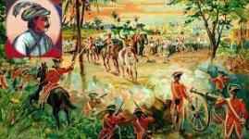
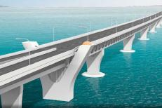
Moon
Historical event
Rose
Large installation

Slide 11
Omission of the articles
Before uncountable nouns
We do not use articles before uncountable and abstract nouns used in a general sense.
Honey is sweet. (NOT The honey is sweet.)
Note that uncountable nouns take the article the when used in a particular sense.
Would you pass the sugar? (the sugar on the table)
Before plural countable nouns
We do not use articles before plural countable nouns used in a general sense.
Children usually rush about.
Note that plural nouns take the article the when they are used in a particular sense.
Where are the children? (Which children? Our children)

Slide 12
Before proper nouns
We do not use articles before the names of countries, people, continents, cities, rivers and lakes.
India is a democratic country. (NOT the India …)
Before the names of meals
We do not use articles before the names of meals.
Mother is cooking lunch.
We use a when there is an adjective before breakfast, lunch, dinner etc. We use the when we are talking about a particular meal.
I had a late dinner yesterday.

Slide 13
Before languages
We do not use articles before the names of languages.
Can you speak English? (NOT Can you speak the English?)
Before school, college, university, church, bed, hospital, prison etc.
He is at university.
The is used before these words when the reference is to the building or object rather than to the normal activity that goes on there.
I met her at the church. (Here the reference is to the building and not to the activity that is going on there.)

Slide 14
Pair work
1. I ride a bike. ___ bike is green.
The
The
2. ___ book on your table is mine.
The
3. ___ Eiffel Tower is in Paris.
4. I never go to Spain in ___ winter.
The
5. I parked the car next to ___ church.
The
6. I would love to visit ___ North Pole.
7. She was not at ___ home when I called.

Slide 15
Group Work:
A
An
Fill in the blanks with A or An .
An
Nuba is (a)….... Good student. She is also (b)……. Intelligent girl. She wants to be (c )…… engineer. Her mother is (d)..….. B.A. Her father is also (e)….... Honest man and he is (f)……. Book of wisdom. Nuba eats (g)..…. Apple every day. She reads the Quran for (h)……. Hour daily. She is so stylish like (i)…… European. She sent (j)…... Email to her grandfather for a new dress.
A
An
A
An
An
A
An

Slide 16
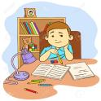
Home Work
Write the rules of using article The with examples.

Slide 17
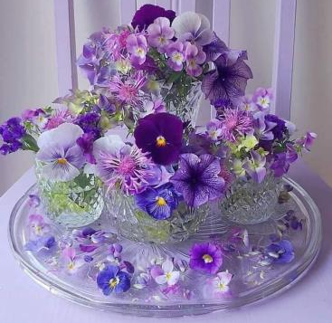
Follow the rules of health,
safe from covid 19.
Thanks
To all

