Slide 1
WELCOME
To English Class

Slide 2
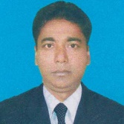
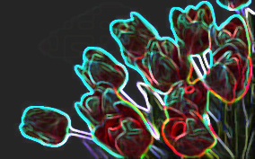
Identity
Md. Monirul Islam
Assistant Teacher (English)
01761714820
Azimnagor Computer Technical School & Commercial College.
Subject – English 1st paper
Class –Nine
Time – 45 mins

Slide 3
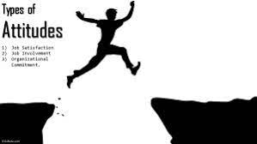
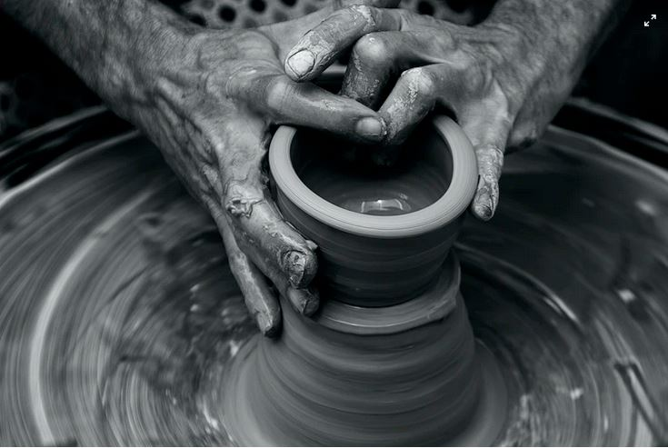
Knowledge
Theoretical, conceptual or procedural understanding required to perform certain asks.
Knowledge can be gained from a book, studing a certain degree or by researching online.
Having knowledge of how to do something does not necessarily mean that you can physically do it, even if you understand the steps and what should be done.
Look and guess about the pictures.
Skills
Difference between skills and knowledge, is that knowledge is theoretical while skills are practical proficiencies.
Skills are learned behaviours that can be improved overtime through training and working experience.
Attitudes
Attitudes are contagious. Make your’s worth catching.
Attitudes are not observable.
What can you see ?

Slide 4
Dear students let’s enjoy a video clip.

Slide 5
Our Today’s Lesson is-
Knowledge, skills and attitudes
Unit-1, Lesson- 2

Slide 6
Learning outcomes.
After completing the lesson , we will be able to—
Infer the word meaning ;
read and understand text through silent reading
ask and answer questions

Slide 7
Vocabu
la
ry
Dear students lets discuss some important vocabulary of the lesson to know more about knowledge , skills and attitudes.

Slide 8
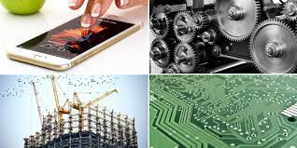
Word
Image
Meaning
The practical use of scientific discoveries.
Technologyy

Slide 9
Word
Image
Meaning
The system of laws and basic principles to govern a country
Constitutiony

Slide 10
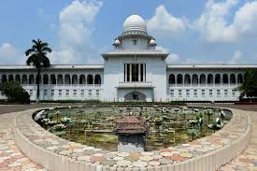
Word
Image
Meaning
Relating to the administration of justic
judicial

Slide 11
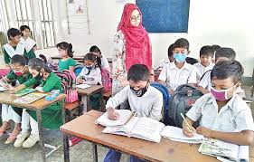
Word
Image
Meaning
To observe and check the progress of someone or something
Monitor

Slide 12
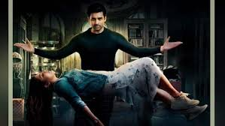
Word
Image
Meaning
The ability to do something well
Skills

Slide 13
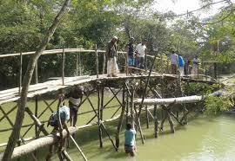
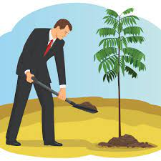
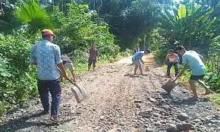
To be a good citizen , you have to prepare yourself to do good work in society.

Slide 14
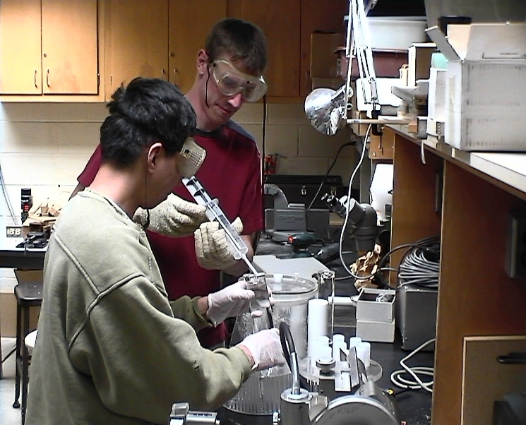
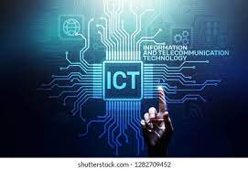
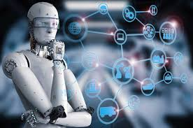
What kind of knowledge is essential to prepare yourself?
The knowledge of-
modern science, technology including ICT .

Slide 15
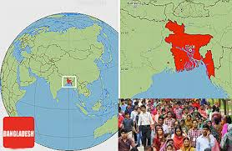
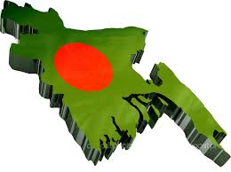
The other areas you, as a good citizen, you should have knowledge of---
Bangladesh
Geography and people,
Its constitution,
our country,

Slide 16
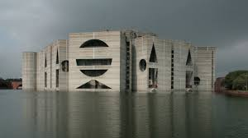
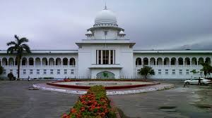
our state
our legislative power

Slide 17
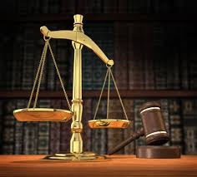
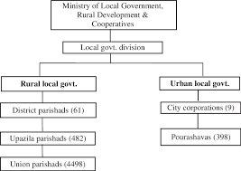
our judicial system.
Functions of our government

Slide 18
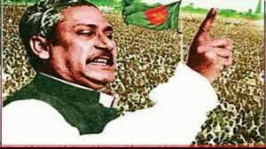
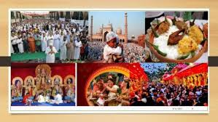
our History.
our culture

Slide 19
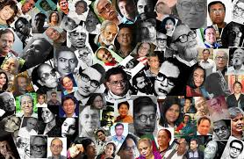
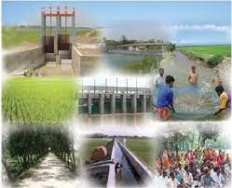
our literature.
our socio-economic activities.

Slide 20
Dear students, read the text silently.
Knowledge , skills and attitudes
If you don’t understand anything, let me know.

Slide 21
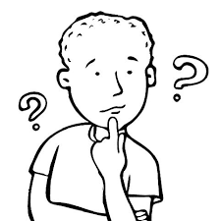
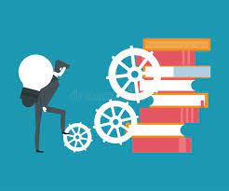
You need skills to do things. Knowledge is not
enough. You must be able to apply your
knowledge to do things practically.

Slide 22
Pair work.
Answer the following questions in pair ?
What is group work ?
What does one need to do good work ?
Where are the behavioural changes, caused by group work, reflected in a student ?

Slide 23
Group work.
Discuss in group, What else do you need in addition to food, shelter and company, to become a good citizen ?
Knowledge about -
Our country, its constitution, geography and people.
our state, its executive and legislative powers.
Our judicial system, our government and its structures and functions
Our history, culture, traditions, literature, moral values and religions.
Our socio-economic activities and educational system.

Slide 24
Evaluation.
Choose the best answer from the alternative.
1 . To be a good citizen we need to acquire----
a. Knowledge b . Money c. culture d. Politics
2. You need ------------ to do things .
a. ICT knowledge b. Science knowledge c. skills d. Good company.
3. Today’s society is ------ society .
a. technology based b. Agriculture based c. knowledge based d. Judicial based.
4. Group will remove your ------
a. Shyness b. helping attitudes c. fellow feeling d. behavioural changes
5. Though regular group work --- changes take place in a students behaviour .
a. pragmatic b. automatic c. noticeable d. france

Slide 25
Finally
Knowing and doing things will bring about a change in your behaviour towards others. This behavioural change will show your attitudes towards others, that is , it will show how you think and feel about a person or things.

Slide 26
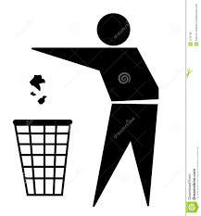
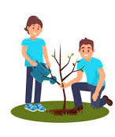
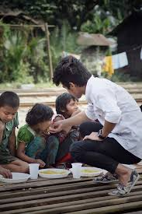
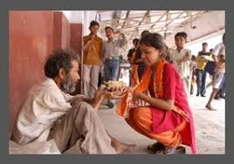
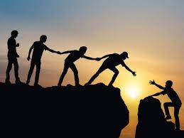
Home work.
Write a short composition about “ A Good Citizen”.

Slide 27
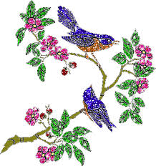
Thank you very much .

