Slide 1
Welcome everybody,
How are you?

Slide 2
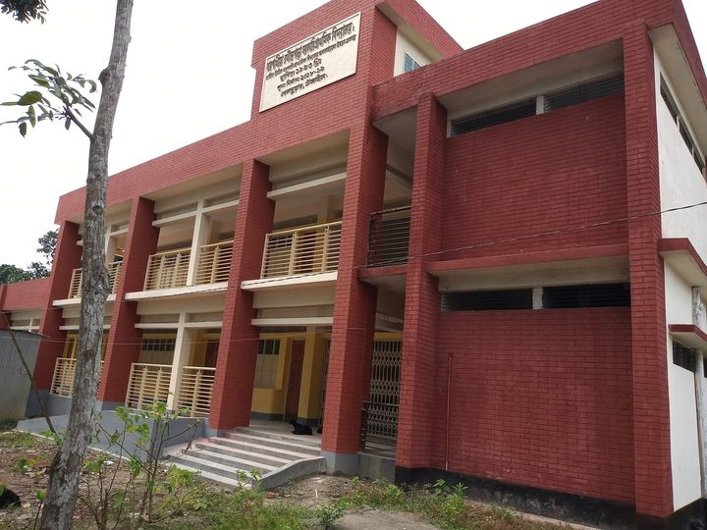
Teacher’s Identity
Dewan Rezaul Hassan
Assistant teacher
Baropakhia Rothindrapara GPS
Delduar,Tangail.
E-mail: drezaulhassan@gmail.com

Slide 3
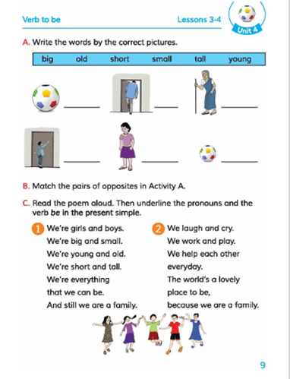
Introduction of the Lesson
Class:- Four
Unite:- 4
Lesson:- 3-4
Lesson Title:-Write Word With Picture
Part:-C (Read)

Slide 4
Learning outcomes:
Listening: 1.1.1.Recognize sound difference in the context of words
1.2.1.Recognize which syllable in a word is stress.
Speaking: 1.1.1.Repeat after the teacher and say words, phrases and
sentence with proper sounds stress and intonation.
Reading: 1.4.1.Read words, phrases and sentence in the text.
Writing: 3.1.1.Write words, phrases and sentence using non-cursive
capital and small letters.

Slide 5
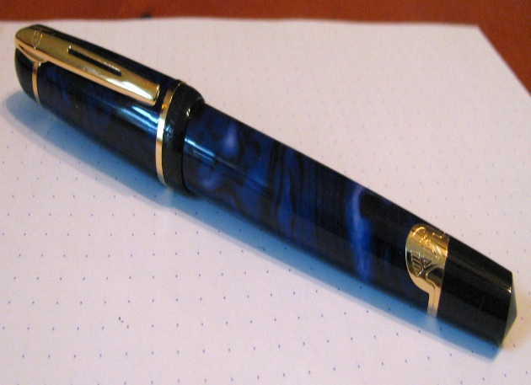
Book
Bird
Pen

Slide 6
Write words with Picture

Slide 7
Some important new words
Girl
Ball
What is this?

Slide 8
All the students, What can see in the picture?
Old

Slide 9
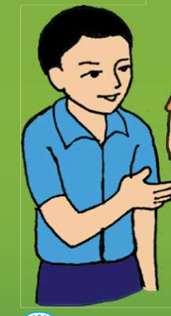
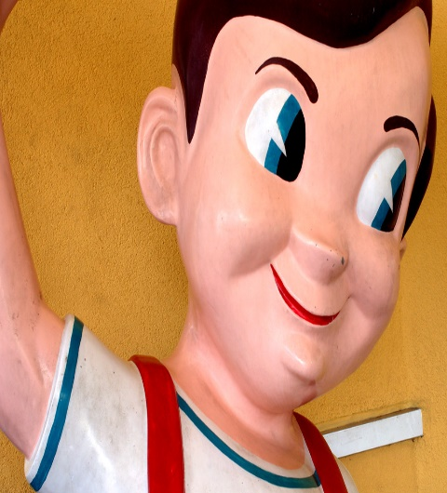
What is this?
Big
Small

Slide 10
Open the text-book page at 9 and read and say with me.

Slide 11
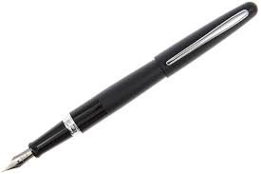
Write the new words on picture in your note-books

Slide 12
Thanks.

