Slide 2
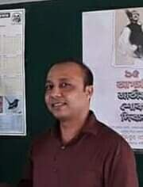
Identity
Satyajit Goswami
Head Teacher
Betory GPS
Sadar,Moulvibazar
Subject: English
Class: Five Unite :13
Telling the time.
Lesson:2-3, Page : 51

Slide 3
Let’s enjoy a song

Slide 4
Today’s lesson is
Telling the time

Slide 5
Learning Outcomes
By the end of the lesson students will be able to
1
Listening:
1.3.1 recognize which words in a sentence are stressed.
2
Speaking:
5.1.1 tell the time.(hours and minutes) and mention a.m./p.m, half past, quarter past, quarter to etc.
3
Reading:
3.2.1 read the clock.(hours and minutes) and say a.m./p.m, half past, quarter past, quarter to etc.

Slide 6
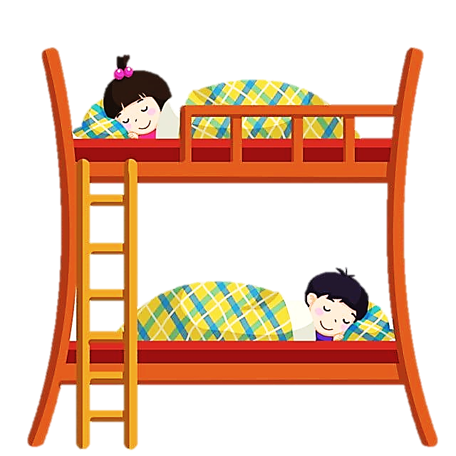
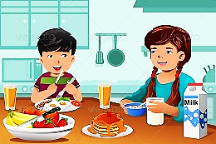
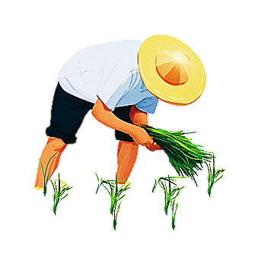
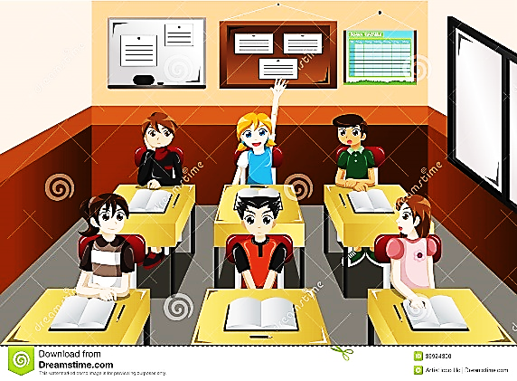
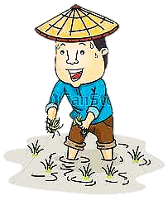
Let`s see some pictures
12
11
12
1
12
12
10
2
11
1
2
10
2
2
3
9
3
3
3
3
9
3
8
4
8
4
7
6
5
7
5
6
12
11
12
1
12
10
2
12
2
11
1
3
3
9
3
10
2
2
8
4
3
3
9
3
7
6
5
8
4
7
6
5
What do you see in the pictures?

Slide 7
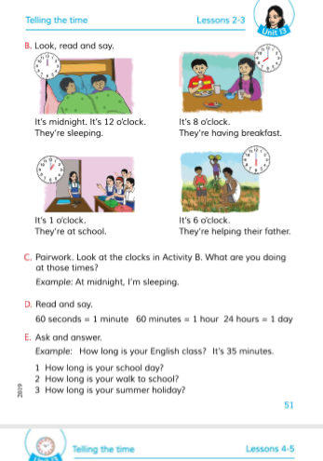
Open your book at page 51

Slide 8
Look at the picture.
12
12
11
1
What do you see in the picture?
10
2
2
3
3
9
3
8
4
7
5
6
It’s midnight.
It’s 12 o’clock. They’re sleeping.
What time is it according to the clock?

Slide 9
Look at the picture.
12
12
11
1
What do you see in the picture?
10
2
2
3
3
9
3
8
4
7
5
6
It’s 8 o’clock. They’re having breakfast.
What time is it according to the clock?

Slide 10
Let`s see a picture.
12
12
11
1
What do you see in the picture?
10
2
2
3
3
9
3
8
4
7
5
6
It’s 1 o’clock. They’re at school
What time is it according to the clock?

Slide 11
Let`s see a picture.
12
12
11
1
What do you see in the picture?
10
2
2
3
3
9
3
8
4
7
5
6
It’s 6 o’clock. They’re helping their father.
What time is it according to the clock?

Slide 12
Group work
Make four groups. Read part B in a group. The group leader of each group will come forward and read aloud the description below each picture.

Slide 13
Pair Work
12
12
12
12
12
12
12
11
1
11
1
12
11
1
11
1
10
2
10
2
2
10
2
2
2
10
2
2
3
9
3
3
3
3
3
3
9
3
9
3
3
3
9
3
8
4
8
4
8
4
8
4
7
5
7
5
7
5
7
6
5
6
6
6
Sit in pair and look at the time above the clocks and discuss what you do at that time .

Slide 14
Homework
Draw four clocks according to your English book page no 51.

