Slide 1
WELCOME
Everyone
To my
English class

Slide 2
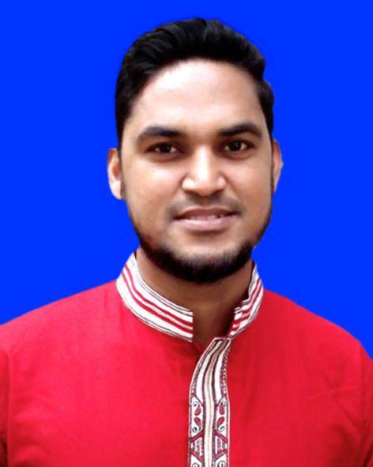
Teacher’s introduction
Md. Shafiul Alam
Assistant teacher
Bazitkhila Govt. Primary School,
Sherpur Sadar, Sherpur.
Mobile no: 01721082430

Slide 3
Class : Two
Subject : English
Time : 30 minute
Unit : 01
Lessons : 4-6
Page : 03

Slide 4
Creat Emotion
By hello song

Slide 5
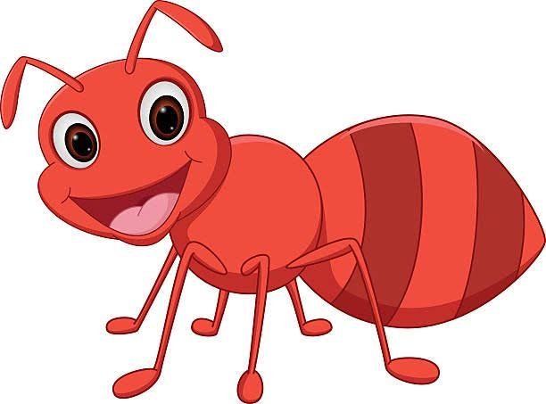
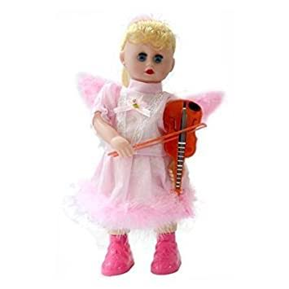
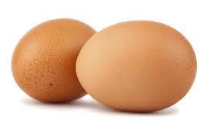
What can you see in this pictures?
There are many kind of pictures.

Slide 6
Today’s lesson
Alphabet ( A a -- E e )
Unit : 01
Lessons : 4-6
Page : 03

Slide 7
Learning outcomes
At the end of the lesson students will be able to-
1.1.1 become familiar with English sounds by listening to common English words.
1.1.2 say simple words and phrases with proper sounds and stress.
1.2.1 recognize and read the alphabet both small and capital (non-cursive).
1.3.1 recognize and read the name of objects having the same initial and final sounds.

Slide 8
Look listen and say-
W.C.W
A a
Ant

Slide 9
Look listen and say-
W.C.W
B b
Bat

Slide 10
Look listen and say-
W.C.W
C c
Cup

Slide 11
Look listen and say-
W.C.W
D d
Doll

Slide 12
Look listen and say-
W.C.W
E e
Egg

Slide 13
Read and say. Trace and write-
wcw
Ant
Bat
Cup
Doll
Egg

Slide 14
Click the right letter
Evaluation
Bat
Q
B
R
T
S

Slide 15
Ant
Q
P
A
S
T

Slide 16
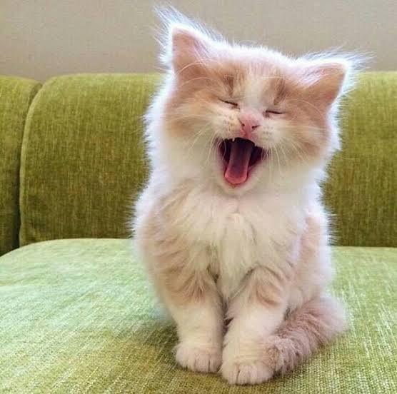
Cat
S
Q
T
C
P

Slide 17
Click the right letter
Doll
N
K
D
L
R

Slide 18
Evaluation
Egg
P
E
T
S
Q

Slide 19
Say read and match
Bat
Cup
Ant
Cat

Slide 20
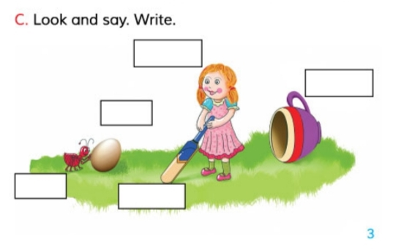
Home Work
Fill in the box.
# Write A a----E e with small & capital letter .

Slide 21
Goodbye song

Slide 22
Thanks to all

