Slide 1
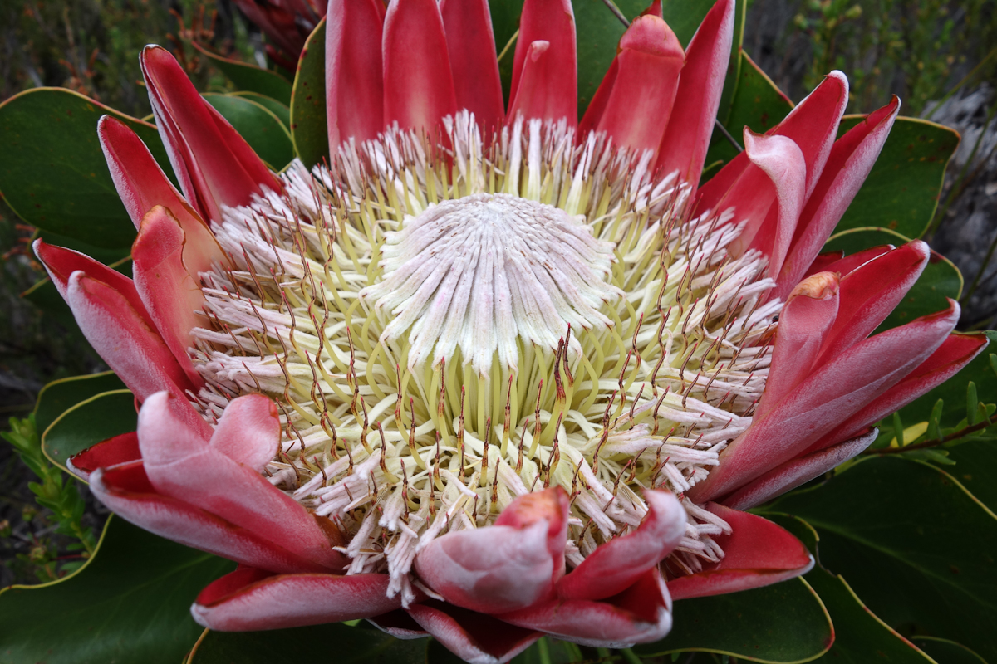
WELCOME

Slide 2
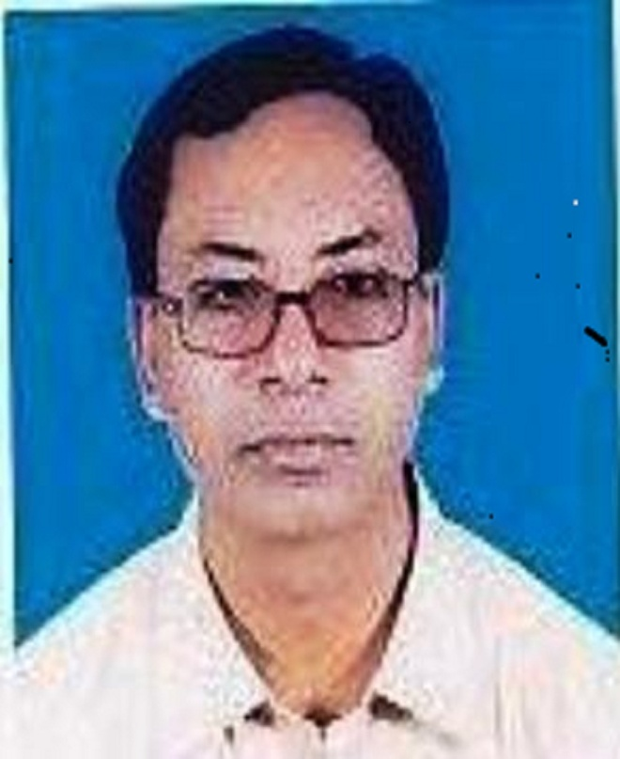
TEACHER’S INTRODUCTION
Md. Eunus Ali Lecturer in English Syedpur Bazar Fazil Madrasah Nabigonj, Habigonj.
Mob: 01720-075156

Slide 3
Going home
the girl started
crying
to get sympathy of
her beloved mother
Does not finish the sentence
finish the sentence
Does not finish the sentence
Does not finish the sentence
Does not finish the sentence

Slide 4
So principal verbs are of 2 kinds:----
Finite Verb (The verb completes the
sentence itself is called finite verb)
2. Non-finite Verb (The verb does not
complete the sentence itself is called
non-finite verb)

Slide 5
Today’s Lesson
Non-finite

Slide 6
Learning Outcomes
After the lesson the SS will be able --------
Know the definition of non-finite
Know the classification of non-finite
Know infinitive
Know participle
Know gerund

Slide 7
3 Non-finite Verbs :
Infinitive
Participle
Gerund.

Slide 8
Infinitive
To + Verb base form
To + Verb base form when it
does not complete the sentence

Slide 9
Infinitive comes 2 form:--
To infinitive form
He wants to go there
2. Zero/bare infinitive form
He can go there

Slide 10
5 Functions of infinitive:---
1. Subject of a verb:
To err is human beings
2. Direct Object of verb:
He wants to play
3. Subject Complement:
He has to go there
4. Adjective:
To eat food is essential
5. Adverb:
He came to see me

Slide 11
Participle
Participles are verb form that ends in- ing/ed/
en/d/t but function as adjective and verb.
Participles have 2 positions:
Before Noun
I saw a flying bird in the sky.
2. After be verbs
The is flying in the sky

Slide 12
Classification of Participle
Participles -3 kinds
1. Present Participle: Present Participle is a verb
form that ends in ing but function as adjective.
He rides on a running horse.
2. Past Participle: Past Participle is a irregular verb form
that ends in ed/en/d/t/n but function as adjective.
He sits on the broken bench.
3. Perfect Participle: Having + verb past participle
form is called perfect participle.
Having forgotten him I went out

Slide 13
Gerund
Gerunds are verbs that ends
in-ing and function as noun
and verb.
Swimming is a good exercise.

Slide 14
5 Positions of gerund
1. Subject: Walking makes a man strong
2. Direct Object: Rahat likes playing.
3. Indirect Object: She teaches us dancing
4. Object of Preposition: Rahat talks about reading
5. Predicate Noun: Her job is Speaking

Slide 15
Thank You

