Slide 1
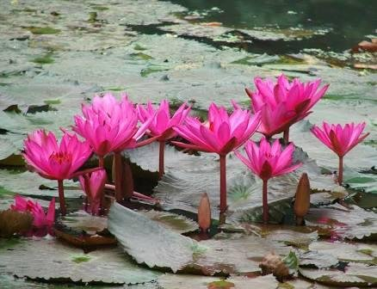
WELCOME MY DEAR LITTLE KIDS

Slide 2
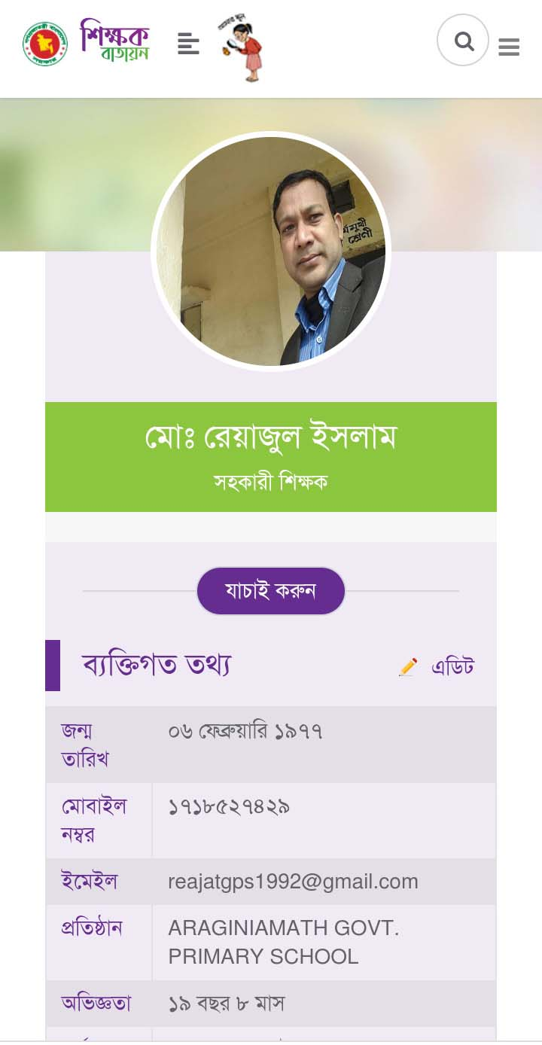
Md. Reajul Islam
M.B.S.(Management)
M.Ed.(1st Class)
Assistant Teacher
ICT4E Ambassador
Arajiniamot Govt. Primary School
Gangachara, Rangpur.
E-mail: reajatgps1992@gmail.com

Slide 3
Lesson’s Identity
Subject : English
Class : Five
Unit : 7
Lesson : 3-5 (Be healthy)
Part of the lesson : C
Time : 30 minutes.
Date : 21.08.2021

Slide 5
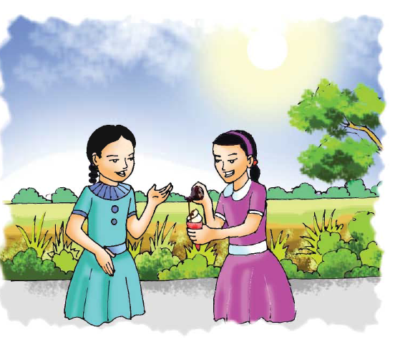
Let’s see the picture

Slide 6
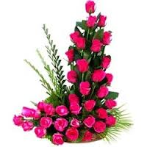
Today’s Lesson
Be healthy

Slide 7
New words
Delicious
সুস্বাদু
tasty
Regularly
নিয়মিতভাবে
daily
Favourite
প্রিয়
Fond of
Quickly
তাড়াতাড়ি
hurriedly
Melt
গলে যাওয়া
To become liquefied

Slide 8
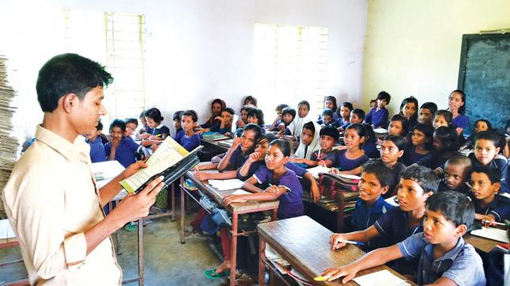
Teacher’s reading
Open your book at page 26

Slide 9
Sima: What are you doing, Nasreen?
Nasreen: I’m putting some chocolate on my ice-cream. Ice-cream is delicious with chocolate.
Sima: Well, it looks good, but you shouldn’t eat a lot of chocolate or ice-cream.
Nasreen: Of course! I don’t eat them regularly.
Sima: What kind of food do you eat regularly?
Nasreen: Oh, fruits and vegetables. I love pineapples and bananas. They are my favourites. I eat cucumbers and lettuce a lot, too.
Sima: I eat fruits and vegetables everyday. Carrots and tomatoes are my favourites, but I also like strawberries and bananas.
Nasreen: Would you like to try some of my ice-cream with chocolate? We should eat it quickly. It will melt soon in hot weather.
Sima: OK! Thanks.

Slide 10
Student’s Reading
Let’s read by change role.

Slide 11
Pair work
Answer the following questions:
a. What is Nasreen putting on chocolate?
b. Why doesn’t Nasreen eat chocolate regularly?
c. What does Nasreen say about ice-cream with chocolate?
d. What does Nasreen’s favourite foods? Are these healthy foods?
e. What does Sima’s favourite foods? Are these healthy foods?

Slide 12
Group work
Group: Rose
Write True for correct statement and False for incorrect statement:
a. Ice-cream and chocolate are healthy.
b. Pineapple is a vegetable.
c. Sima consumes fruits daily.
Group: Lily
Fill in the blanks using the right words:
a. The chocolate tastes --------.
b. Ice-cream ---------- in hot weather.
c. Nobody should -------- a lot of ice-cream or chocolate.
sweet
melts
False
eat
F
True

Slide 13
Evaluation
Answer the questions
a. What foods do you eat everyday?
b. Do you eat this regulary? Why?
c. Do you eat ice-cream or chocolate regularly? Why?

Slide 14
One day one word
Weather
অর্থ
আবহাওয়া
The weather is fine today.

Slide 15
Home work
Tell five sentences about ‘Your Favourite Food’.

Slide 16
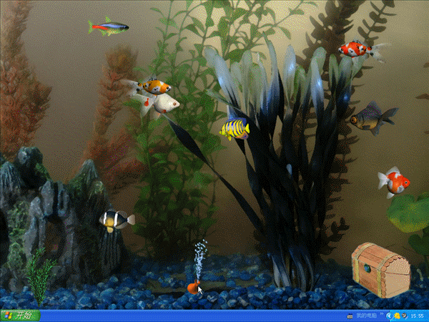
Thanks everybody

