Slide 1
Welcome
Notes:
Welcome slide

Slide 2
Uday Krishna Das
Senior Teacher (English)
Patkelghata High School
Patkelghata, Satkhira
dasudaykrishna3@gmail.com
01740-574686
English 2nd Paper
Class- VIII -X
Notes:
Introduction of teacher and identity.

Slide 3
He is a good boy.
He is not a bad boy.
Notes:
Suspension.

Slide 4
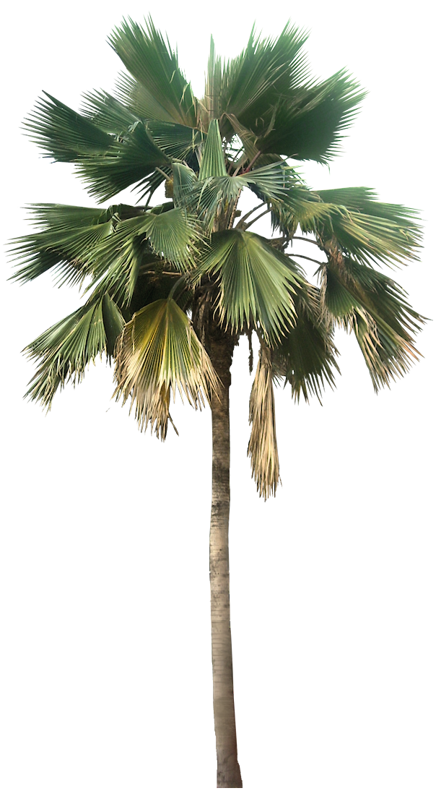
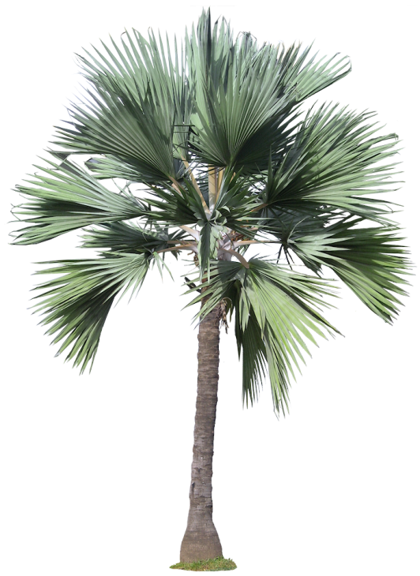
It is not a short tree.
It is a tall tree.
Notes:
Suspension -2.

Slide 5
What is our today’s topic?
Transformation of sentence.
Part-1(Affirmative to negative)
Notes:
Lesson declaration.

Slide 6
Learning outcomes
After completing this lesson, we will be able to---
differ conversion and transformation
tell the definition of transformation
transform sentences from affirmative to negative
Notes:
To make the students clear about transformation and its use is the main focus of the lesson.

Slide 7
Follow
He is a clever boy. (Make it negative)
He is a clever boy. (Make it negative)
He is not a clever boy.
He is not a fool boy.
Both the meaning and formation is changed here. So it is conversion of sentence.
Only formation is changed. Meaning is not changed. So it is transformation of sentence.
What is the difference between conversion and transformation?
Notes:
Difference between conversion and transformation is shown here clearly.

Slide 8
Let us try to solve some problems
Man is mortal.
He is a dishonest man.
He is an active man.
We must die.
All hate him.
He is my friend.
I like my mother very much.
He is really a very poor man.
Abraham Lincoln was a wise man.
Notes:
Class activities. Teacher may conduct this by oral teaching/writing.

Slide 9
Follow
Only an industrious man can gain success in life. (Negative)
None but an industrious man can gain success in life.
You must follow the way of truth. (Negative)
You cannot but follow the way of truth.
Everyone respects a man of character. (Negative)
There is no one but respects a man of character.
Notes:
Affirmative to negative transformation is focused here.

Slide 10
Some rules of changing from affirmative into negative
Affirmative | Negative | To mean
only | none but | god/human
only | nothing but | objects (without personal pronoun)
only | not more/not less than | age
must | cannot but
both---and ---- | not only---but also---
every | there is no one but | human
as soon as | no sooner had+v₃---than
Notes:
Basic points of changing from affirmative to negative/ How to change affirmative into negative.

Slide 11
Some more rules of changing from affirmative into negative
Affirmative | Negative
sometimes | ---- not/not always
always | never + antonym of head word
too---to | so+ adj + that + sub + can/could not +verb
many | not a few
a few | not many
a little | not much
much | not a little
Notes:
Basic points of changing from affirmative to negative/ How to change affirmative into negative.

Slide 12
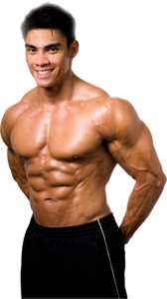
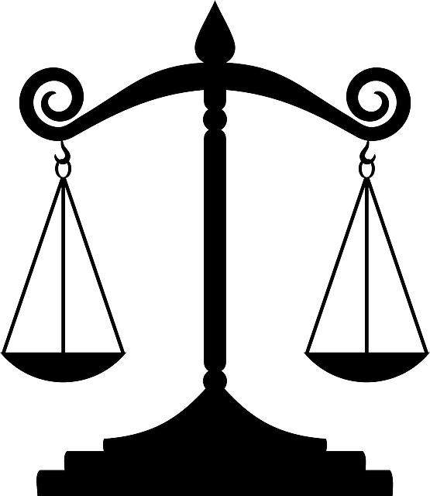
The earth is round.
Health is wealth.
Honesty is the best policy.
Universal truth
In case of universal truth, the sentence is changed into negative + interrogative. (don’t/doesn’t/ isn’t/aren’t/wasn’t + subject +….+?
Notes:
How universal truth sentences are transferred from affirmative to negative.

Slide 13
Change the sentences into negative.
Truth is beauty.
Love is divine.
Kindness is a noble virtue.
The sun rises in the east.
The moon shines at night.
Prevention is better than cure.
Addiction to drinking is dangerous.
Education is the backbone of a nation.
Man is the servant of habit.
Practice makes a man perfect.
Notes:
Evaluation option.

Slide 14
Examples of some opposite/antonymous words.
Word | Antonym | Word | Antonym
good | bad | doubtful | undoubtful / sure
friend | foe | pleased | displeased
moral | immoral | happy | unhappy
mortal | immortal | possible | impossible
regular | irregular | literate | illiterate
active | inactive | responsible | irresponsible
wise | unwise | hard | easy/soft
pleasant | unpleasant | absent | present
honest | dishonest | real | unreal
honesty | dishonesty | always | never
Notes:
Very important words with their antonym are given to make them eligible transformation from affirmative to negative.

Slide 15
Examples of some more opposite/antonymous words.
Word | Antonym | Word | Antonym
honour | dishonour | ordinary | extraordinary
present | absent | willing | unwilling
healthy | unhealthy | obey | disobey
rich | poor | obedient | disobedient
love | hate | solvent | insolvent
remember | forget | right | wrong
grateful | ungrateful | comfortable | uncomfortable
agreed | disagreed | Sincere | insincere
punctual | late | conscious | unconscious
Notes:
It will be helpful for the students to transfer from affirmative to negative.

Slide 16
Inviting you in the next content (Part-2)
Thank You
Notes:
Ending slide.

