Slide 1
WELCOME
To my
English class

Slide 2
Teacher’s introduction
Md. Shafiul Alam
Assistant teacher
Bazitkhila Govt. Primary School,
Sherpur Sadar, Sherpur.
Mobile no: 01721082430

Slide 3
Alphabet F f -- J j
Class : Two
Subject : English
Time : 30 minute
Unit : 02
Lessons : 4-6
Page : 05

Slide 4
Creat Emotion
By hello song

Slide 5
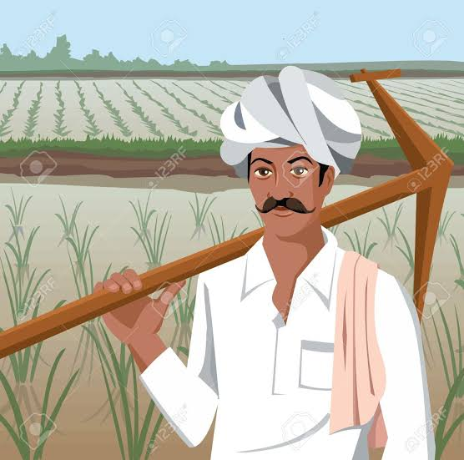
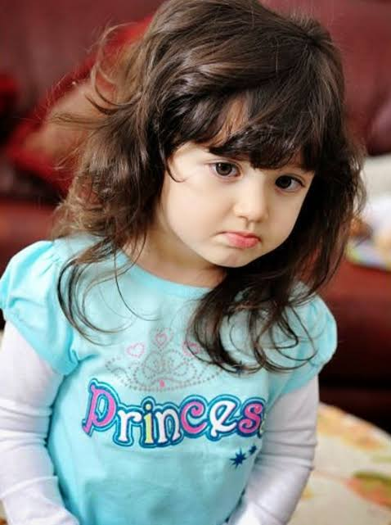
What can you see in this pictures?
There are many kind of pictures.

Slide 6
Today’s lesson
Alphabet F f -- J j
Unit : 02
Lessons : 4-6
Page : 05

Slide 7
Learning outcomes
At the end of the lesson students will be able to-
1.1.1 become familiar with English sounds by listening to common English words.
1.1.2 say simple words and phrases with proper sounds and stress.
1.2.1 recognize and read the alphabet both small and capital (non-cursive).
1.3.1 recognize and read the name of objects having the same initial and final sounds.

Slide 8
Look listen and say-
W.C.W
F f
Farmer

Slide 9
Look listen and say-
W.C.W
G g
Girl

Slide 10
Look listen and say-
W.C.W
H h
Hut

Slide 11
Look listen and say-
W.C.W
I i
Igloo

Slide 12
Look listen and say-
W.C.W
J j
Jeep

Slide 13
Read and say. Trace and write-
wcw
farmer
igloo
hut
jeep
girl

Slide 14
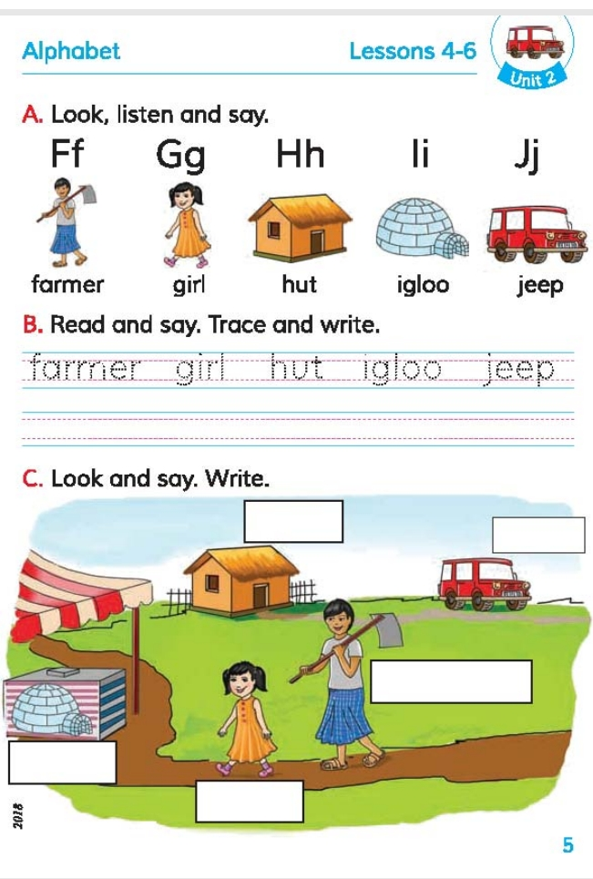
Open your EFT Book at page no 05

Slide 15
Click the right letter
Evaluation
Farmer
Q
P
R
F
S

Slide 16
Jeep
Q
J
R
S
T

Slide 17
Igloo
S
I
T
R
P

Slide 18
Click the right letter
Girl
N
K
O
L
G

Slide 19
Evaluation
Hut
P
R
T
H
Q

Slide 20
Say read & match
Igloo
Hut
Jeep
Farmer

Slide 21
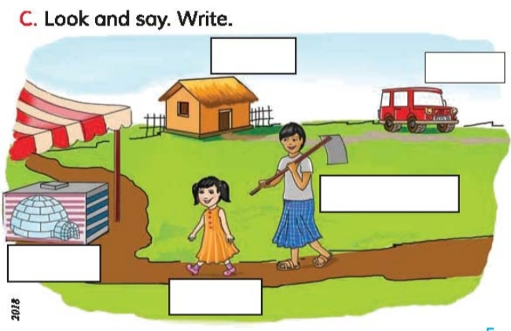
Home Work
Fill in the box.
# Write F f ----J j with small & capital letter .

Slide 22
Goodbye song

Slide 23
Thanks to all

