Slide 1
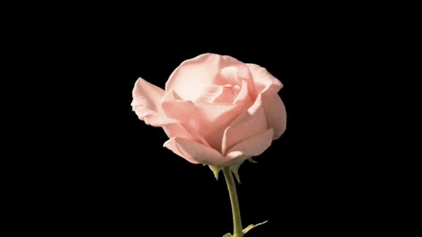
WELCOME

Slide 3
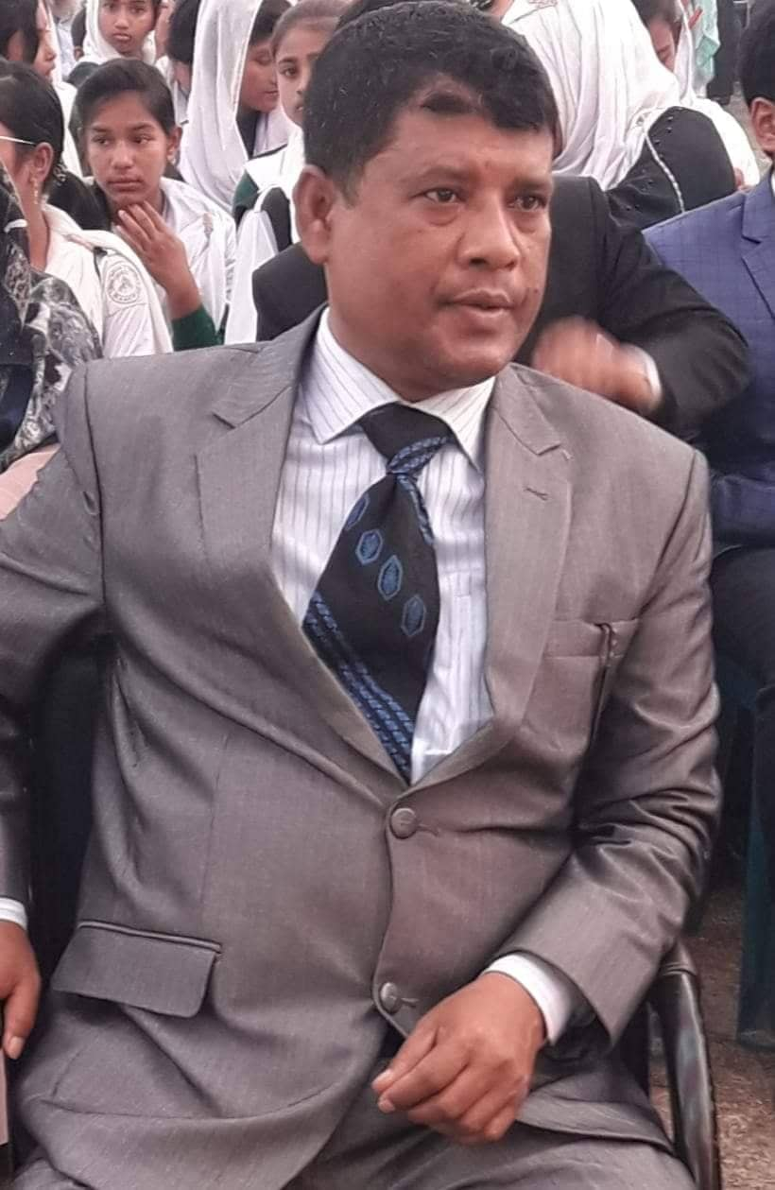
TEACHER’S IDENTIFICATION
Md. Rafiqul Islam
Senior teacher
Sureswar High School and college
Naria, Shariatpur
Email : rafiq91269@gmail.com

Slide 4
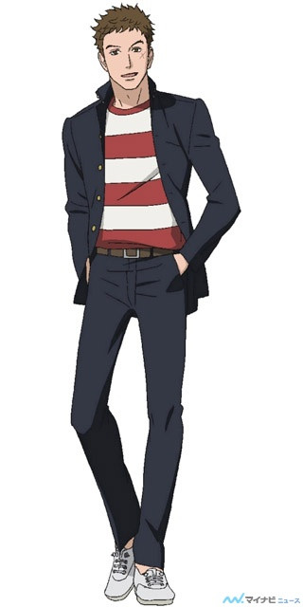
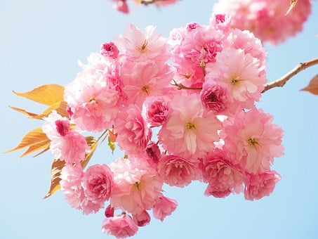
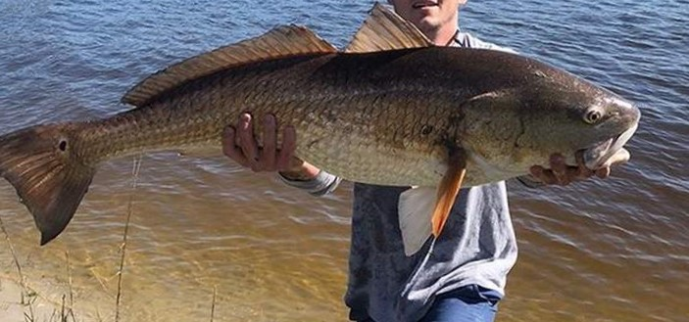
What do you see in the picture ?
Beautiful flower
Big fish
Tall boy

Slide 5
What are these ?
These are Adjectives……?
Yes, Todays topic is Adjective.

Slide 6
Target
End of the lesson learners will able to know –
What is Adjective ?
About some adjective.
Form of Adjective(degree).

Slide 7
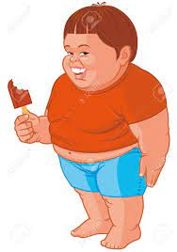
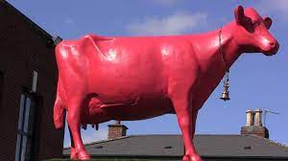
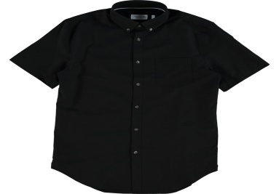
What is Adjective?
An Adjective is a word which qualifies or modifies a noun or a pronoun.
Example :
This is a short boy.
That is a red cow.
I have a black shirt

Slide 8
Here are some Adjectives.
good, bad, black, beautiful, useful, wonderful, ugly, red, nice, many, some, little, big, short, white , nice, ten, two, new, old, small, red long, short, tall, rich, poor, honest, bright, blind, cold, deep, low etc.

Slide 9
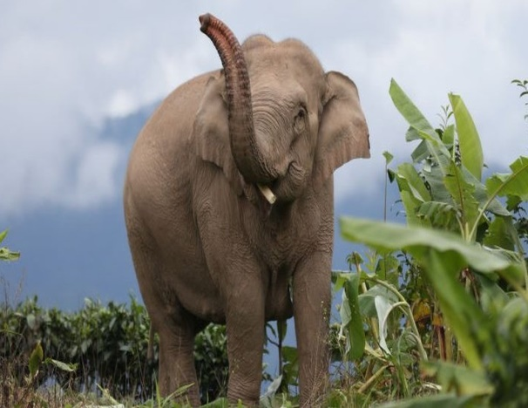
Form of Adjective(degree)
Big
Bigger
Biggest

Slide 10
What is degree ?
A degree in English grammar refers to the level or intensity of an Adjective or Adverb.
There are three degrees :
Positive degree
Sweet, fat, happy
Comparative degree
Sweeter , fatter, happier
Superlative degree
Sweetest, fattest, happiest

Slide 11
Some form of Adjective(Degree)
Black blacker blackest
Old older oldest
Ugly uglier ugliest
Healthy healthier healthiest
Many more most
Big bigger biggest
Beautiful more beautiful most beautiful
Good better best
Bad worse worst
Positive
Comparative
Superlative

Slide 12
Find out Adjective in the following sentences :
a) She is a beautiful girl.
b) Are you happy ?
c) Dhaka is a populous city.
d) Siam is an honest man.
e) These books are new.
f) There is little water in the pond.
g) I won the first prize.
h) He gives me five mangoes.
i) We have much money.

Slide 13
Solution :
b) happy
c) populous
a) beautiful
d) honest
e) new
f) little
g) first
h) much

Slide 14
Give the comparative and superlative forms of the following.
Positive comparative superlative
Wonderful ________ _________
Hot ________ _________
Easy ________ _________
Strong ________ __________
Brave ________ __________
Poor ________ __________
Good ________ _________
Bad _________ _________

Slide 15
Solution :
Positive comparative superlative
Wonderful more wonderful most wonderful
Hot hotter hottest
Easy easier easiest
Strong stronger strongest
Brave braver bravest
Poor poorer poorest
Good better best
Bad worse worst

Slide 16
Find out the Adjective in the following sentences :
I am weak in English.
The poor lives from hand to mouth.
There is a little water in the jar.
He is a wise man.
This boy is brilliant.
He is a rich man.
We have much money.

Slide 17
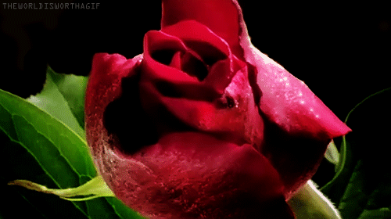
THANK YOU

