Slide 1
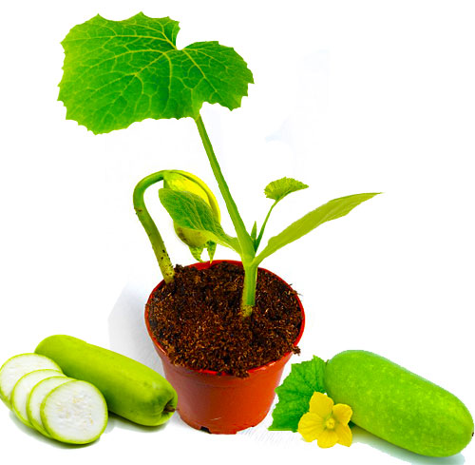
Welcome
To my English class

Slide 2
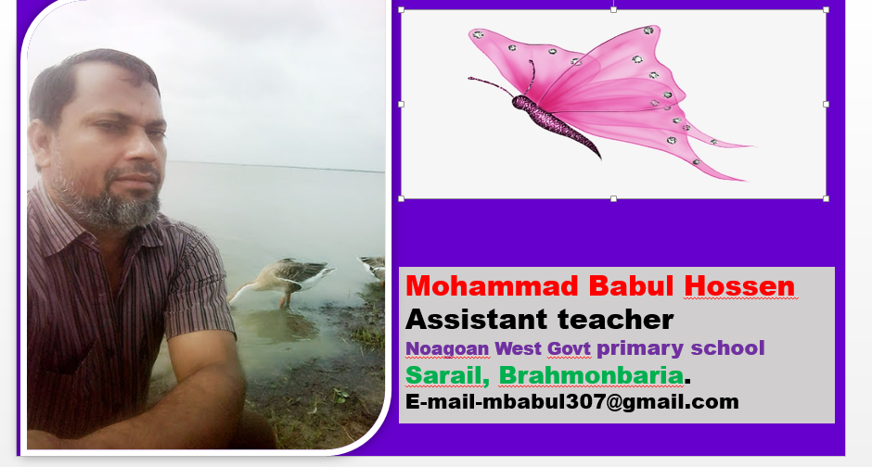
Sub : English
Class : 5
Unit : 4
Topics- Leisure time
Activity -(E,F,G)
Lesson : 5

Slide 3
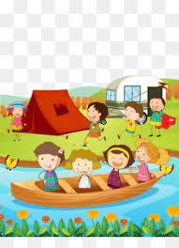
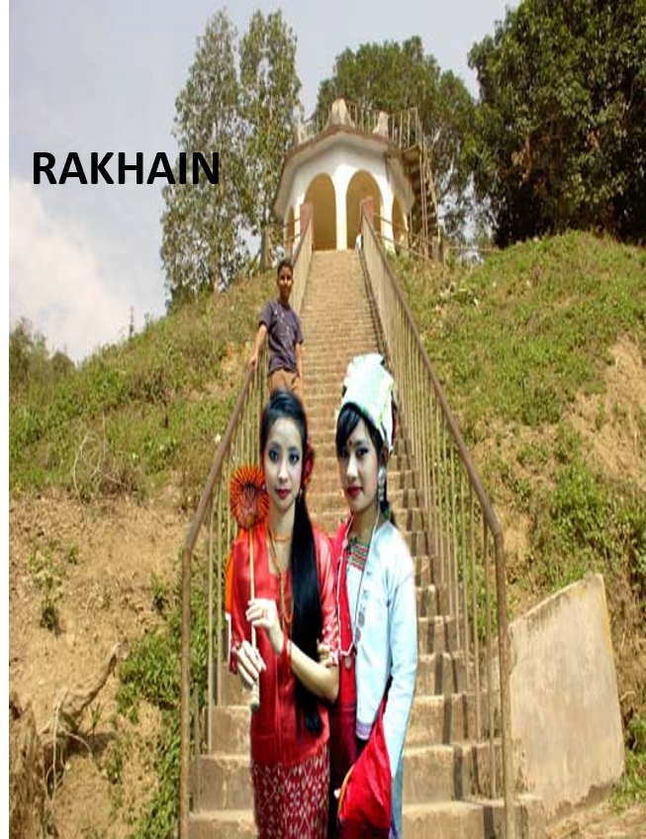
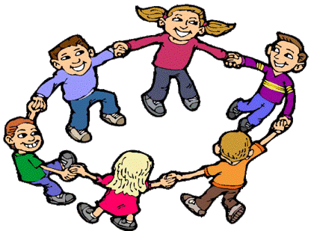
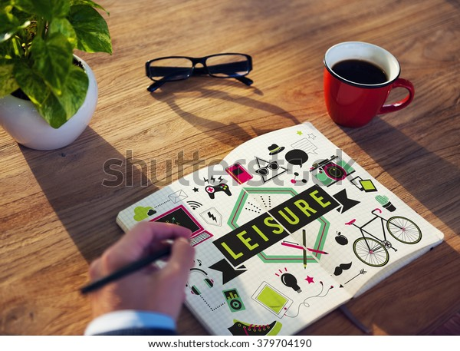
What you do in your free time and why you do it?

Slide 4
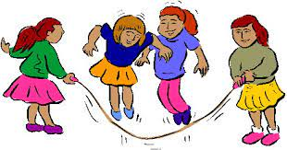
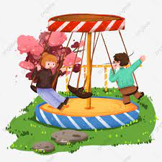
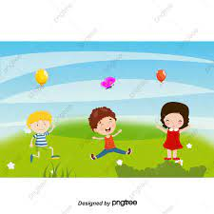
Today’s Lesson
Leisure Time

Slide 6
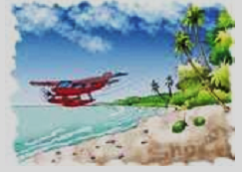
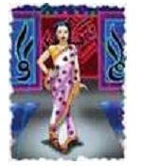
What can see you in these picture ?
Fashion
Travel

Slide 7
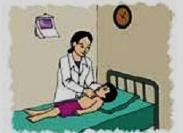
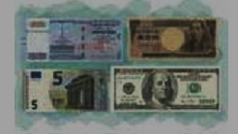
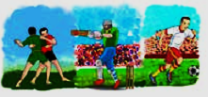
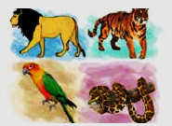
What can see you in these picture ?
Health
Business
Sports
Wildlife

Slide 8
Meaning of words
A.
D.
Fashion(ধরন, রেওয়াজ)
Business(ব্যবসা)
B.
E.
Travel (ভ্রমন,ঘুরা )
Sports(খেলাধুলা)
C.
F.
Health,(স্বাস্থ্য)
Wildlife(বন্যপ্রানী)

Slide 9
Match the picture with the following words
Wildlife
Business
Health
Travel
Sports
Fashion

Slide 10
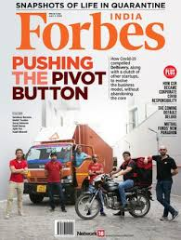
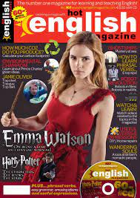
What can see you in the picture ?

Slide 15
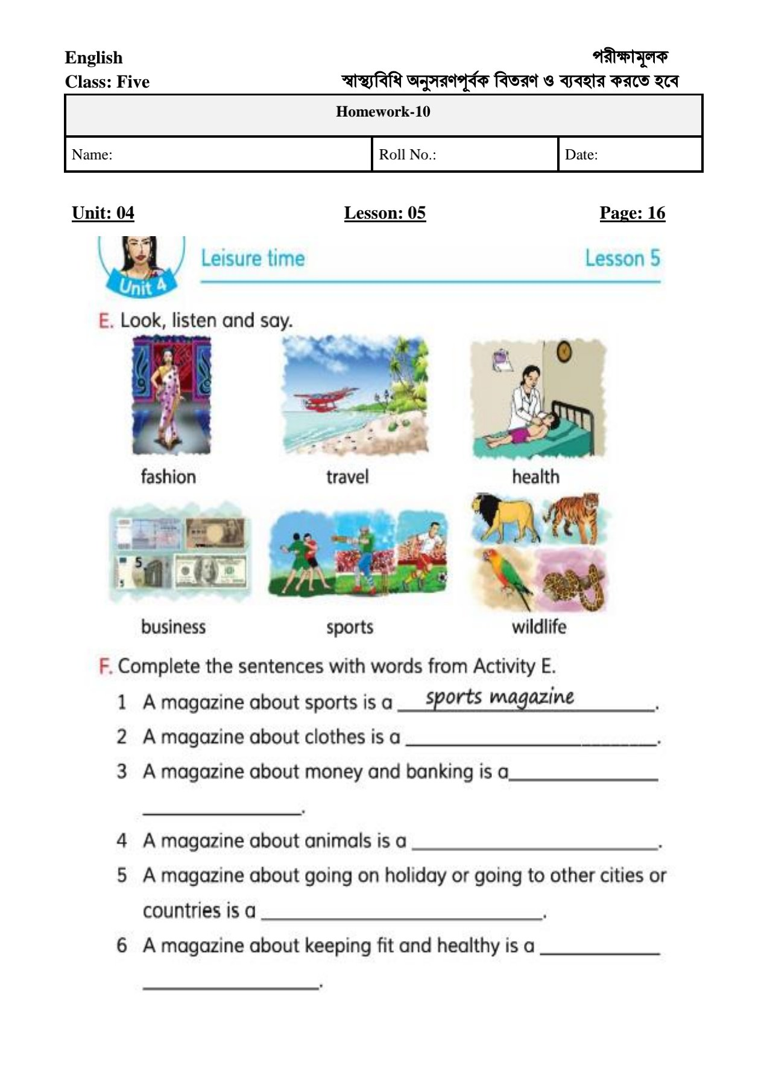
Open at page 16 .
Discuss in groups and fill in the blanks
Group work

Slide 16
Pair work
Talk about a magazine that you like .If don’t read magazine,
talk about the topics you’re interested in---
Example: I like sports magazines.
I love cricket and kabadi.

Slide 17
Evaluation
IF true RAISE YOUR RIGHT HAND
and if false RAISE YOUR LEFT HAND .
A magazine about sports is a sports magazine .
A magazine about clothes is a health magazine.
A magazine about money and banking is a fashion magazine .
A magazine about animals is a wildlife magazine .
A magazine about going on holiday to other cities is a travel magazine
A magazine about keeping fit and healthy is a business magazine .

Slide 18
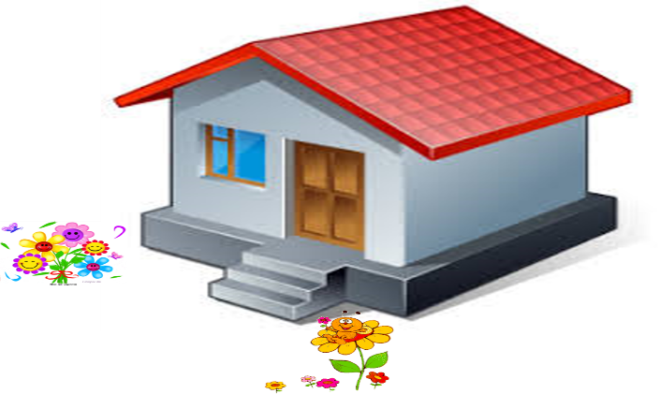

Slide 19
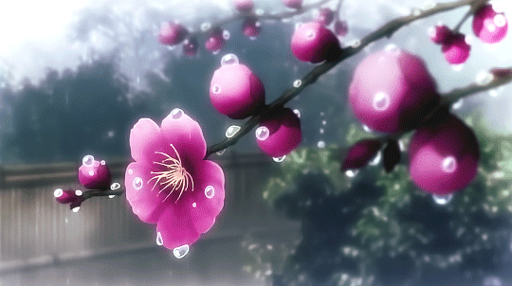
Thank you very much.
No more today
See you later.

