Slide 1
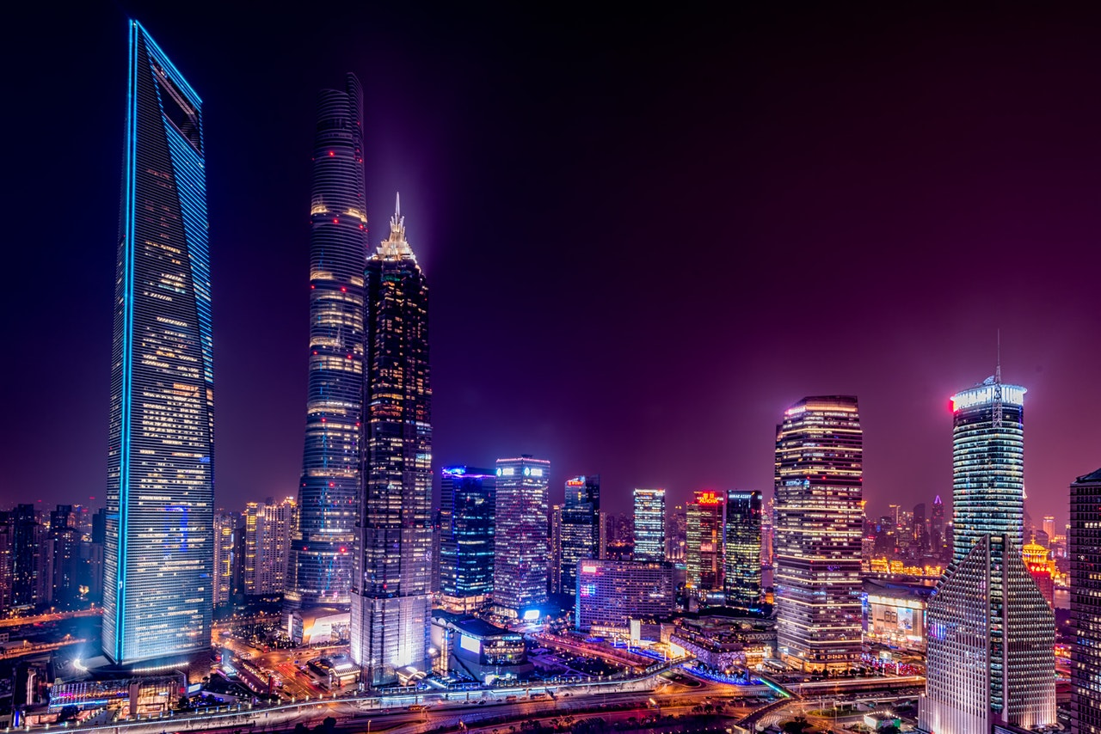
Welcome to multimedia class
Use mask, stay safe.
Thanks for enjoying my class
Congratulation all

Slide 2






Lutfor Rahman (M,A, M-Ed)
Assistant Teacher,
SB Trainer English, Arts and Crafts and BGS.
Selected Master Trainer in English TMTE Project British Council and DPE.
ICT4E District Ambassador, Dinajpur
Kundarampur, Government Primary school School,
Ghoraghat, Dinajpur.
E-mail: mlutfor81@gmail.com

Slide 3

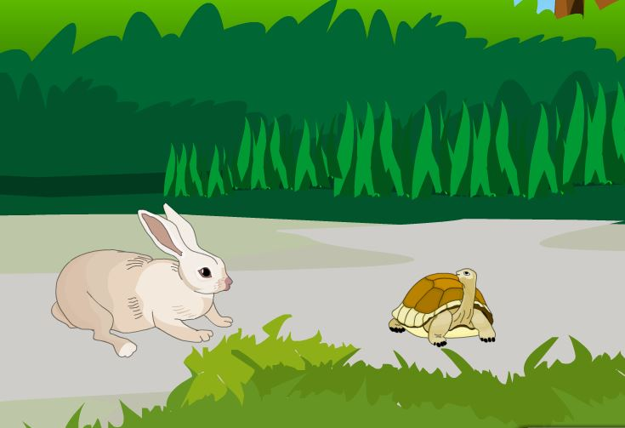

Dear students, think and try to say, what about the story.
Yes, you are correct. The story is about the hare and the tortoise. Thank you all. Today`s lesson is…

Slide 4
Dear students, think and try to say, what about the story.
Yes, you are correct. The story is about the hare and the tortoise. Thank you all. Today`s lesson is…

Slide 5

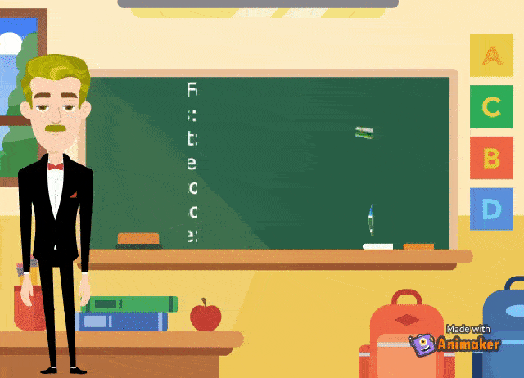
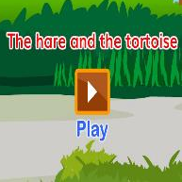

Slide 6
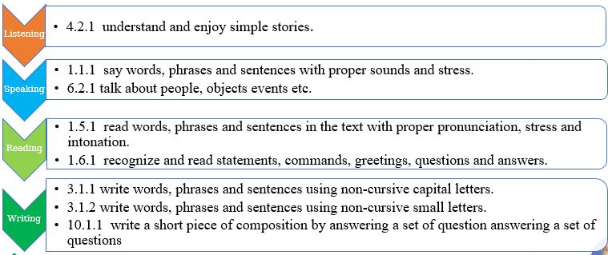
Learning Outcomes
Listening
4.2.1 understand and enjoy simple stories.
Speaking
1.1.1 say words, phrases and sentences with proper sounds and stress.
Reading
1.5.1 read words, phrases and sentences in the text with proper pronunciation, stress and intonation.
Writing
3.1.1 write words, phrases and sentences using non-cursive capital letters.
6.2.1 talk about people, objects events etc.
1.6.1 recognize and read statements, commands, greetings, questions and answers.
3.1.2 write words, phrases and sentences using non-cursive small letters.
10.1.1 write a short piece of composition by answering a set of question answering a set of questions

Slide 7

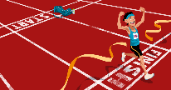
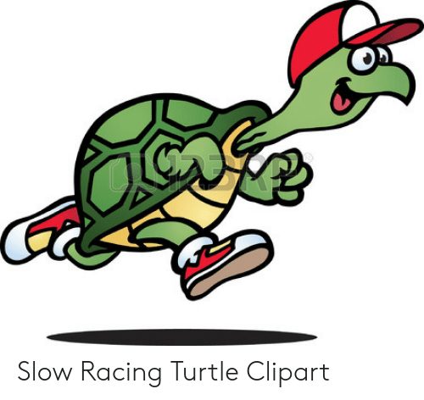
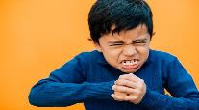
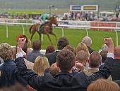
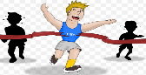
Fast
Quick
The hare is a fastest animal.
Slow
Late
The tortoise is a slowest animal.
Angry
Crazy
He felt angry.
Watch
Observe
Why don`t we have a race?
Race
Run
Can`t you run?
Win
victory
Maybe I can win!

Slide 8
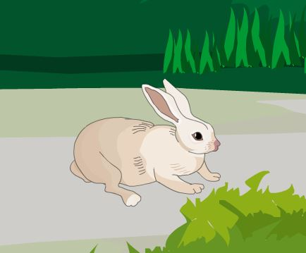

One day, a hare was walking in the forest when he saw a tortoise. The hare was the fastest animal in the forest. The tortoise was the slowest animal in the forest.

Slide 9
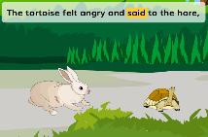
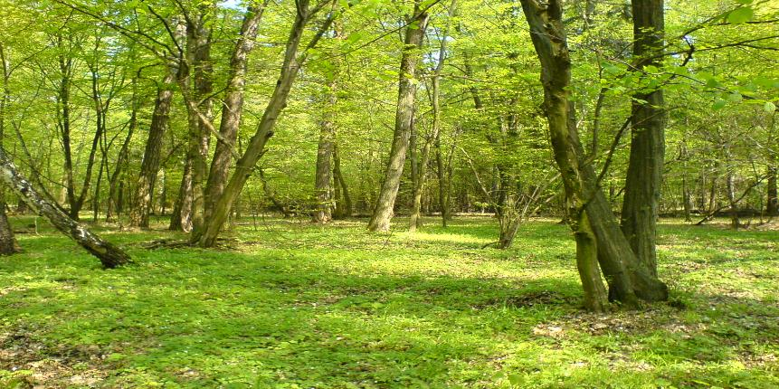
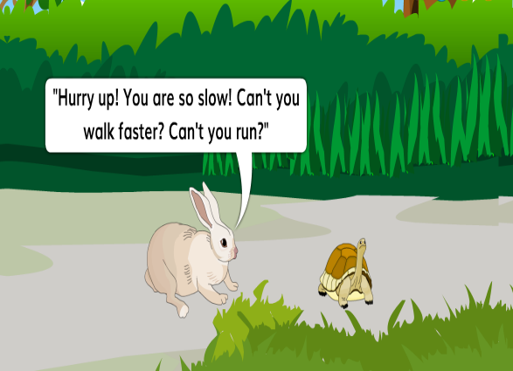
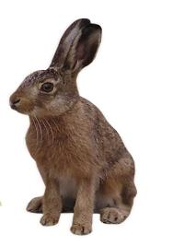

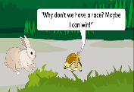
The tortoise felt angry and said to the hare, “Why don’t we have a race? Maybe I can win!”
The hare called out to the tortoise, `` Hurry up! you are so slow! can`t you walk faster? can`t you run?

Slide 10
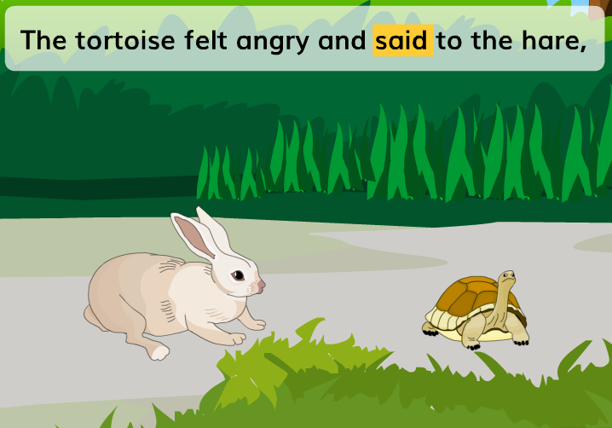
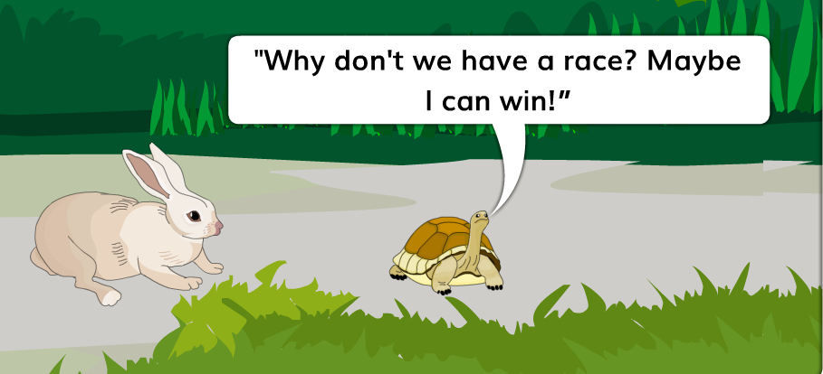
The tortoise felt angry and said to the hare, “Why don’t we have a race? Maybe I can win!”

Slide 11
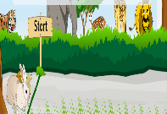
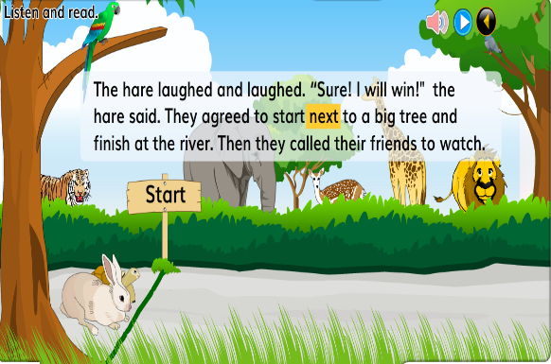
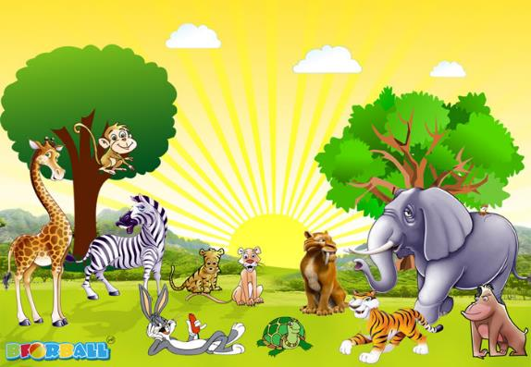
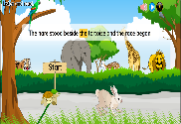
The hare stood beside the tortoise and the race began.
The hare laughed and laughed. “Sure! I will win!” the hare said. They agreed to start next to a big tree and finish at the river. Then they called their friends to watch.

Slide 12
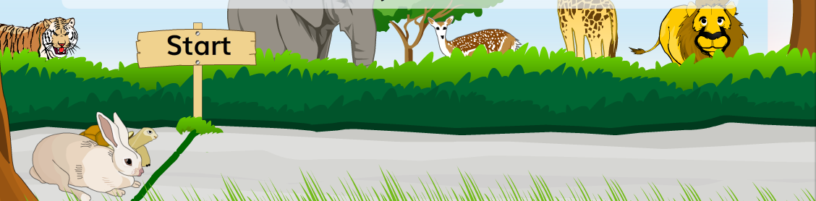
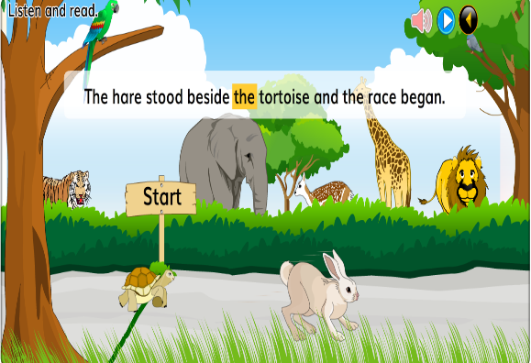
The hare stood beside the tortoise and the race began.

Slide 13

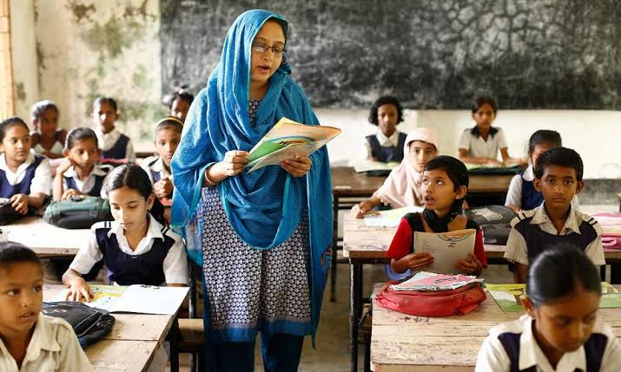
Dear students,
open your book at page 54. Say after me.

Slide 14


One day, a hare was walking in the forest when he saw a tortoise. The hare was the fastest animal in the forest. The tortoise was the slowest animal in the forest. The hare called out to the tortoise, `` Hurry up! you are so slow! can`t you walk faster? can`t you run? The tortoise felt angry and said to the hare, “Why don’t we have a race? Maybe I can win!” The hare laughed and laughed. “Sure! I will win!” the hare said. They agreed to start next to a big tree and finish at the river. Then they called their friends to watch. The hare stood beside the tortoise and the race began.

Slide 15

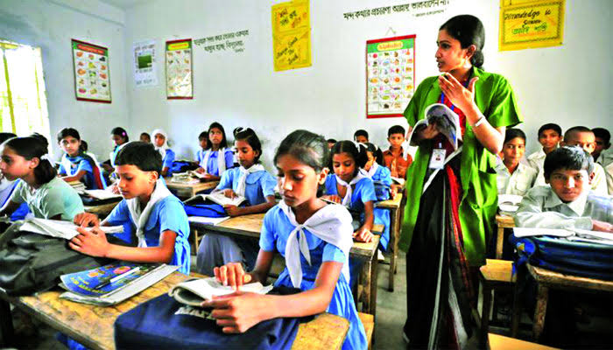
Dear students, read the text silently.
Open your English book at page number 54 read and point out with your finger.

Slide 16

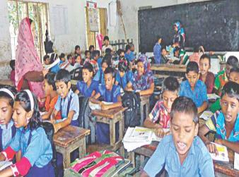
Dear students read the text loudly.

Slide 17

Write ‘True’ for correct statement or ‘False’ for incorrect statement.
a) The hare was the fastest animal.
b) The tortoise laughed and laughed.
c) The tortoise called out the hare at first. d) The Tortoise felt angry.
d) The hare and the tortoise agreed to start a race.
e) The hare was dancing in the forest
True
False
False
True
False

Slide 18

Answer the following questions.
Answers:
One day the hare was walking in the forest.
The hare was the fastest animal in the forest.
The hare called out to the tortoise, “Hurry up! You are so slow!
They agreed to start next to a big tree and finished at the river.
a) What was hare doing one day?
b) Who was the fastest animal in the forest?
c) What did the hare call out to the tortoise?
d) What did the hare and the tortoise agree?

Slide 19

Answers the following questions:
Answers:
The hare was moving fast.
The hare saw the tortoise when he was walking.
The hare laughed and laughed.
The tortoise felt angry.
Other animal came to see the race.
1. How was the hare moving ?
What did the hare see when he was walking ?
Who laughed and laughed?
4. Who felt angry ?
5. Who came to watch the race?

Slide 20

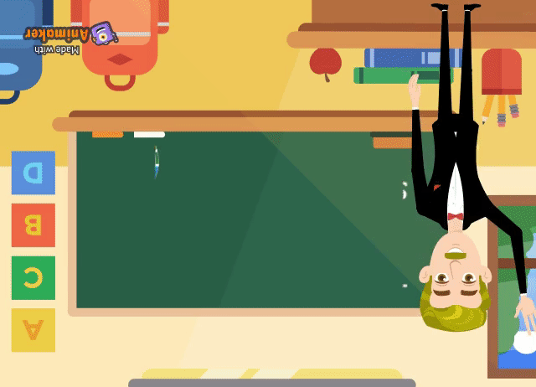
Write a short composition on “The Hare and the Tortoise in at least 5 sentences answering the following questions.
1. Who was the fastest animal?
2. Who was the slowest animal?
3. What happened one day?
4. Who was angry?
5. Who was sure to win?

Slide 21


