Slide 1

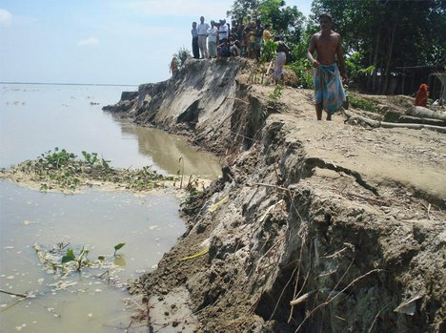
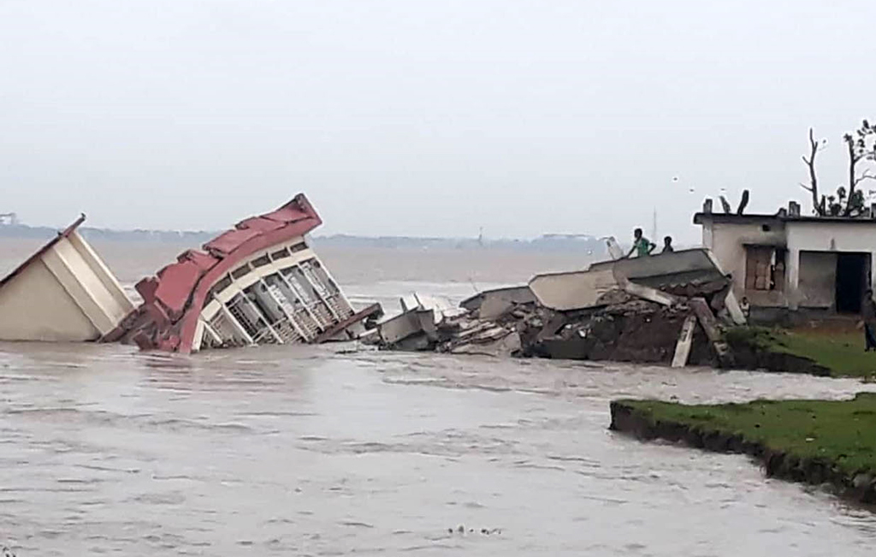

Slide 2
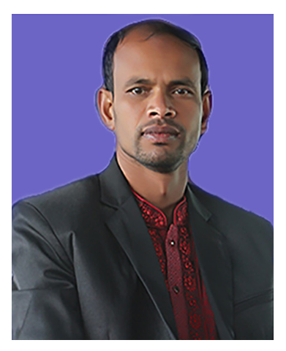
Presented by-
Mottalib Hossain
Assistant Teacher (English)
Shambhudia M.LHigh School.
Mobile: 01723-457771
Email: m.mottalib95@gmail.com

Slide 3
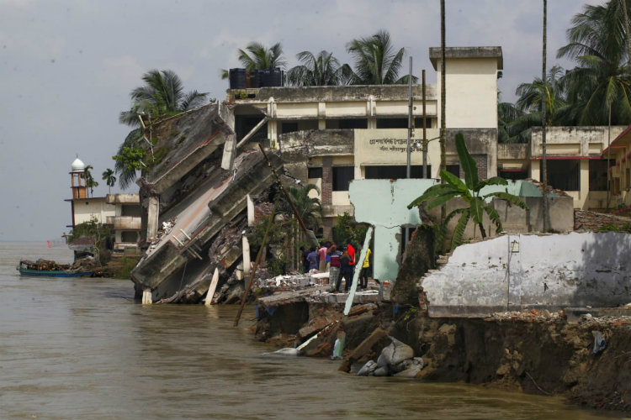
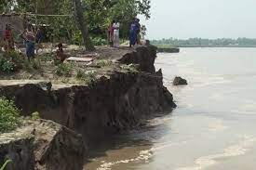
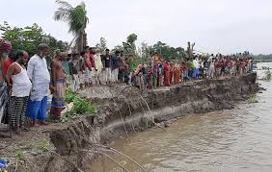

Slide 4
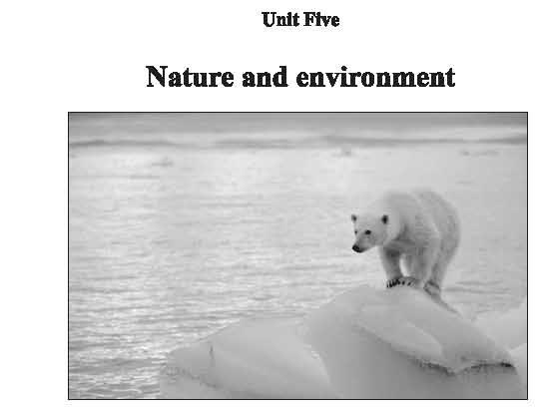
What is our today’s topic?
Our today’s topic is…
Unit : Five
Lesson : One
Page : 56
The greed of the mighty rivers

Slide 5
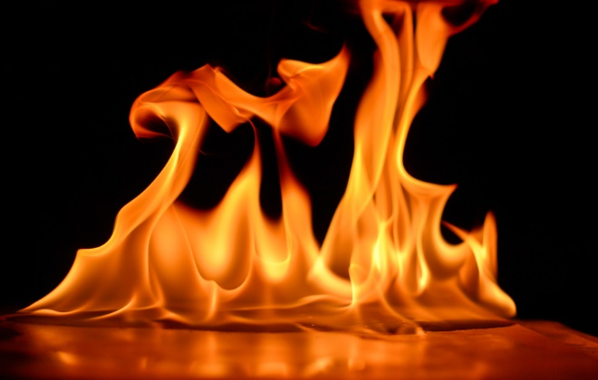
Important words to know
embankment
/ɪmˈbæŋk.mənt/
an artificial slope made of earth or stones:
Example: a river embankment
tremble
/ˈtrem.bəl/
to shake slightly, usually because you are cold, frightened, or very emotional:
Example: When he came out of the water, he was trembling with cold.
flame
/fleɪm/
a stream of hot, burning gas from something on fire:

Slide 6
turmoil
/ˈtɜːmɔɪl/
a state of , uncertainty, or disorder
প্রচন্ড আলোড়ন, অশান্তি
shattered
/ˈʃæt.əd/
broken into very small pieces
Example: Shattered glass lay all over the road.
whisper
/ˈwɪs.pər/
to speak very quietly, using the breath but not the voice, so that only the person close to you can hear you
Example: It's rude to whisper!

Slide 7
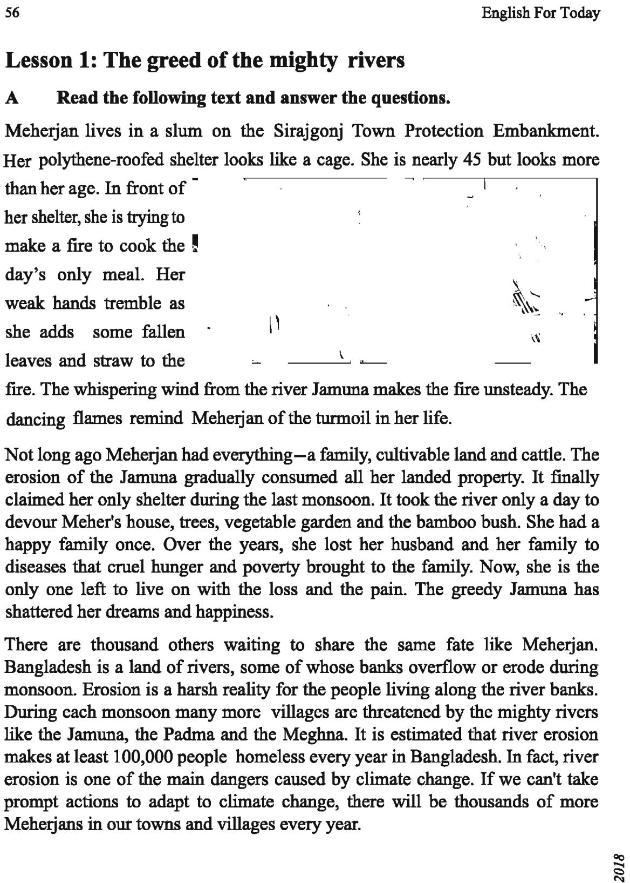

Slide 8
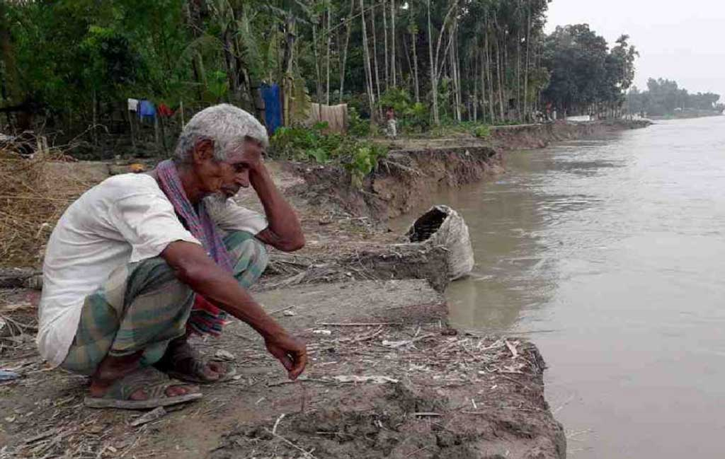

Slide 10
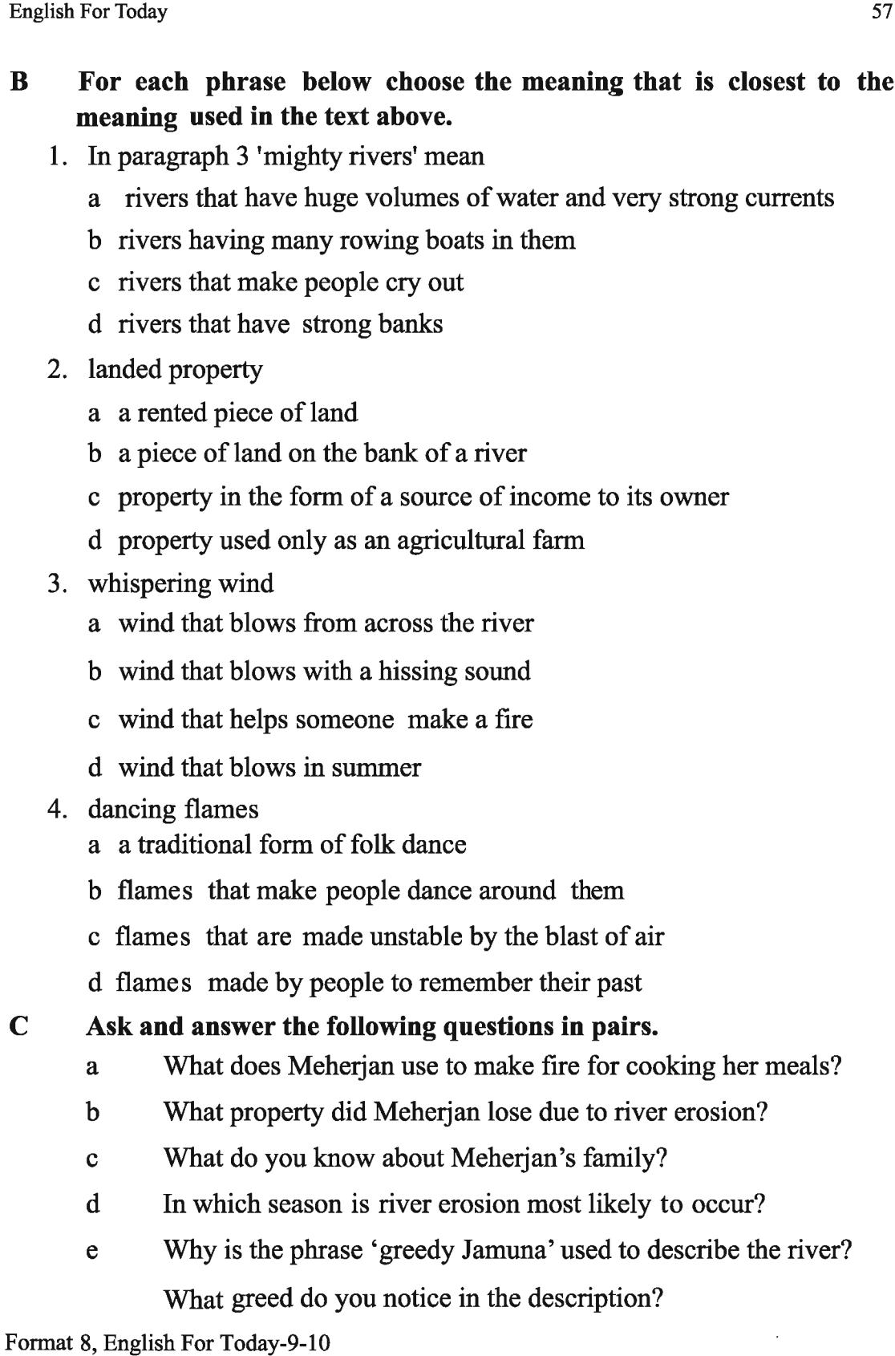

Slide 12
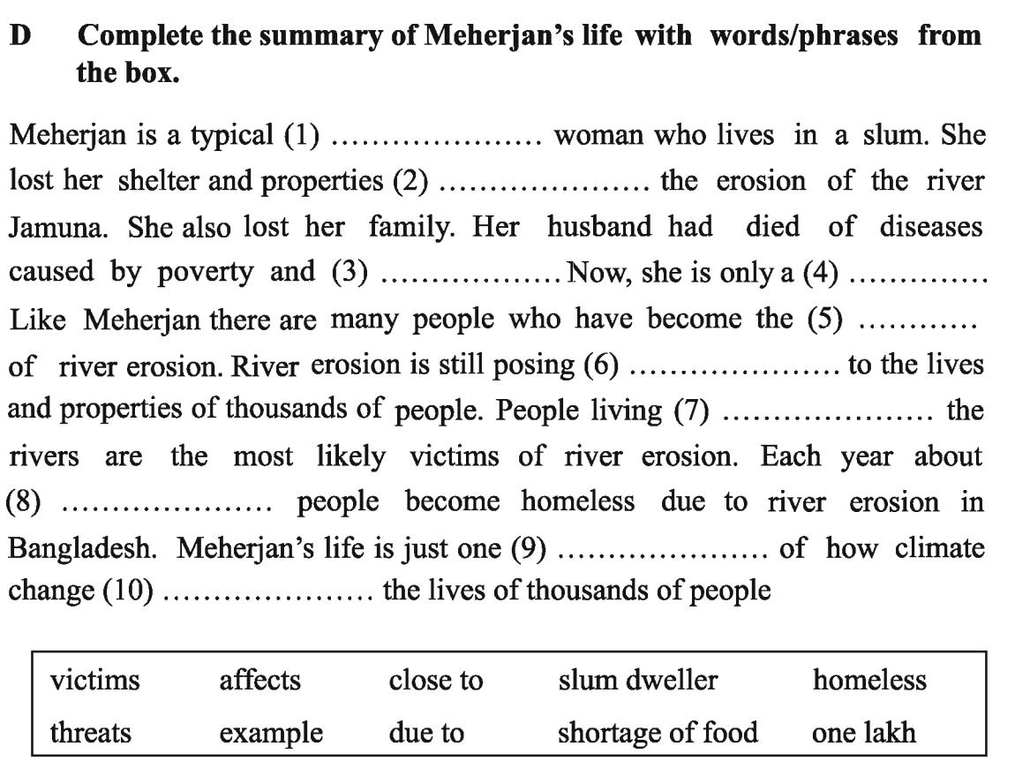
Assignment
homeless

Slide 13

