Slide 1
Welcome
Notes:
Welcome slide.

Slide 2
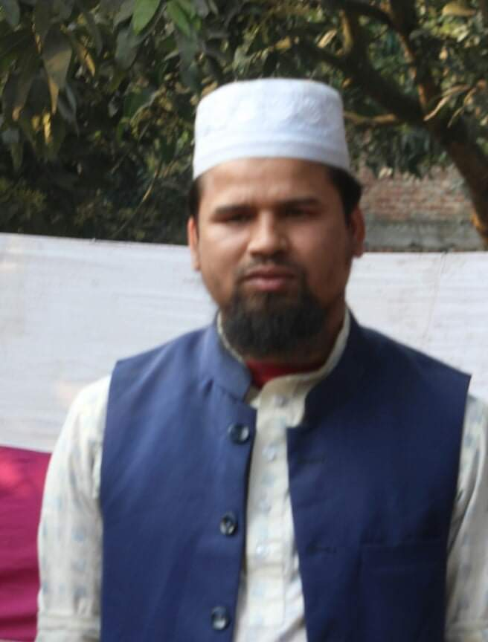
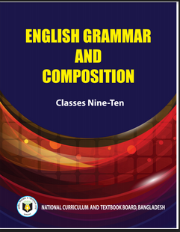
Identity
Md. Farid Uddin
ENGLISH
Dupchanchia D.S Fazil Madrasah.

Slide 3
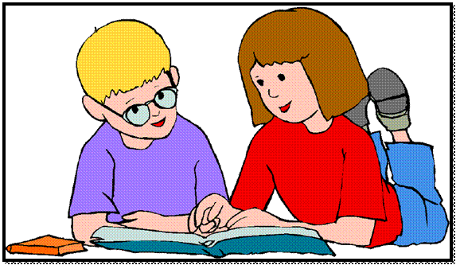
WHAT ARE THE STUDENTS DOING HERE?

Slide 4
Our Topic is
Exercise on Sentence Connectors

Slide 5
Learning outcomes
After completing this lesson, we will be able to –
prepare for the S.S.C examination
Notes:
Aim of this lesson.

Slide 6
1. Complete the passage using suitable connectors.1 x 5 = 5
City life has its both advantages (a) --- disadvantages. (b) --- it provides many facilities, it is often expensive and over-crowded. The people (c)-------earn much money can enjoy city life very well. Many young people like the excitements of city life. (d) --- many older people do not like it (e) --- it is full of noise and pollution.

Slide 7
Answer-1
and
(b) Though
(c)Who
(d) But/On the other hand
(e) because/as/since

Slide 8
2. Complete the passage using suitable connectors.1 x 5 = 5
Travelling has a great importance in our life. (a) --- we go out visiting various interesting places, we can learn many things practically. (b) ---, it also removes our monotony and boredom. (c) --- we have read in books on history or geography will remain incomplete without visiting them. (d) ---, many countries have laid great importance on travelling. In Russia, (e) ---, there are some subjects on which theoretical teaching is not given to the students in the first year of their schooling.

Slide 9
Answer-2
If
(b) Moreover
(c) That
(d) So/For which
(e) for example

Slide 10
3. Complete the passage using suitable connectors.1 x 5 = 5
Everybody knows (a) ----- sincerity is the key to success. A sincere person can prosper in life. The man (b) ----- does not follow the rules of sincerity can never go a long way in the world. Many a man is not conscious of the importance of sincerity for (c) ----- they don’t have the benefit of success. (d) ------, we should be sincere to our work. (e) ----- we are sincere to our work, we will suffer in the long run

Slide 11
Answer-3
that
(b) who
(c) which
(d) So/As a result
(e) Unless

Slide 12
4. Complete the passage using suitable connectors.1 x 5 = 5
The moon is a very familiar figure to all of us. She awakens a feeling of love and tenderness in our hearts. (a) ----- the infant in arm stretches out its hands to grab this beautiful object, (b) ---- her appeal is not confined to only children. The full moon has always played an important role in literature, (c) ----- science has different things to tell about the moon, (d) ----- on a clear night, we lookout on the magic of moon light, It is often difficult for us to realize (e) ----- the moon is shining in borrowed feathers.

Slide 13
Answer-4
Even
(b) but
(c) though
(d) when
(e) that

Slide 14
5. Complete the passage using suitable connectors.1 x 5 = 5
Forests are very important (a) --- trees produce oxygen (b) --- is essential for man and all living beings. (c) ---, trees help us in many ways. (d) --- trees are less in number, there will be an increased amount of carbon dioxide in the atmosphere and (e) --- tree plantation will less costly task than cure.

Slide 15
Answer-5
(a) because/as/since
(b) which
(c) Besides
(d) If
(e) so

Slide 16
6. Complete the passage using suitable connectors.1 x 5 = 5
Water is an important element of the environment. (a) ----- it is essential for living, it is called life. But polluted water is harmful (b) ----- it causes dangerous diseases. Polluted water causes not only diseases (c) ----- death. (d) ----- polluted water is dangerous, illiterate people drink it. We should prevent water pollution (e) ----- we may get safe and sound environment.

Slide 17
Answer-6
(a) As/Since
(b) because/as/since
(c) but also
(d) Though
(e) so that

Slide 18
7. Complete the passage using suitable connectors.1 x 5 = 5
It is known to all (a) --- about half of our populations are women. They are entitled to equal rights and privileges, (b) --- men enjoy. (c) --- in reality, they do not get their due. For the true development of our country, they should be given proper education and training. (d) ---, every woman is a potential mother and her influence on her children is very great. (e) --- we should pay proper attention to our women folk.

Slide 19
Answer-7
(a) that
(b) what
(c) But
(d) Moreover,
(e) So/As a result

Slide 20
8. Complete the passage using suitable connectors.1 x 5 = 5
Corruption has become a part and parcel of our life. (a) --- no office work is done without corruption; people have it as an acceptable practice. (b) --- this evil practice should be stopped. (c) --- the government is strict, it will not be possible. (d) --- some corrupt officials are punished, it has not been evicted from govt. offices. (e) --- , it must be eradicated at any cost.

Slide 21
Answer-8
(a) As
(b) But
(c) Unless
(d) Though
(e) So

Slide 22
9. Complete the passage using suitable connectors.1 x 5 = 5
Global warming is increasing day by day (a)------ deforestation. We cut down trees (b) --- never think of planting more trees, (c) --- humans and other living beings are in the threat of extinction. Time is coming (d) --- there will be no tree left for us. (e) --- we have to face bitter consequences of deforestation.

Slide 23
Answer-9
(a) due to
(b) but
(c) so
(d) when
(e) As a result

Slide 24
10. Complete the passage using suitable connectors.1 x 5 = 5
It is better to have brain (a) ----- beauty. (b) ----- physical beauty is purely visual, the beauty of brain is all encompassing. It is (c) ----- a known fact that beauty is only-skin deep. What is worse is (d) ----- physical beauty is not ever-lasting (e) ----- it declines with age and time.

Slide 25
Answer-10
(a) than
(b) Though
(c) certainly
(d) that
(e) as/because/since

Slide 26
Thank You
Notes:
Ending slide.

