Slide 1
Welcome to you all

Slide 2
Identity
Edited by
Md.firoj Hossain
Assistant Teacher( Social science)
Subrajpur High School
Patnitola,Naogaon
E-Mail:firojpatnitola@gmail.com
Mob: 01716697972
Class : Nine
Subject : English 1st paper
Unit: Eight
Time : 50 Minutes
Date : 16/10/2021

Slide 3
Introduction
Md. Asgar Ali
Asst. Teacher(English)
Nutan Anantapur Girls’ High School
Ulipur, Kurihram.

Slide 4
English 1st paper
Class: Nine
Story writing

Slide 5
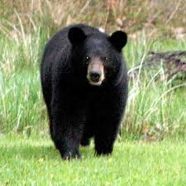
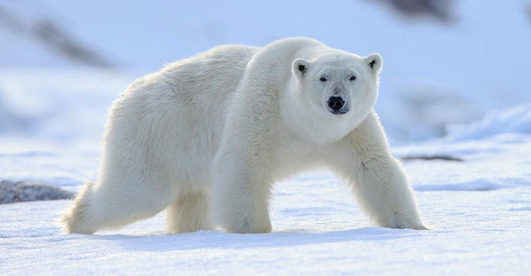
What do you see in the picture?
Bear

Slide 6
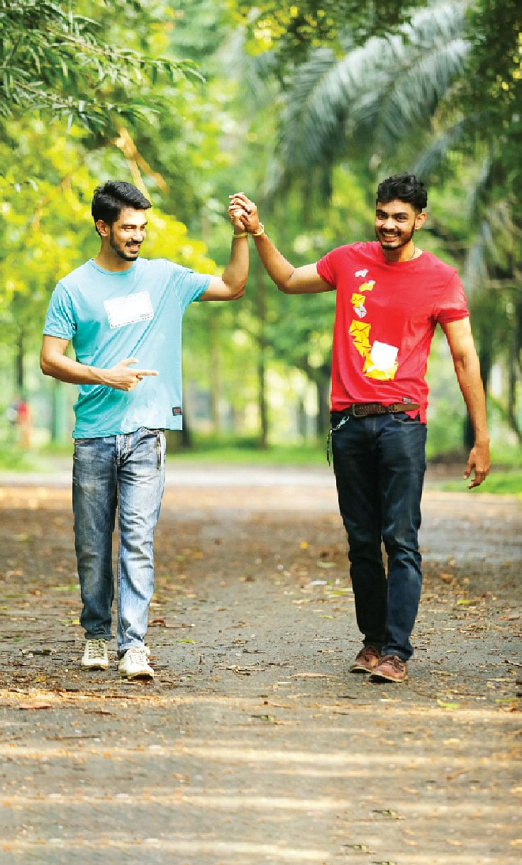
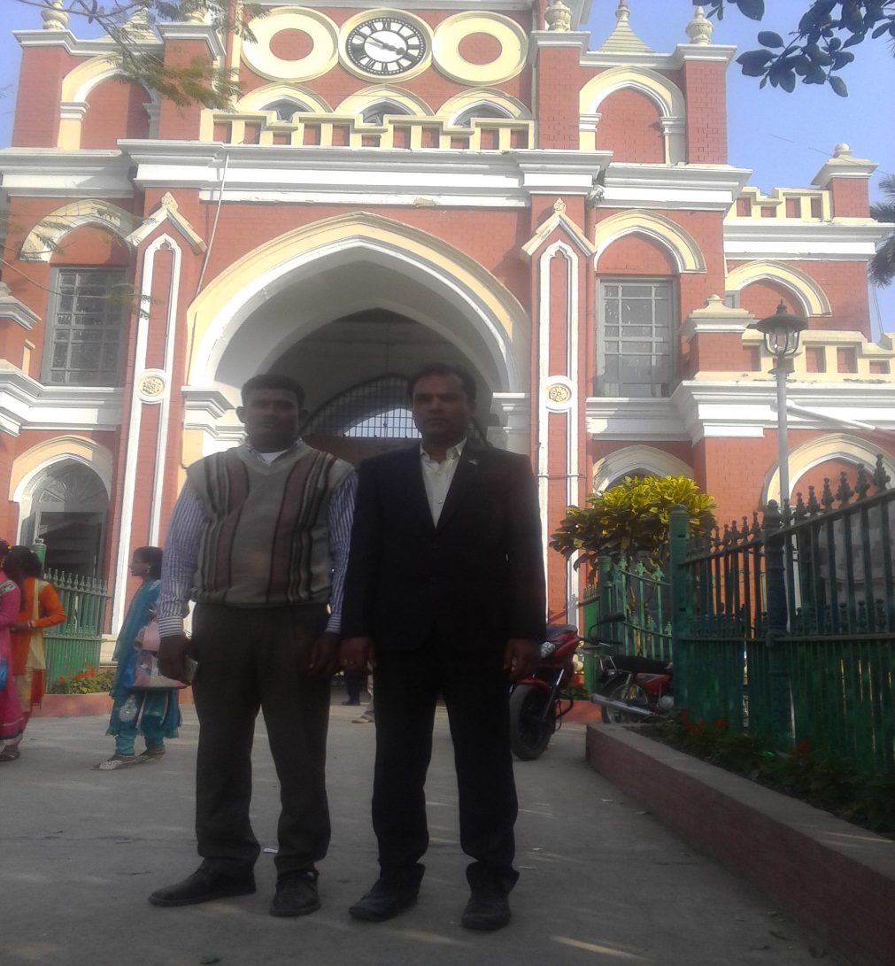
What do you see in the picture?
Two Friends

Slide 7
Today ,we shall discuss about the story of
Two Friewnds And a Bear

Slide 8
Learning Outcomes
After this lesson Students will be able to---
i)Describe the story;
ii) Say the antonyms of new words;
iii) Expand their imaginative power;
iv) Say the moral of the story.

Slide 9
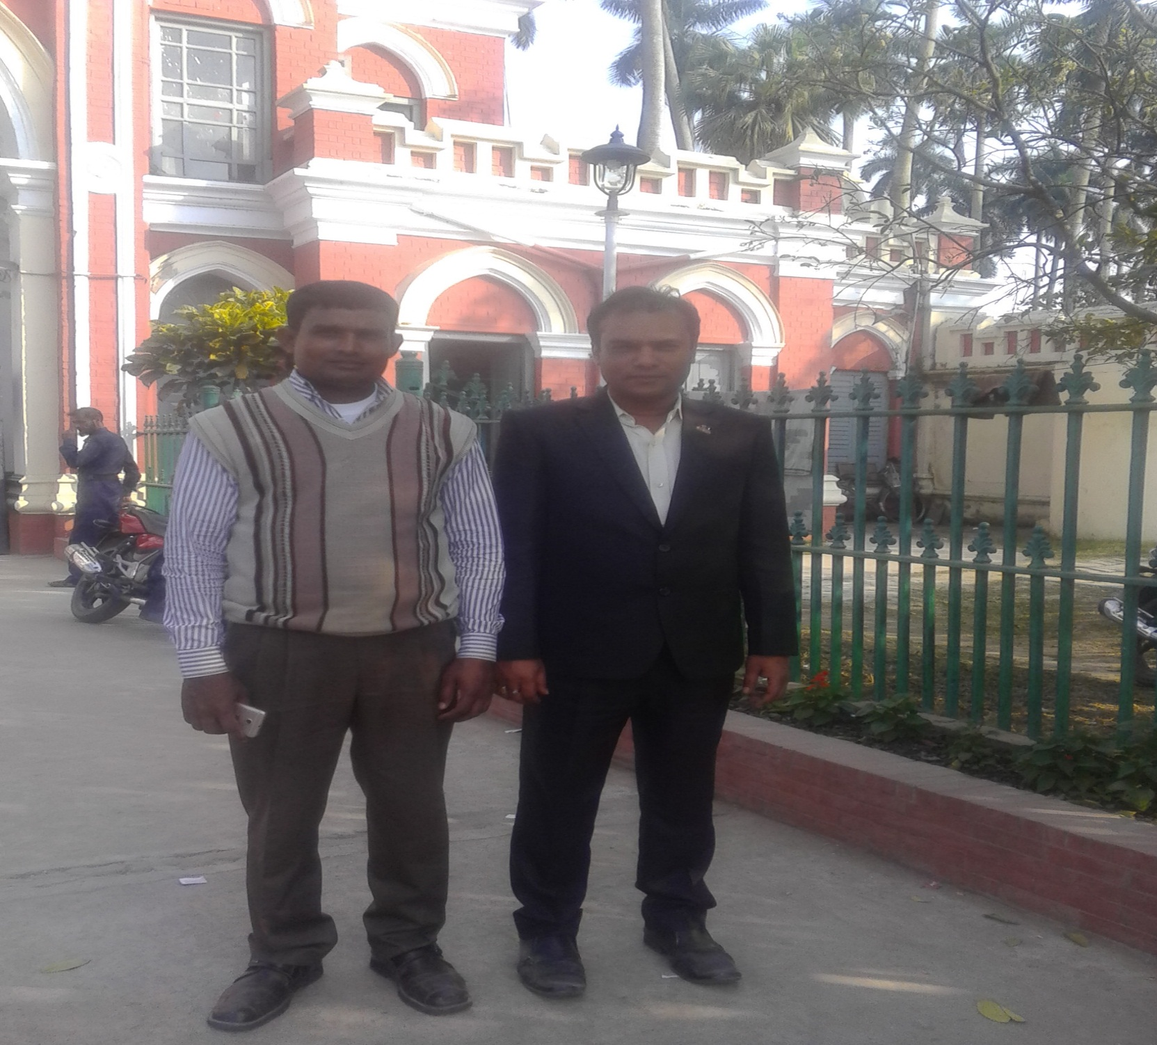
Once there were two intimate friends in a village.

Slide 10
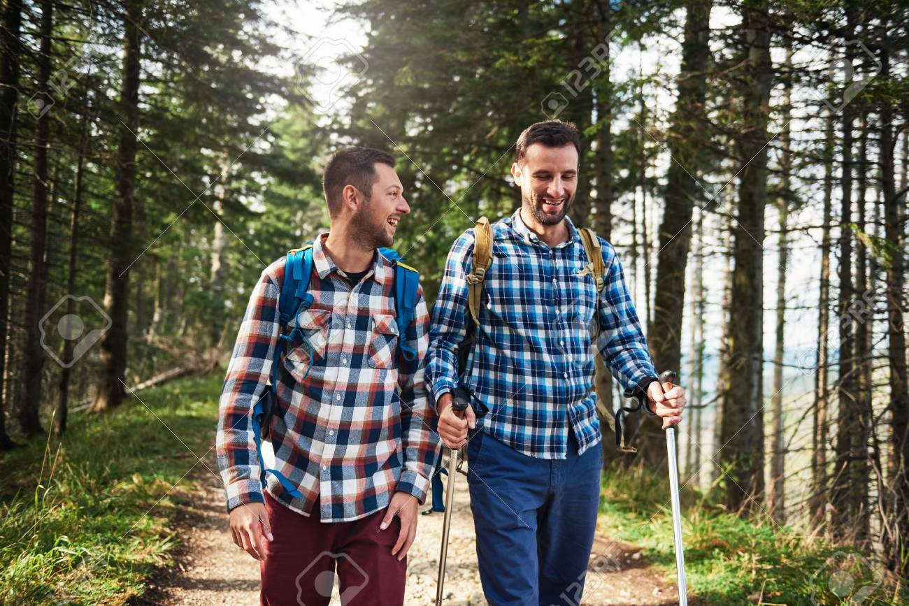
One day , they were walking in a forest. They promised to help each other in time of danger.

Slide 11
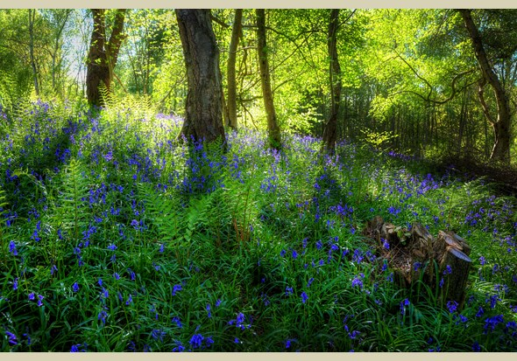
They walked and gossiped for a long time and entered into a deep forest.

Slide 12
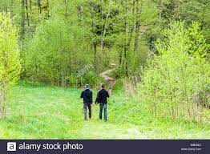
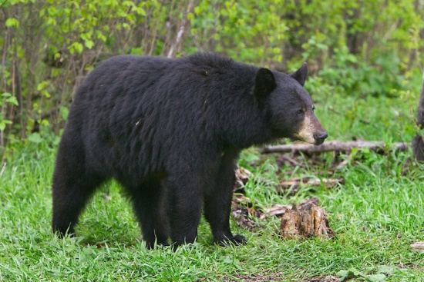
All on a sudden , they saw a bear coming towards them.

Slide 13
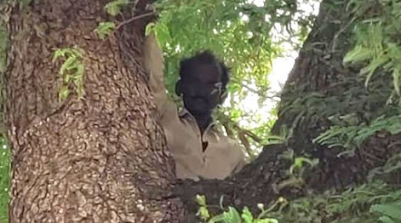
Instantly, 1st friend climbed up a tree.

Slide 14
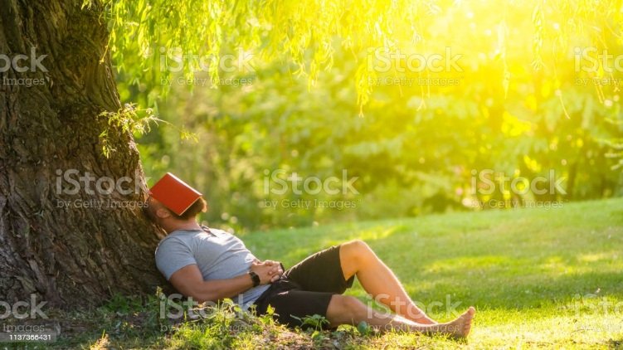
The other friend didn’t know how to climb up a tree. He lay down on the ground as a dead man . Because , he knew that a bear doesn’t eat a dead man.

Slide 15
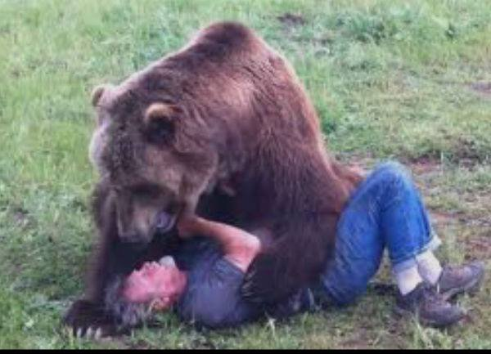
The bear came . It smelt the 2nd friend’s nose and ear .

Slide 16
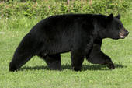
It thought him to be a dead man and went away.

Slide 17
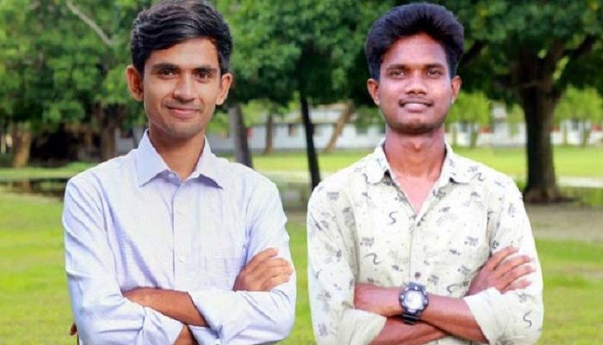
The first friend got down from the tree and asked the second friend what did the bear whisper into your ear. The second friend said ,”The bear advised me not to believe a friend who leaves his friend in time of danger.”

Slide 18
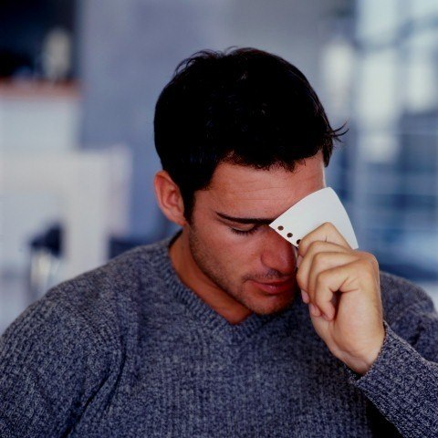
At this, the first friend felt ashamed
and left the place quickly.

Slide 19
Pair Work
i)Where did two friends live?
ii) What kind of friends were they?

Slide 20
Antonyms
Words Opposite words
Climbed up
Got down
Friend
Enemy/foe
intimate
unfriendly
instantly
slowly

Slide 21
Write ten sentences about the characteristic about second friend.

Slide 22
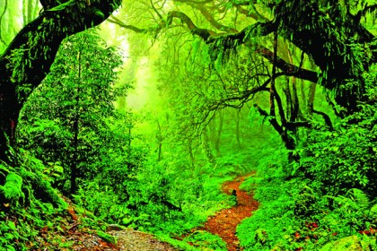
Thanks to all

