Slide 1
Welcome everybody

Slide 2
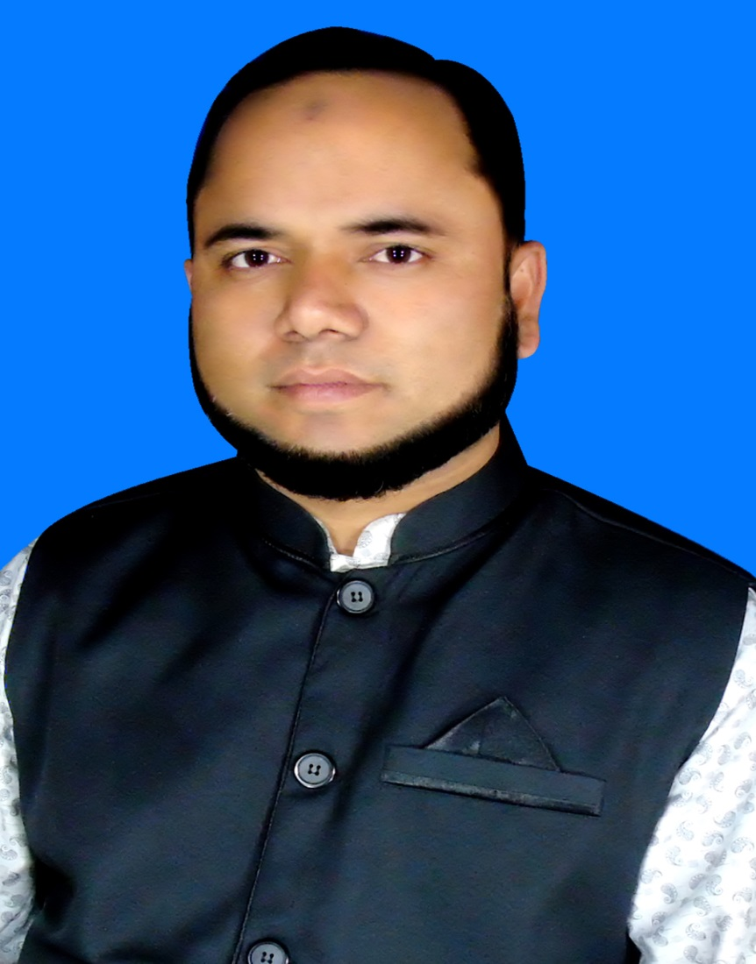
Teacher`s identity
Md.Zakir Hossain Molla
(M.B.S,B.Ed)
Assistant Teacher(Social Science)
Baneswardi High School,
Nagarkanda,Faridpur.
Mobile No:01621401412

Slide 3
Lesson introduction
Class: Nine & Ten
Subject:English-1
Unit: 10
Lesson:03
Date:15-08-2021

Slide 4
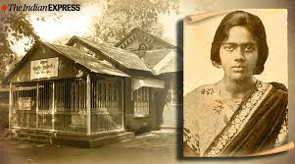
Warm up
T: Do you know the woman ?
Ss: Yes, she is Pritilata Waddedar .
T: Thanks. You are right.So …………….

Slide 5
Declaration of lesson
So dear learners, we shall discuss about “Pritilata Waddedar”

Slide 6
Learning Outcomes:
After completing the lesson, students will be able to:
*read the passage with meaning
*answer to the questions
*tell the meaning of words
*match the column /table
* Write a paragraph

Slide 8
Individual work -2
T: Read the words in column A and match them with the meanings in column B.
Column-A | Column-B
graduated | a member of a certain social or political group
activist | fight
movement | took a university degree
Gender discrimination | Rule by a powerful country over a weaker country
Colonial rule | battle
combat | Inequality between male and female
gradually | slowly
Resistance | Give responsibilities
notorious | activities
assign | dishonorable

Slide 9
T: How to make Wh-question?
Ss: Wh-word +Auxiliary verb + other words:
Examples:
1.When was Pritilata born?
2.Where was she born?
3. What did she graduate in?
4.Why was the Pahartali European Club famous for ?
5. What did she decide ?
6.Who was assigned Pritilata to attack the Club?
7.How did Pritilata die?

Slide 10
Group work
When Where What Why What Who How | Was did | she graduate in? Pritilata born? assigned Pritilata to attack the Club? she decide ? the Pahartali European Club famous for ? Pritilata die? she born? | On 5 May 1911. in Chittagong. Philosophy. to fight against the British rule. For its notorious sign-dogs and Indians not allowed. Surja Sen. she commited suicide by taking potassium cyanide.

Slide 11
Pair work
T: Make a chart about Pritilata to answer the questions.
fought on the Pahartali European Club
Fought in 1932.
Pritilata
Was a teacher by profession
Fought for saving her motherland from British colonial rule.
Proved that Women can work like men they need to be prepared to sacrifice their lives for freedom.

Slide 12
D. Now answer the questions.
Evaluation
1.Where did Pritilata fight?
2. When did she fight?
3. Why did she fight?
4.What was Pritilata’s profession ?
5. What do you learn from Pritilata’s life?
Answer :
1.Pritilata fought on the Pahartali European Club.
2. She fought in 1932.
3.She fought for saving her motherland from British colonial rule.
4.Pritilata was a teacher by profession.
5. We learn from Pritilata’s life she proved that Women can work like men they need to be prepared to sacrifice their lives for freedom.

Slide 13
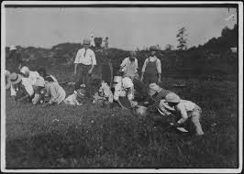
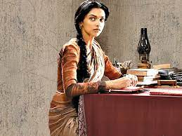
Information for tudents
A great cinema ”The Solders”
Training for fighting.
Pritilata as a teacher

Slide 14
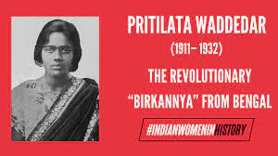
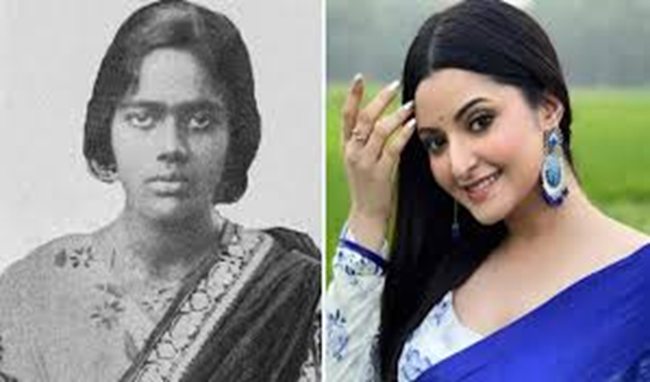
Information for students
*A film is being made in Bangladesh named :
Porimoni will act as a character of Pritilata Waddedar.

Slide 15
Home work
*Write a paragraph on “Pritilata and her activities.”

