Slide 1
WELCOME

Slide 2
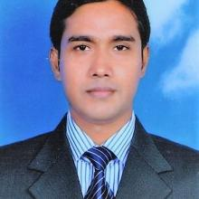
Presented By
Lesson Identity
Md.Mostafizur Rahman
Assistant teacher
Maheshpur govt.Primary School
Fulbari,Dinajpur.
E-mail: mostafizpst@gmail.com
Class:Five
Subject:English For Today
Unit:14
Lesson:The hare and the tortoise
Part of the lesson:One day…..race began.
Time: 40 min

Slide 3
Learning Outcomes
By the end of the lesson student will be able to…
4.2.1 understand and enjoy simple stories.
5.1.2 read silently with understanding stories.

Slide 4
Lets sing a song

Slide 5
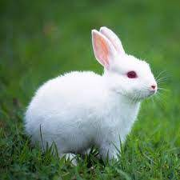
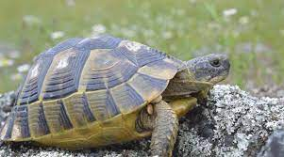
Story:The hare and the tortoise

Slide 6
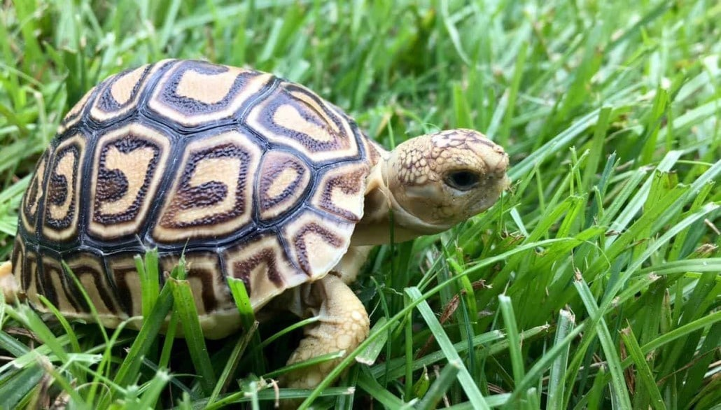
One day,a hare was walking in the forest

Slide 7
He saw a tortoise

Slide 8
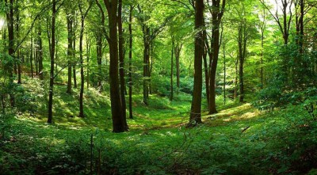
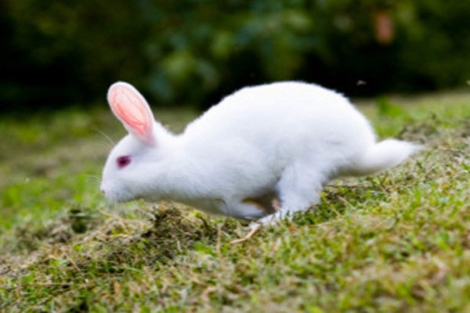
The hare was the fastest animal in the forest

Slide 9
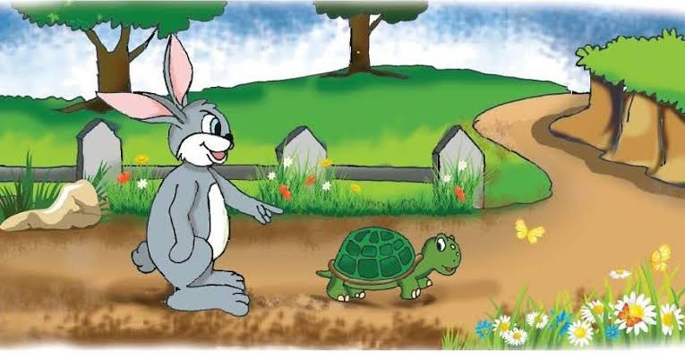
The hare called you are slow

Slide 10
The tortoise felt angry

Slide 11
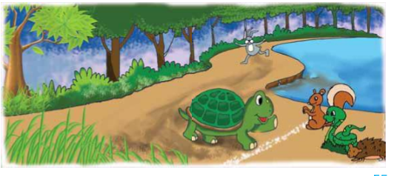
Why don’t we have a race?

Slide 12
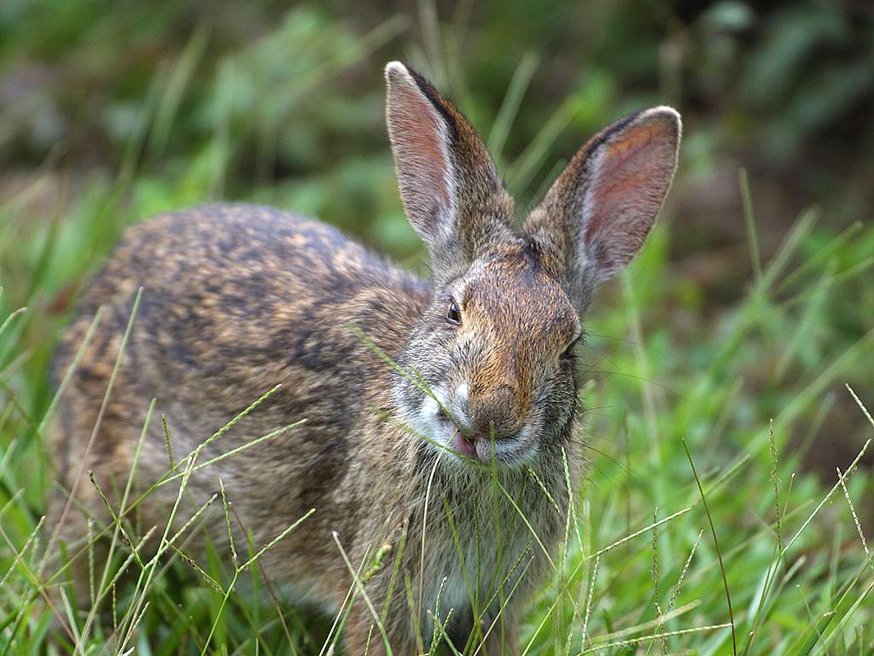
The hare laughed and laughed

Slide 13
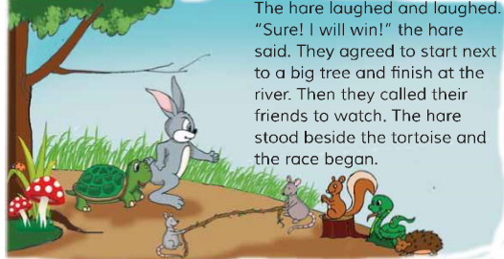
They called their friends to watch

Slide 14
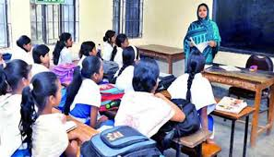
Teachers reading
Page at 54

Slide 15
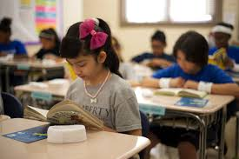
Students Reading

Slide 16
Meaning of New words
Forest
A large area covered with trees.
Compete with another.
Race
Fastest
Moving at high speed.
Angry
Having a strong feeling.
Win
Be successful

Slide 17
Group Work
Discuss with your group and answer the questions
Group-Tiger&Lion:
Write 3 sentences about the hare.
Group-Deer&Monkey:
Write 3 sentences about the totoise.

Slide 18
Pair Work
If the sentence is true then write T and F for false
1.One day,the hare was walking in the forest
T
2.The tortoise is the fastest animal in the forest
F
3.The hare is the slowest animal in the forest
T
4.The called their friends to watch the race
T
5.The tprtoise proposed the race
T

Slide 19
Indivisual Work
Answer to the questions your notebook
1.Who is the fastest animal in the forest?
2.Who is the slowest animal in the forest?
3.Why the tortoise felt angry?
4.Why they called their friends?

Slide 20
Task
Fill in the gap choose the correct words in the box
friends | slowest | walking | fastest | forest
1.The hare was…….in the forest
walking
2.The hare is the………animal in the forest
fastest
3. The tortoise is the…….animal in the forest.
slowest
4.T.hey called their……to watch the race
friends
5.The tortoise and the hare are live in a…...
forest

Slide 21
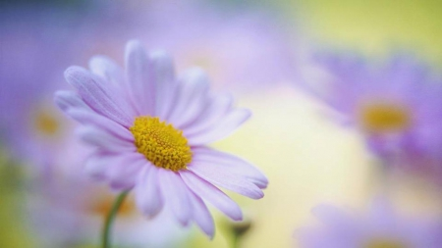
Goodbye
see you again tommorrow

