Slide 1
Welcome

Slide 2
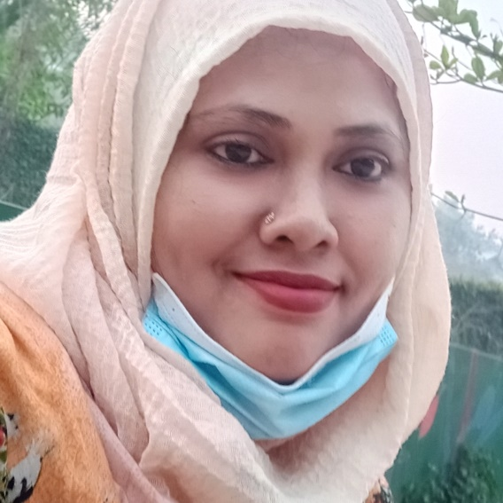
Mst.Sharmin Akter
Assistant teacher
Matain Govt. Primary School
Hajiganj, Chandpur
E-mail:
mstsharminakter1985@gmail.com

Slide 3
Class : Five
Subject : English
Lesson :1-2
Unit:8
Activity : A
Time : 40 min
A
e
r
G

Slide 4
Learning Outcomes
Student’s will be able to-
Listening:1.3.1-recognize which words in a sentence are stressed.
Speaking:1.1.1-say words and phrases and sentences with proper sounds and stress.
Reading:1.5.1-read words , phrases and sentences with proper pronunciation , stress and intonation.

Slide 5
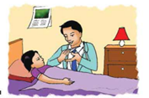
Look at the pictures and think about the picture.

Slide 6
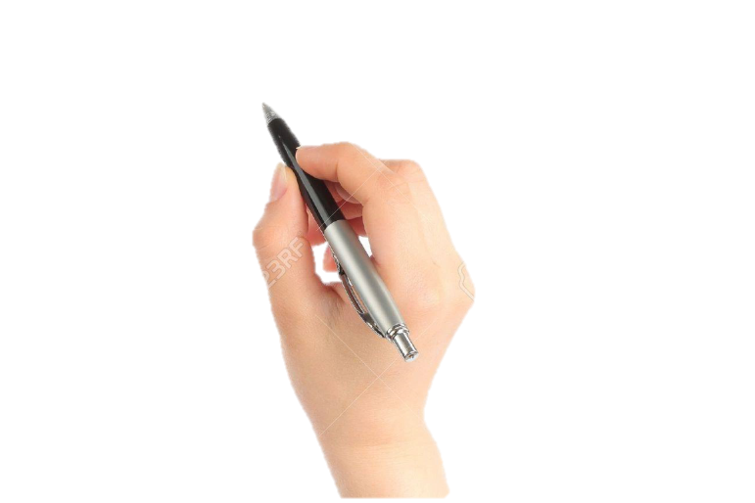
Lesson declaration
Our todays lesson is Write to me soon !

Slide 7
hungry
rest
New word
sneezing
Soft drinks
cough

Slide 8
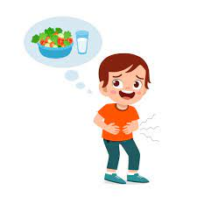
hungry
Hunger-bit
He feels hungry a lot.

Slide 9
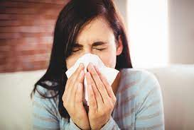
sneezing
blow
He is sneezing a lot.

Slide 10
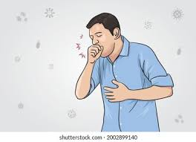
Cough
An act or sound of coughing.
He is coughing a lot.

Slide 11
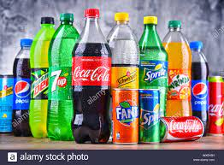
Soft drink
A nonalcoholic drink
He likes soft drink.

Slide 12
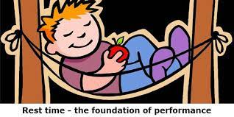
rest
repose
He needs to take rest.

Slide 13
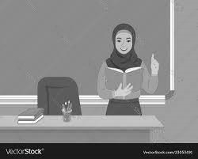
Teacher’s Reading

Slide 14
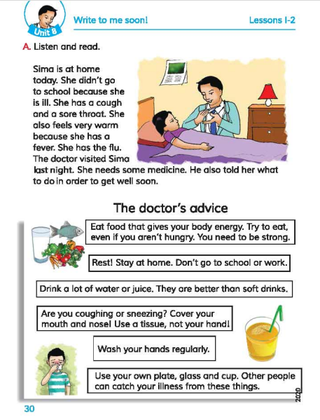
Open your book at page 30.

Slide 15
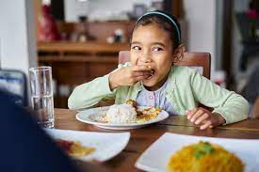
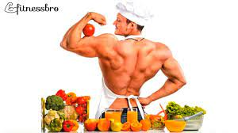
Eat food that gives your body energy. Try to eat even if you aren’t hungry. You needs to be strong.

Slide 16
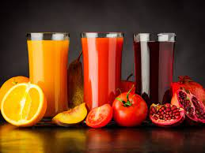
Rest !Stay at home . Don’t go to school.
Drink a lot of water or juice. They are better than soft drinks .

Slide 17
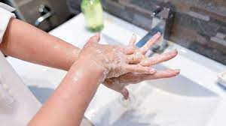
Are you coughing or sneezing ? Cover your mouth and nose ! Use a tissue , not your hand.
Wash your hands regularly.

Slide 18
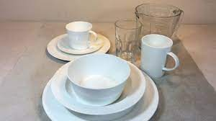
Use your own plate , glass and cup. Other people can catch your illness from these things .

Slide 19
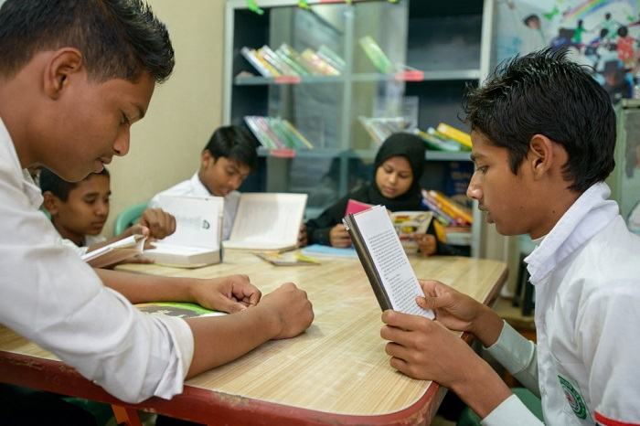
Group reading

Slide 20
Read in pair

Slide 21
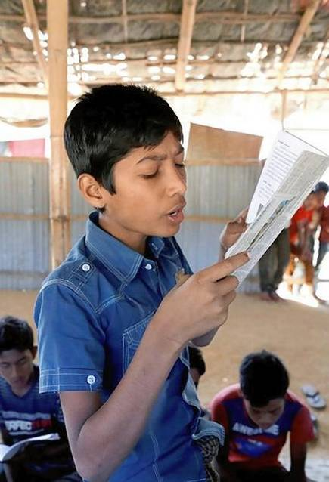
IW
Student’s reading

Slide 22
Questions:
Why Sima try to eat even she isn’t hungry ?
2. Why she is feeling warm ?
3.Who visited Sima ?
4.What the doctor advised Sima? Write in 2 sentences.

Slide 23
Answers:
Try to eat even if she isn’t hungry because she needs to be strong
2.She is feeling warm because she has the flu .
3. Doctor visited Sima .
4. Eat food that gives your body energy. Drink a lot of water or juice.

Slide 24
One day one word
Cough- কাশি

Slide 25
Goodbye

