Slide 1
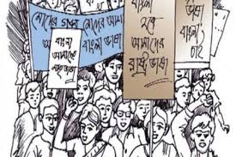
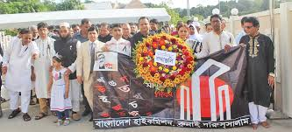
Welcome To My Class

Slide 2
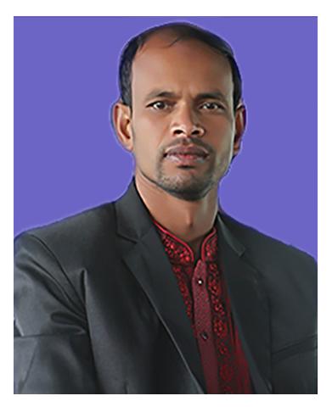
Presented by-
Mottalib Hossain
Assistant Teacher (English)
Shambhudia M.LHigh School.
Mobile: 01723-457771
Email: m.mottalib95@gmail.com

Slide 3
Events And Festivals
Subject: English 1st Paper
Unit :3, Lesson: 4

Slide 4
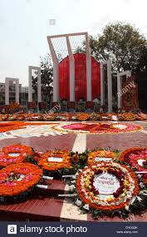
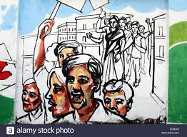
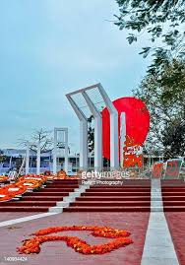
Look at the photoes

Slide 5
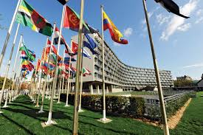
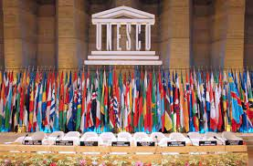
What is this Institution?

Slide 6
Why Was it built?

Slide 7
Learning Outcome
Ss will be able to .........
* Read and understand the text
* Learn infer meaning
* Ask and answer questions.
* Write a Paragraph about International Mother Language Day.

Slide 8
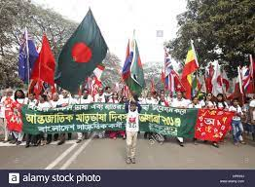
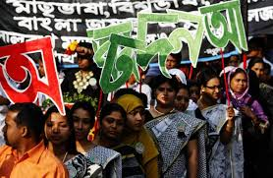
21 February is observed as shaheed Dibosh every year throughout the country in remembrance of the martyrs of language movement of 1952. The commemoration begins at the early hours of the day with mourning songs that recall the supreme sacrifices of our language martyrs. People wear black badges and go to the Shaheed Minar in barefoot processions, singing mourning songs. They place wreaths at the minar . Many of them visit the graves of the martyrs at Azimpur graveyard and pray for them. They also attend various programmes organized in remembrance of language martyrs.
Wreath – An arrangement of flowers in circular shape
Graveyard – a burial ground
Barefoot – Foot without shoes

Slide 9
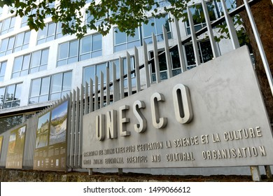
The UNESCO ( United nations Educational, Scientific and Cultural Organization) on 17 November in 1999 proclaimed February 21 as the International Mother Language Day in recognition of the sacrifices of the martyrs for the rightful place of Bangla. Two Bangladeshi expatriates living in Vancouver in Canada, Rafiqul Islam and Abdus Salam , sent a proposal to Kofi Anan , the then secretary general of United Nations. They requested him to declare 21st February as the International Mother Language Day.
Proclaim – Announce publicly
Expatriates – A person who lives outside their native
country
Declare - annonce

Slide 10
They added that the decision will honour and save all extinct languages of the world. As per their logical expectations Prime Minister Sheikh Hasina then took prompt initiative by sending formal proposal to UNESCO. Finally, on 17 November 1999, UNESCO declare 21st February as the International Mother Language Day . The day is now annually observed worldwide to promote awareness of linguistic and diversity and multilingualism.
Extinct – No longer in existence
Prompt – Active
Linguistic – Relating to language
Diversity – Variety
Multilingualism – Practice of using several language
Promote - Declare

Slide 11
Pair work
Answer the question
What did the UNESCO proclaim on 17 November, 1999?
Why is the day is now annually observed worldwide?
How do people celebrate Shaheed Dibosh?
People place wreaths at the minar . What does wreath symbolize.?
Rafiqul Islam and Abdus Salam were basically Canadian citizen?
Explain in 2/3 sentences.

Slide 12
Pair work
Fill in the blanks
21 February is (a) ……. As the International Mother Language Day not only in Bangladesh, but also in worldwide. We (b) …… this day as Shaheed Dibosh every year. The people of Bangladesh observe the day with © …. Songs to (d) …. Respect to the martyrs. They go to the Shaheed Miner (e) ….. To the martyrs.

Slide 13
Group Work
Choose the best answers
The Shaheed Dibosh begins with … songs
i) mourning ii) morning iii) happy iv) chorous
2. People go the Shaheed Minar ….
i) to sing ii) to dance iii) to show respect iv) to lament
3. What does black badge symbolize ….
i) courage ii) sadness iii) disrespect iv) joy
4. The word diversity means
i) similarity ii) variety iii) likeness iv) comparision
5.Supreme sacrifice means
i) utter ii) suicide iii) highest iv) at any cost.

Slide 14
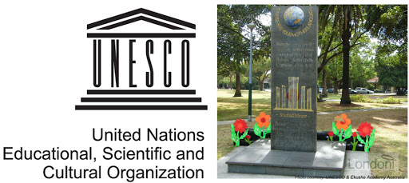
Home Work
Write an e-mail to your friend about “ how do you celebrate International Mother Language Day”.

Slide 15
