Slide 1
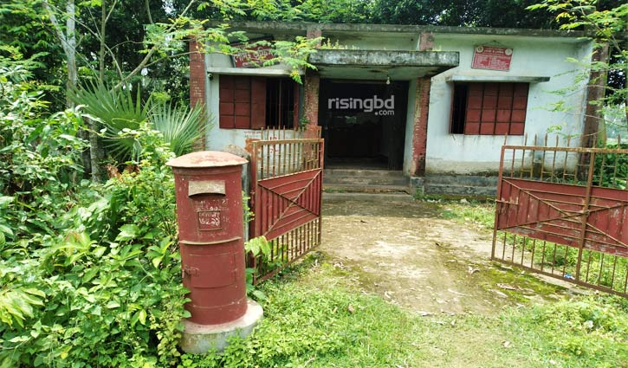

Slide 2
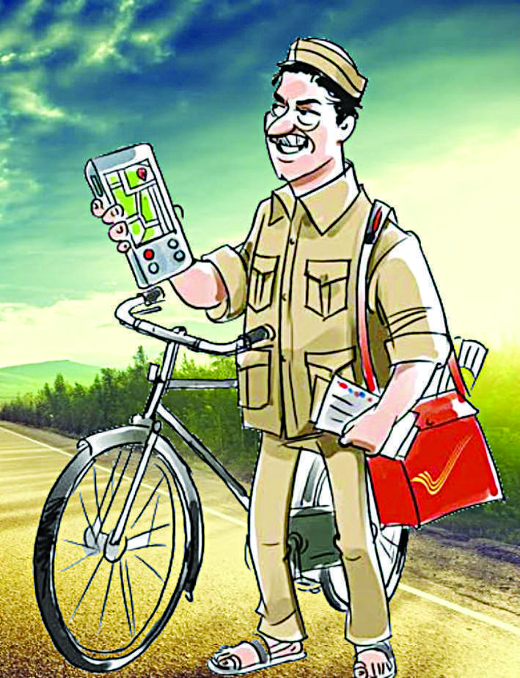

Slide 3
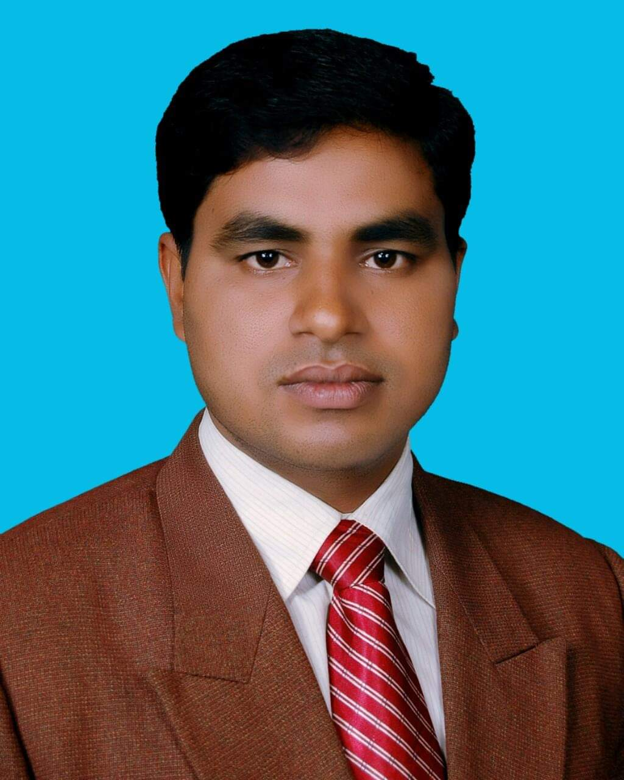
Identity
Md. Noor –E- Alam Siddiki
Asstt. Teacher
Nageswari Keramatia M.L High School.
Mobile- 01716962418
Email- nooralam.na35@gmail.com
Unit -3, Lesson 5

Slide 4
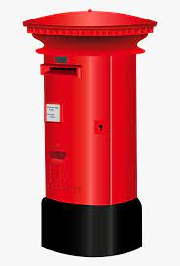
What do you see in the slide?
Letter

Slide 5
Today’s lesson title is…
A letter
Unit 3, Lesson 5

Slide 6
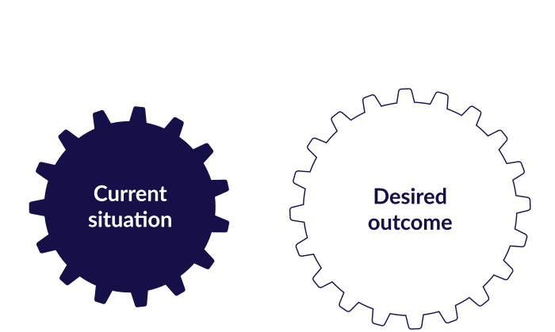
After studied the lesson , students will be able to …
infer meaning from the text.
identify right information.
ask and answer questions.
write a reply of a letter.

Slide 7
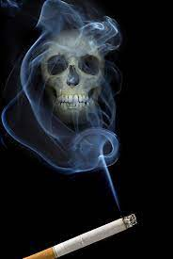
Let’s know some new words.
nicotine
Noun
Nicotine is the addictive substance found in tobacco products, such as cigarettes and cigars. It is a drug that can affect a person's brain function
a poisonous chemical, found in tobacco, that is addictive

Slide 8
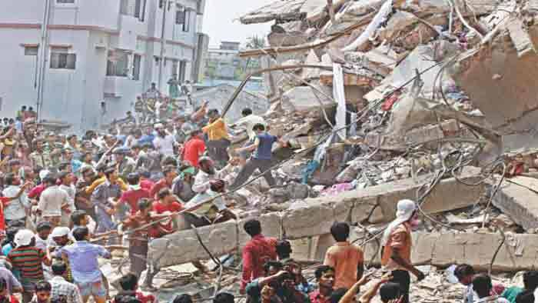
tragedy
noun
an event causing great suffering, destruction, and distress, such as a serious accident, crime, or natural catastrophe.
Rabi’s fathers death was a tragedy of their family.

Slide 9
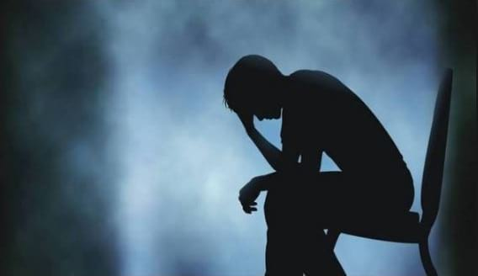
Broke
adjective
having completely run out of money.
Rabi’s family is now broke because they have no source of income.

Slide 10
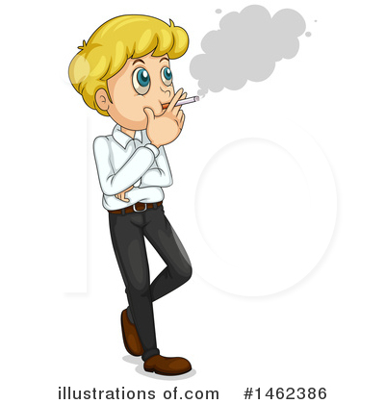
puff
verb
a small burst of smoke, air, or something that can rise into the air in a small cloud
swell or become swollen.
When a person smokes cigarettes, nicotine enters into his lungs with every puff.

Slide 11
A. Read the letter silently

Slide 12
Individual work
Tick the best answer.

Slide 13
Match your answer
1. “My father’s death is a great tragedy.”
The underlined word means
a) A very sad event.
c) Smoking heavily.
b) Avery strong warning .
d) Lung cancer.
2. Rabi’s family is now completely broke because
a) His father had a lung cancer
b) They have no source of income
c) His father’s death was heart breaking.
d) His father is a chain smoker.

Slide 14
Pair work
Ask and answer the questions. First say, then write.

Slide 15
Match your answer
1. Answer- They are friend.
2. Answer- Nicotine causes cancer.
3. Answer- Rabi has mother, brother ,sister, grandfather and grandmother. Because he told that he has a big family.

Slide 16
Evaluation
Imagine you are Sohel. Now write a reply to Rabi’s letter.

Slide 17
Thank you.

