Slide 1

Welcome everyone to “Multimedia Classroom”

Slide 2
Teacher’s Identity
Presented By,
Md.Saidur Rahman
Assistant teacher
Dhulbari Government Primary School
Sadar ,Tangail.

Slide 3

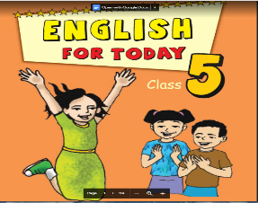
Subjest’s Identity
Subject:English
Class:Five
Lesson title:The Liberation war Museum
Lessons 1-2,Unit:19
Lesson parth:On 14 December……never forget.
Time:50 minutes.

Slide 4
Learning outcomes:
By the end of the lesson students will be able to-
1.Listening:4.2-to enjoy and understand simple stories.
2.Speaking:1.1.1-to say words,phrases and sentences with proper sounds,stress and intonation.
3.Reading:1.4-to read words,phrases and sentences in the text with proper pronunciation,stress and intonation.
4.Writing:5.1.1-to write words,phrases and sentences in the text

Slide 5
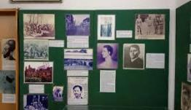
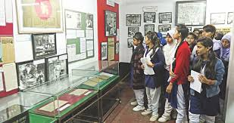
Let’s see some picture
The Father of our Nation Bangabandhu Sheikh Mujibur Rahman.
Liberation War Museum
Different Gallerries”
Some visitors
What kinds of picture do you see in the picture?Can you guess?

Slide 6
Today we are going to read-
“The Liberation War Museum”
Unit-19
Lessons 7-8
Page -74

Slide 7

Introducing new words
Release or discharge
মুক্তিযুদ্ধ
Liberation
Our class went to the Liberation War Museum on 14 December.

Slide 8

Introducing new words
Museum
Gallery or collection
যাদুঘর
There are four permanent gallaries in the Liberation War Museum.

Slide 9
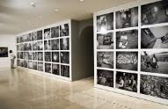
Introducing new words
Exibit
show or display
প্রদর্শন করা
There are four permanent galleries that exhibited rare photographs,documents and newspaper clippings.

Slide 10
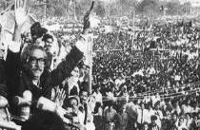
Introducing new words
Declaration
announcement or statement
ঘোষণা
At “Gallery 2 our teachers read out to us the Declaration of Independence by Bangabandhu Sheikh Mujibur Rahman.

Slide 11

Introducing new words
Independence
Self-rule or home rule
স্বাধীনতা
We watched a video clip on our liberation war and our Independence.

Slide 12
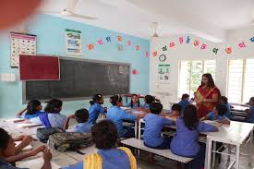
Teacher speaking loudly
Whole class work
Open your book & trun to page 74

Slide 13

Introducing new words
স্বাধীনতা
Self-rule or home rule
Independence
We watched a video clip on our liberation war and our Independence

Slide 15
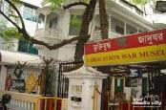
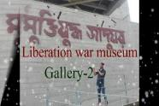


On 14 December,our class went on a field trip to the Liberation War Museum at Agaraon,Dhaka.The trip was planned as part of our Bangladesh and Global Studies course.Our bus reached the museum at 10a.m.A guide was waiting for us.He welcomed us warmly and took us on a quick tour of our different galleries and exhibits of the museum.At first we watched a video clip on our liberation war and our Independence.

Slide 16
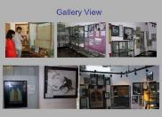

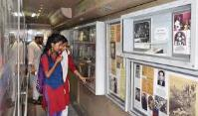
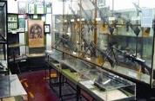
There werw four permanent galleries that exhibited rare photographs,documents and newspaper clippings,and objects used by the freedom fighters and the martyrs of our liberation war.At “Gallery 2-Our Rights,Our Saccrifies,”our teachers read out to us the Declaration of Independence by Bangabandhu Sheikh Mujibur Rahman.Some other visitors also stopped and listened to it attentively.As we went inside “Gallery 4-Our Victory ,Our Values,”we fell silent.

Slide 17
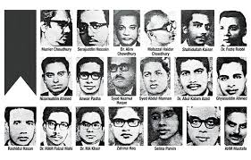
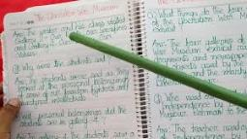
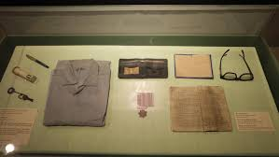
We were sad as we looked at the personal belongings of some of our martyred intellectuals and freedom fighters-a pair of glasses,a pen,a notebook,a money-bag,a shirt,and other such things.
We left the museum at 12:30.It was an experience we would never forget

Slide 18
Match the words column A with column B
Column-A | Column-B
a.Trip | i) .a person who died in our Liberation.
b.warmly | ii) .a person who guid others.
c.Guid | iii.journey
d.Exhibited | iv)gadly
e.Martyrs | v) friend.
 | vi) displayed
 | vii)killers of the Liberation War.

Slide 19
Answer the following questions:
Ques:1.When did the class go to the Liberation War museum ?
Ans:The class went to the Liberation War Mesume on 14 December
Ques:2.Why did the class go to the Liberation War Museum?
Ans:The class went to the Liberation War Museum on 14 December.

Slide 20
Ques:3.How many permanent gallaries are there in the Liberation War Museum?
Ans:There are four permanent gallaries are there in the Liberation War Museum?
Ques:4.Who made the declaration of Independence?
Ans:Bangabandhu Sheikh Mujibur Rahman made the declaration of Independence.
Ques:5.when did the team reach and leave the museum?
Ans:They reached the museum at 10 a.m and left it at 12:30 pm

Slide 21
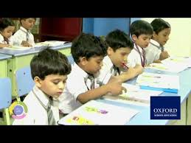
Student’s speaking loudly

Slide 22
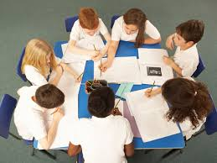
Group work-10 minutes
I will ask the students to divided into several groups.They will read the text again and complete the group work as instructed.

Slide 23
S.L | Group Name | Groups Works
1 | The Padma | Write word meaning: Liberation,Museum,Decleration,Exibit,Independence
2 | The Meghna | Make Sentences: Using the following words: Liberation,Museum,Decleration,Exibit,Independence.
3 | The Jamuna | Match the words of the column A with their meanings in column B flow the chart.
4 | The Karnafully | Write true or false following the statement. 1.There werw three permanent galleries in the Liberation War Museum. 2.None listened to the declaration attentively. 3.The trip was a part of BGS course. 4.The personal belongings of the martyrs are kept at Gallery-4.

Slide 24
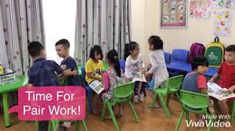
Pair work-07 minutes
I will let the students fill in the blanks and asked themto read the text again and discuss in pair and fill in the blanks correctly.
a.The trip was a --------of a course.
b. A guide --------------welcomed us.
c.The students started for the museum in the-------------
d.The students got a-----------reception at the museum
e. The -----------------of Independence is kept at gallery 2.

Slide 25
Match the correct answer.
dots | blind | friends | before | early
early
a.Maria is an--------riser.
b.Maria takes her breakfast-----------going to school.
c.Maria is fond of her----------
d.Maria is-----------
e.Raised---------are used in Braille.
before
Friends
blind
dots

Slide 26
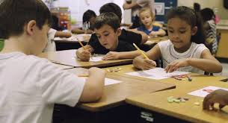
Individual work-07 minutes
True or False
I will give some statements to the studentsto determine the true and false and ask them to read the text silently to find out the correct answer.
a) There were three permanent gallaries in the Liberation War Museum.
b)The teacher read the Declaration of Independence loudly.
C)The personal belongings of the martyrs are kept at Galler -4.
d)None listened to the declaration attentively
e)The trip was a part of BGS course.

Slide 27
Let’s check the answer:
a) There were three permanent gallaries in the Liberation War Museum.
False
b)The teacher read the Declaration of Independence loudly.
True
C)The personal belongings of the martyrs are kept at Galler -4.
True
d)None listened to the declaration attentively
False
e)The trip was a part of BGS course.
True

Slide 28
Evaluation
1.When did the class go to the Liberation War Museum ?
2.Why did the class go to the Liberation War Museum?
3.How many permanent galleries are there in the Liberation War Museum?
4.Which two gallerirs did the writer and his class visit?

Slide 29
One day one word
Personal belongings
ব্যক্তিগত মালপত্র
sentence making
We were sad as we looked at the personal belongings of some our martyred intelectuals

Slide 30
Home Task
Students, what we have learned today? You will practice at home and write down it on your note book.

Slide 31


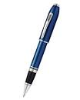
Thanks to all

