Slide 1
Welcome To our Online School

Slide 2
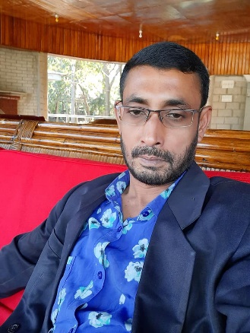
Identification
Class: Six
Subject: English For Today
Unit: One
Lesson: 01
Topic: Going To a New School
Lotiful Kabir
Assistant Teacher
SHYAMPUR ALIM MADRASAH
lktonic1978@gmail.com
Sadar,Sirajgonj.

Slide 3
Learning Outcomes:
After completing the lesson students will be able to-
Read and understand texts
Talk about people,places and familiar objects in short and simple sentences
Writ short paragraphs

Slide 4
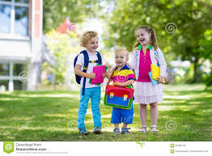
Look at the picture and tell what are they going?
They are going to school

Slide 5
A1. Read the following text and answer the question that follows.
Tarun`s first day in the new school
My first day at the school was interesting. I was going to school with my father in a rickshaw. We reached school after fifteen minutes. My father said good bye and left me at the school gate. I went in and found that everyone had gone to class. I walked into my classroom and found a seat. After sometime a teacher came and warmly greeted us. I found the students very friendly in my new class.

Slide 6
1. Key Words:
Interesting, Frightened, Happy, Excited.

Slide 7
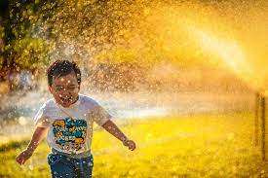
Interesting
Word meaning
amusing

Slide 8
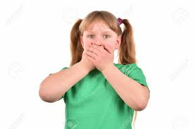
Frightened
Word meaning
Afraid

Slide 9
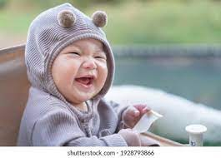
Happy
Word meaning
Glad

Slide 10
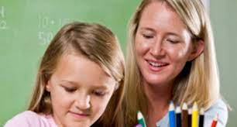
Warmly
Word Meaning
Cordially

Slide 11
2. Choose the best answer.
(i) Tarun`s first day in the new school was-
(a) Pleasant (b) tiring (c) unpleasant (d) boring
( ii) The passage relates to Tarun`s first day-
(a) In his friend`s school (b) in the college ( c) in the new school (d) in his old school
He was going to school with his-
(a) Father (b) sister (c) mother (d) teacher
(iv) His friends were-
(a) Hostile (b) unkind (c) cruel (d) amicable
(v) His teacher behaved-
(a)Cruelly (b) roughly (c) hardly (d) cordially

Slide 12
Answer the question No.02
(i) Tarun`s first day in the new school was- (a) Pleasant
( ii) The passage relates to Tarun`s first day- (c) In the new School
He was going to School with his- (a) Father
(iv) His friends were- (d) amicable
(v) His teacher behaved- (d) Cordially

Slide 13
3. Answer the questions.
1. When Tarun went in the class?
2 . What is the passage about?
3. What was Tarun`s first day his new school?
4. Who did say good bye?
5. Who was going to school with Tarun?

Slide 14
Answer the questions no.03
When Tarun went in the class?
Ans: When everyone was in the class, Tarun went in.
2 . What is the passage about?
Ans: The passage is about going to a new school.
What was Tarun`s first day his new school?
Ans: Tarun`s first day his new school was very interesting.
Who did say good bye?
Ans: Tarun`s father said good bye.
Who was going to school with Tarun?
Ans: Tarun`s father was going to school with him.

Slide 15
Home Work
Write a paragraph about your first day at school

Slide 16
Thanks Everybody

