Slide 1


Slide 2
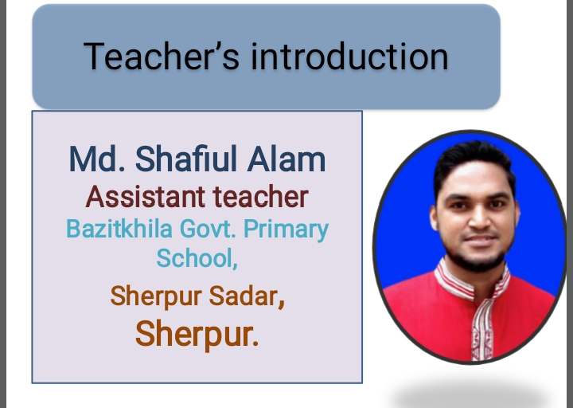

Slide 3
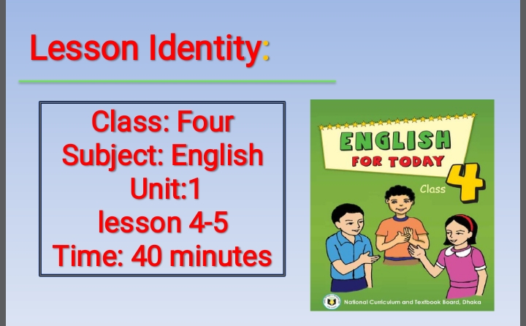

Slide 4
Learning outcomes:
Listening:
1.1.1: recognize sound differences in the context of words.
1.4.1 :recognize and use intonation patters for Wh- and Yes/No
questions, greetings and statements.
Speaking:
1.1.1: repeat after the teacher and say words,phrases and sentences
with proper sounds, stress and intonation.
2.1.1: exchange greetings and fairwell.
Reading:
1.4.1: read words, phrases and sentences in the text.
1.5.1: read words, phrases and sentences in the text with proper pronunciation, stress and intonation.

Slide 5
Say with me

Slide 6
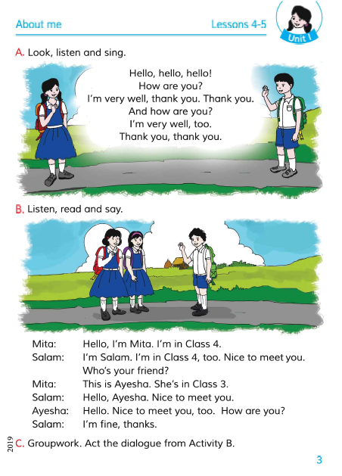
Lesson of part: A
Hello, hello,------thank you.
Open Your English At Page no- 03

Slide 7
Teacher’s Recite the rhyme

Slide 8
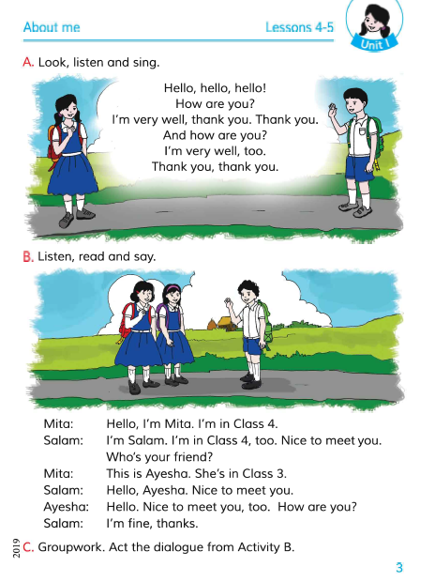
Open your English book
Unit-1, page no- 03
Notes:
u

Slide 9
Vocabulary:
Hello
How
Well
Thank
Very

Slide 10
Make sentences:
    How=How are you?
    Well=I am well.
    Hello=Hello, hello,
    Thank=Thank you.
    Very=I’m very well.

Slide 11
Group work:
Students Recite the rhyme

Slide 12
Wh- questions:
  1.Who are you?
  2.How are you?
  3.What class are you in?

Slide 13
Yes/No questions:
    1.Are you well?
    Ans. Yes.
    2.Are you in class 3?
    Ans. No.

Slide 14

Task:
  1. By recite the Rhyme.
  2.By sing the Rhyme.

Slide 15
