Slide 1
Welcome

Slide 2
Let's play a game

Slide 3
INTRODUCTION
Mohammad Ruhul Amin Shapan
Assistant Teacher
Ghagotia Govt. Primary School
Tahirpur, Sunamganj.

Slide 4
INTRODUCTION of LESSON
Class :One
Subject :English
Unit :09, Numbers
Lesson :1-3
Date :
Part of Lesson:
B, Say and read. Trace and write.

Slide 5
Learning outcomes:
By the end of the lesson students will be able to……
Reading:
2.1.1- Recognize and read cardinal numbers up to 10.
Writing:
2.1.1- Write cardinal numbers up to 10 in figures.

Slide 6
Say and Read
1
2
3
4

Slide 7
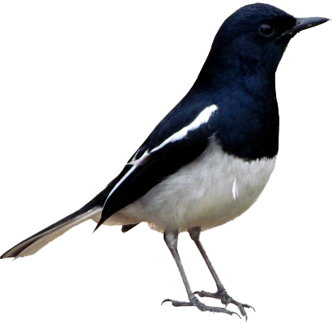
How many birds are there?
4

Slide 8
Trace 4 on air
Write 4 On your note book

Slide 9
Open your book at page 18

Slide 10
Trace 1 on air
Write 1 On your note book

Slide 11
Trace 2 on air
Write 2 On your note book

Slide 12
Trace 3 on air
Write 3 On your note book

Slide 13
Trace 4 on air
Write 4 On your note book

Slide 14
Group work
Match correctly
1
4
3
2

Slide 15
Thank You

