Slide 2
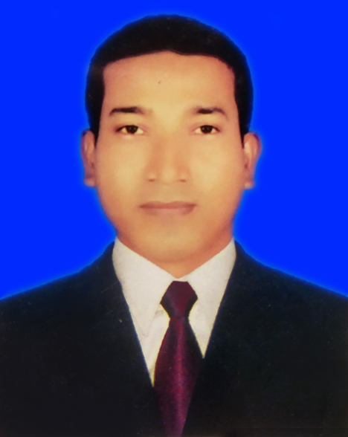
About Teacher
MD. Shaifur Rahman Chowdhury
Assistant teacher
Debiganj Model G.P.S
Mobile: 01757983700
E-mail:
saifur1980ict@gmail.com

Slide 3
Class: 3
Today’s lesson
Introducing a teacher
Subject: English
Unit: 2 Lesson: 1-3

Slide 4
Learning outcomes : Students will be albe to
Listening:
3.1.1 understand simple questions about students, family and friends.
3.3.1 understand statements.
Speaking:
6.2.1 talk about people and objects.
Reading:
1.5.1 read simple sentences with proper pronunciation and stress.
5.1.3 read texts.

Slide 5
Look
at the picture

Slide 6
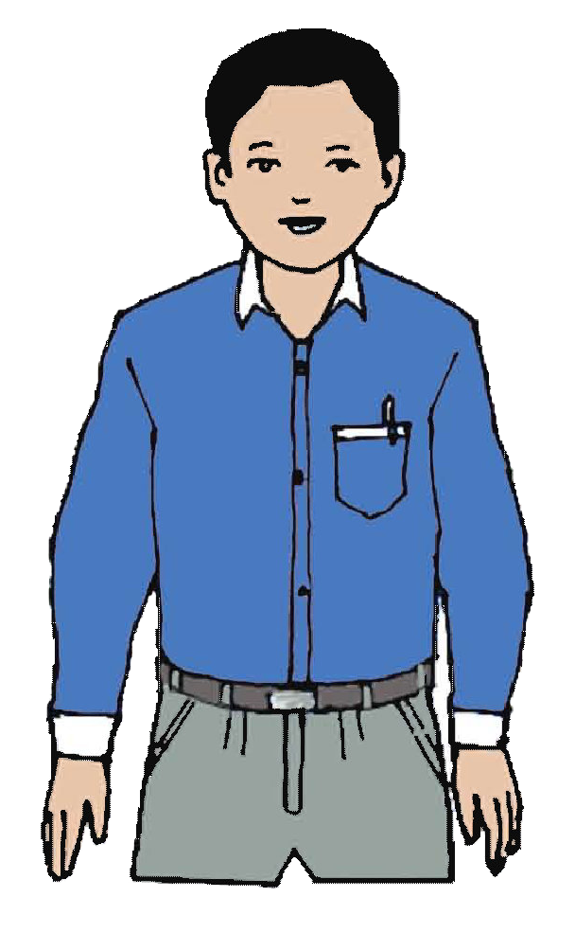
Introducing a teacher
This is Mahbub Alam. He’s 30 years old. He’s an English teacher. He works in a primary school in Narail.

Slide 7
Mahbub Alam
30
Teaching
A primary school in Narail.

Slide 8
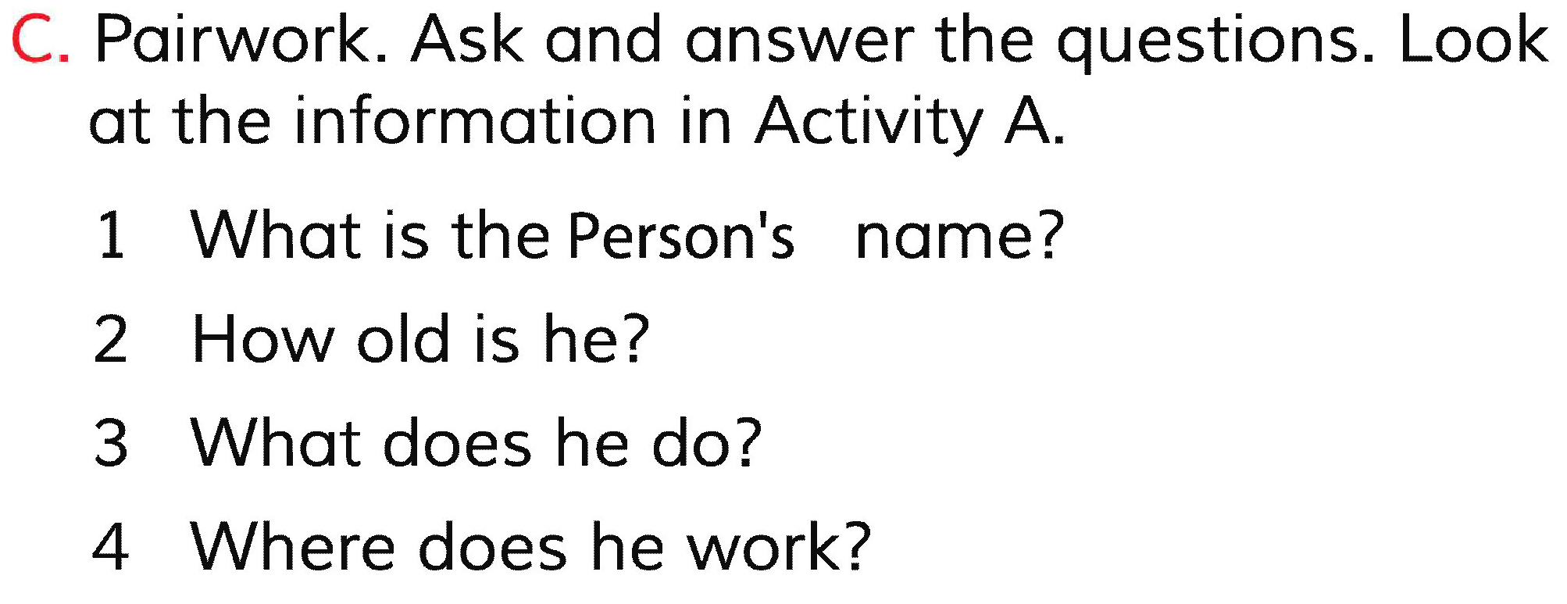
Home work

Slide 9
Thanks

